Slide 1


Bring your own device (BYOD)
Bring your own technology(BYOT
…..but move forward to Flipped Classrooms
University of Arheim March 4th
Professor Christina Preston
MirandaNet Fellowship
Project Number: 531086-LLP-1-2012-1-ES-KA3-KA3MP
Agreement Number: 2012-4275 / 001-001

Slide 2
BYOT/BYOD/Flipped Classroom
3 very different schools: private school in London; state school in a rural area; state school in a run-down coastal town
3 MirandaNet Fellows with Masters and Ph.Ds
Advice from pupils:
Teachers should be given these devices before us
Teachers should be given some training about what these devices can do
Teachers need some advice about how to manage these devices in class
Teachers should work with us to learn more
What not to do: get them out from a cupboard for half and hour every day!

Slide 3
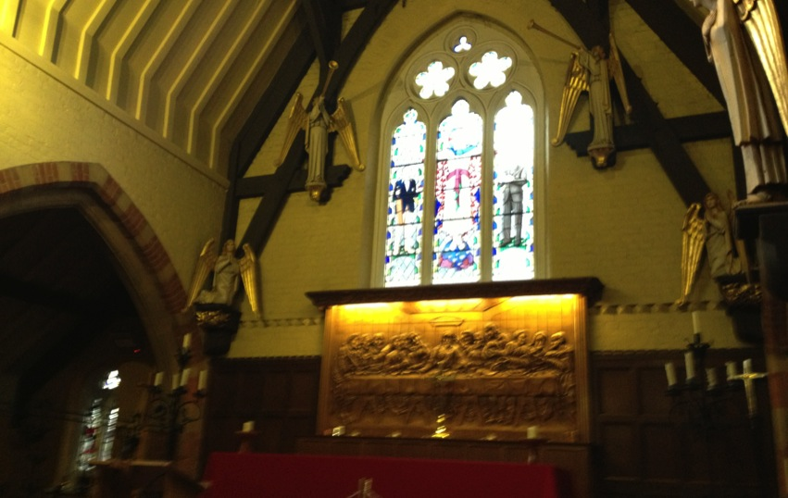
A private school in London
The historic chapel built when the school was founded in 1834.

Slide 4
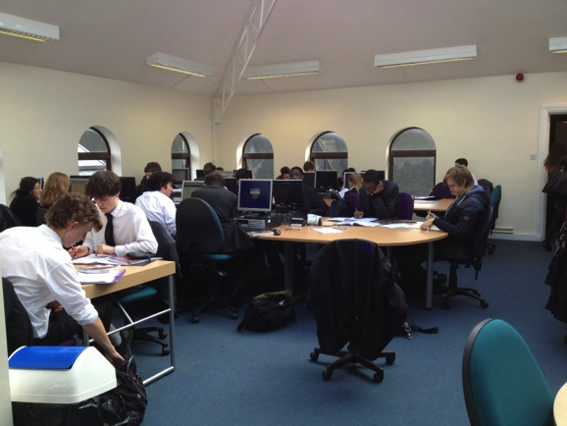
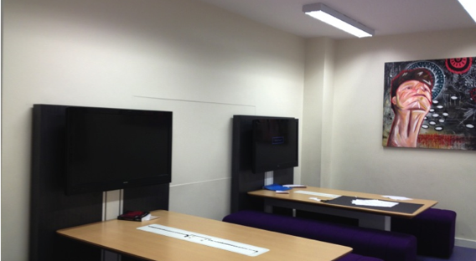
Starting the project in the sixth form?

Slide 5
Private school, London: Impact x1
The project has deliberately been started slowly in the Sixth form because the risks to be avoided from the organisational point of view were:
A sudden influx of new devices might be too challenging for teachers;
Too sudden introduction of devices might place strain on networks;
Theft and loss of devices might occur and appropriate use codes be abused.
The impact on pupils has been greater below the sixth form where they lobbied to be involved.

Slide 6
From the point of view of staff the barriers or obstacles are:
Teachers’ fears of lack of control or impact on discipline: as a result teachers can decide at any time whether devices are to be used in class, or not.
Teachers’ feeling overwhelmed: for this reason BYOD was initially limited to 6th form and there is still no enforced curriculum use.
From the point of view of the digital leaders
Personal organisation and research was a major benefit, but distraction in class was a concern of the digital leaders.

Slide 7
Private School : Impact x2
Three teachers mentioned particular impacts.
A MFL teacher was disturbed by inappropriate exchanges from students abroad in a class project.
Financial advantage can be gauged from a Computer Science example. The department can now afford for each student to work on their choice of computer language using a free or very low cost app
The potential impact of BYOD/BYOT in facilitating collaborative learning could be as great as the expected impact on independent learning. Ultimately the manager supports a shift to Flipped Classrooms and suggests an action research programme for staff might increase the opportunities to rethink the school’s teaching and learning policies.
Current assessment is a major barrier, however, in an academically orientated school

Slide 8
Key lessons - Private School x1
All teachers must be acquainted with the Code of Conduct that pupils’ must sign if working online;
While pupils are comfortable using personal devices in the other aspects of their lives, they appear to struggle a little with integrating this into school/learning;
Flexible environments are important in making it easy and workable to have and manage own devices in and between classrooms;
More public communication with pupils and parents in the next stage to ensure their enthusiasm.

Slide 9

Collaborative working desks with iPad connections and Apple tv in the 6th form centre, meeting rooms and assembly halls

Slide 10
Key lessons- Private School x2
The pupil focus group agreed that some teachers in the pilot were not aware that time-wasting activities were happening. More teachers need appropriate strategies to deal with these behaviours including getting control early and moving around the classroom.
The pupil focus group also thought that there should be more acknowledgement at the start of the next stage of tech-savvy pupils who are keen to be a resource for staff and pupils.
Overall training about the technicalities should be balanced in the next stage by more formal training about classroom management and pedagogical advantage.

Slide 11
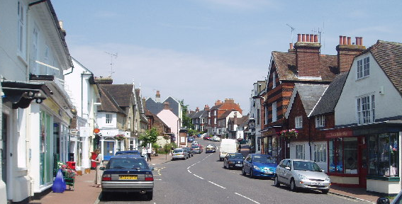
A state school in rural Surrey

Slide 12
Rural town: impact
The 32 staff with the first iPads are including pedagogy in their deliberations about the value of these devices
Impact on staff
A well-organized trials plan was communicated in an engaging way to parents who are invited to discuss the results with their children. Subjects where interesting practice is emerging are: PE, Information and Communications Technology and Geography.
In History a comic strip designer and book creator apps ‘engaged the student’s creativity whilst keeping them focused on the content of the curriculum. This helped students who are visual learners to remember key terms and concepts more readily.’

Slide 13
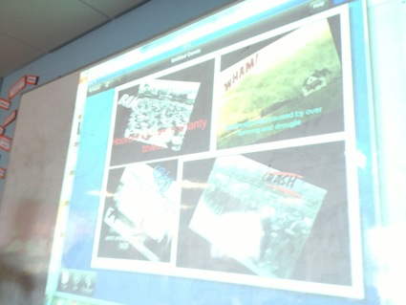
In History a comic strip designer and book creator app ‘engaged the student’s creativity whilst keeping them focused on the content of the curriculum.
‘This helped students who are visual learners to remember key terms and concepts more readily.’ said the teacher.

Slide 14
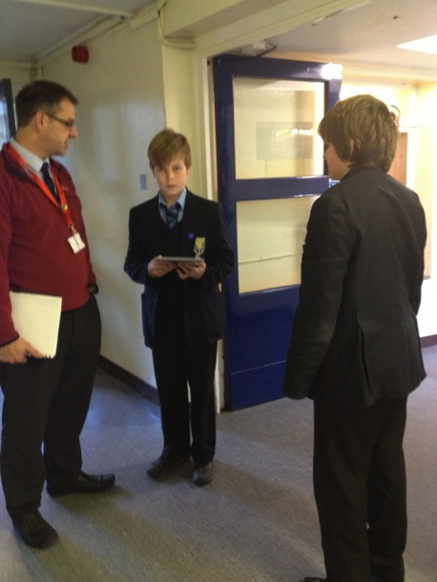
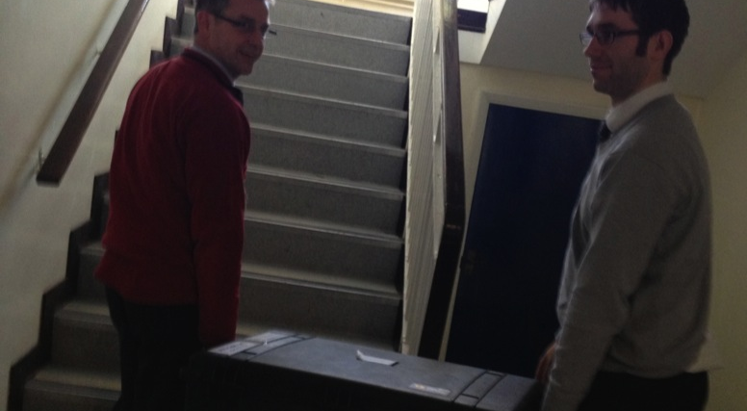

Slide 15
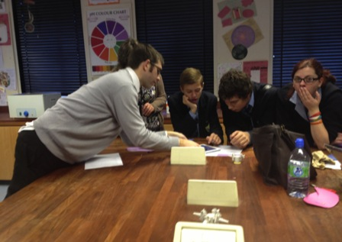
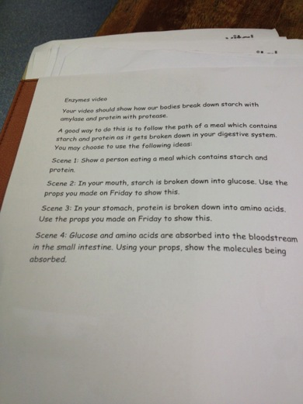
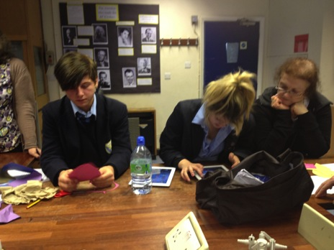
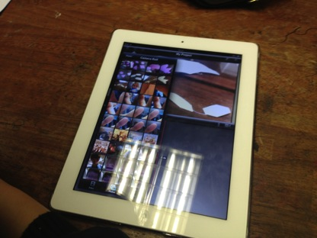
Science: Using the iPad to make a video about the action of enzymes using paper props was motivating for Special Needs students
SEN pupils and students with behavioural problems have responded particularly well to the use of iPads as a personal tool.

Slide 16
Rural town: impact
Teachers view positively the move to use these tools in personal administrative tasks: for example registration and email on the move; note taking; and, resource collection.
Impact on the school/organisation
The results of the first pilot will be used to make agreed alterations to policies on teaching and learning, appropriate use and e-safety policy.
Impact on pupils
Data is still being collected on the impact, but we are having to extend the project to Year 10 because of parental and student pressure
Pupil reporters for the school news stream have found the job easier and pupils in the focus group welcomed opportunities to help the teachers”

Slide 17
Key lesson: rural school x1
Research is essential if a project that promotes change is to succeed. The viability of the plan was researched over a year and a half by investigating research papers, videos, forum discussions supplier demos, exhibition show products, the E-learning foundation, technology conferences and visits to schools where similar programs have been implemented.
The iPads pilot fits into a long-term strategy to put more responsibility in the hand of the pupils for learning. Ownership of the iPad has meant that each teacher also experiences more ownership over changing practice from the classroom perspective.
Do not underestimate the emergence of technical issues as the project progresses and allow time to sort these out and orientate the technical team to be able to work with new technology in new ways.

Slide 18
Key lesson: rural school
Communicate sympathetically with parents and staff members who are concerned about league tables and academic rigour. The current assessment environment does not encourage the changes in teaching and learning that are pursued in this project.
Debate the wider and broader aims of education within the staff because at some point the whole staff will want to consider whether they are willing to adjust the theoretical underpinning that informs their professional life and adjust school policies on teaching and learning.

Slide 19
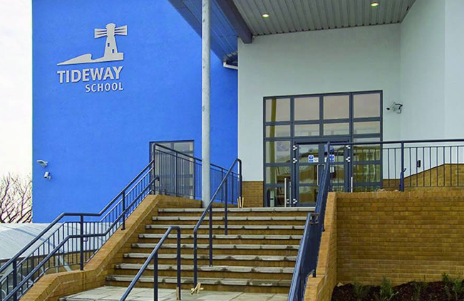
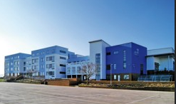
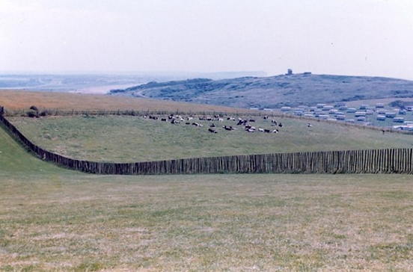
A state school in a run-down costal town

Slide 20
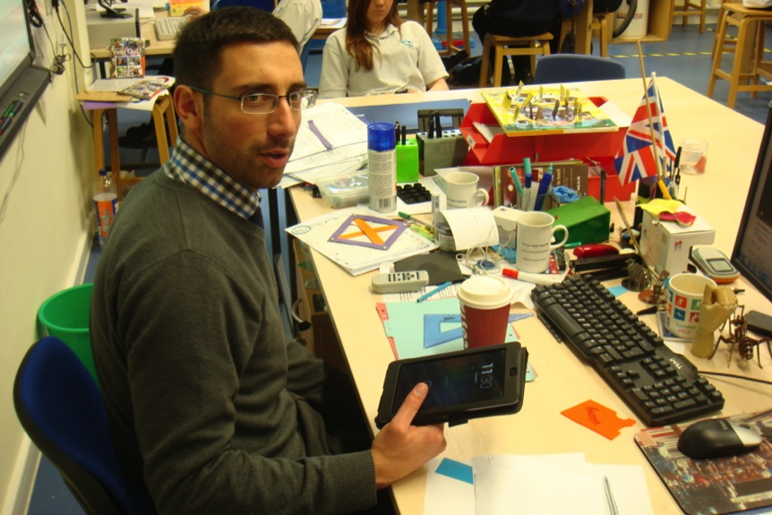
Figure four: registration made easier

Slide 21
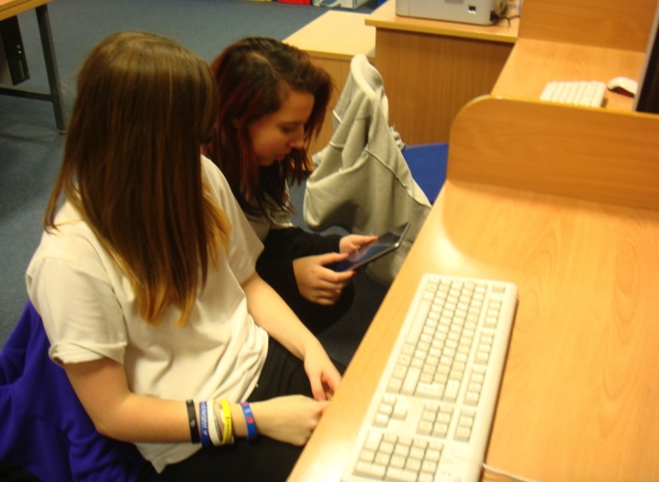
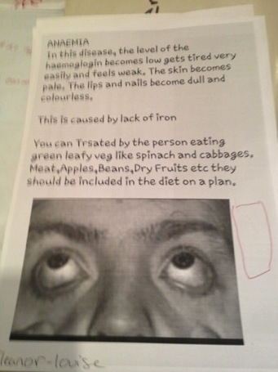
Pupils researching on the internet to make a poster about anaemia in a science lesson

Slide 22
Coastal town: impact
Organization: learning policy developing slowly
Based on teachers’ and pupils’ observations in the pilot a teaching and learning framework that supports the use of devices is emerging, but currently this is quite limited. Staff plan to widen involvement and share insights in order to ensure the richness of this document. The timescale envisaged is about another year.
Progress in the school community about the value of devices
Survey important, in ensuring that all members of the school community are aware of the benefits and issues relating to BYOT/BYOD
The enthusiasts at this point who are making progress in developing a code of conduct to be discussed with the community as the next stage. Pupils and parents will be included in this process.
Hard evidence of the impacts of BYOT/BYOT on teaching and learning.
Not well advanced. The pupils and the teachers can provide convincing anecdotal evidence that changes in performance, engagement, motivation and behaviours have taken place.
Main results for staff so far:
major impact on their lesson preparation time because they can use the tablets in transit;
administrative tasks like registration are easier;
ease of use in classrooms because of significant time savings over the use of PCs.
More systematic action research now need to take place to confirm that BYOT/BYOT can impact on learning outcomes as well

Slide 23
Research into ownership was essential in planning the pilot and also in engaging staff, pupils and parents. Ownership of devices at 38% was lower than expected and has slowed up progress. Provision must be developed for students and staff who cannot fund their own device;
Currently some staff still ban the use of devices in their classrooms despite changing policy;
According to the pupils more staff need their own devices and specific training in order to ensure a new teaching and learning policy is embedded. Pupils have offered to teach the teachers informally;
Coastal town - key lessons x1
Working slowly and inclusively in pilot mode has insured high expectation of success
in full implementation over the next year. Some key points have arisen for inclusion in the emerging policies:

Slide 24
Wifi is essential through the school if take-up of BYOD/BYOT is to be improved. An affordable solution has now been found but the absence of overall wifi in the pilot was a barrier to change;
Pupils using their own hotspots where wifi is not available has raised concerns about how the school will control what websites pupils are accessing;
The Senior Management team needs to trial more thoroughly key online administrative and teaching software as poor performance dampened enthusiasm for the pilot amongst staff and pupils.
Coastal town - key lessons x2

Slide 25
Key questions that now need to be investigated
How does the use of personal hotspots by pupils affect responsible use in the school?
What are the best methods for engaging and motivating reluctant teachers to consider changes in their practice?
What level of on-going support is needed: teacher pedagogical support, technical, student skills etc.
What should be the balance between informal and formal CPD for teachers?
How much should the teachers know about pedagogical theory in this area?
What theories of project management are applicable in this school?
What commitment should there be to Flipped Classrooms?
What about Google and ownership of materials?
What about the challenges in schools creating their own resources?
ome teachers wanted to start action research on the pedagogical value of the devices that are still to be discovered.

Slide 26
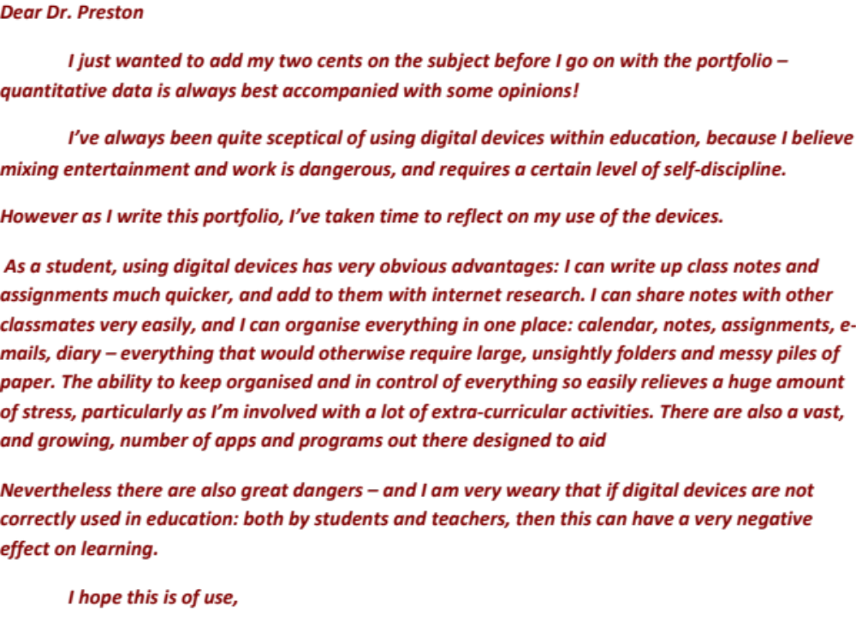
Introduction to a journal by a digital leader of 15 years old.

Slide 27







The Teachers involved in this project were MIrandaNet members
MirandaNet is a Partner in the Handson Project
800 members in 80 countries on six continents who are committed to learning from each other about innovation in education
Members are researchers, teacher educators, senior managers, practitioners, policy makers and, companies who are committed to improving education.
ASSOCIATES

Slide 28

Thanks!
Acknowledgements:
This project has been funded with support from the European Commission. This presentation reflects the views only of the author, and the Commission cannot be held responsible for any use which may be made of the information contained therein
Project Number: 531086-LLP-1-2012-1-ES-KA3-KA3MP
Agreement Number: 2012-4275 / 001-001

