Slide 1

Dragon Stone
Participants Wanted Project
Team: Dragon Stone
Members: Dongbo Tang 2077538T
Hongzhan Qiu 2081541Q
Lingli Cai 2097448C
Ge Qu 2098665Q
Wangteng Fan 2044849F

Slide 2
Goal of the application
This system aims to provide the simulated experiments projects management services which is run by experimenters for the participants (students).
Two User Personas
Two kinds of USER: Registered User and Non-Registered
Registered user : The person who could not only find the suitable
experiments for themselves, wait for the confirm from
the experimenter, but also publish the experiment,
accept or reject the applicants.
Non-Registered user(Visitor) : Some one who only could check or search the project details.

Slide 3
Specification list
The MoSCoW method is used in this specification.
Must
The system must allow university student and experimenter register this PW system with some general information.
The main page must be browsed by all types of users.
When the user identifies an experiment, they can check the details of the experiment.
The system must allow the registered user to apply the experiment.
The registered user can view the list containing the available experiments, or what they have undertaken and the experiments currently bid on.
The registered user can create a new experiment .
The registered user can accept or reject the application.

Slide 4
Specification list
Should
The main page should encourage the participants to register by providing a login box and linking to experimenter page
The main page should summaries of the last 5 experiments published, 5 summaries of experiments with up and coming closing dates and 5 summaries of experiments which pay the most rewards
Could
The system could offer slots/times when they could undertake the experiment
Before the deadline, the experimenters can update, modify, and delete the experiment general information.
Won’t
The registered user can set the type of experiment which they are prefer, when this type of experiment is created, the system would send an confirm letter to the registered user.
The experimenter would add some commands for the registered user who was undertaken the experiment. When this user applies new experiment, other experimenter can see the commands. This function would also add to the registered user for the owner of experiment.

Slide 5
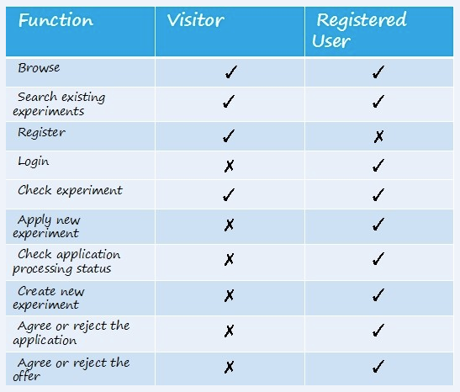
User needs matrix

Slide 6
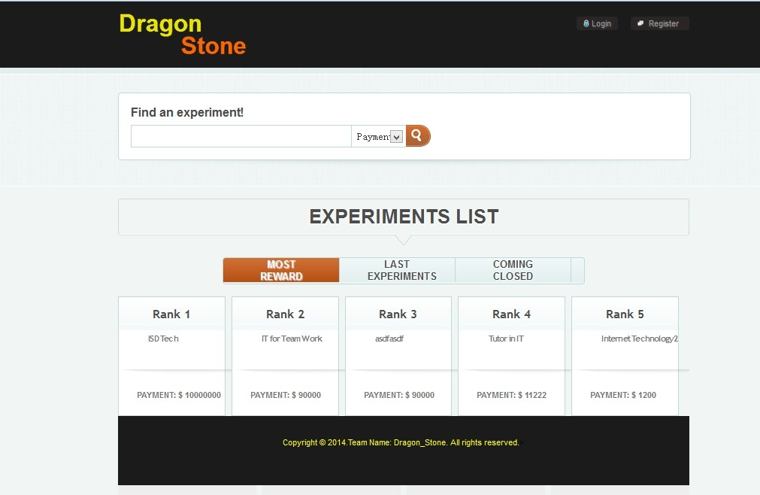
wireframe
The main page for all the types of users.

Slide 7
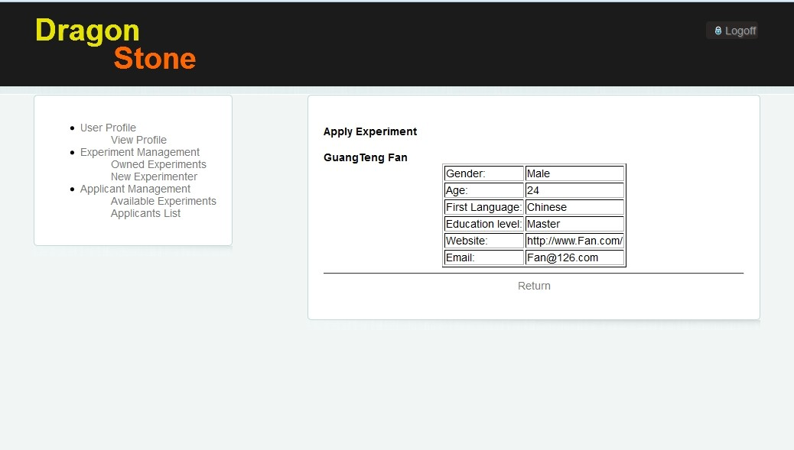
The student page or view after people register and login page/view.

Slide 8
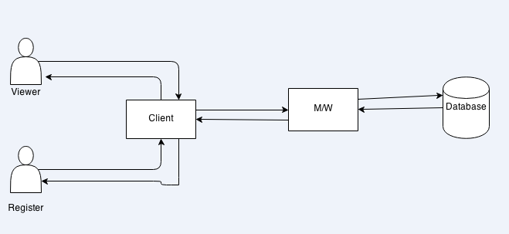
Overall system architecture diagram
The client will be a web Brower (i.e Chrome, Firfox, Safari, etc) which will render HTML/CSS pages.
The middleware will be a Django application, and will be dispatched through Django’s built-in development web server while we develop.
The database will be the Python-based SQLite3 Database engine.

Slide 9
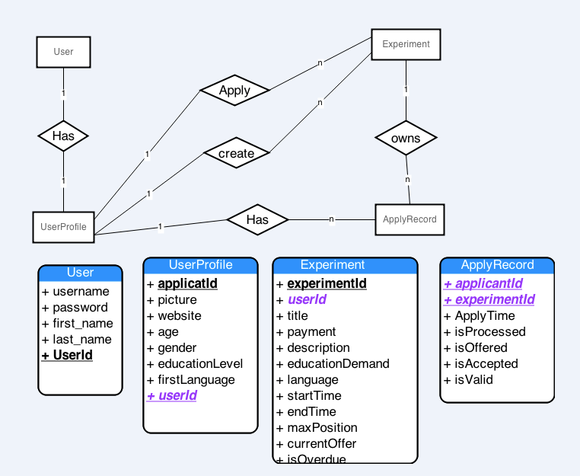
E-r diagram

Slide 10
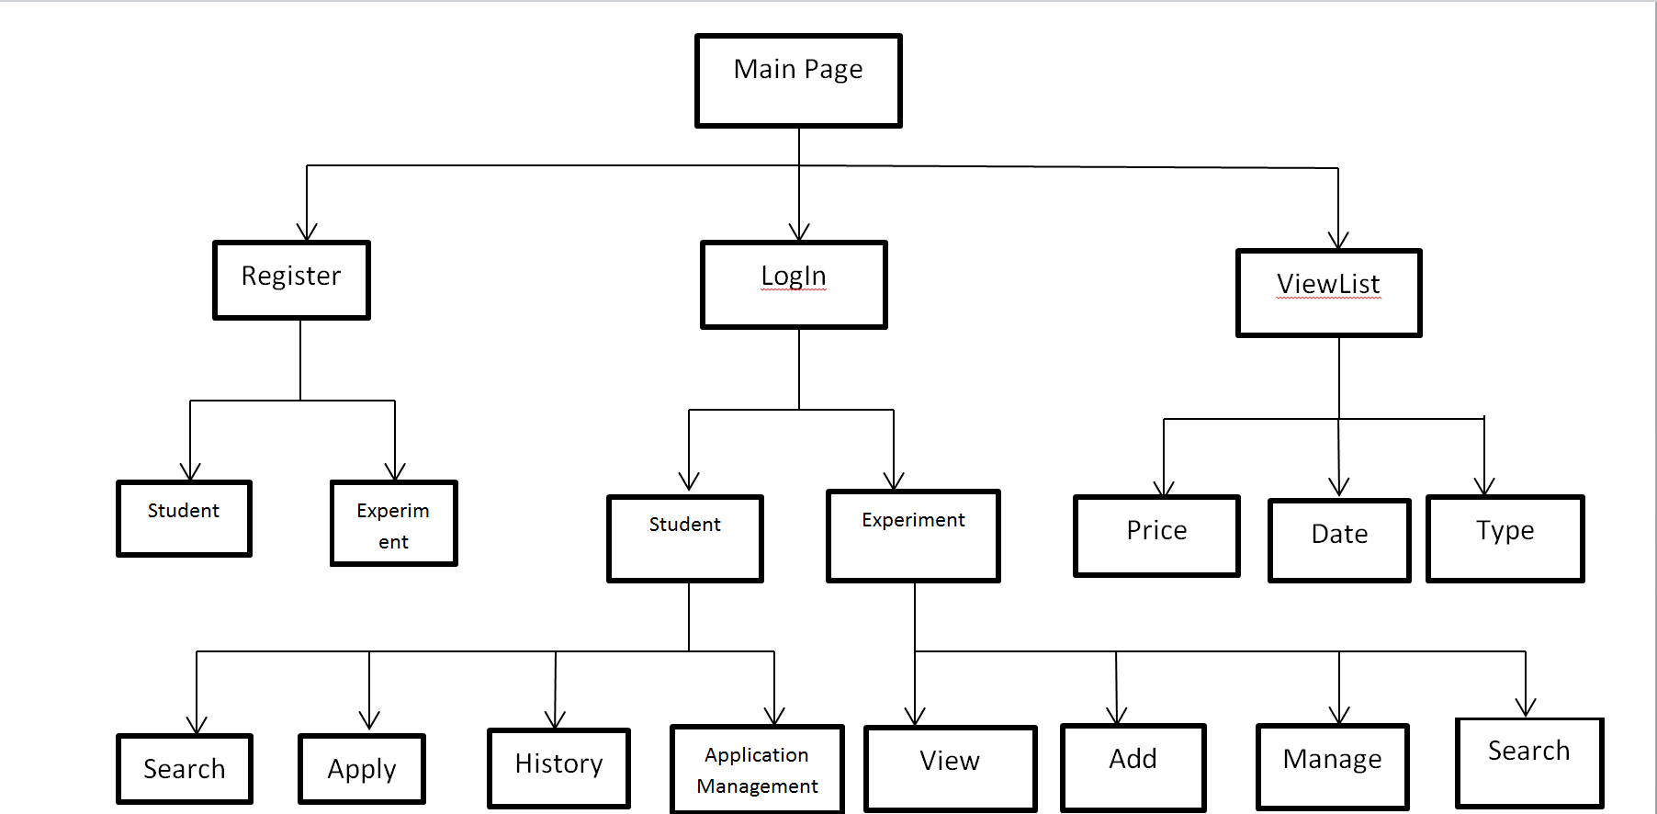
Urls and site map

Slide 11
Stand out features
The dynamic application results of the experiment project could be checked by the registerer account system.
After the students made the decision on the offer, the experimenter could check the status of the offer by the system.

Slide 12
Limitation
we can not connect the e-mail server.It is the biggesy limitation among our website.
The interface of our website is not very clear, and we will change the style in the futher .

Slide 13
Pythonwhere url: http://kinfan2000.pythonanywhere.com/dragon/
GitHub url:
https://github.com/TinaQu/Dragon-Stone

Slide 14
Question Time!
Thank you!

