Slide 1
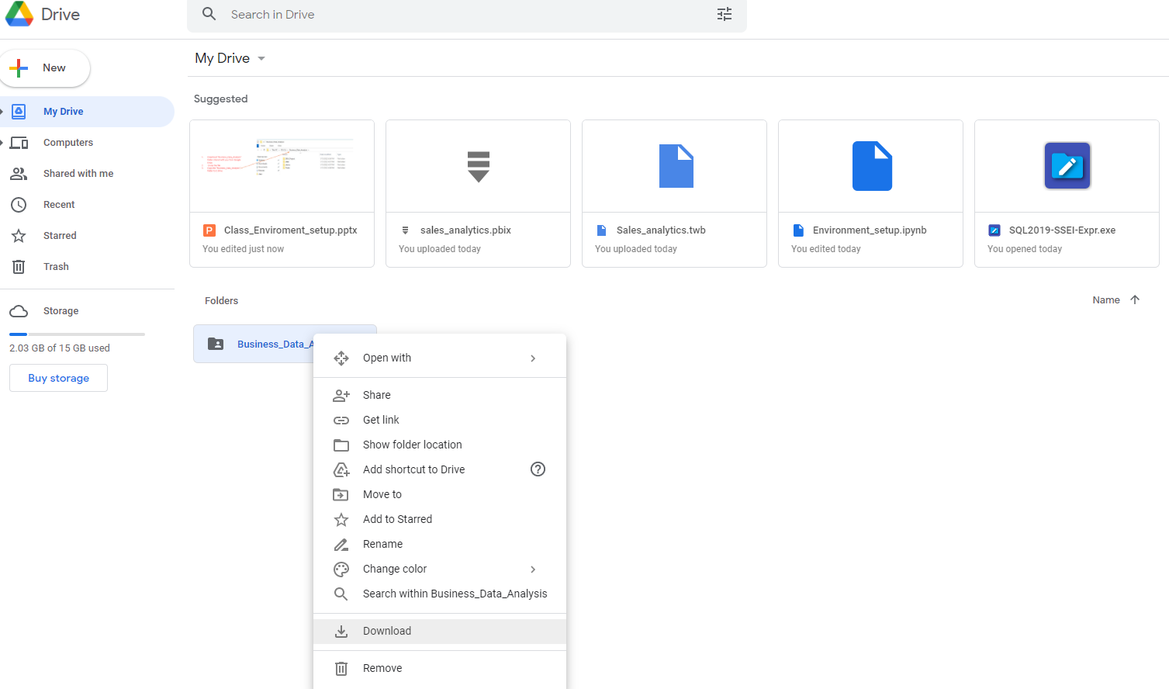
Download “Business_Data_Analysis_lv1” folder shared with you from Google Drive.
Unzip the file

Slide 2
Download “Tools” folder shared with you from Google Drive.
Unzip the file

Slide 3
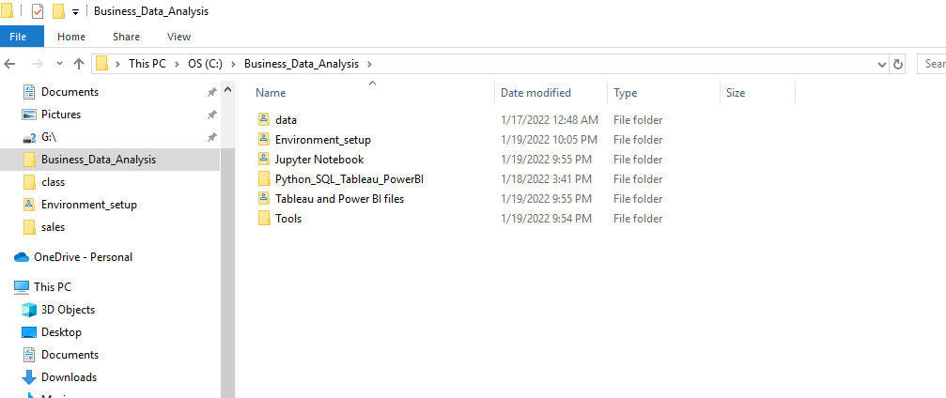

Go to your C drive
Create a new folder “Business_Data_Analysis” folder in C drive

Slide 4
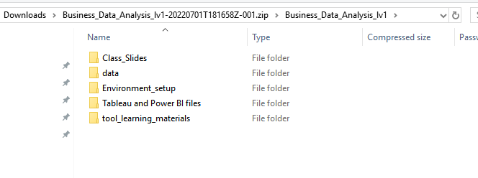
Copy the all the folders in the “Business_Data_Analysis_lv1” folder
Paste them to the “Business_Data_Analysis” folder you just created in your C drive

Slide 5
Copy the unziped “Tools” folder to “Business_Data_Analysis” folder in C drive

Slide 6
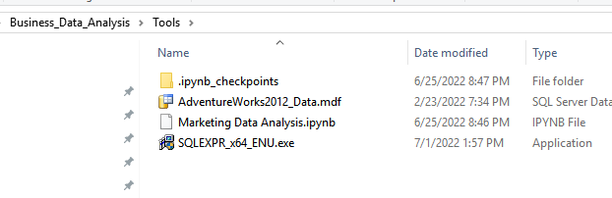
Install SQL SERVER
Go to “C:\Business_Data_Analysis\Tools”
Double Click SQLEXPR_x64_ENU

Slide 7
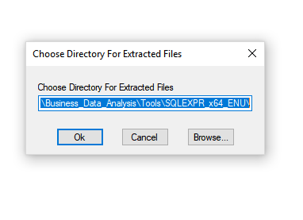
Install SQL SERVER
Click ok

Slide 8
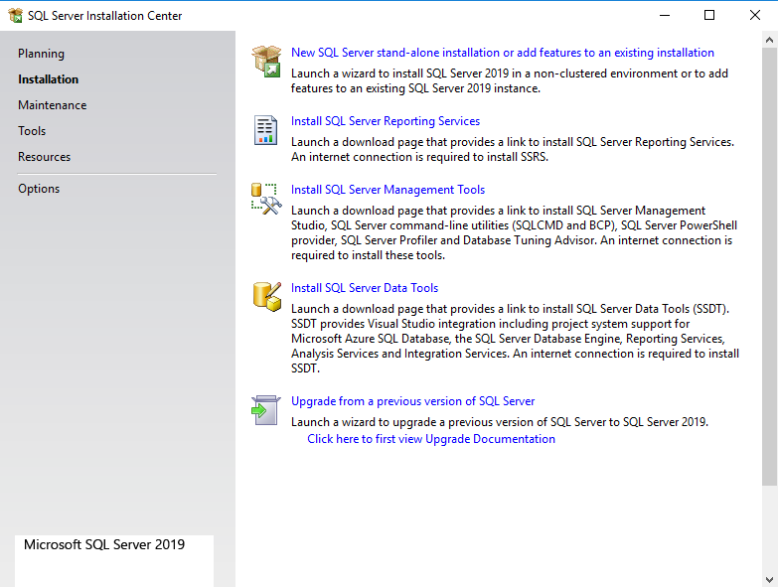
Click the first option

Slide 9
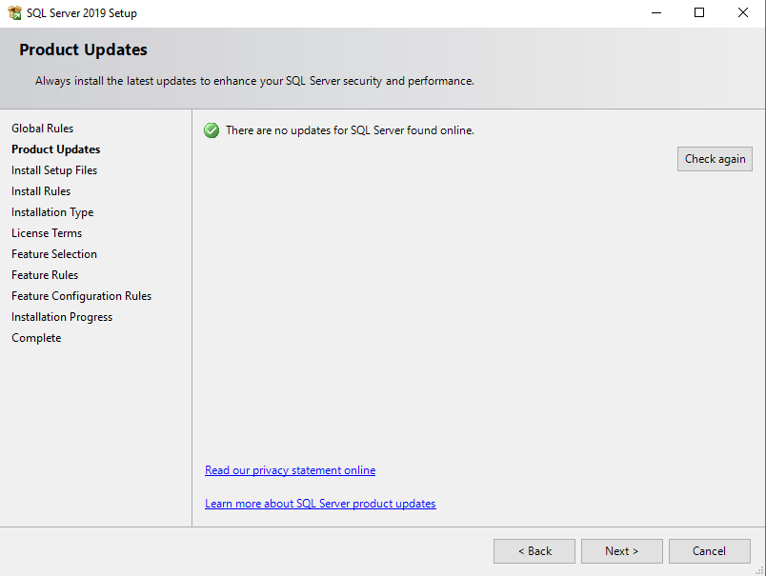
Click Next

Slide 10
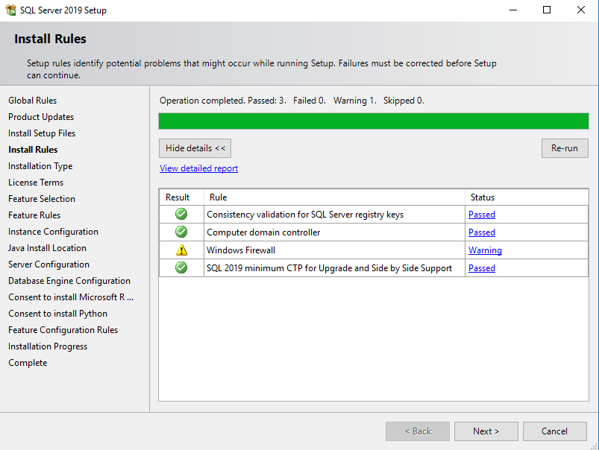
Click Next

Slide 11
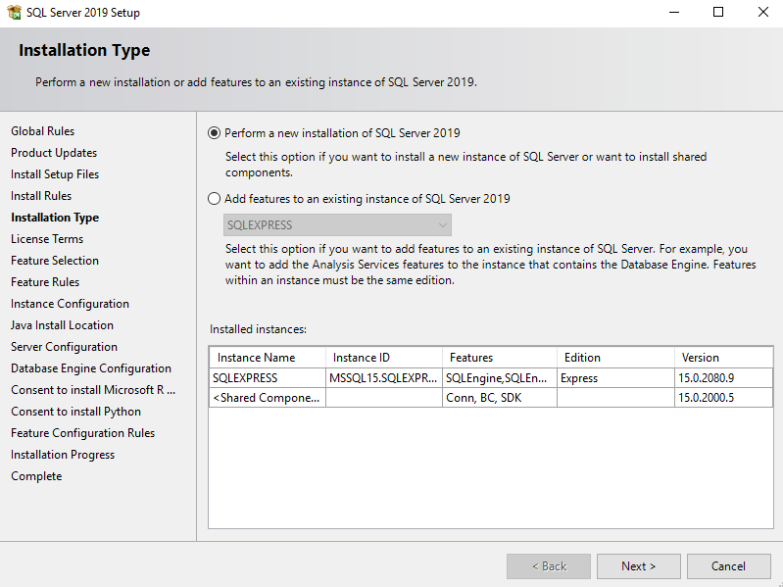
Click Next

Slide 12
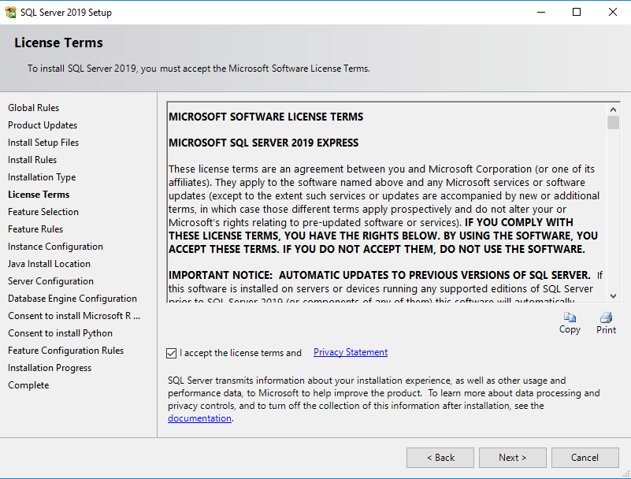
Accept the license term
Click Next

Slide 13
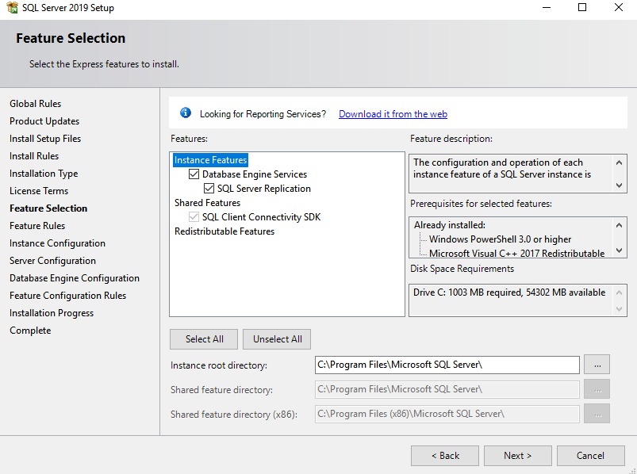
Click Next

Slide 14
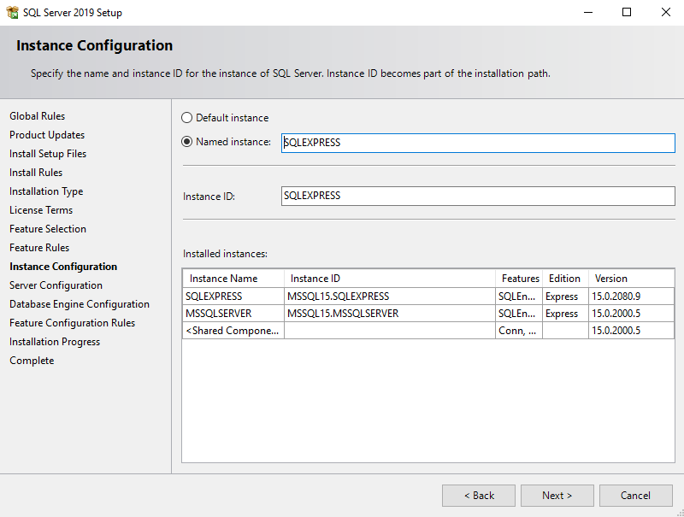
Select Named instance and type “SQLEXPRESS” if it’s blank
Click Next

Slide 15
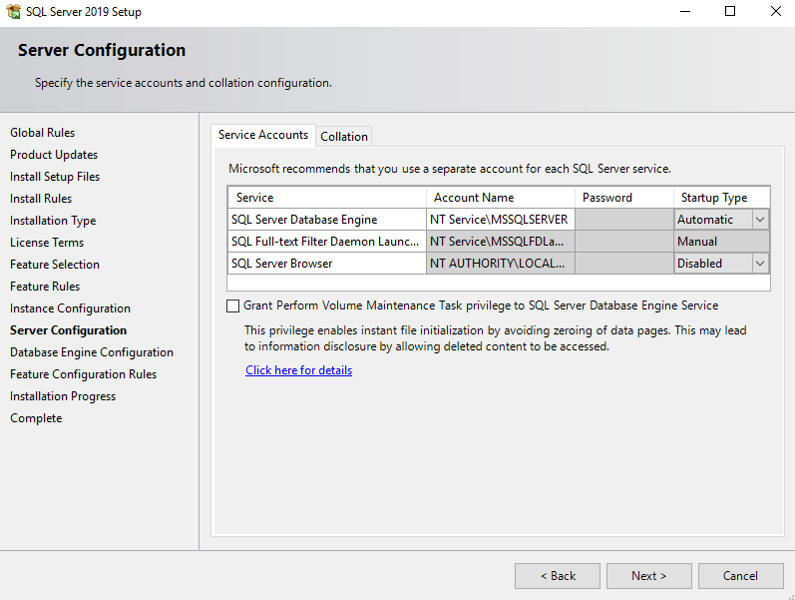
Click Next

Slide 16
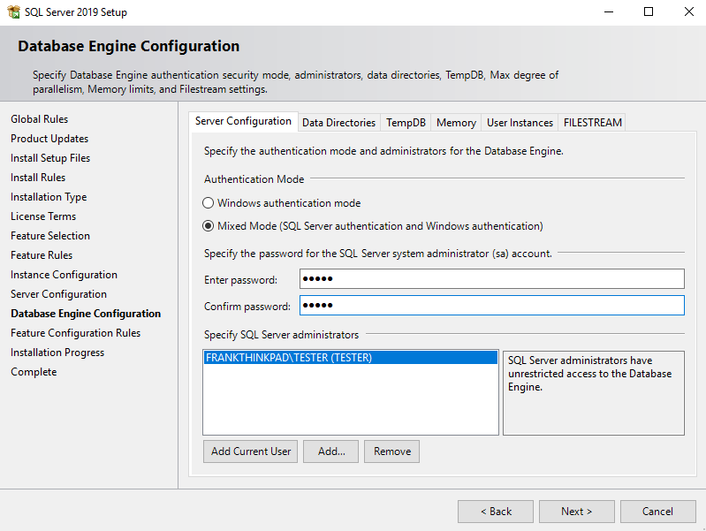
Select Mixed Mode
User password “user1”
Click Next

Slide 17
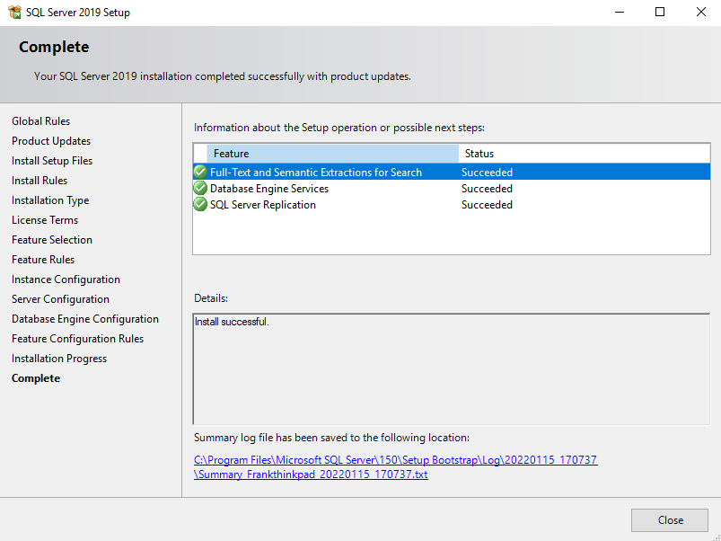
Click Close

Slide 18
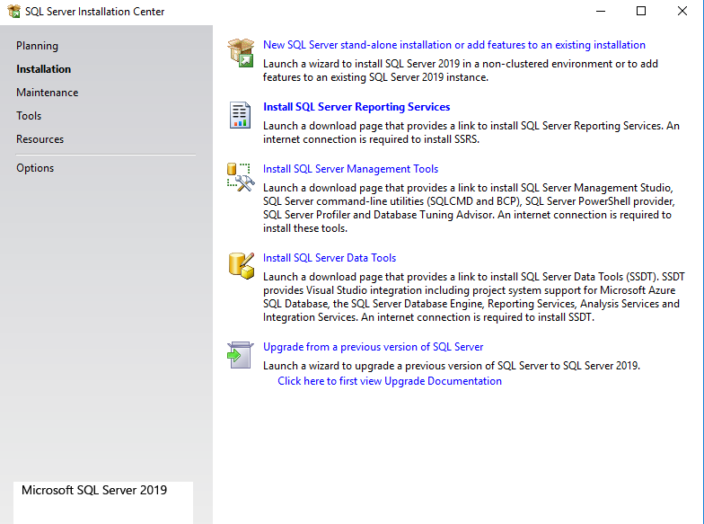
Click Close

Slide 19
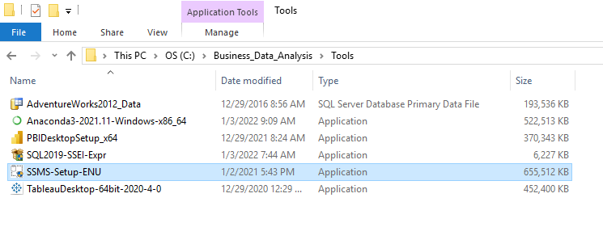
Install SSMS
Go to “C:\Business_Data_Analysis\Tools”
Double Click SSMS-Setup-ENU

Slide 20
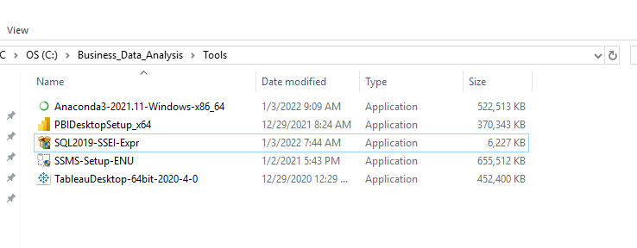
Install Python
Go to “C:\Business_Data_Analysis\Tools”
Double Click “Anaconda3-2021.11-Windows-x86_64”

Slide 21
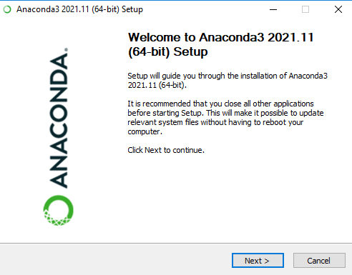
Install Python
Click Next

Slide 22
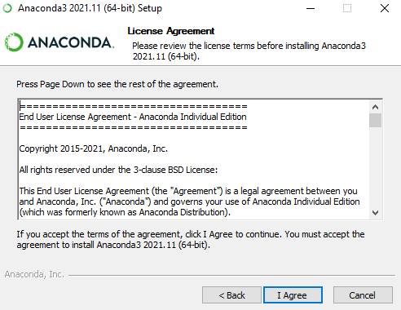
Install Python
Click I Agree

Slide 23
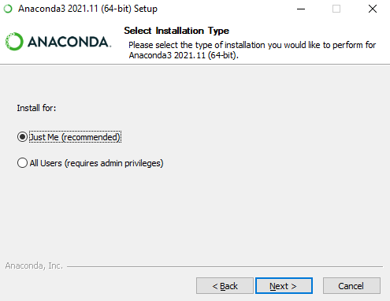
Install Python
Click Just Me

Slide 24
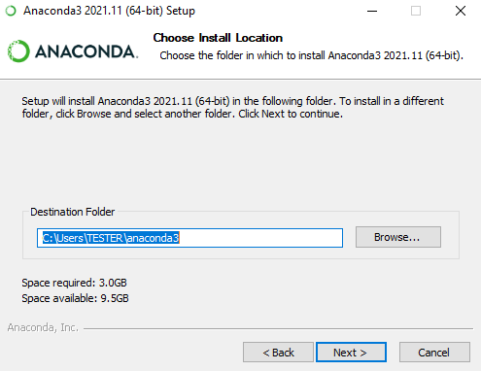
Install Python
Click Next

Slide 25
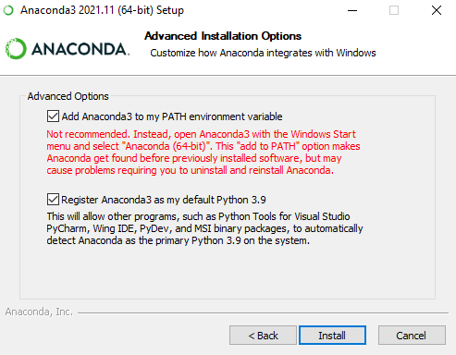
Install Python
Check both boxes
Click Install

Slide 26
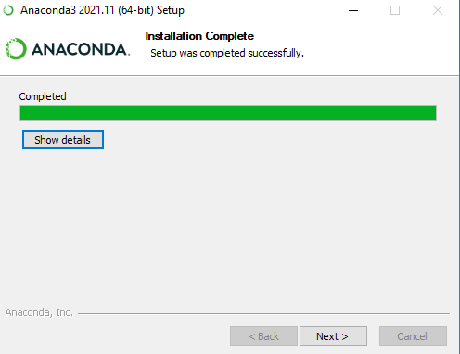
Install Python
Click Next

Slide 27
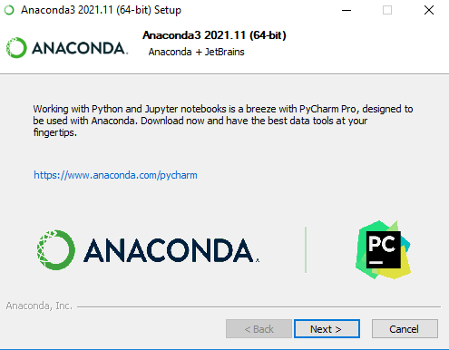
Install Python
Click Cancel and then Yes

Slide 28
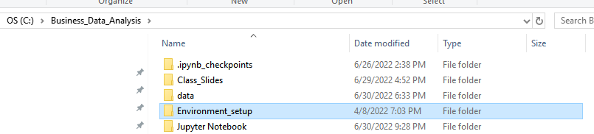
Install Python
Go to “Environment_setup” folder

Slide 29
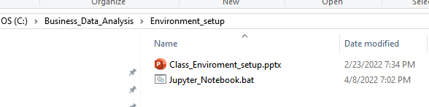
Install Python
Double click “Jupyter_Notebook.bat “

Slide 30
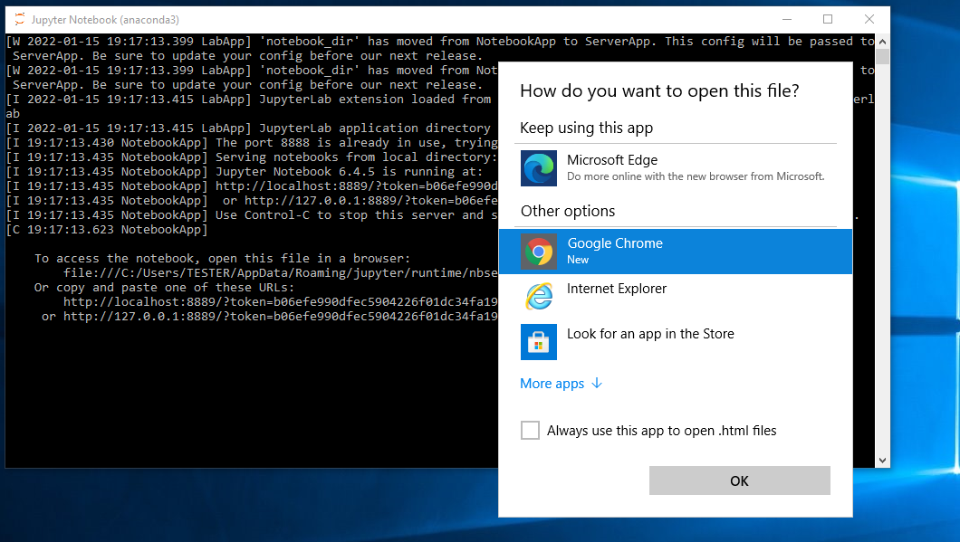
Setup Environment
Choose Google Chrome (note: if you don’t see the menu it’s ok to use Microsoft Edge)
If you don’t see this, it’s ok. Go to next slide

Slide 31
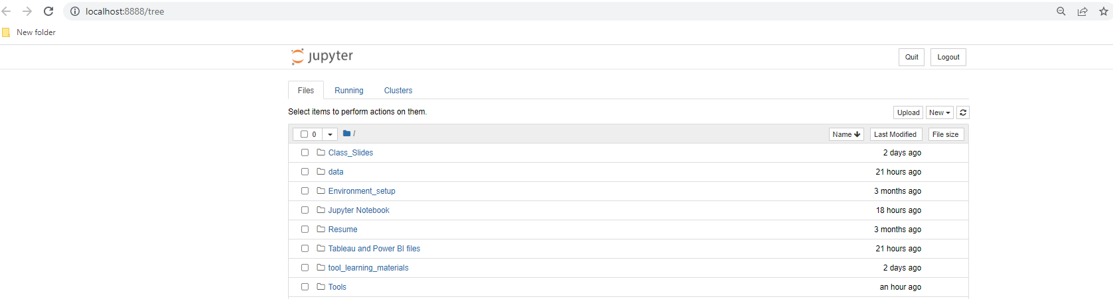
Setup Environment
You should see a tab in the browser

Slide 32
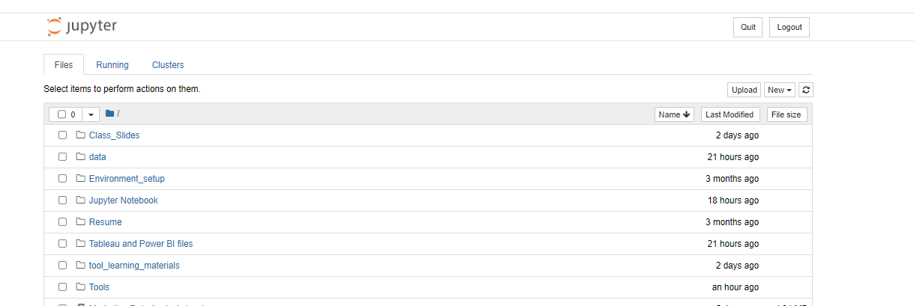
Setup Environment
In the open browser Click “tool_learning_materials”

Slide 33
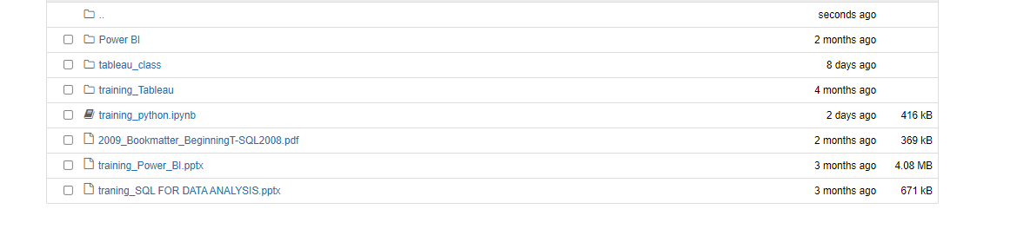
Setup Environment
Click “training_python.ipynb”

Slide 34
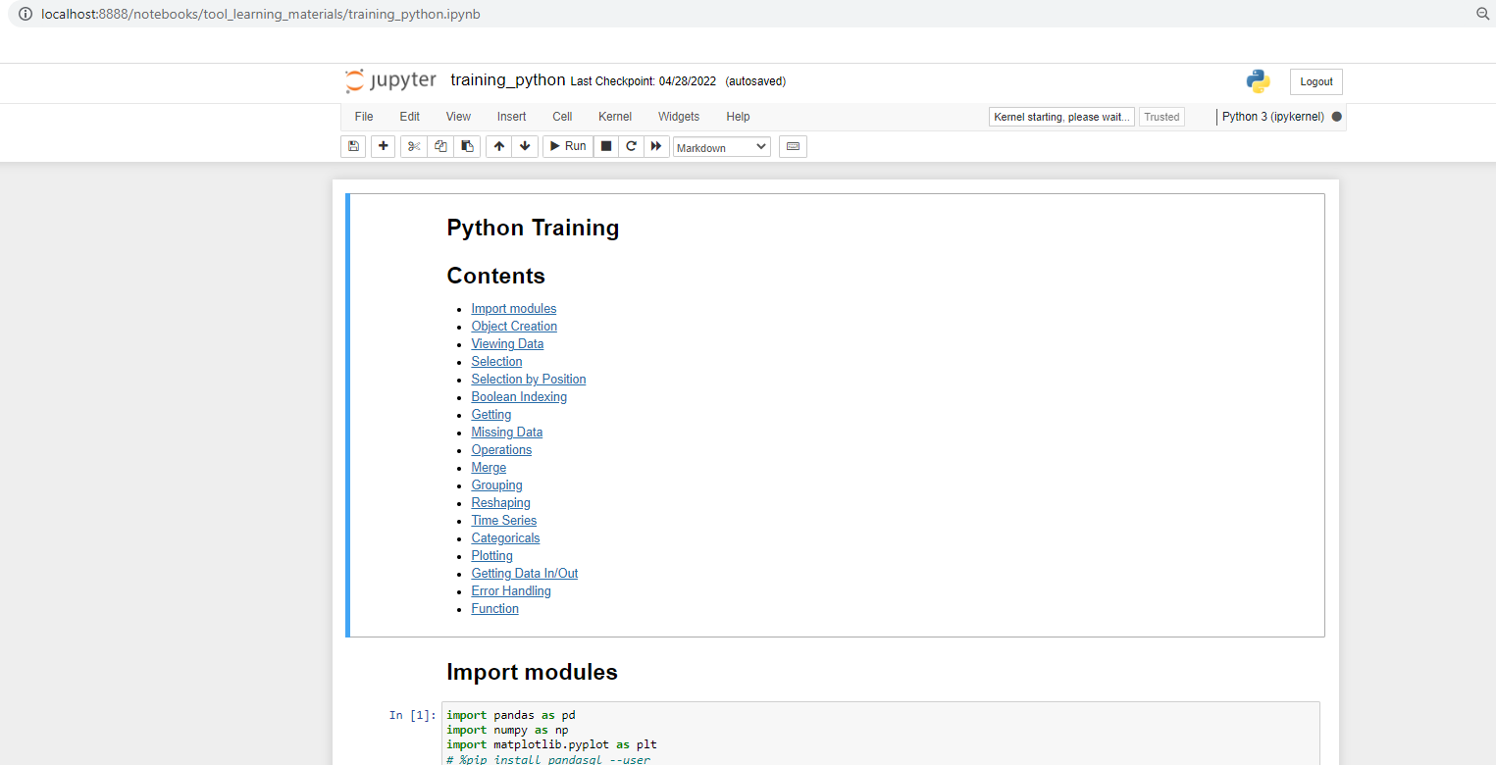
Setup Environment
You should see this

Slide 35
Install Power BI
Go to “C:\Business_Data_Analysis\Tools”
Double Click “PBIDesktopSetup_x64”

Slide 36
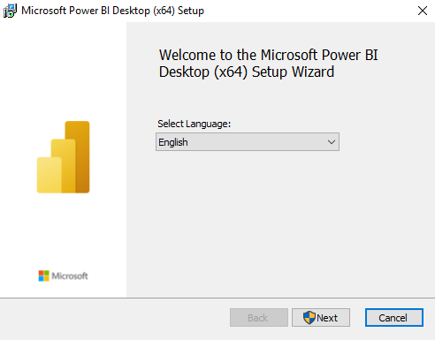
Install Power BI
Click Next

Slide 37
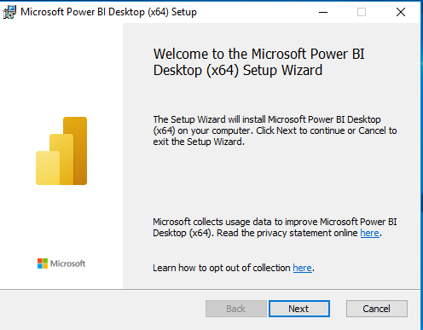
Install Power BI
Click Next

Slide 38
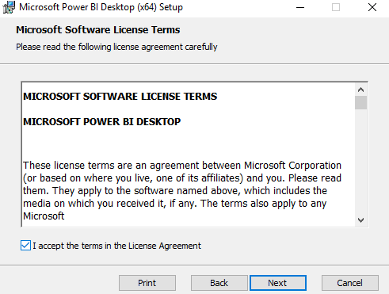
Install Power BI
Click Accept and then Next

Slide 39
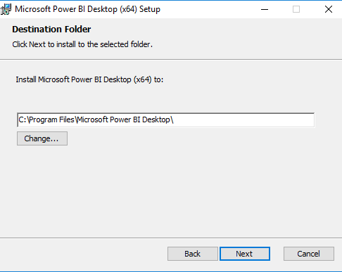
Install Power BI
Click Next

Slide 40
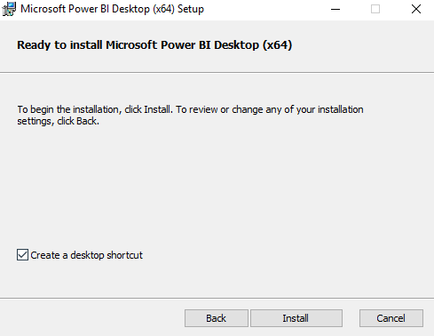
Install Power BI
Click Install

Slide 41
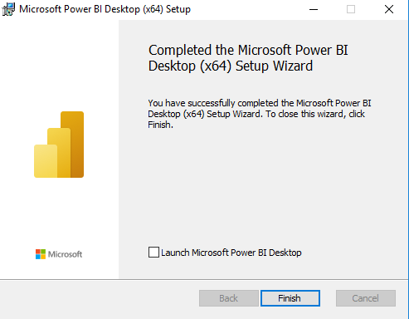
Install Power BI
Click Finish

Slide 42
Install Tableau
Go to “C:\Business_Data_Analysis\Tools”
Double Click “TableauDesktop-64bit-202x-x-x”

Slide 43
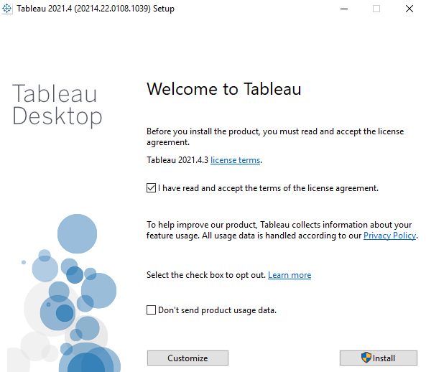
Install Tableau
Agree with the term and Click Install

Slide 44
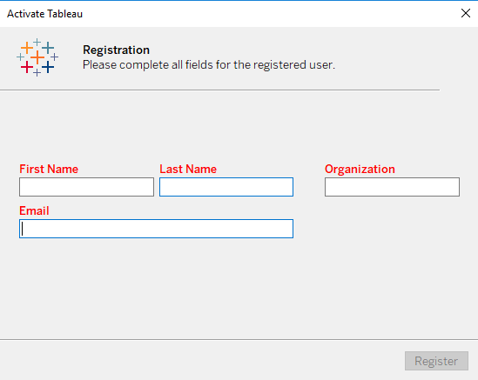
Install Tableau
Fill out the form and Click Register

Slide 45
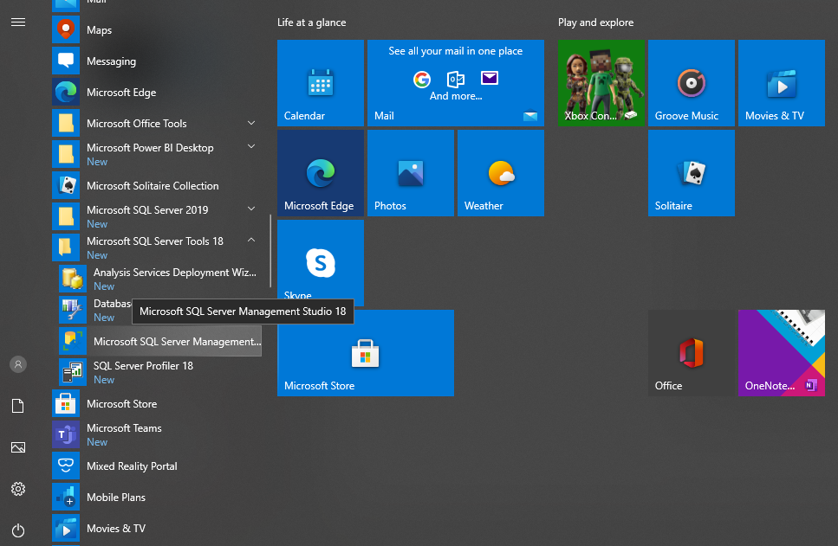
Setup Environment
Go to Window Start menu and find “Microsoft SQL Server Tools 18” and then Click “Microsoft SQL Sever Management Studio 18”

Slide 47
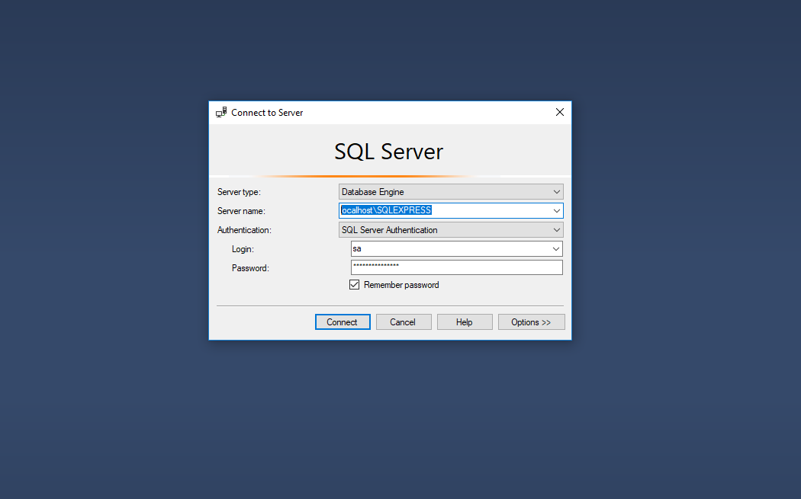
Setup Environment
In Server choose “Database Engine”
In Sever name type “localhost\SQLEXPRESS”
In Authentication choose “ SQL ServerAuthentication”
In Login type “sa”
In Password type “user1”
Click “Remember password”
Click “Connect”

Slide 48
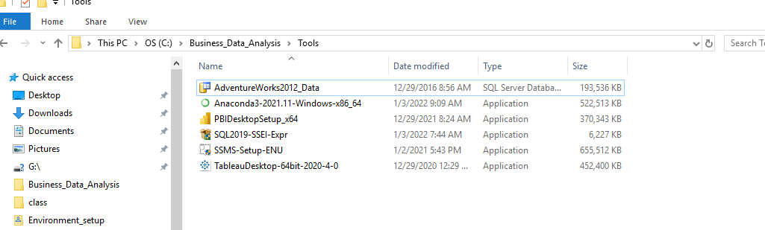
Go to Tools and copy AdventureWorks2012_Data

Slide 49
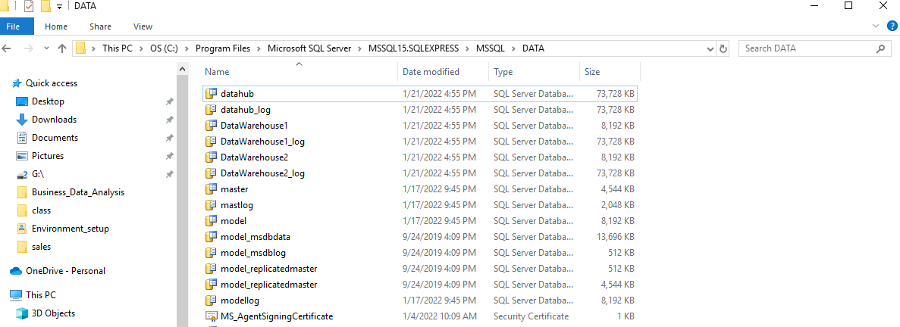
Go to “C:\Program Files\Microsoft SQL Server\MSSQL15.SQLEXPRESS\MSSQL\DATA”
Paste the copied file to the folder

Slide 50
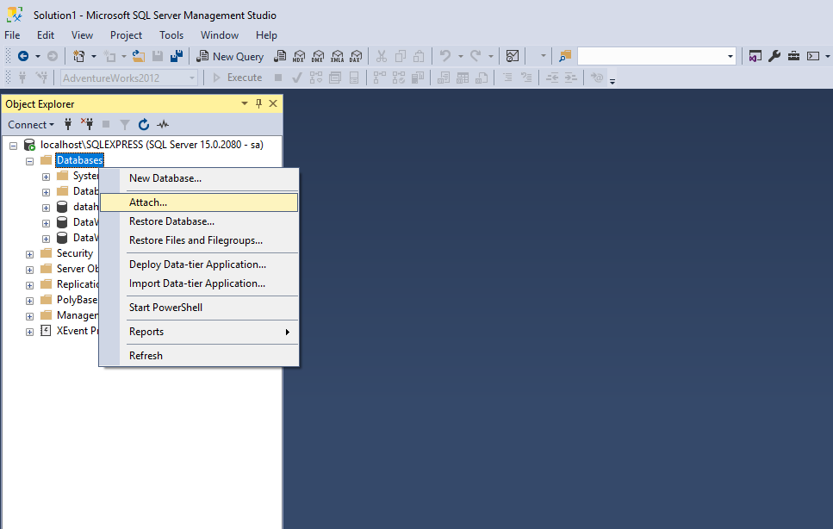
Right click Databases
Click “Attach”

Slide 51
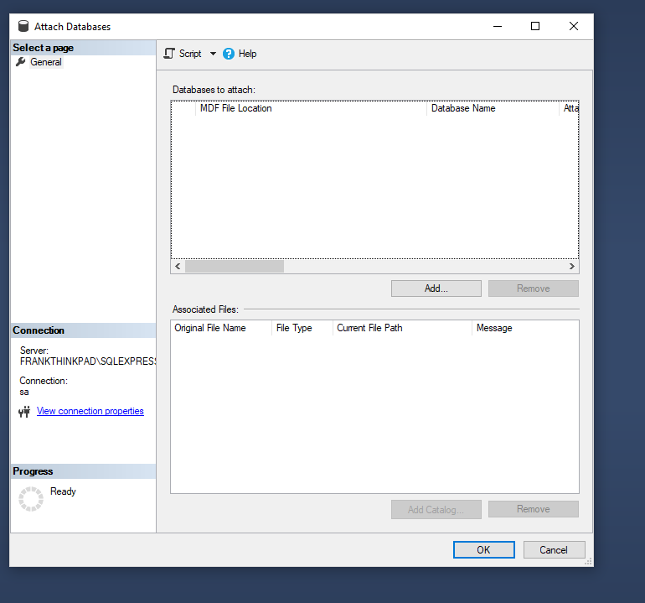
Click “Add”

Slide 52
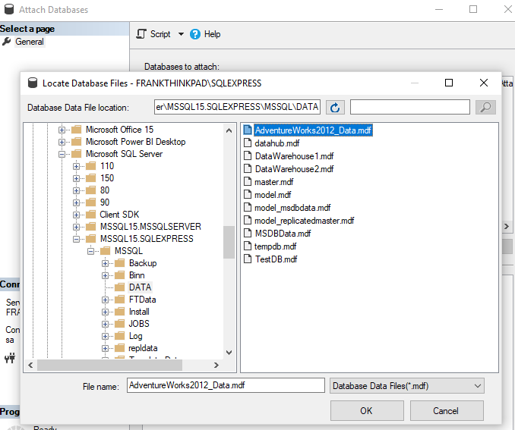
Click “DATA”
SELECT “AdventureWorks2012_Data”
Click “OK”

Slide 53
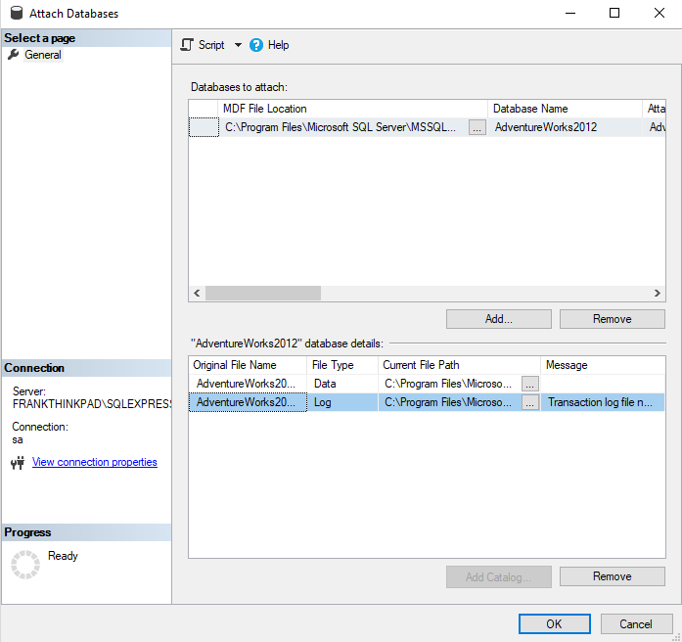
Click on the Log file
Click “Remove”
Click “OK”

Slide 54
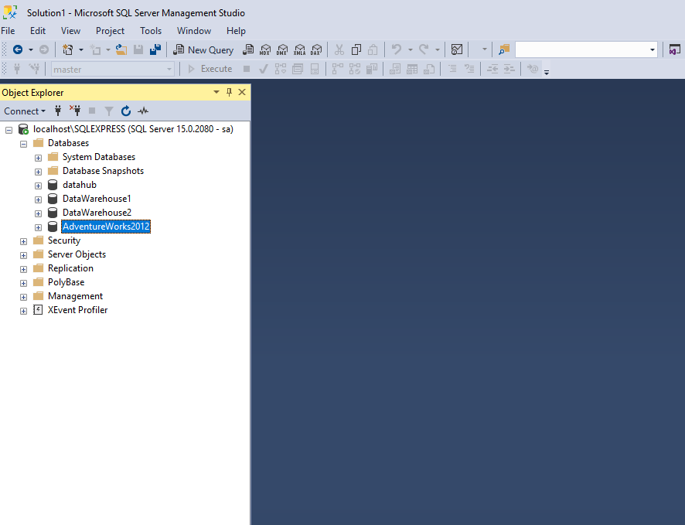
Now you should see “AdventureWork2012” database

