Slide 1
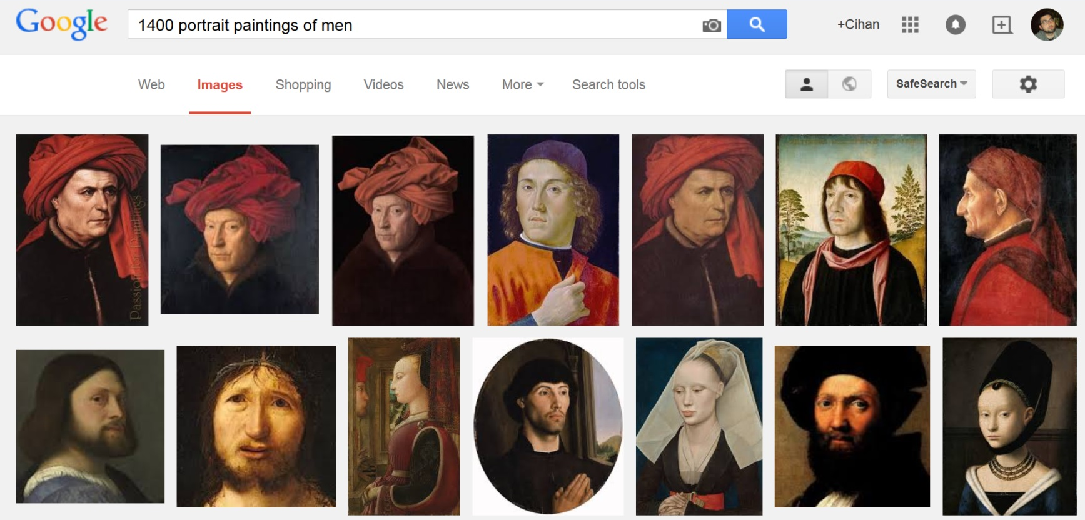

Slide 2
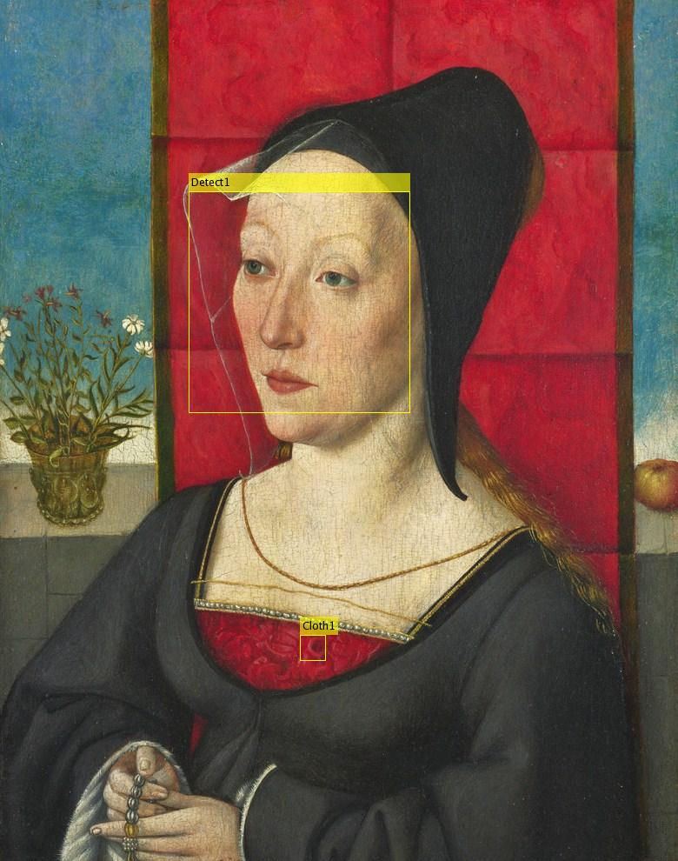

Slide 3

Female Male
1400, 1403, 1406, ….. , 2012, 2015

