Slide 1
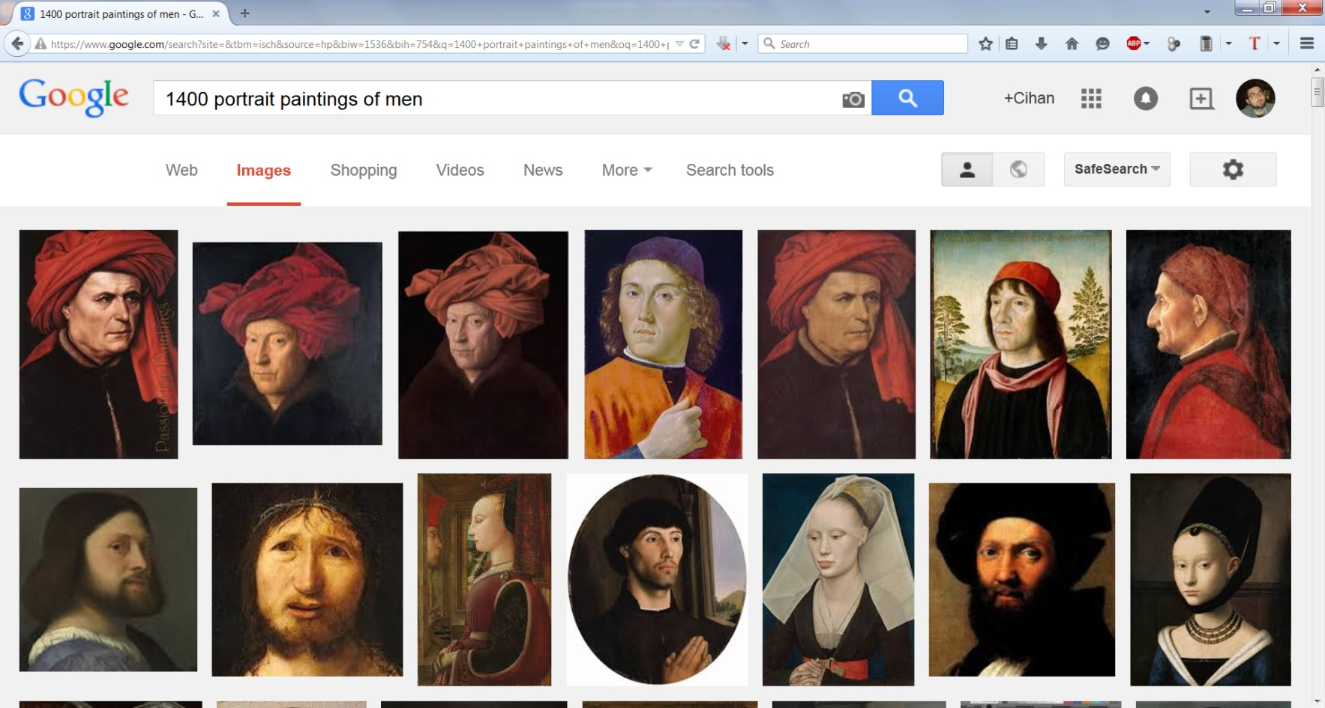

Slide 2
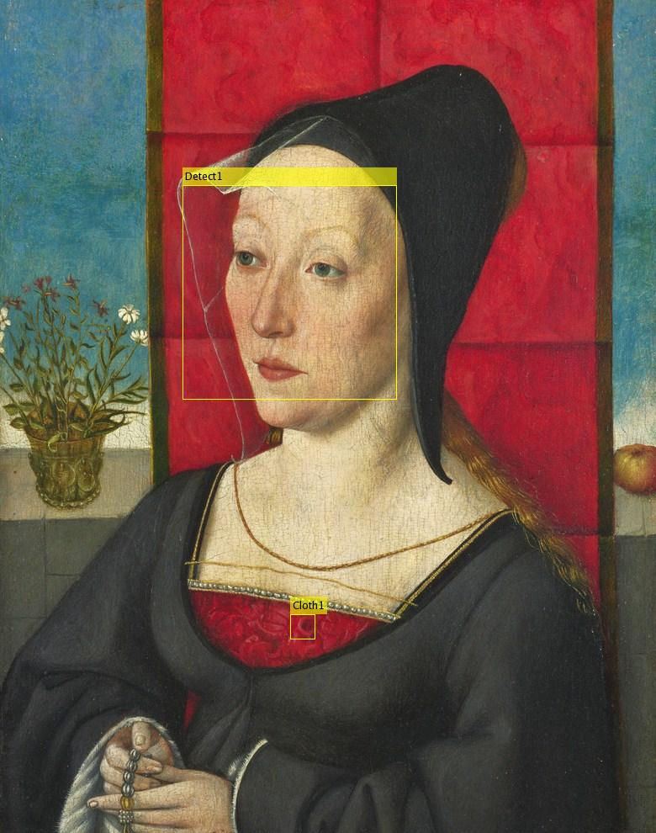

Slide 3

Female Male
1400, 1403, 1406, ….. , 2012, 2015

Slide 4
Portrait
Arm
Bag
Cup
Hair
Jewelry
Pants
Plate
Painting

Slide 5
Portrait
Arm
Bag
Cup
Hair
Jewelry
Pants
Plate
Painting

