Slide 1
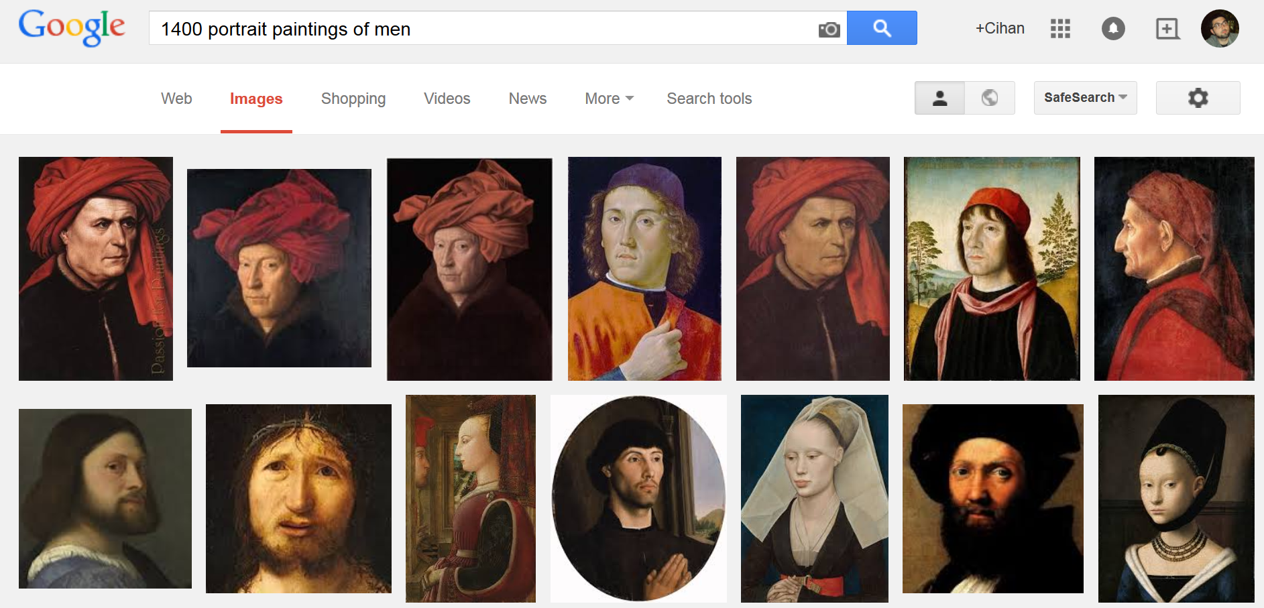
17467 images
~100 per each 3 years
~50 per gender per each 3 years
1400 => 2015
Men & Women

Slide 2
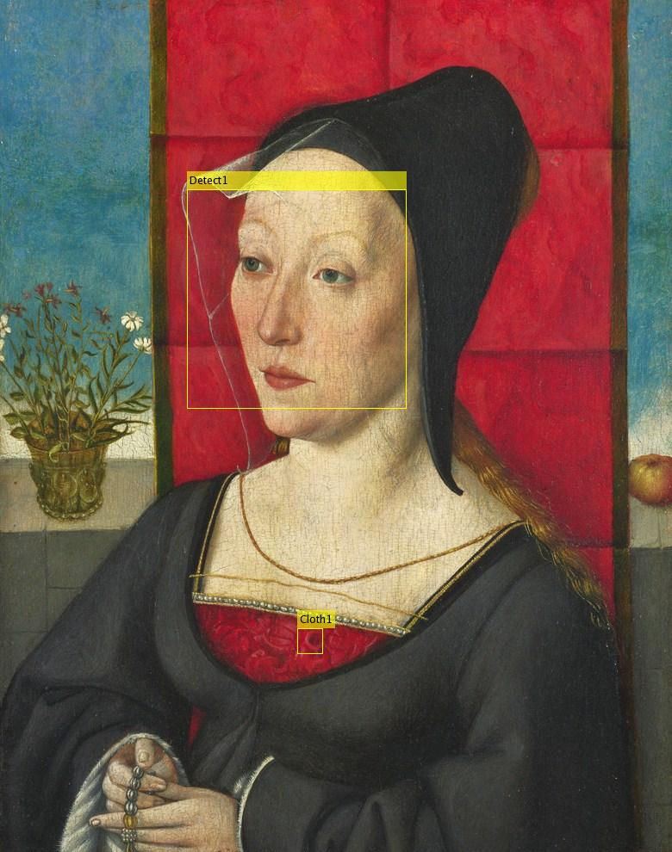
Cascade detector (Face, Profile, upper body)
Static vector to find the cloth
Gather all cloths per gender per era (~50 images, 900 pixel / image)

Slide 3
k-means on pixel values (RGB) => 5 cluster centers define 3 years period / gender

Slide 4
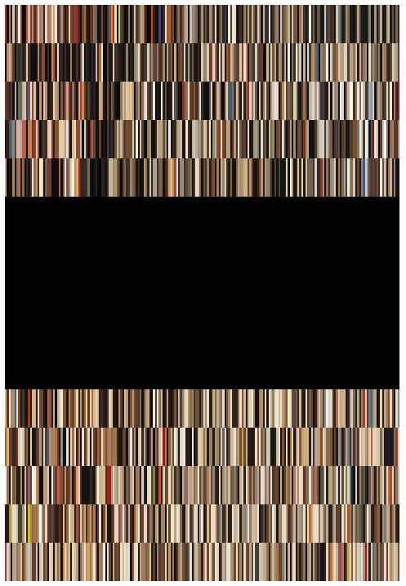
Male 1400 - 2015
Female 1400 - 2015

Slide 5
Download relevant data (with real meta data)
Use known features for cloth detection
Improve cloth detection

Slide 6
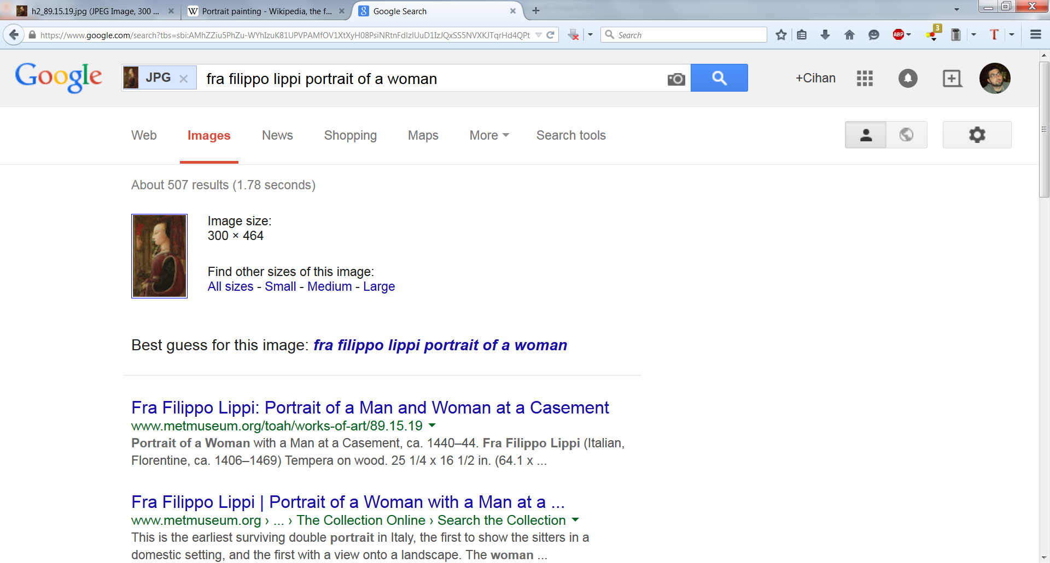
Reverse image search?

