Slide 1
Segmentation of Hyderabad Localities

Slide 2
Introduction
Hyderabad is the capital city of Telangana occupying 650 square kilometers (250 sq mi).
It consists of over 1000 neighborhoods with over 9.7 million population making in Fourth most populous city in India.

Slide 3
Problem Statement
Under a example of a person looking to buy a new house, he often wonders which area he has to choose.
To solve this problem, we use K means algorithm to determine best areas to buy new house.

Slide 4
Data acquisition and cleaning
Neighborhood names, plot pricing from manamm.com
Location Coordinates using geocoder
Near by places using Four Square API
Entire dataset has been processed to reduce redundancy.

Slide 5
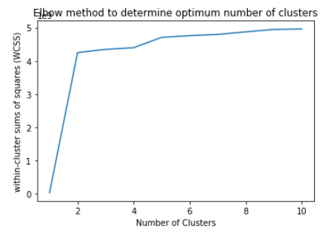
Elbow method
As the change is maximum at k=2, we choose no of clusters as two.

Slide 6
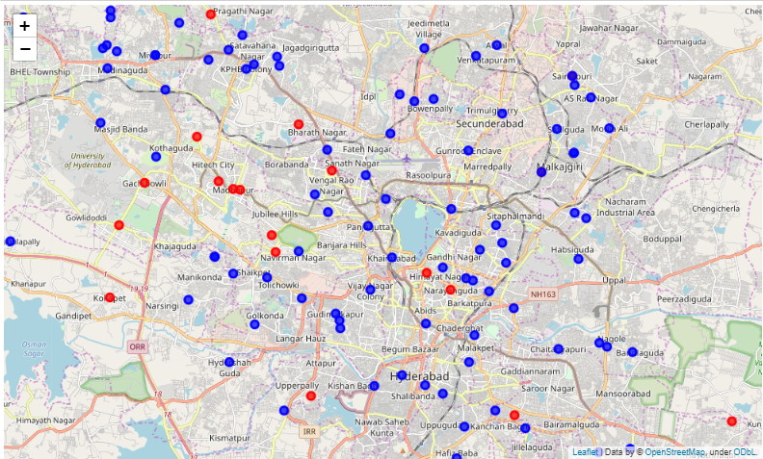
Result using Folium
Best areas to buy/rest houses is marked as red.
Not good areas are marked as blue.

Slide 7
Future Reference and
Conclusion
Data of land survey such as drought/flood prone areas, soil minerals can help to have more insight about neighborhoods.

