Slide 1
AdventureWorks Reseller Sales & Profitability Analysis
Management-Focused Business Analysis | Project #3
Analytical storyline
Business problem → evidence → business risk → root-cause hypotheses → diagnostic analysis → corrective actions → expected impact → continuous decision support
SQL Server • Excel Financial Modeling • Power BI
Prepared by Tina Vo

Slide 2
Agenda
2
01
Business Problem & Executive Evidence
02
Business Risks, Root-Cause Hypotheses & Diagnostic Analysis
03
Major Profitability Drivers & Comparative Impact
04
SWOT: Analytical Business Context
05
Recommendations & Corrective Actions
06
Expected Business Impact & Decision-Support Framework
Source: Project #3 SQL, Excel financial analysis, and Power BI report

Slide 3
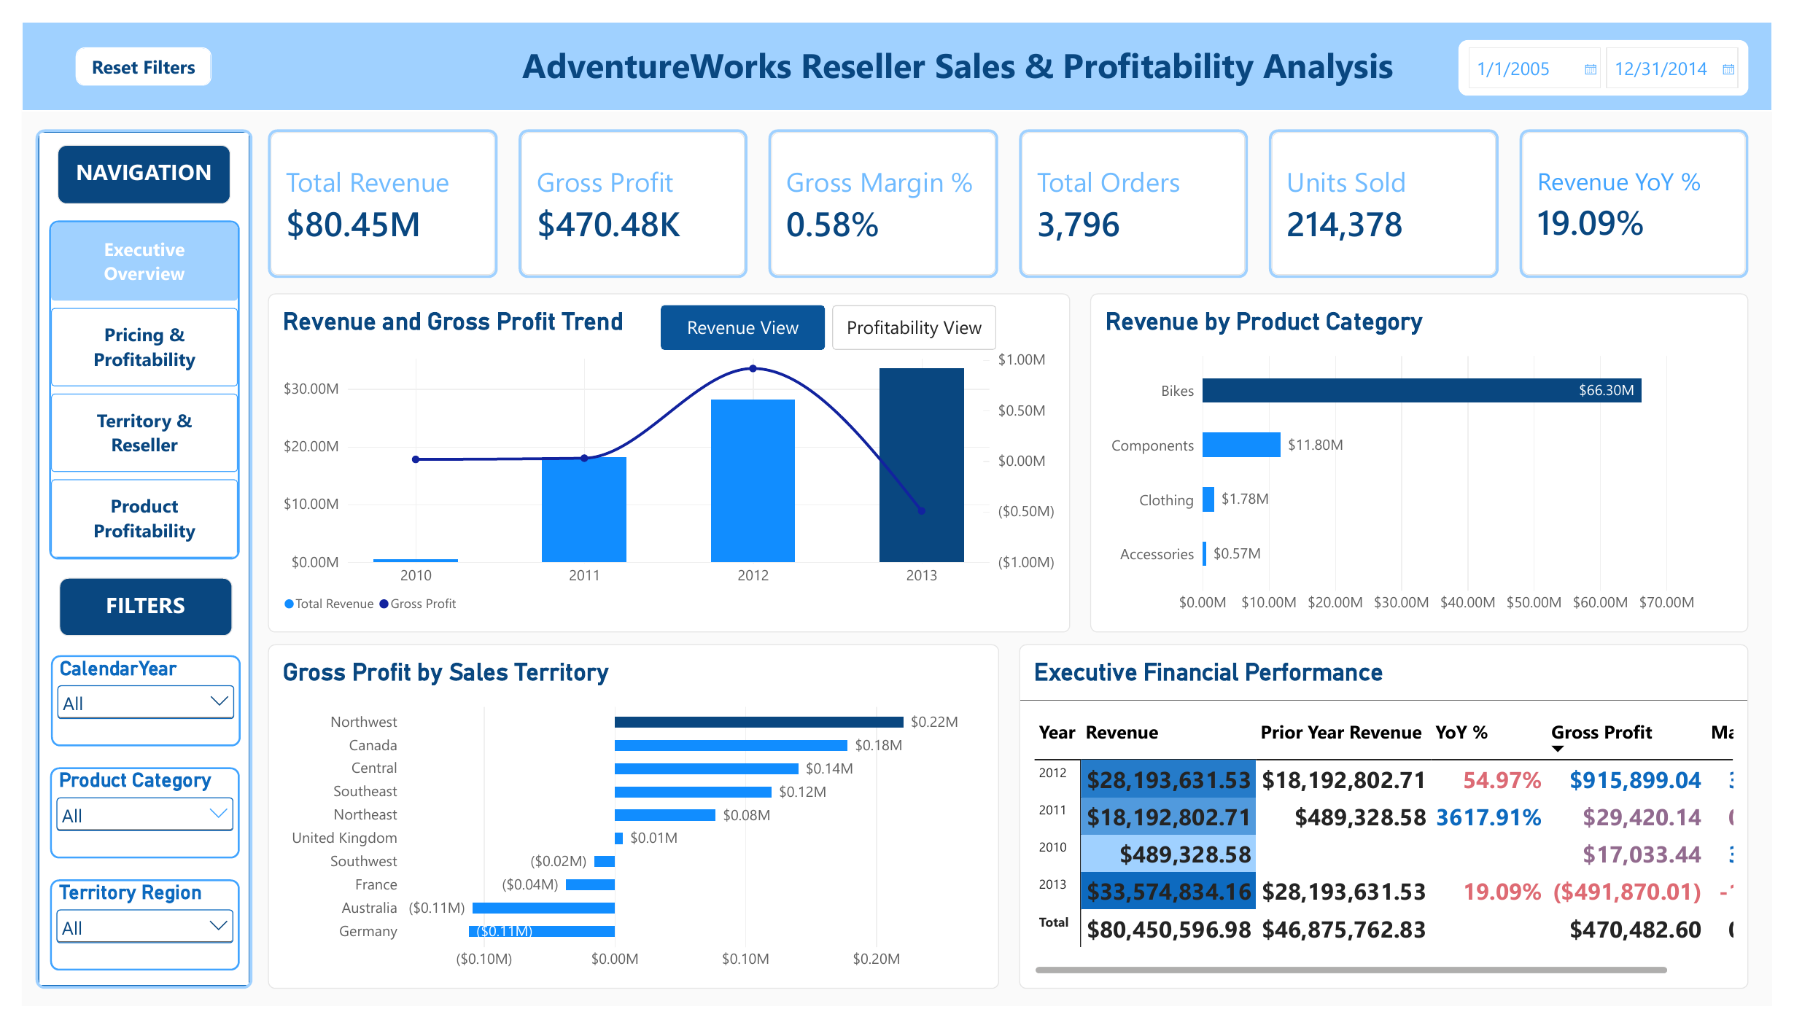
1. Business Problem: Strong Sales, Weak Profit Conversion
3
Evidence first—before diagnosing causes
Total Revenue
Gross Profit
Overall GM
2013 GM
$80.45M
$470.48K
0.58%
-1.46%
What the data proves
The reseller business generated substantial revenue, but the overall margin was only 0.58%. In 2013, revenue reached $33.57M while gross profit fell to ($491.87K).
Management problem
Revenue growth is not converting into profitable growth. Management needs to identify where margin is being lost, quantify the strongest drivers, and determine which levers deserve priority.
Source: Power BI Executive Overview + SQL profitability KPIs

Slide 4
2. Evidence → Risk: 2013 Became the Profitability Inflection Point
4
2012 GP
2013 GP
GP Deterioration
GM Change
$1.10M
($491.87K)
($1.59M)
(5.77) pp
Evidence
Business risk
Decision need
Jan–Nov 2013 revenue increased 31.52% versus the comparable Jan–Nov 2012 period. Units increased 45.06% and sales lines increased 43.08%.
More volume is being processed while profit is falling. If the pattern continues, growth can consume working capacity without creating economic value.
Identify whether the deterioration is primarily driven by product mix, selling below cost, promotion/discount behavior, cost pressure, or combinations of these factors.
Important scope note
2013 is partial-year data ending November 29; YoY diagnostic comparisons use Jan–Nov 2012 versus Jan–Nov 2013.
Source: Excel Performance Variance Analysis

Slide 5
3. Business Risks, Root-Cause Hypotheses & Diagnostic Tests
5
Explicitly separating proof from what management should investigate
RISK / HYPOTHESIS
EVIDENCE / SIGNAL
DIAGNOSTIC TEST
Product mix concentration
Bikes dominate revenue and show losses
Compare category and subcategory GP variance
Below-cost pricing
40.27% of 2013 sales lines were below cost
Price vs. standard cost by category/product
Promotion / discount pressure
Some promotions show weak economics
Compare promotion-level margin; test No Discount
Cost / price imbalance
Thin margin makes results cost-sensitive
Price-cost sensitivity and Goal Seek
Territory / reseller mix
Profitability differs by market/customer
Drill into territory and reseller performance
Analytical discipline
A hypothesis becomes a management conclusion only after the diagnostic evidence supports it.
Source: Project #3 SQL, Excel financial analysis, and Power BI report

Slide 6
4. Major Driver Comparison: Which Categories Drove the GP Decline?
6
Jan–Nov 2012 → Jan–Nov 2013 gross-profit variance
Bikes
($1,404K)
88.34% of net GP deterioration
Components
($188K)
11.81%
Clothing
($100K)
6.27%
Accessories
$102K
Positive offset
Strongest category driver
Offsetting effect
Bikes account for approximately 88% of the net overall GP deterioration. This makes Bikes the first management priority for deeper diagnosis.
Accessories improved GP by about $102K, partially offsetting losses elsewhere. Not every category deteriorated.
Source: Excel Product Category YoY Performance + GP Variance analysis

Slide 7
5. Diagnostic Drill-Down: What Drove the Bikes Loss?
7
Bikes gross-profit variance by subcategory
Touring Bikes
($1,031K)
73.42% of Bikes deterioration
Road Bikes
($189K)
13.45%
Mountain Bikes
($184K)
13.13%
Touring Bikes
Road Bikes
Mountain Bikes
2013 revenue ≈ $9.91M
2013 GM ≈ -10.41%
Largest Bikes GP deterioration.
Revenue declined ≈ 27%
GM worsened to ≈ -6.75%
Already negative and deteriorated.
Remained profitable
2013 GM ≈ 7.50%
But GP still declined versus 2012.
Source: Excel Bikes Subcategory Profitability Drill-Down

Slide 8
6. Diagnostic Analysis: Below-Cost Pricing Is a Material Risk Signal
8
2013 Sales Lines
Below-Cost Lines
Below-Cost Share
Bikes Below-Cost
28,540
11,492
40.27%
72.09%
What the data supports
What the data does NOT prove
Below-cost selling is widespread enough to be financially material, and it is especially concentrated in Bikes. This is consistent with the negative margin pattern.
The analysis does not prove that below-cost pricing alone caused every loss. Product mix, cost structure, promotions, territory, and reseller economics can interact.
Management diagnostic question
Which high-revenue Bikes products, territories, resellers, and transaction groups repeatedly sell below standard cost—and are those transactions strategically justified?
Source: Excel Pricing Effectiveness + SQL Price vs. Cost Analysis

Slide 9
7. Diagnostic Analysis: Promotions Are Not the Sole Explanation
9
Promotion hypothesis
Diagnostic result
Management implication
Discount and promotion activity can reduce realized price, so promotion-level margin should be tested as a potential driver.
The project analysis found negative economics even in the No Discount population. Some promotions were worse, but losses were not limited to promoted sales.
Avoid a blanket conclusion that promotions caused the loss. Investigate pricing discipline and product economics more broadly.
Cost / price imbalance hypothesis
Territory / reseller hypothesis
Because baseline Bikes margin is already negative, relatively small changes in realized price or product cost can materially change profitability.
North America is profitable overall, while Europe and Pacific are negative. Customer and market mix therefore deserve targeted review rather than one global response.
Diagnostic conclusion
The evidence points to a multi-factor profitability problem, with Bikes product economics and below-cost exposure as the strongest signals.
Source: SQL Promotion & Time Trend Analysis + Power BI Territory & Reseller

Slide 10
8. SWOT: Business & Analytical Context
10
Using the findings to frame management choices
STRENGTHS
WEAKNESSES
• Strong revenue scale and reseller activity
• Profitable categories offset part of Bikes losses
• North America profitable overall
• Integrated SQL–Excel–Power BI monitoring capability
• Overall GM only 0.58%
• 2013 GM negative
• Bikes dominate revenue but lose money
• High below-cost exposure in 2013 Bikes
OPPORTUNITIES
THREATS
• Exception-based pricing governance
• Product/subcategory price-cost review
• Territory/reseller profitability segmentation
• Scenario modeling before commercial decisions
• Revenue growth can deepen losses
• Cost inflation can quickly erode thin margins
• Broad pricing changes may affect demand/customer retention
• Partial-year and historical data limit forward-looking certainty
Source: Project #3 SQL, Excel financial analysis, and Power BI report

Slide 11
9. Decision Support: Test Corrective Levers Before Acting
11
Bikes price-cost sensitivity
Historical Bikes GM
+5% Price
+7.5% Price
Price for ~5% GM
-1.49%
3.34%
5.59%
~+6.82%
What the model shows
What management must add
Under a constant-cost assumption, Bikes margin is highly sensitive to realized price. A price change around 6.82% is required in the model to approach a 5% GM target.
Demand elasticity, competitor pricing, customer retention, contract terms, inventory position, and strategic account considerations before implementation.
Decision principle
Use sensitivity analysis to define the financial requirement; use commercial evidence to decide whether and how to act.
Source: Excel Price & Cost Sensitivity Analysis

Slide 12
10. Recommendations & Corrective Actions
12
Prioritized by evidence and financial exposure
1
Touring / Road Bikes deep dive
Review price-to-cost gaps at product, reseller, and territory level; validate whether loss-making transactions are intentional.
2
Pricing exception governance
Use the watchlist to route high-exposure below-cost / low-margin transactions for review before margin risk compounds.
3
Margin-based performance management
Pair revenue KPIs with GP and GM so growth is evaluated on economic quality, not sales volume alone.
4
Targeted—not blanket—commercial action
Differentiate by product, territory, reseller, and promotion rather than applying one global pricing response.
5
Scenario + commercial validation
Use sensitivity models to size required financial improvement, then test against customer and market constraints.
Source: Project #3 SQL, Excel financial analysis, and Power BI report

Slide 13
11. Expected Business Impact
13
What improvement should management expect to influence?
Margin protection
Better prioritization
Higher-quality growth
Earlier visibility into below-cost and low-margin transactions can reduce unmanaged margin leakage.
Driver ranking focuses management attention on the products and transaction groups with the largest financial impact.
Revenue decisions can be evaluated together with GP and GM, improving the distinction between volume growth and profitable growth.
Faster diagnosis
More disciplined decisions
Drill-through, tooltips, and exception analysis shorten the path from an executive KPI to product, reseller, and territory-level investigation.
Scenario analysis makes the financial trade-off visible before pricing or cost actions are implemented.
Measurement note
These are expected decision-support benefits. Actual financial impact requires implementation data and post-action measurement.
Source: Project #3 SQL, Excel financial analysis, and Power BI report

Slide 14
12. Continuous-Improvement & Management Decision-Support Framework
14
1
2
3
4
5
6
MONITOR
→
DETECT
→
DIAGNOSE
→
MODEL
→
DECIDE
→
MEASURE
Revenue • GP • GM • exceptions
Below-cost / low-margin signals
Product • territory • reseller • promotion
Price / cost sensitivity
Targeted corrective action
Post-action KPI & variance review
Role of the Power BI dashboard
The dashboard becomes the front end of a repeatable management cycle: monitor performance, identify exceptions, drill into drivers, evaluate scenarios, take action, and measure whether profitability improves.
Source: Project #3 SQL, Excel financial analysis, and Power BI report

Slide 15
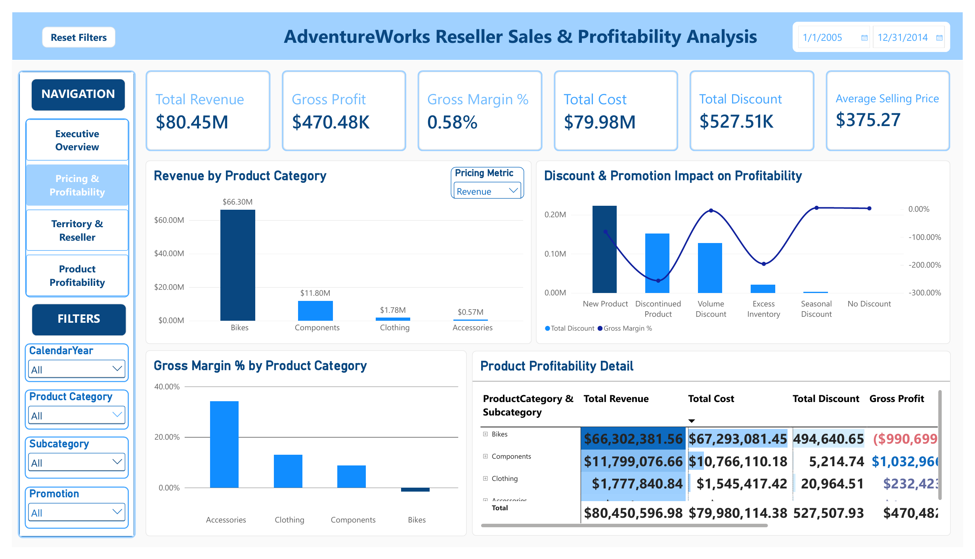
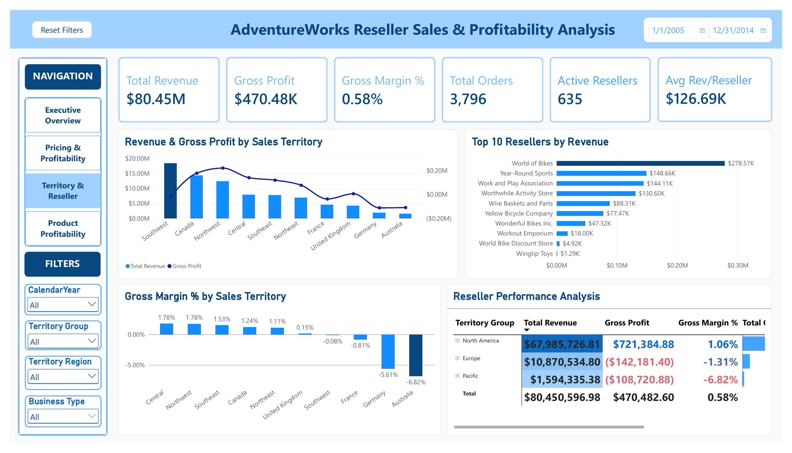
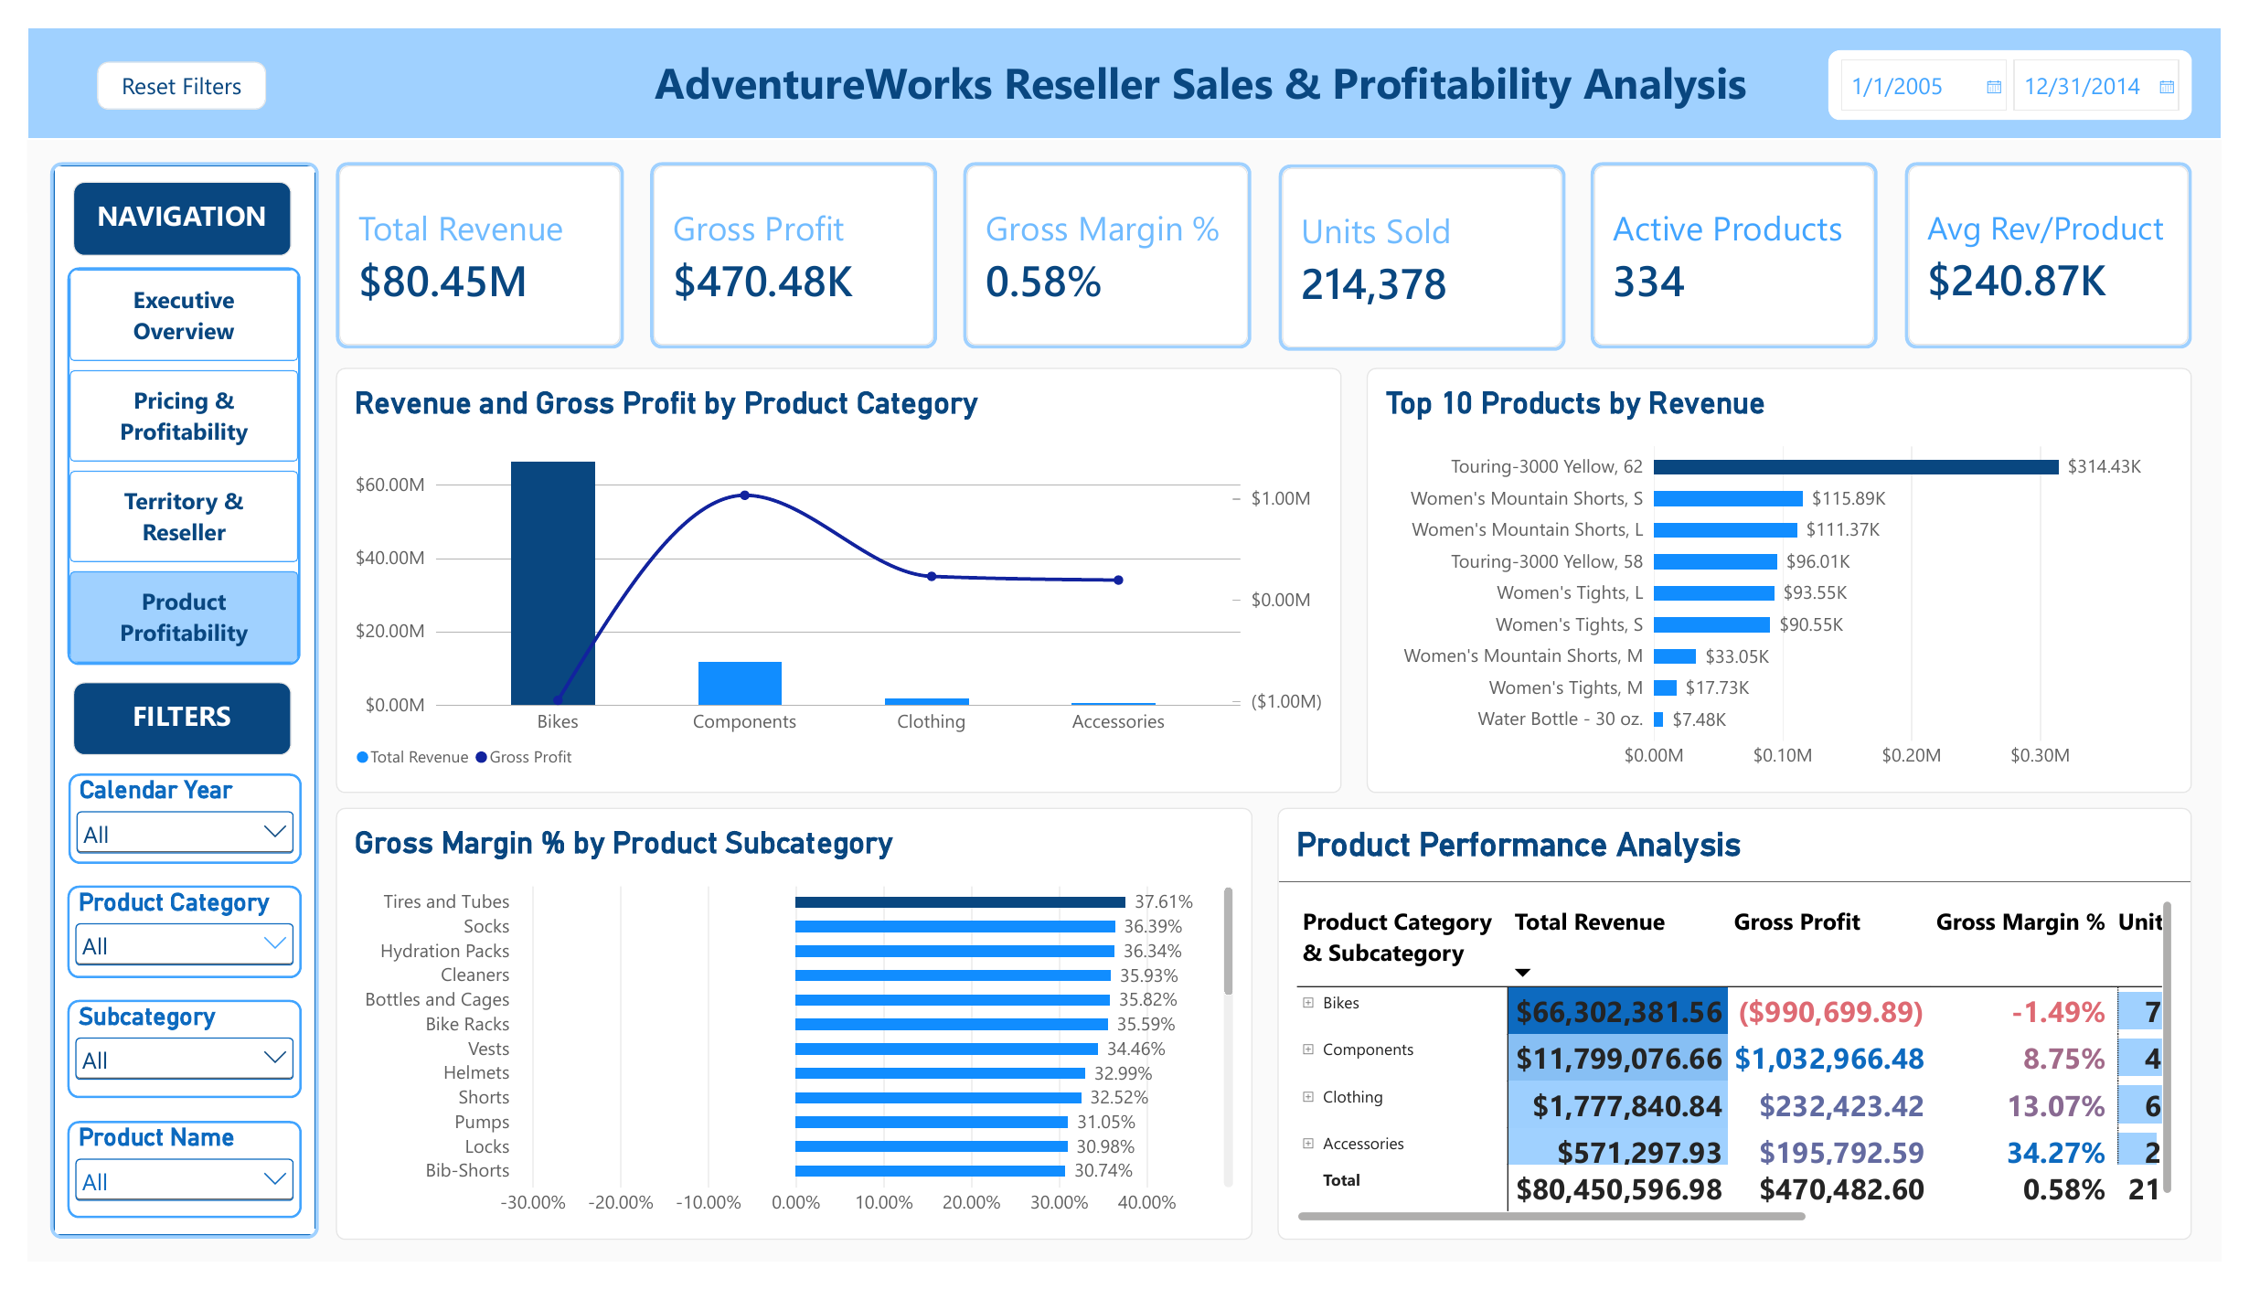
13. Management Dashboard: From KPI to Decision
15
Executive Overview
Pricing & Profitability
Territory & Reseller
Product Profitability
Management conclusion
Profitability deterioration is concentrated—not random. Bikes are the dominant category driver, Touring Bikes are the strongest subcategory driver, and below-cost exposure is a major risk signal. The dashboard supports continuous diagnosis and targeted action.
Project #3 value proposition
SQL validates and diagnoses the data → Excel quantifies variance, exceptions, and scenarios → Power BI converts the analysis into an interactive management decision-support system.
Tina Vo | SQL • Excel • Power BI • Sales Finance & Business Analytics
Source: Project #3 SQL, Excel financial analysis, and Power BI report

Slide 16
Thank You
AdventureWorks Reseller Sales & Profitability Analysis
From KPI → diagnosis → financial modeling → targeted management action
Tina Vo | SQL • Excel • Power BI • Sales Finance & Business Analytics

