Slide 1
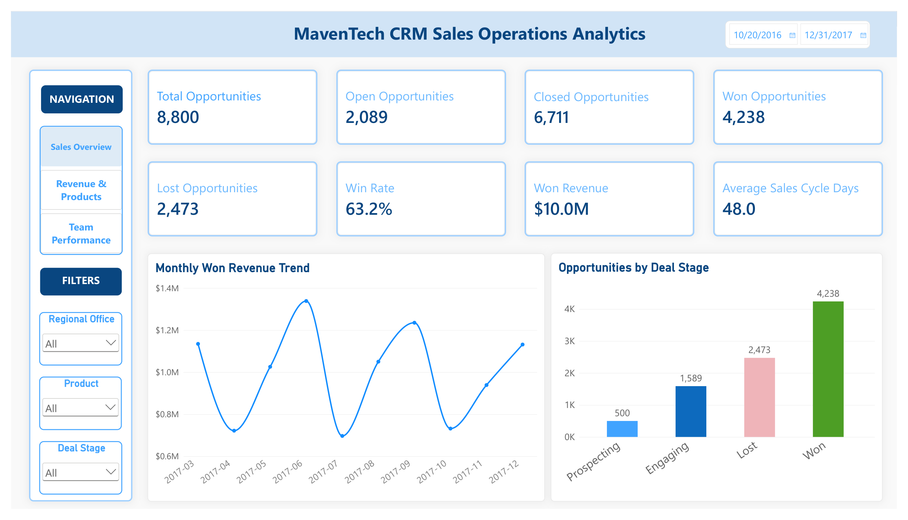
MavenTech CRM Sales Operations Analytics
Turning CRM Data into Sales Performance & Decision Support
Business Analysis Presentation
CRM Analytics · Sales Performance · Risk Identification · Decision Support
1

Slide 2
Agenda
How this analysis moves from business problem to management action
1 Business Problem & Management Questions
What leadership needs to understand, and the questions the dashboard must answer.
2 Executive Sales Performance
Baseline KPIs across 8,800 opportunities, including 2,473 lost.
3 Revenue & Product Performance
Where the $10.0M in won revenue is concentrated by product and region.
4 Regional & Team Performance
Highest and lowest performing teams, compared on multiple metrics.
5 Risks, Root Causes & SWOT
What the data proves versus what management should investigate.
6 Recommendations & Expected Impact
Corrective actions and the Monitor-Diagnose-Investigate-Act framework.
2

Slide 3
Business Problem & Management Questions
From CRM records to management-ready decision support
Business Problem
Raw CRM opportunity records do not provide leadership with a consolidated view of sales performance.
Management needs to connect pipeline outcomes, revenue, products, regions, teams, deal size, and sales-cycle efficiency.
A single KPI can hide important trade-offs, for example, high conversion does not necessarily mean high revenue.
Management Questions
Where is won revenue being generated, and where is it concentrated?
Which products perform best by revenue versus conversion?
Which regions, managers, and agents lead performance?
Where are lost opportunities, longer sales cycles, or performance gaps creating risk?
What should management investigate and improve next?
3

Slide 4
Executive Sales Performance
Current-state performance establishes the baseline for diagnosis
Total Opportunities
8,800
Won Opportunities
4,238
Win Rate
63.2%
Won Revenue
$10.0M
Lost Opportunities
2,473
Avg. Sales Cycle
48 days
Analytical Interpretation
The business converted 4,238 of 6,711 closed opportunities into wins.
2,473 lost opportunities represent the clearest pool for conversion-loss analysis.
The 48-day average sales cycle provides an internal benchmark for identifying longer-cycle opportunities, potential process or performance gaps.
4

Slide 5
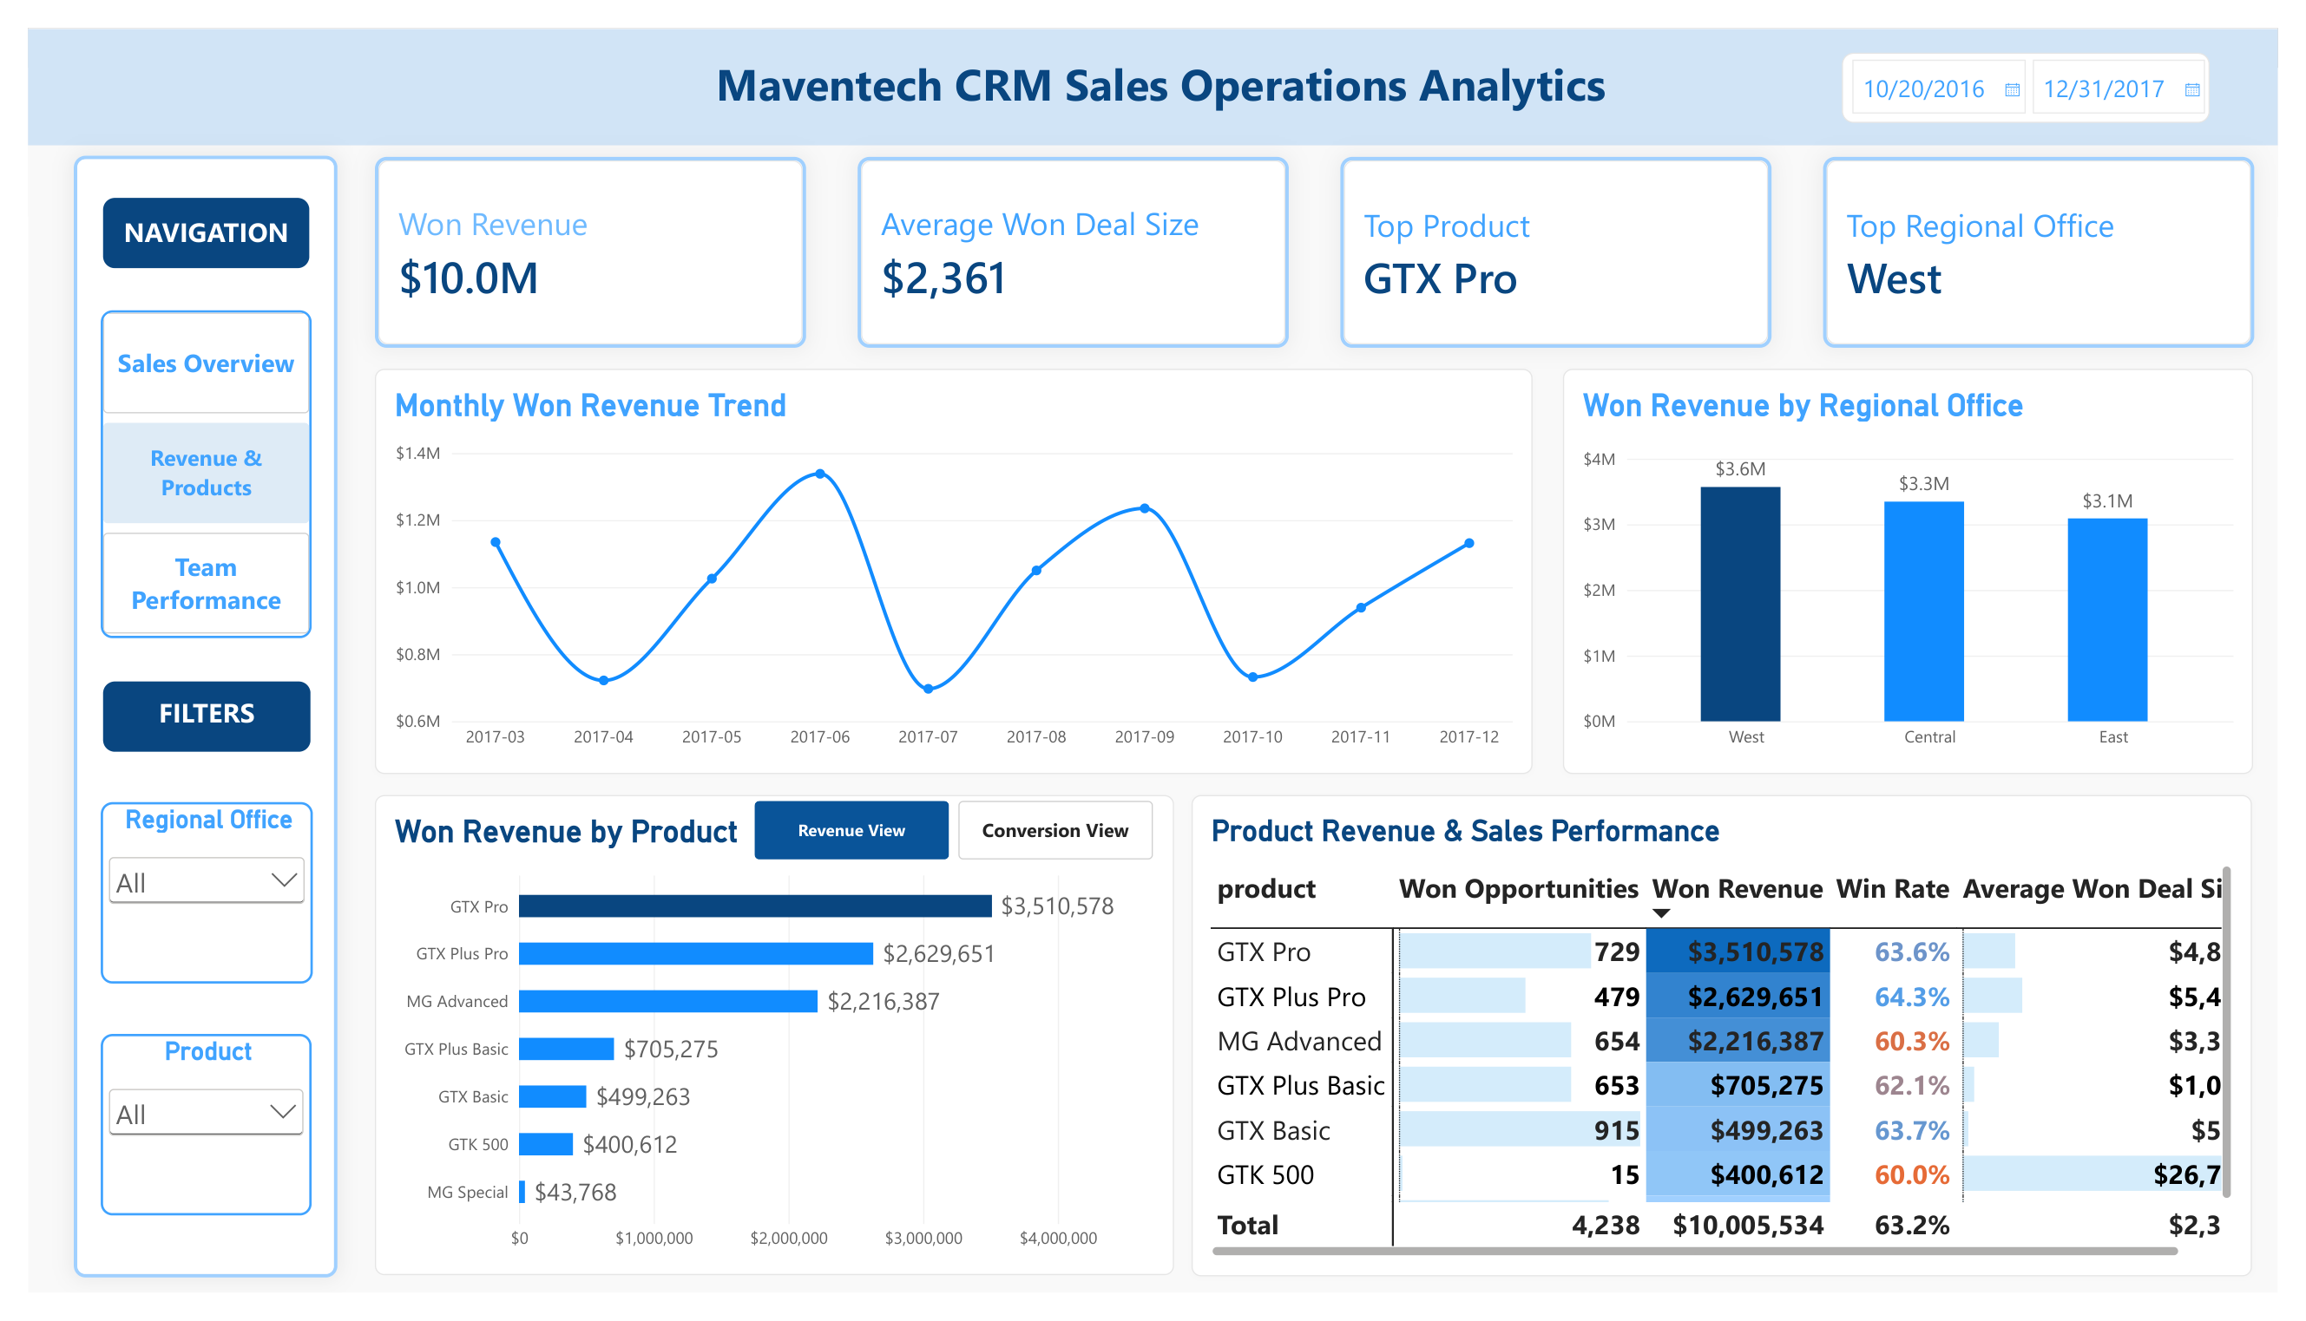
Revenue & Product Performance
Revenue contribution and conversion effectiveness tell different stories
Evidence
GTX Pro leads Won Revenue at $3.51M with a 63.6% Win Rate.
MG Special posts a higher 64.8% Win Rate but only about $43.8K in Won Revenue.
Diagnostic Interpretation
Conversion rate alone does not explain financial contribution.
Deal size, opportunity volume, product mix, and conversion should be analyzed together.
Revenue concentration in GTX Pro, GTX Plus Pro, and MG Advanced creates both strength and concentration risk.
5

Slide 6
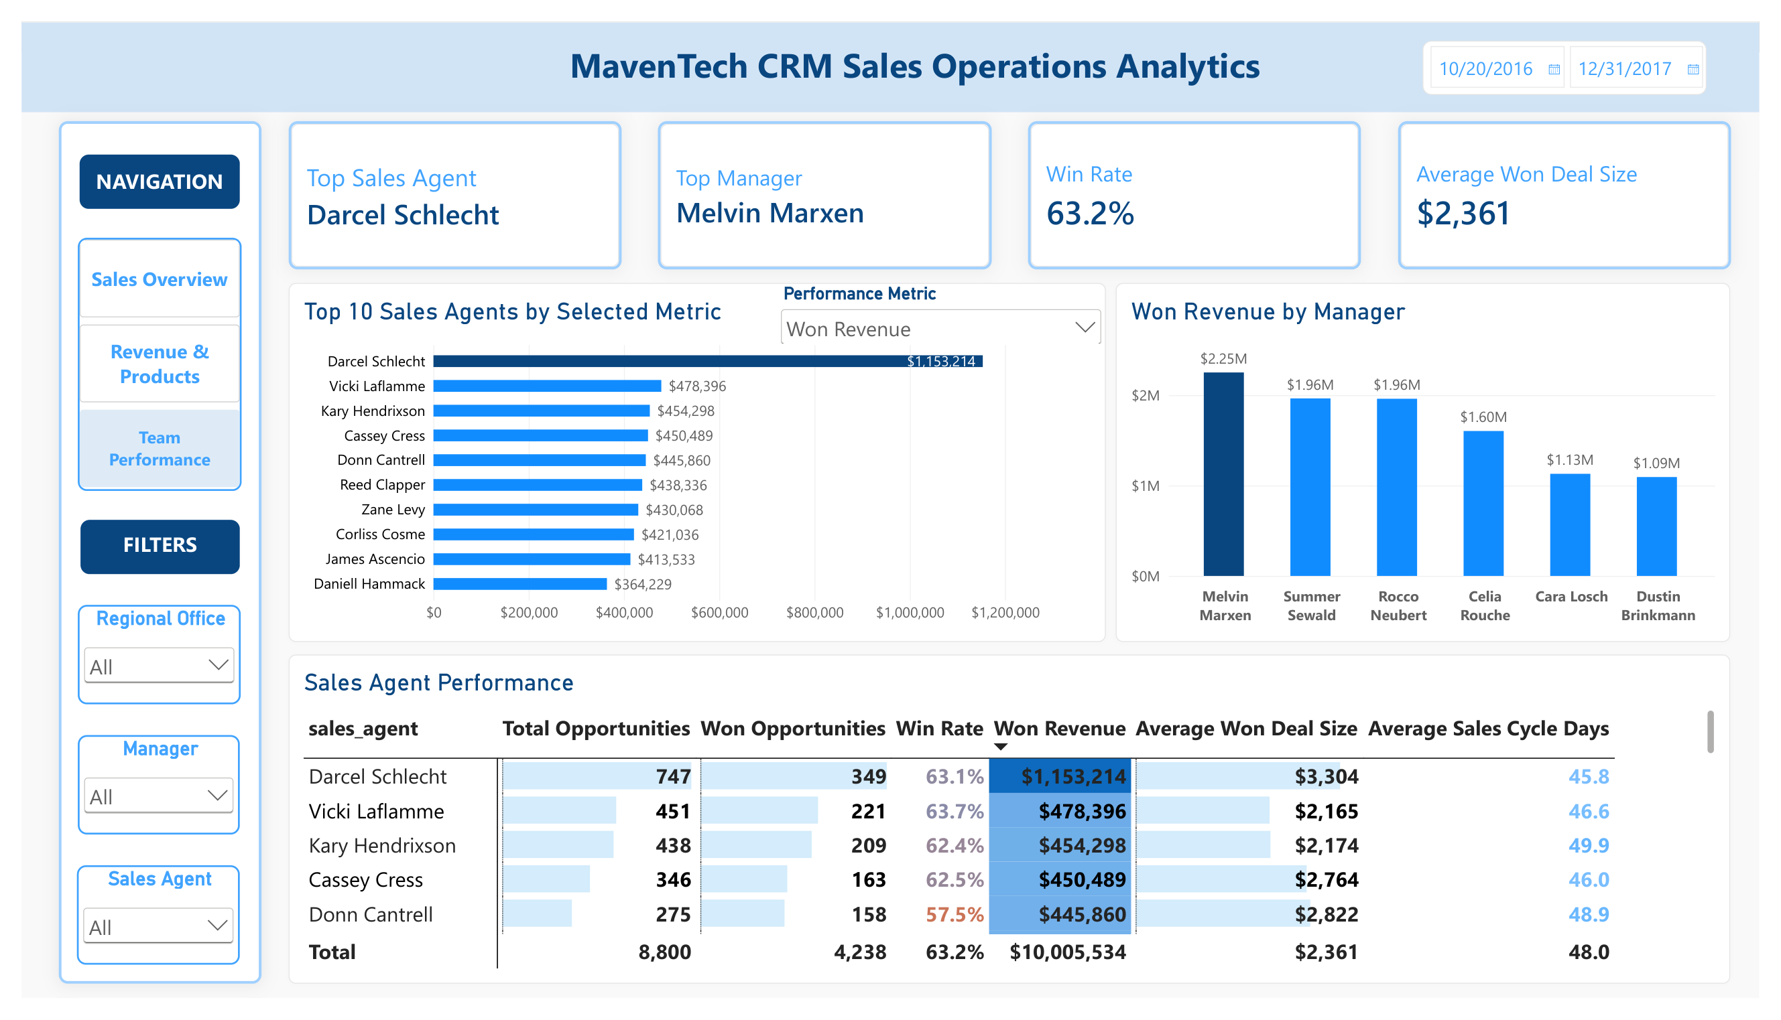
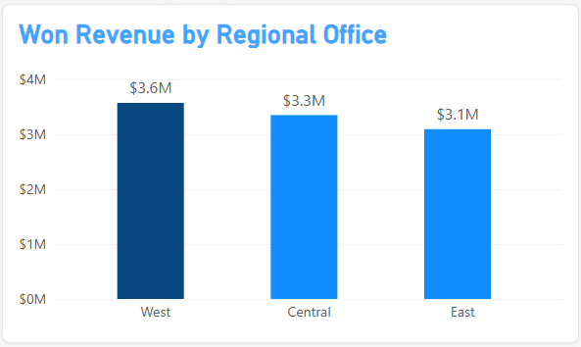
Regional & Team Performance
Performance differences identify where management should investigate, not where it should assume causality
Evidence — Highest vs. Lowest Team
West leads regional Won Revenue at approximately $3.6M.
Melvin Marxen leads managers at approximately $2.25M, with Darcel Schlecht leading all agents at approximately $1.15M.
Dustin Brinkmann ranks lowest among managers at approximately $1.09M; within his team, Anna Snelling generates approximately $275K.
Darcel and Anna have relatively similar Win Rates of approximately 63.1% and 61.9%, respectively, despite a substantial revenue difference.”
What Management Should Investigate
Because conversion alone may not explain the revenue gap, investigate opportunity volume, average deal size, product mix, customer mix, territory, and sales-cycle performance.
Determine which factors and potentially which sales practices are contributing to the performance gap before recommending corrective action.
6

Slide 7
Business Risks, Root-Cause Hypotheses & Diagnostic Analysis
Separate what the dashboard proves from what management should investigate
Observed Evidence
Potential Risk
Root-Cause Hypotheses / Diagnostic Next Step
2,473 lost opportunities
Conversion leakage
Analyze losses by product, region, agent, account, and deal stage; identify recurring patterns.
Revenue concentrated in leading products
Product concentration
Assess whether concentration is driven by demand, pricing, opportunity volume, or larger deal sizes.
West leads regional revenue
Regional performance gap
Compare opportunity volume, product/customer mix, deal size, conversion, and agent composition across regions.
Agent/manager results vary
Execution inconsistency
Benchmark high performers across multiple metrics; test whether practices are transferable.
48-day average sales cycle
Cycle-time risk
Identify long-cycle outliers and investigate qualification, follow-up, approval, or customer-decision delays.
7

Slide 8
SWOT Analysis — Sales Operations Position
Strategic framing of what the CRM evidence implies for management
S Strengths
63.2% win rate on 8,800 opportunities; $10.0M won revenue; consistent conversion across products and regions.
W Weaknesses
There are 2,473 lost opportunities. They represent an area where management can investigate potential revenue leakage.
The most interesting weakness is the product value imbalance:
GTX Basic: 915 wins × $546 average deal size → $499K revenue Vs. GTX Plus Pro: 479 wins × $5,490 average deal size → $2.63M revenue.
It suggests management should investigate product positioning, customer mix, pricing, and potential upselling or cross-selling opportunities.
O Opportunities
Explore opportunities to increase average deal value for high-conversion, low-revenue products, while evaluating cost and margin implications before making investment or resource-allocation decisions.
T Threats
Revenue concentration among GTX Pro, GTX Plus Pro, and MG Advanced, which account for roughly 83% of Won Revenue, combined with dependence on a limited number of top-performing agents and managers, may increase performance risk if those revenue sources decline.
Strategic Implication
Performance is stable but concentrated. Future growth opportunities include widening the revenue base, increasing value from successful deals, and reducing avoidable opportunity losses.
Management Focus
Convert SWOT into the corrective actions and monitoring cadence on the following slides.
8

Slide 9
Recommendations & Corrective Actions
Translate findings into focused management actions
1 Product Strategy
Use a revenue × conversion × deal-size view to protect high-value products, improve weaker conversion, and investigate low-revenue/high-conversion products for pricing or deal-size opportunity.
2 Pipeline Improvement
Segment lost opportunities to understand where losses are occurring, identify repeatable loss patterns; prioritize corrective action on higher-value opportunity groups.
3 Sales Coaching
Benchmark top performers across multiple KPIs, identify transferable best practices, and use targeted coaching to address performance gaps.
4 Regional Best-Practice Analysis
Diagnose why West leads before replicating practices; distinguish territory/customer/product advantages from execution advantages.
5 Sales-Cycle Improvement
Use 48 days as a baseline; investigate long-cycle outliers and remove avoidable qualification, approval, or follow-up delays.
6 Risk Monitoring
Track Win Rate, open pipeline, cycle time, revenue concentration, regional gaps, and agent performance for early signs of deterioration.
9

Slide 10
Expected Business Impact & Decision-Support Framework
Move from reporting historical results to continuous performance improvement
MONITOR
What is happening?
KPIs, trends, pipeline outcomes
DIAGNOSE
Where is performance different?
Product, region, manager, agent
INVESTIGATE
What may be driving it?
Conversion, deal size, mix, cycle time
ACT
What should management do?
Corrective actions, coaching, process improvement
Expected Business Impact
More balanced performance decisions by combining revenue, conversion, deal size, opportunity volume, and cycle efficiency.
Earlier identification of pipeline, product, regional, and execution risks.
More targeted coaching and process improvement based on diagnostic evidence rather than single-metric rankings.
Closing message: The dashboard is not only a reporting tool - it is a framework for monitoring performance, diagnosing gaps, and guiding continuous improvement.
10

Slide 11
Thank You
Thank you for taking the time to review my
MavenTech CRM Sales Operations Analytics project.
Sales Operations Analytics · CRM Analytics · Decision Support
Tina Vo
11

