Slide 1
PROJECT #1
Sales Performance &
Forecasting Analysis
Business Performance • Profitability • Forecast Validation • Decision Support
2019–2022 Actuals
2023 Forecast
Advanced Excel | Power Query | Pivot Analysis | FORECAST.ETS | MAPE
Tina Vo

Slide 2
Agenda
Management-focused analytical storyline
01
Business Problem & Management Questions
05
Business Risks, Root-Cause Hypotheses & Diagnostics
02
Executive Performance Overview
06
Forecasting Analysis & Validation
03
6P Business Diagnostic
07
SWOT Analysis
04
Customer, Product, Regional & Shipping Performance
08
Recommendations, Corrective Actions & Decision Support
02

Slide 3
Business Problem & Management Questions
Move beyond reporting totals to explain performance, risk and decision implications.
BUSINESS PROBLEM
MANAGEMENT QUESTIONS
Aggregate revenue and profit do not show where growth is coming from, where profitability is being lost, whether fulfillment performance is consistent, or how much confidence management should place in the 2023 forecast.
1
Where are revenue and profit actually generated?
2
Which products, customers and regions require management attention?
3
Where does strong revenue fail to translate into strong profitability?
4
Are shipping differences operationally meaningful?
5
How reliable is the forecast for planning and resource decisions?
Objective: convert historical performance into evidence for action, not just charts.
03

Slide 4
Executive Performance Overview
Historical performance baseline | 2019–2022
Revenue
Profit
Profit Margin
Orders
Avg Order Value
$2.30M
$286K
12.47%
5,009
$459
EXECUTIVE READOUT
Positive baseline
Hidden mix risk
Planning challenge
$2.30M revenue and $286K profit establish a profitable historical base.
Aggregate KPIs conceal large differences in category profitability and regional contribution.
Revenue varies materially over time, increasing the importance of forecast validation.
Management takeaway: overall performance is positive, but the quality and predictability of that performance require deeper diagnosis.
04

Slide 5
6P Business Diagnostic Framework
Use the 6Ps to organize evidence, hypotheses and next-level analysis.
People
Product
Price
Consumer leads customer-segment revenue; assess segment/account concentration.
Technology leads; Furniture shows a major revenue-to-profit disconnect.
Discount and pricing effects are plausible margin drivers to test—not assumed causes.
Place
Period
Promotion
Compare regional revenue, profit and shipping performance.
Assess monthly/quarterly volatility, seasonality and shipping-time trends.
Evaluate campaign/promotion effects only if supporting promotion data is available.
Analytical discipline: evidence first → hypothesis second → targeted diagnostic test third.
05

Slide 6
Customer, Product, Regional & Shipping Performance
Key performance drivers mapped directly to the 6P business diagnostic framework.
CUSTOMER
PRODUCT
REGION
SHIPPING
PEOPLE
PRODUCT + PRICE
PLACE
PLACE + PERIOD
Consumer ≈ $1.16M revenue
≈ $134K profit
Technology ≈ $836K revenue
≈ $145K profit
Furniture ≈ $742K revenue
but only ≈ $18K profit
West ≈ $725K revenue
East ≈ $679K revenue
Central ≈ 4.06 days
Other regions ≈ 3.91–3.96 days
Largest customer segment; monitor contribution and concentration.
Strongest profitability signal; investigate pricing, discount and product mix.
Shows where geographic revenue contribution is strongest.
Regional spread is small; test whether shipping varies by location and period.
MANAGEMENT IMPLICATION
Furniture profitability is the clearest immediate concern. Customer mix, regional contribution and shipping performance provide additional 6P diagnostic dimensions for targeted follow-up analysis.
06

Slide 7
Business Risks, Root-Cause Hypotheses & Diagnostic Analysis
Explicitly separate what the data proves from what management should investigate.
EVIDENCE
BUSINESS RISK
ROOT-CAUSE HYPOTHESIS
DIAGNOSTIC ACTION
Furniture: ~$742K revenue / ~$18K profit
Margin erosion despite strong sales
Discounting, product mix, cost-to-serve or pricing
Analyze margin by subcategory/SKU, discount, customer and region
Monthly revenue is volatile
Resource and planning instability
Seasonality, large orders or concentration
Decompose variance by period, account, category and region
Central: ~4.06 shipping days
Potential fulfillment friction
Mode mix, distance, product mix or carrier effects
Compare shipping by region × period × category × ship mode
Backtest MAPE: 47.99%
Forecast-driven decisions may be inaccurate
Limited history, volatility, outliers or ETS limitations
Compare models, extend history, monitor error and bias
Evidence establishes the performance gap; hypotheses guide the next analysis—they are not presented as proven causes.
07

Slide 8
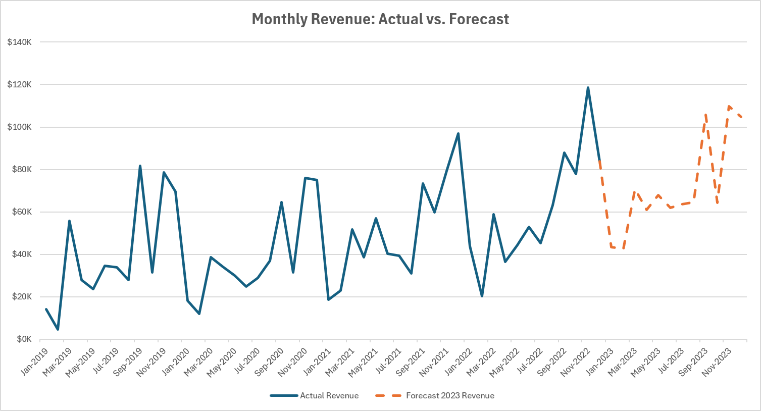
2023 Forecasting Analysis
FORECAST.ETS converts historical monthly revenue into a directional planning outlook.
2023 Forecast Revenue
$860,252
Average Monthly Forecast
$71,688
Highest Forecast Month
Nov | $109,854
Lowest Forecast Month
Feb | $42,569
08

Slide 9
Forecast Validation: Can Management Trust the Forecast?
Holdout backtest: train on 2019–2021 → forecast 2022 → compare with actual 2022.
BACKTEST MAPE
2022 Holdout Backtest — Monthly Absolute % Error
47.99%
Month
Absolute % Error
Jan-2022
44.10%
Feb-2022
217.32%
Substantial monthly uncertainty
Mar-2022
11.22%
Apr-2022
82.18%
May-2022
52.71%
Jun-2022
29.57%
Jul-2022
54.00%
Aug-2022
12.11%
DECISION RULE
Sep-2022
18.26%
Oct-2022
6.30%
Use the 2023 ETS forecast as a directional planning estimate—not a precise operating commitment.
Nov-2022
37.58%
Dec-2022
10.54%
MAPE
47.99%
Absolute percentage error by month (%)
MANAGEMENT RESPONSE
Use scenario ranges rather than one-point commitments. • Refresh the model as actuals arrive and track MAPE / bias. • Test alternative methods and add more history before high-stakes planning.
09

Slide 10
SWOT Analysis
Translate analytical findings into strategic management context.
STRENGTHS
WEAKNESSES
$2.30M historical revenue base
Positive $286K profit
Technology category leadership
Strong West-region contribution
Furniture profitability gap
Revenue volatility
47.99% forecast backtest MAPE
Uneven category contribution
OPPORTUNITIES
THREATS
Improve Furniture margin
Expand high-performing Technology
Develop account-level growth actions
Refine forecasting and monitoring
Forecast error affecting resource decisions
Margin erosion despite sales growth
Customer/category concentration
Hidden operational inefficiencies
SWOT is a strategic interpretation of the evidence—not proof of causal relationships.
10

Slide 11
Recommendations & Corrective Actions
Convert diagnosed risks into targeted management actions and measurable KPIs.
PRIORITY
CORRECTIVE ACTION
MANAGEMENT KPI
Furniture margin
Diagnose margin by subcategory/SKU, discount, customer and region; review pricing/discount controls.
Profit margin by product
Revenue concentration
Monitor segment/account/category concentration and identify profitable diversification opportunities.
Revenue & profit concentration
Regional + shipping
Protect strong regions while testing whether shipping differences persist by period, mode and product mix.
Regional growth + shipping days
Forecast reliability
Extend history, compare methods, track forecast error and refresh the model routinely.
MAPE • bias • variance
Management reporting
Use the dashboard as a recurring exception-monitoring and decision-support tool.
Monthly KPI variance
Priority principle: protect proven strengths, diagnose material gaps, and avoid acting on untested causal assumptions.
11

Slide 12
Expected Business Impact & Decision-Support Framework
Position the dashboard as a continuous-improvement management system.
Profitability
Resource Allocation
Forecasting
Operations
Management
Identify margin leakage and improve quality of revenue.
Focus attention on profitable products, accounts and regions.
Reduce the risk of treating uncertain forecasts as commitments.
Surface shipping/performance exceptions for targeted diagnosis.
Create one repeatable evidence-to-action decision process.
MEASURE
→
DIAGNOSE
→
PRIORITIZE
→
ACT
→
MONITOR
→
VALIDATE
→
ADJUST
Final message: connect historical performance, diagnostic analysis, forecast validation and corrective action into one continuous management decision-support loop.
Source: Project #1 Sales Performance & Forecasting Analytics workbook and forecast validation outputs.

Slide 13
Thank You
Sales Performance & Forecasting Analysis
Turning historical performance, diagnostic analysis, and forecast validation into management decision support.
Measure → Diagnose → Forecast → Validate → Act → Monitor
Questions & Discussion
Tina Vo | Data Analytics Portfolio
13

