Slide 1


Organisation

Slide 2

Generel virksomhedsforståelse
Duis autem vel eum iriure dolor in hendrerit in vulputate velit esse molestie consequat,

Slide 3
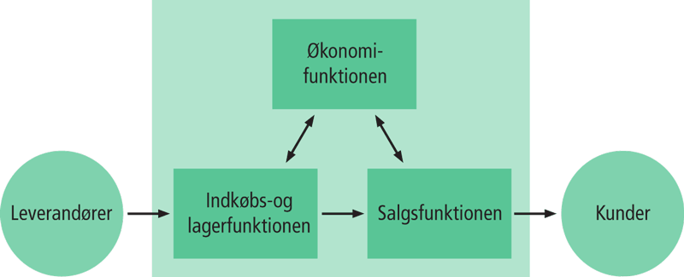
Virksomhedens funktioner
Ved en funktion forstås arbejdsopgaver, der hører sammen.
En handelsvirksomhed vil som udgangspunkt have følgende funktioner:
Indkøb og lager
Salg
Økonomi

Slide 4
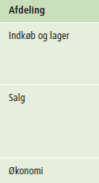
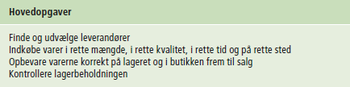


Virksomhedens funktioner

Slide 5
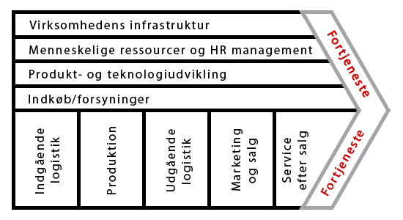
Produktionsvirksomhed

Slide 6
Formelle organisationsstrukturer
Ved formel organisation forstås:
Arbejdsopgaverne fordeles på personer og afdelinger.
Organisationsplan
En organisationsplan bruges til at vise virksomhedens formelle organisation.
Pyramidestruktur
En struktur, hvor organisation er opdelt i niveauer med afgrænsede afdelinger samt velbeskrevne arbejdsfunktioner og arbejdsopgaver.

Slide 7
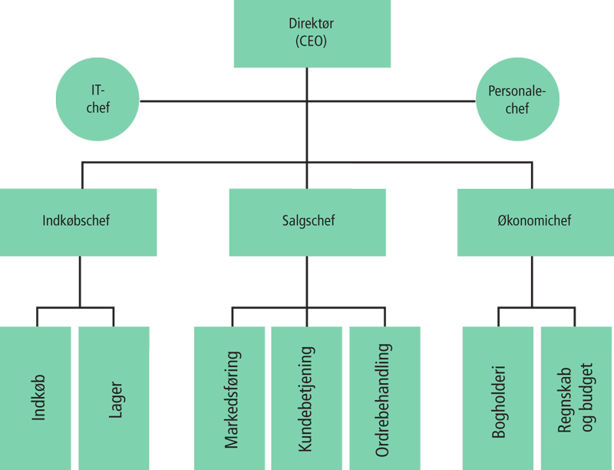
Virksomheden
Formelle organisationsstrukturer
Eksempel på organisationsplan med pyramidestruktur:

Slide 8
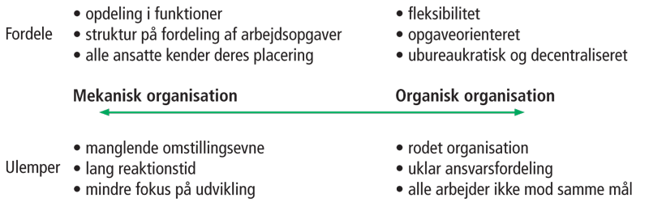
Virksomheden
Organisationsstrukturer
- Mekanisk og organisk organisation

Slide 9
Virksomheden - generelt
Hvad laver virksomheden – hvordan tjener den penge?
Hvad er dens produkter?
Hvem er kunderne?
Hvad er de forskellige arbejdsopgaver?
Hvordan organiserer den arbejdsopgaverne?

Slide 10
Forandringsmodstand

Slide 11
IT Systems can be a technical success but an organizational failure.

Slide 12
False Beliefs…
“People want this change.”
“Monday morning we’ll turn on the new system and they’ll use it.”
“A good training program will answer all of their questions and then they’ll love it.”
“Our people have been through a lot of change - what’s one more change going to matter?”
“They have two choices: they can change or they can leave.”

Slide 13
However, the results may be quite different…
The change may not occur.
People will comply for a time and then do things to get around the change.
Users will accept only a portion of the change.
The full benefits of the project are never realized or are realized only after a great deal of time and resources have been expended.

Slide 14
Signs of Resistance to Change
Active signs of resistance
Being critical
Finding fault
Ridiculing
Appealing to fear
Using facts selectively
Blaming or accusing
Sabotaging
Threatening
Manipulating
Undermining.
Starting rumors
Arguing
Passive signs of resistance
Agreeing verbally but not following through (“malicious compliance”)
Failing to implement change
Feigning ignorance
Withholding information, suggestions, help, or support
Standing by and allowing change to fail

Slide 15
Why Do People Resist Change?
Dislike of change
People don’t resist change, they resist pain!
Boredom can be pain, too.
Discomfort with uncertainty
Low tolerance for ambiguity
Perceived negative effects of interests
Authority, status, rewards, salary
Attachment to the established culture/ways of doing things
Perceived breach of psychological contract

Slide 16
Why Do People Resist Change?
Lack of conviction that change is needed
Lack of clarity as to what is needed
Belief that the specific change being proposed is inappropriate
Belief that the timing is wrong
Excessive change
Cumulative effects of other changes in one’s life
Reaction to the experience of previous changes
Disagreement with the way the change is being managed

Slide 17
Why do people support change?
Security
Money
Authority
Status/prestige
Responsibility
Better working conditions
Self-satisfaction
Less time and effort

Slide 18
Managing Resistance – The Situational Approach
The classic steps:
Education and communication
Participation and involvement
Facilitation and support
Negotiation and agreement
Explicit and implicit coercion

Slide 19
Change Has an Impact On Different Areas of the Organization
People
Structure
Technology
Task
Figure 11.4: Leavitt’s Model of Organizational Change

Slide 20
Lewin’s Three-Step Model For Implementing Change
Unfreezing
Change efforts to overcome the pressures of both individual resistance and group conformity.
Moving
Efforts to get employees involved in the change process.
Refreezing
Stabilizing a change intervention by balancing driving and restraining forces.

Slide 21
Deployment-strategies
Definition:
Deployment (technical): installation and configuration of the IT functionality (eg a module or an entire system) in an environment so that end users can use it Rollout in the organization: deployment of IT functionality in one or more departments so that it works in conjunction with the daily work processes. The rollout includes training of staff, changing working practices etc.

Slide 22
Deployment-strategies
There are several approaches to the implementation of IT systems: Big Bang approach
The IT solution and all new working practices are implemented throughout the company in one major implementation Phased approach
The IT solution and all new working practices are divided into smaller, incremental implementations.
Subsystem 1 -> Subsystem 2 -> Subsystem 3 ->the full system Cluster approach
The full Solution to be gradually rolled out in subsidiaries / departments
Subsidiary B -> Subsidiary A -> Headquarters
Phased-cluster approach
Subsystem 1 in department A -> Subsystem 1 in department B -> Subsystem 2 in department A ->…………………………-> the full system in all departments

Slide 23
TRAINING / EDUCATION
- Significant factor to anchor the system in the organization - A rule of thumb: At least 20% of the cost of implementation should be used on education and training Effect: Users use the system as it is supposed to be used. Less errors when used. There is less wasted time. Reduction of resistance to the changes that the IT system would cost. Reduction of duration and "depth" of the effectiveness decreases in the company, which typically occur just after operation start.

Slide 24
TRAINING / EDUCATION
Opportunities. - All employees - Key Employees - Super User Strategy
Clarify training needs - Analysis of system - Analysis of staff skills
Select Training Strategy - Resources - Time - Employee time - Organization time - Staff - Qualified intructors
Remember that training can be a ”change manage-ment activity”!

Slide 25
IT Security
Organizational view

Slide 26
Important ?
During the agricultural age, crops and the tools to produce them were the most important asset.
During the industrial age, manufactured goods and the factories that produced them were the most important asset.
Today, information is a key asset of almost every organization and individual!

Slide 27
The 3 core missions of Information Security:
Making information available when needed.
Keeping data confidential
Maintaining data integrity

Slide 28
Elements of security
Prevention
Firewalls, authentication, segmentation, antivirus etc.
Discovery
Intrusion Detection, log analysis, alerting, etc.
Repair
Backup systems, insurance, containment, etc.
Risk = Probability x impact

Slide 29
Risks & threats
Viruses and Trojans
E-mail viruses, macro viruses, worms
Discrediting
Deface by a web server, mail spoffing
Denial of service
DoS, Unable to work / use computer systems
Loss of data
Data is lost when the systems are destroyed, downtime
Compromise of data
Breach of confidentiality / secrecy, modification of data
Unauthorized access
Springboard - can be used to compromise other web servers
Distribution of illegal / pirated material

Slide 30
Risk Reduction
Security is achieved by a combination of
Procedures & Management / (management issues)
Design, tools and technical solutions
Ongoing monitoring and maintenance

