Slide 1
Graz air pollution

Slide 2
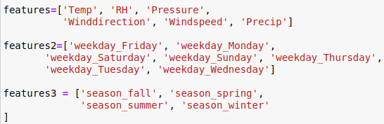
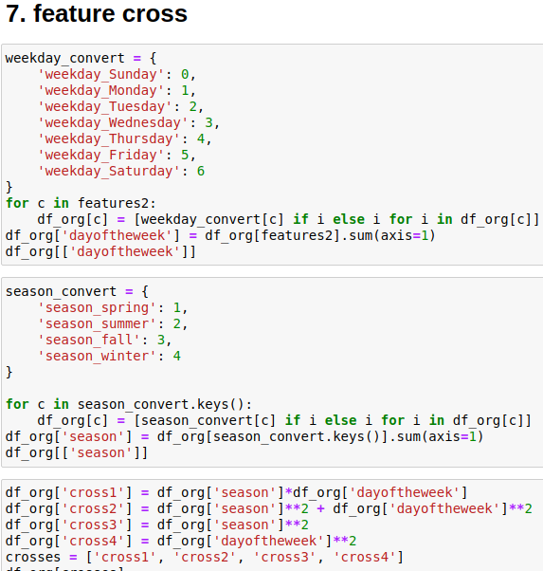
Methods
Base additive
Base multiplicative
Base multicative cutoffs
Features (f3)
f3_cutoffs
Features2 (f4)
f4_cutoffs
features3
crossed_feaures

Slide 3
Lockdown1 vs. train

Slide 4
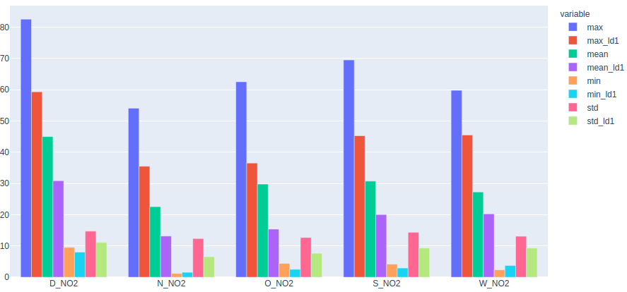
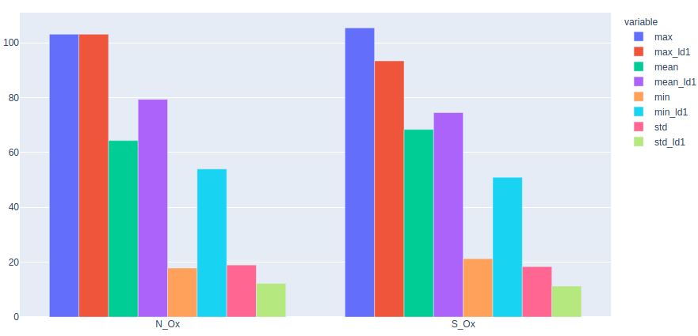
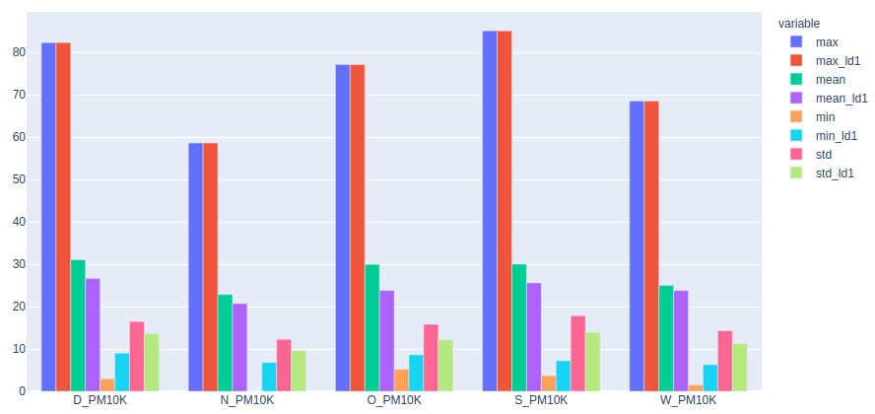
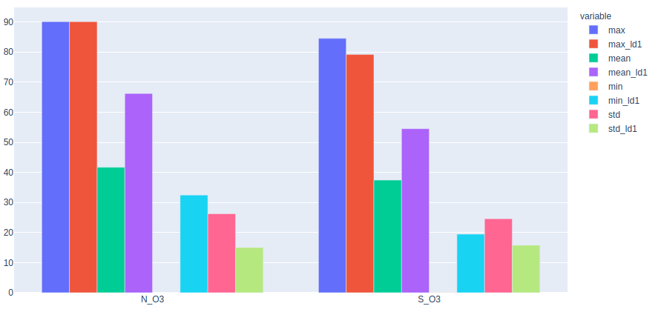
Lockdown1 vs. train
Test data for NO2 is more simple than PM10
  max_test ~ max_train

Slide 5
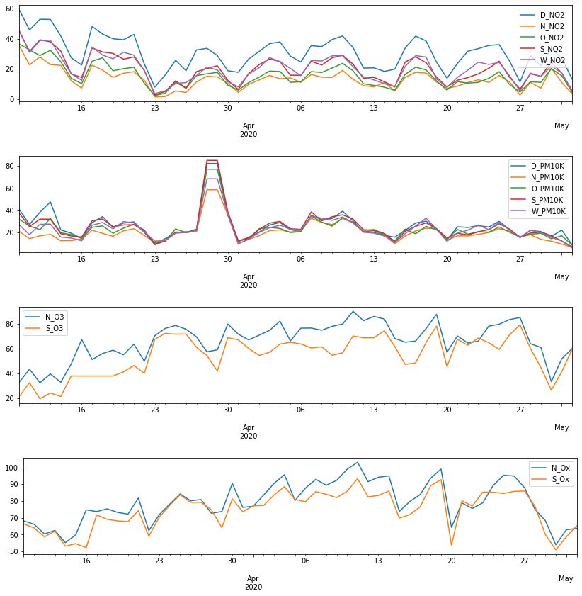

Slide 6
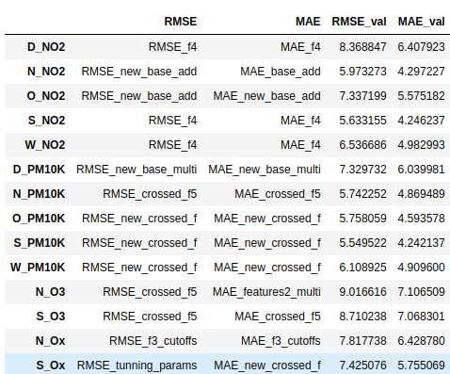
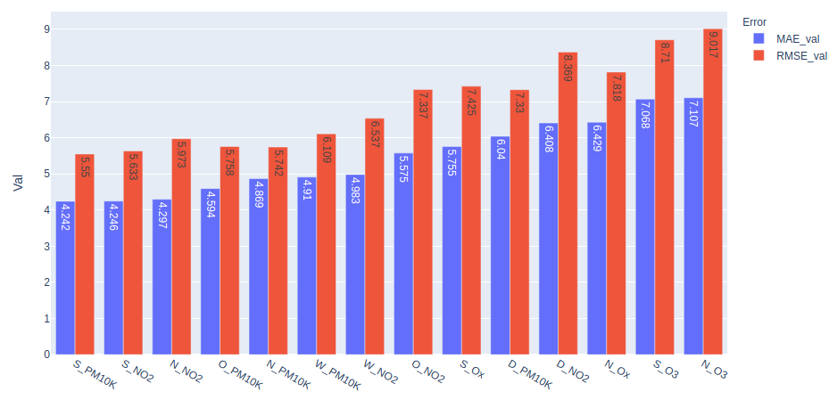
Min
Methods
  50%:50 for new and old data
  crossed_features dominate
    S_PM10
    N_PM10
    O_PM10
    W_PM10
  base_add fits well for N_NO2, O_NO2 and base_mul for D_PM10K
Values
  S_PM10K

Slide 7
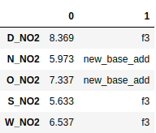
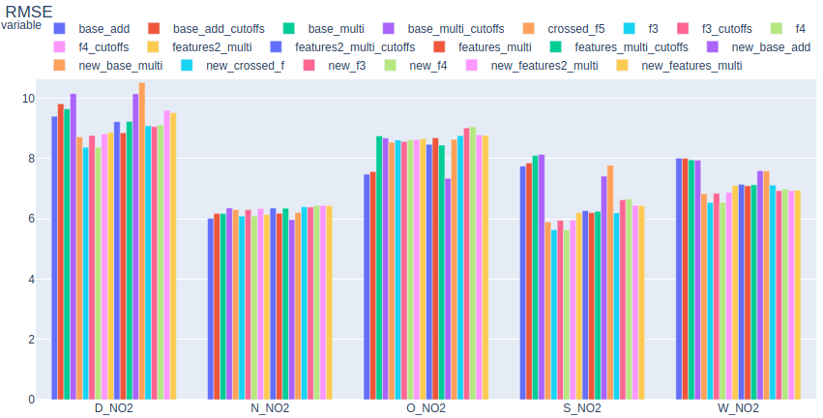
RMSE
N_NO2
  is already low error compared to other NO2
N_NO2 and O_NO2: more features do not help
  Best at new base additive
  → tune the parameters of the algorithm/preprocess more data to get better results
D_, S_, W_: best at f3 (=f4) from old data

Slide 8
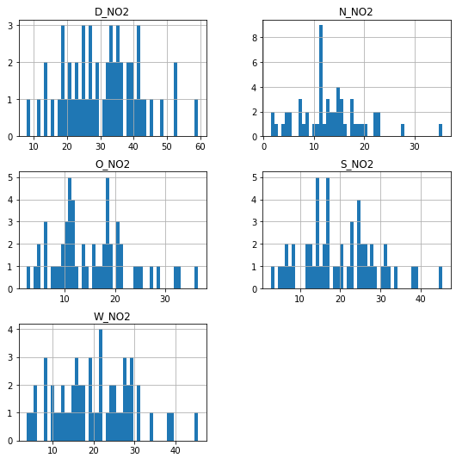
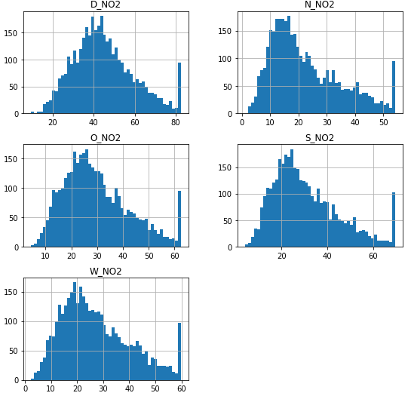
Explanation
N_NO2 and S_NO2 with lower error:
D_NO2 bigger error
test
train

Slide 9
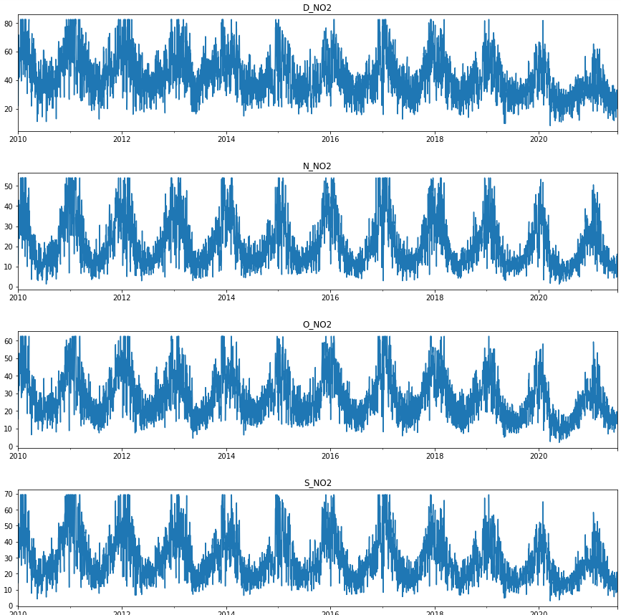
Explanation

Slide 10
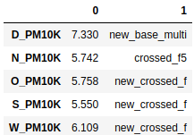
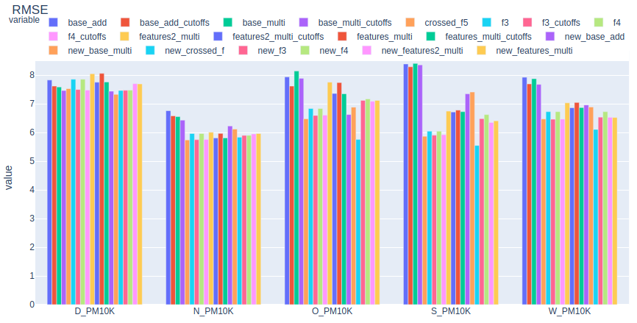
RMSE

Slide 11

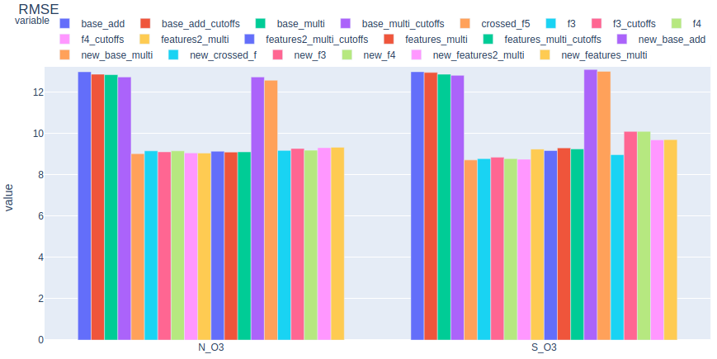
RMSE

Slide 12

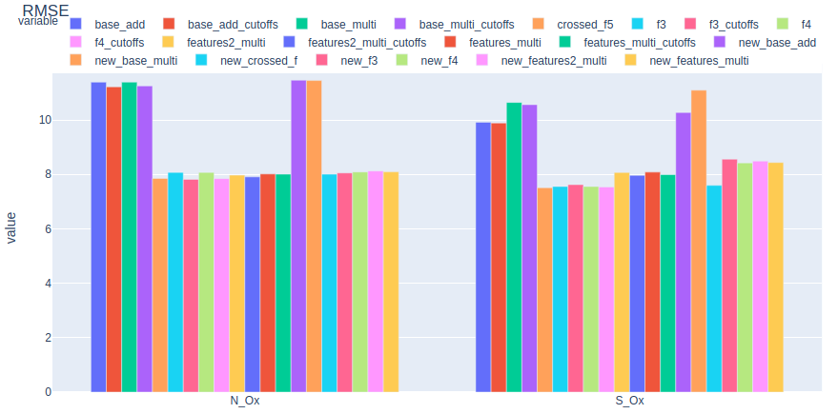
RMSE

Slide 13
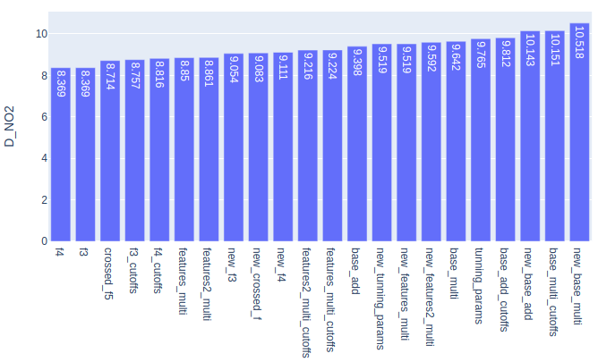
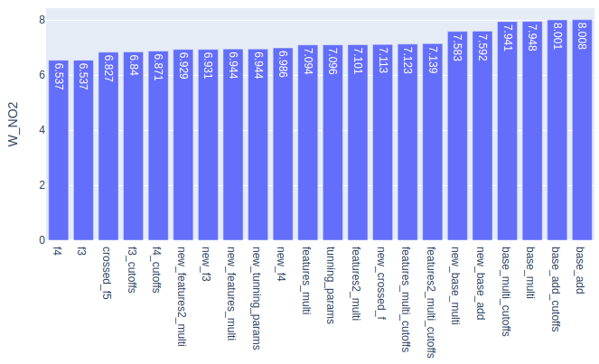
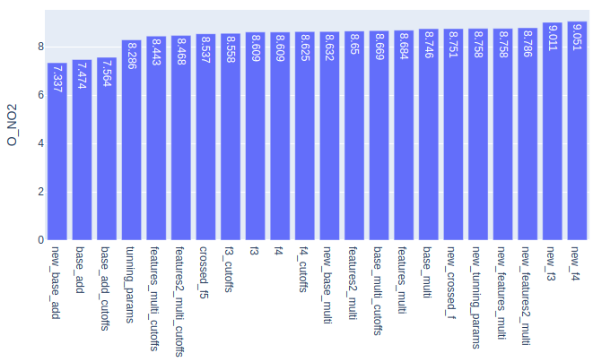
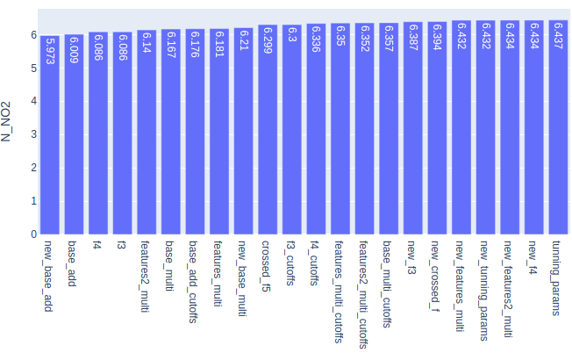
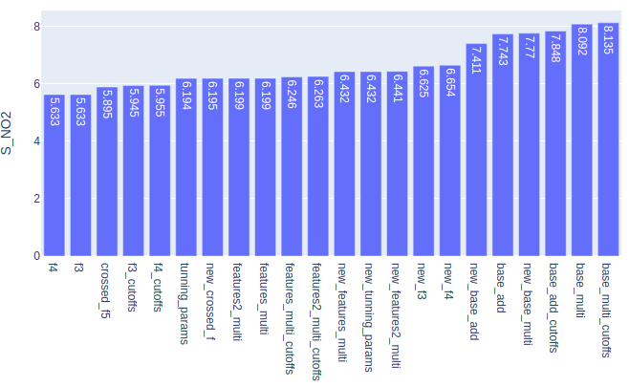
RMSE

Slide 14
Next Steps
Cutoffs
Optimization for each area
Lockdown 2, 3?

Slide 15
Thank you!

