Slide 1
Graz air pollution
Full data

Slide 2
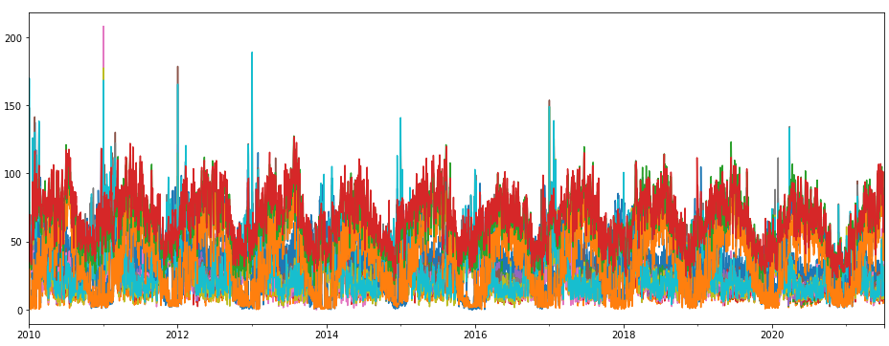
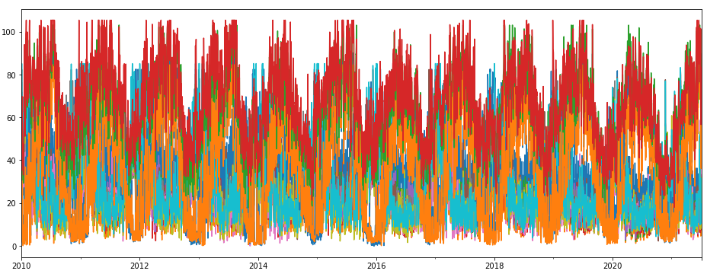
Cutoffs – 0.98

Slide 3
Lockdown1 vs. train

Slide 4
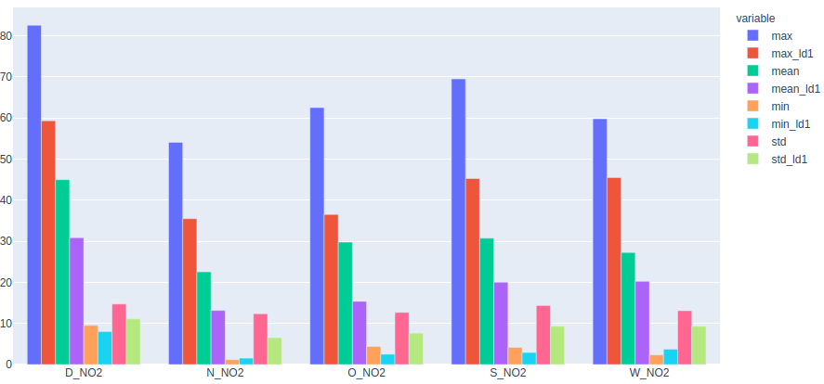
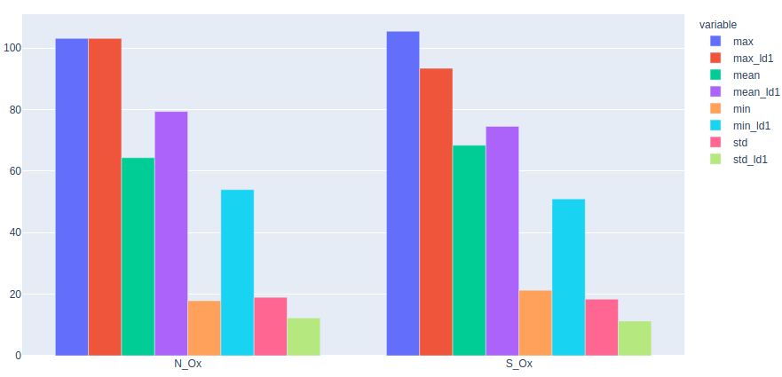
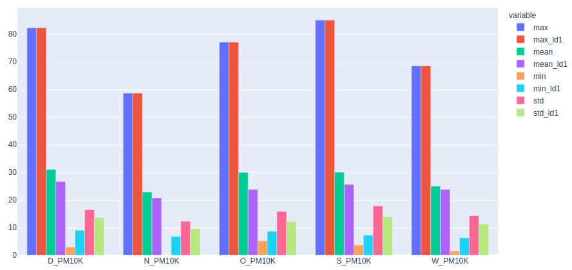
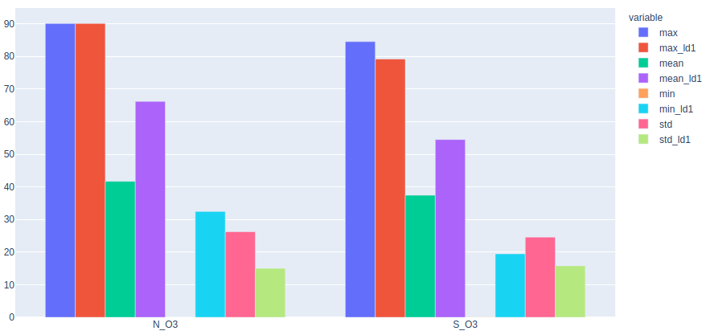
Lockdown1 vs. train
Test data for NO2 is more simple than PM10
  max_test ~ max_train

Slide 5
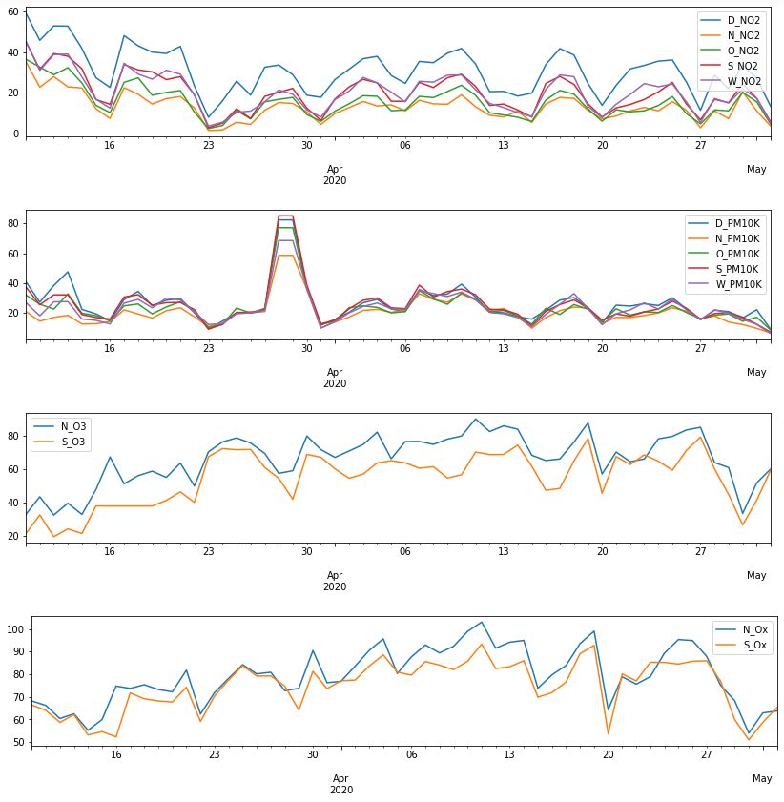
test

Slide 6
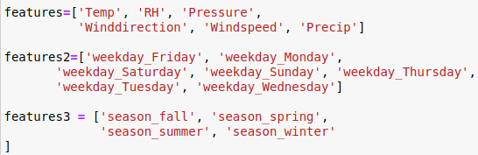
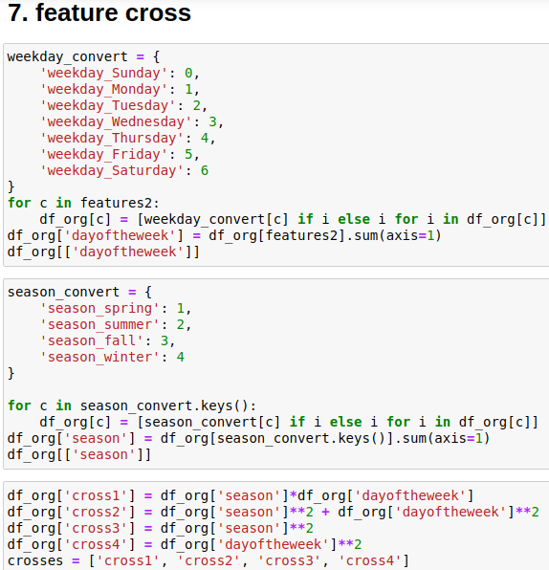
Methods
Base additive: f0_add
Base multiplicative: f0_mul
+ features: f1
+ features + features2: f2
+ holidays + features: f3
+ holidays + featues + features2 + features3: f4
6. + crossed_features: f5

Slide 7
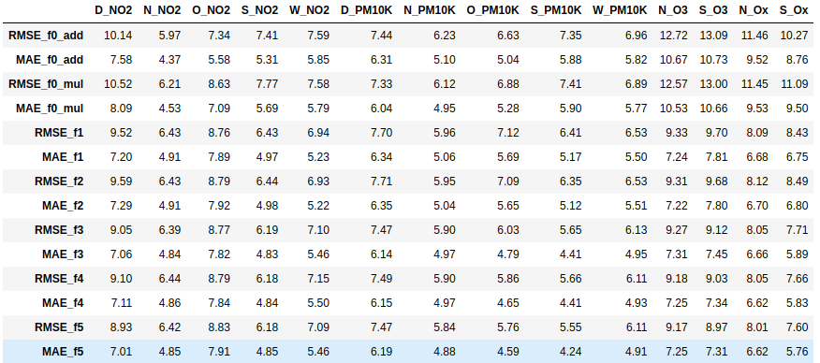
Results

Slide 8
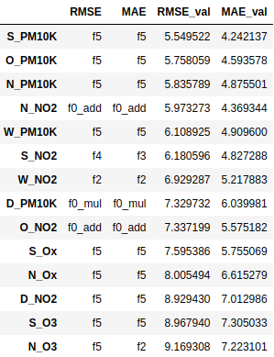
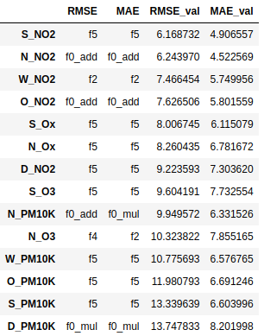
The best
Without [26.03 – 30.03]
With [26.03 – 30.03]

Slide 9
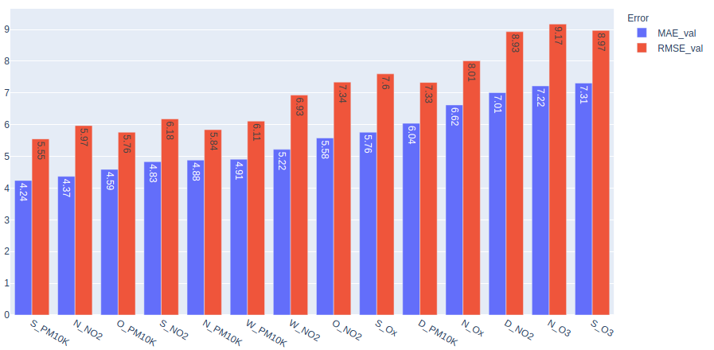
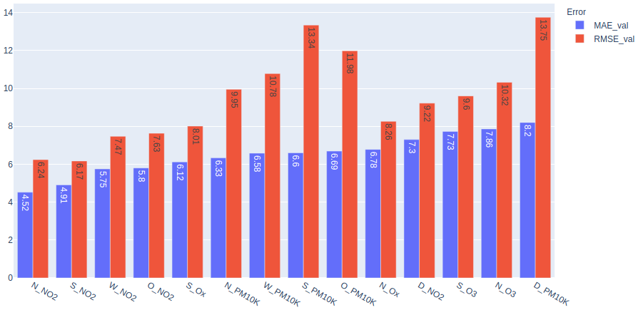
Should use MAE to measure, b/c some abnormal points?
With [26.03 – 30.03]

Slide 10
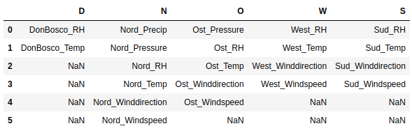
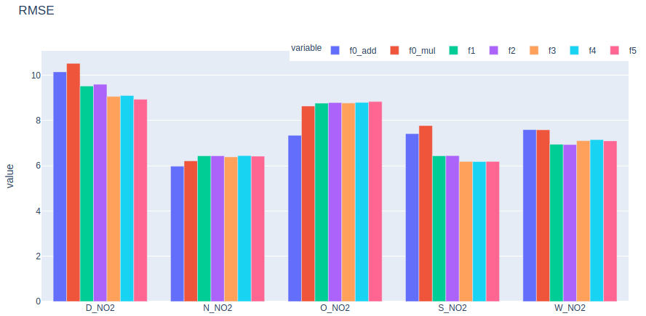
Base additive: f0_add
Base multiplicative: f0_mul
+ features: f1
+ features + features2: f2
+ holidays + features: f3
+ holidays + featues + features2 + features3: f4
6. + crossed_features: f5
Holidays contribute
N_NO2 + O_NO2
  Additive aggresors do not affect
  Features of O_ are only available from 19.05.2017 → less data than other areas
D_NO2
  Improve not much due to
    lack of extra features (only 2 available)
    Test data is more complex than other areas
S_NO2
  f4 and f5 does not help to improve
W_NO2
  After f3, results not better
summary for NO2
F2 not good → features2 do not affect

Slide 11
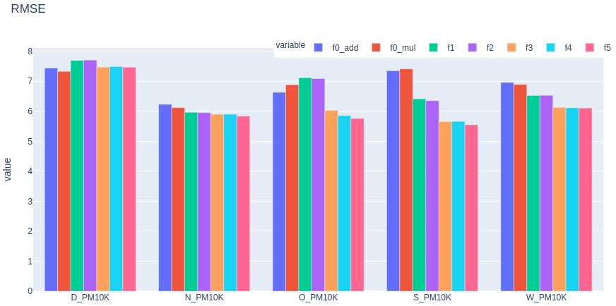
Base additive: f0_add
Base multiplicative: f0_mul
+ features: f1
+ features + features2: f2
+ holidays + features: f3
+ holidays + featues + features2 + features3: f4
6. + crossed_features: f5
Holidays contribute much
summary for PM10
f2 not good → features2 do not affect
f4 only works on O_PM10 → features3 do not affect
cross more features

Slide 12
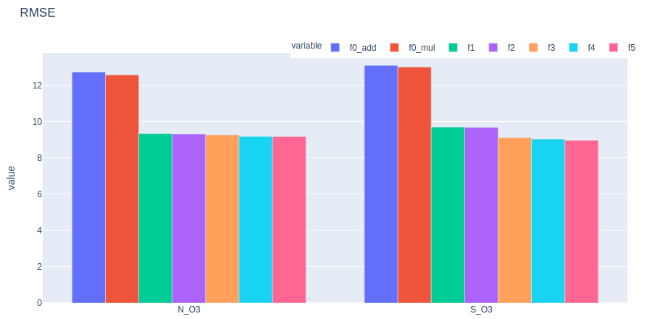
Base additive: f0_add
Base multiplicative: f0_mul
+ features: f1
+ features + features2: f2
+ holidays + features: f3
+ holidays + featues + features2 + features3: f4
6. + crossed_features: f5
The more modified algorithm and the more additional aggressors added, the better
summary for NO2
F2 not good → features2 do not affect

Slide 13
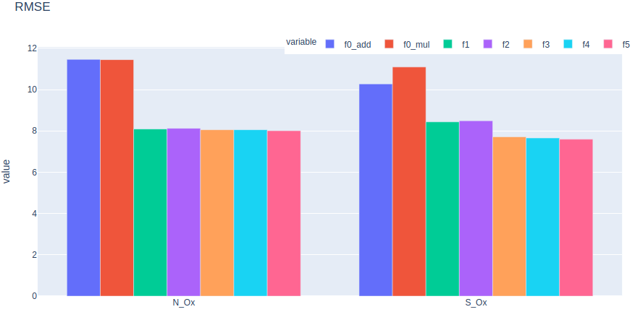
Base additive: f0_add
Base multiplicative: f0_mul
+ features: f1
+ features + features2: f2
+ holidays + features: f3
+ holidays + featues + features2 + features3: f4
6. + crossed_features: f5
Seems “features” to be enough for N_Ox, can not improve after f2
Holidays work for S_Ox

Slide 14

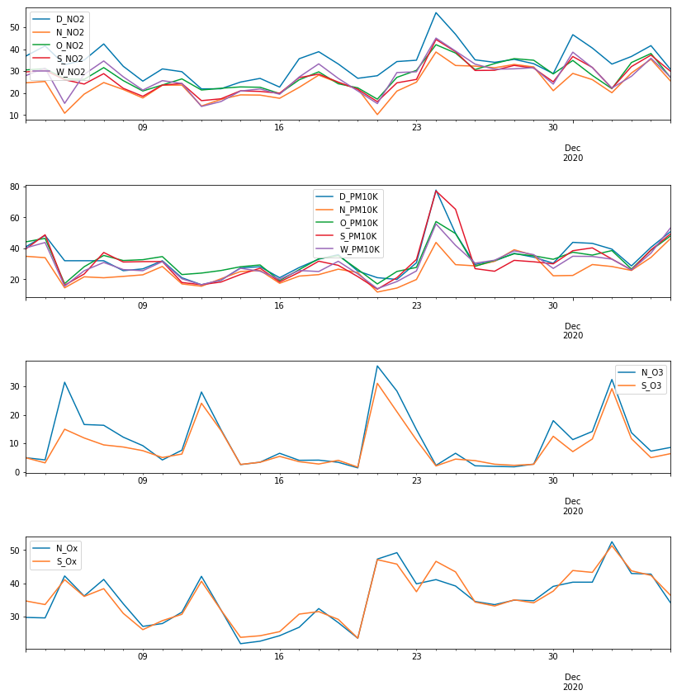
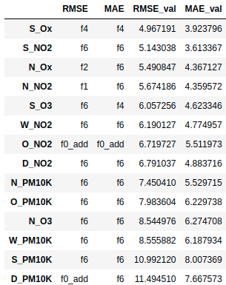
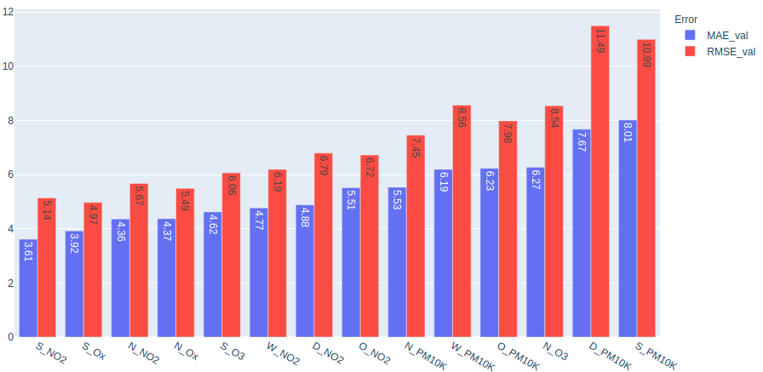
Lockdown2

Slide 15
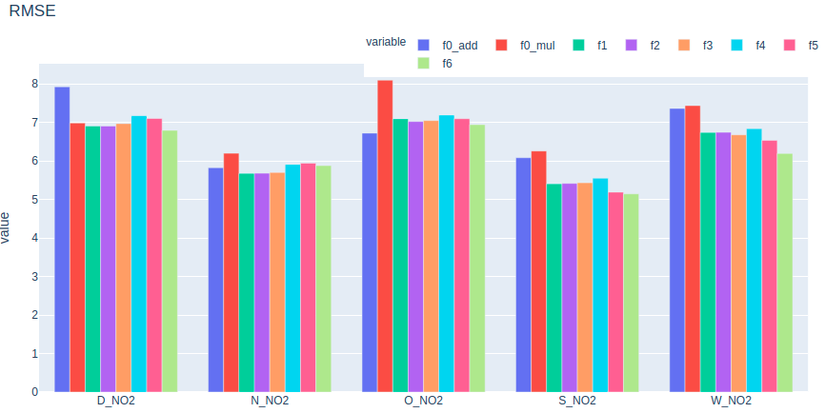
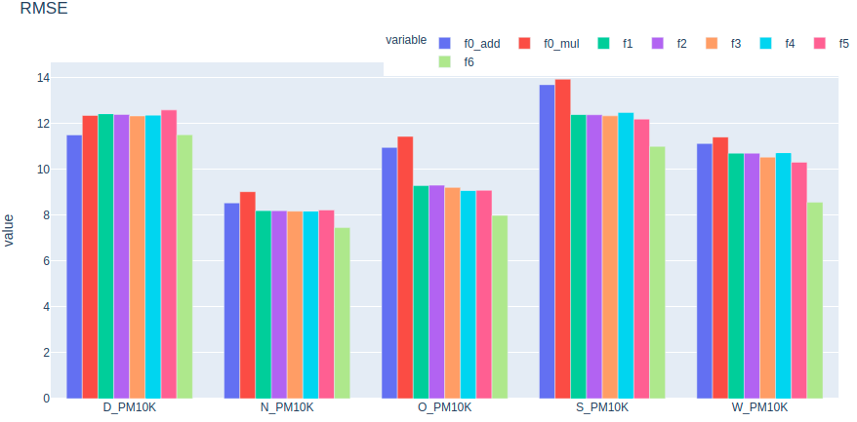
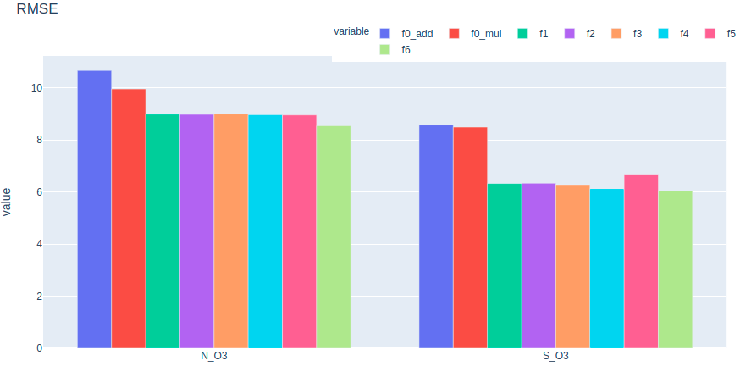
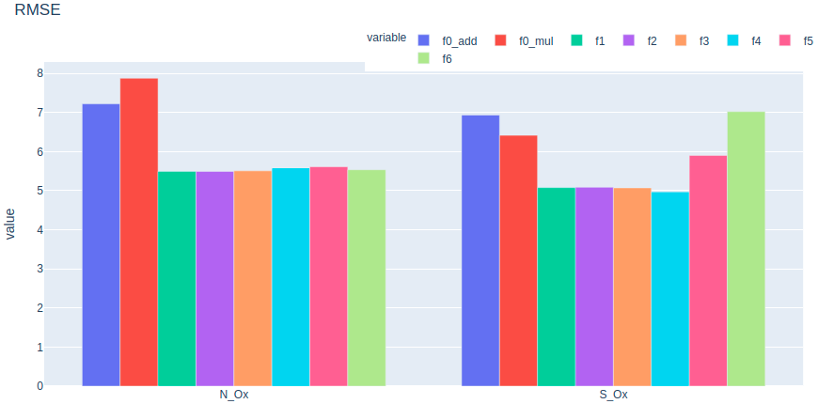

Slide 16
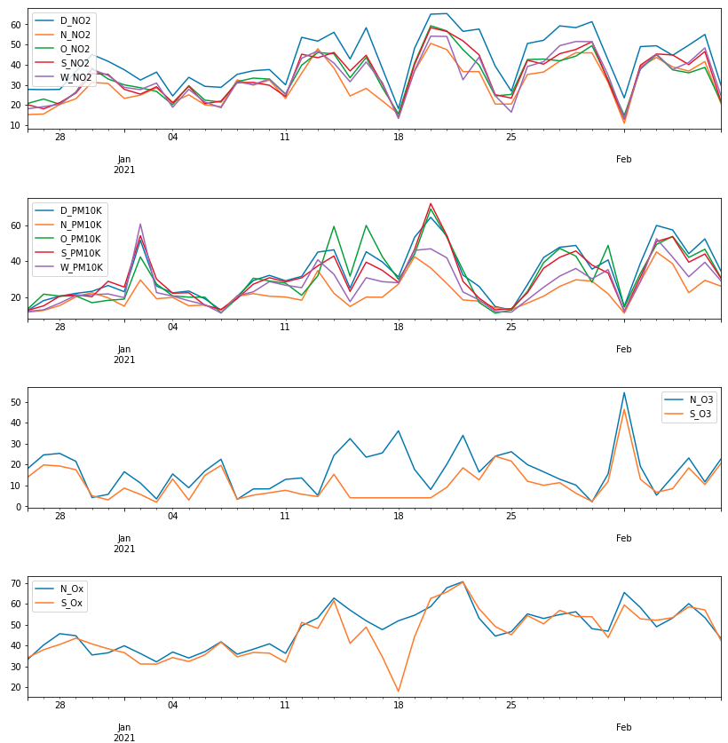
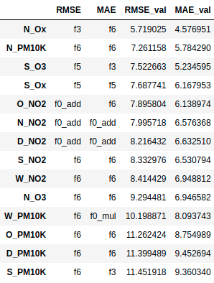
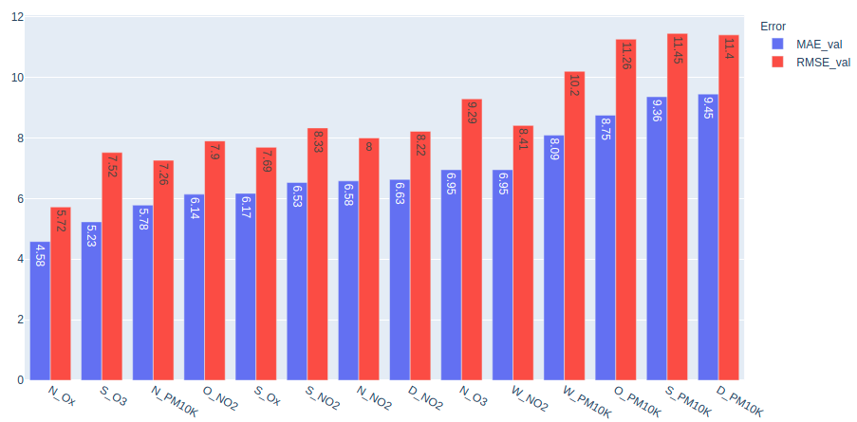
Lockdown3

Slide 17
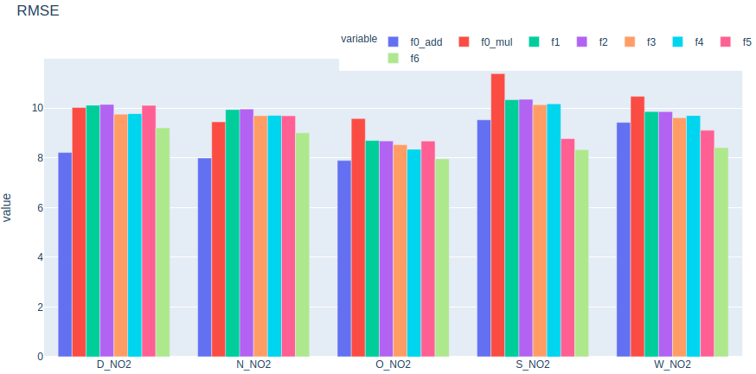
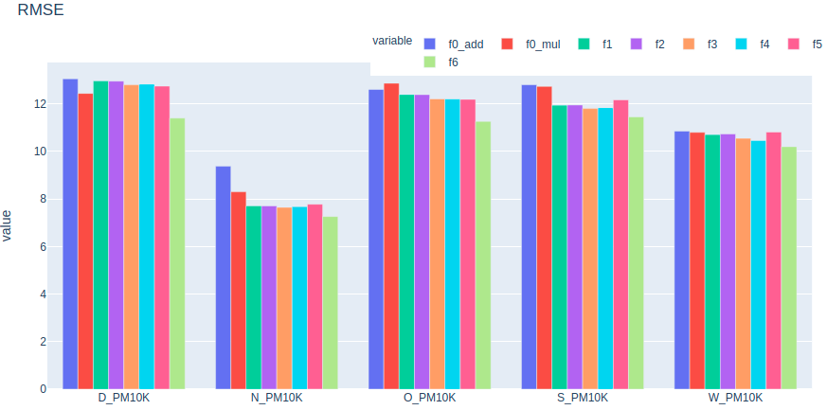
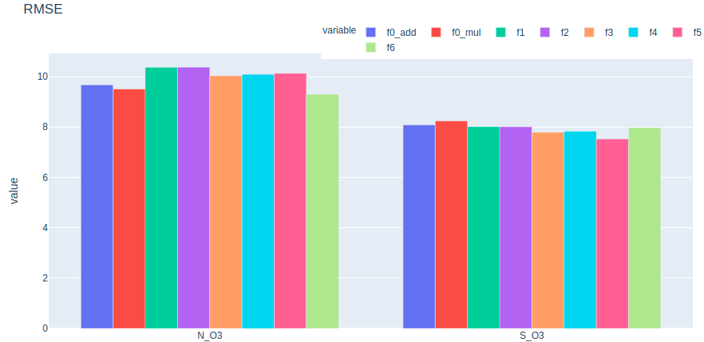
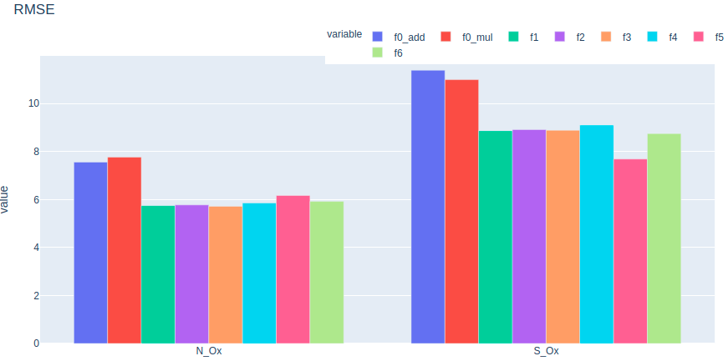

Slide 18
Summary
Depend on test data → different methods apply

Slide 19
Next Steps
Cutoffs
Optimization for each area and factor
  Cross “features”
  PM10: remove (features + features2)
Lockdown 2, 3?

Slide 20
Thank you!

Slide 21
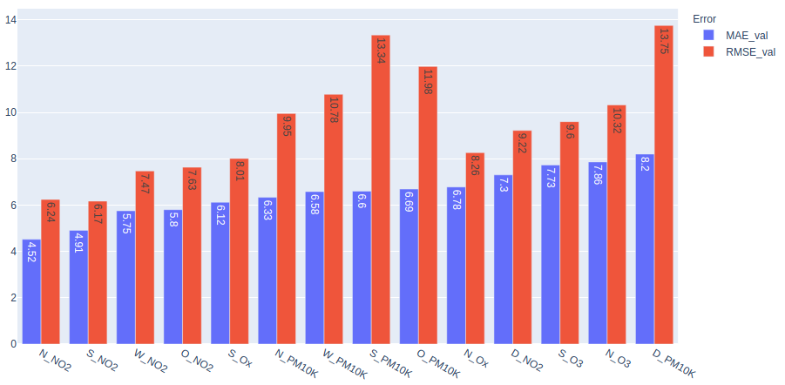
Apendix – with 26-30 March

Slide 22
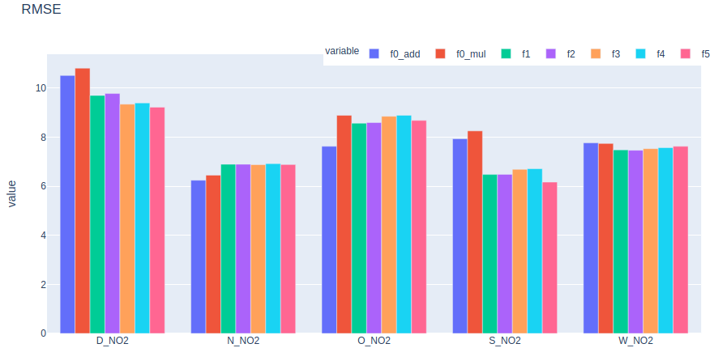
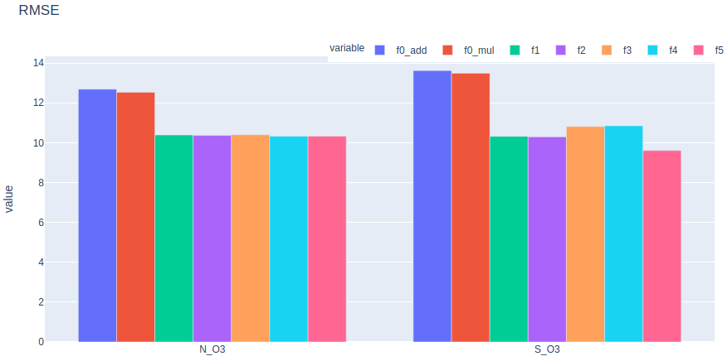
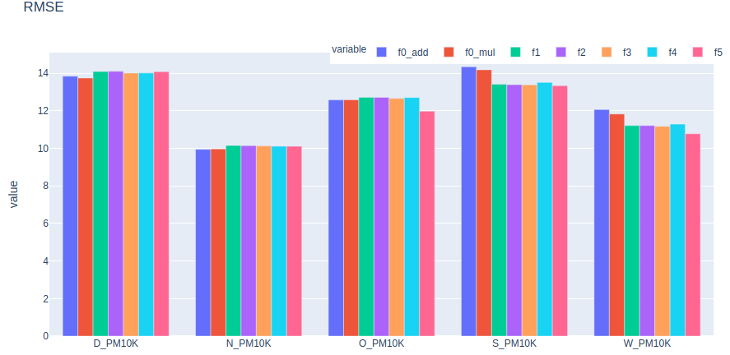
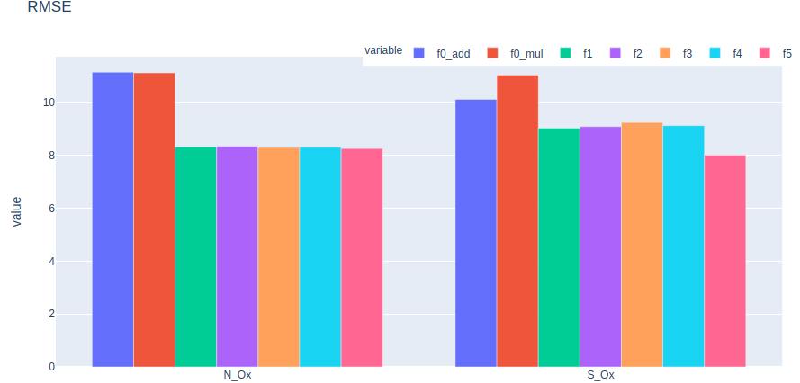

Slide 23
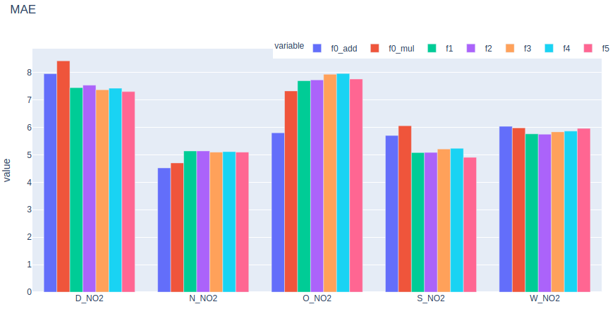
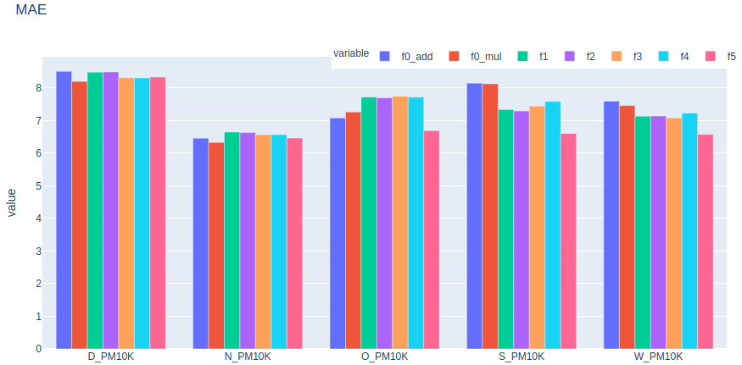

Slide 24
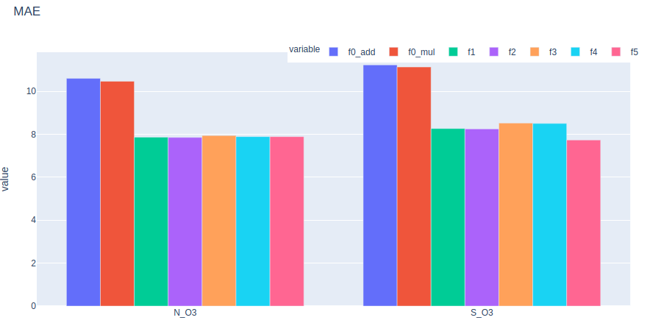
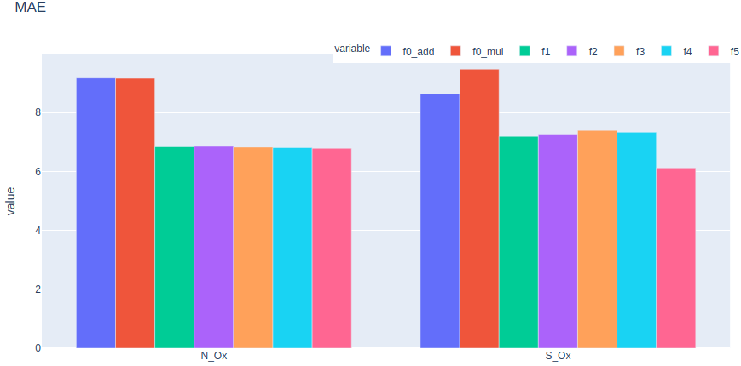

Slide 25
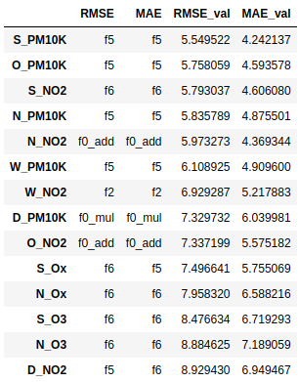
f6
f5

Slide 26
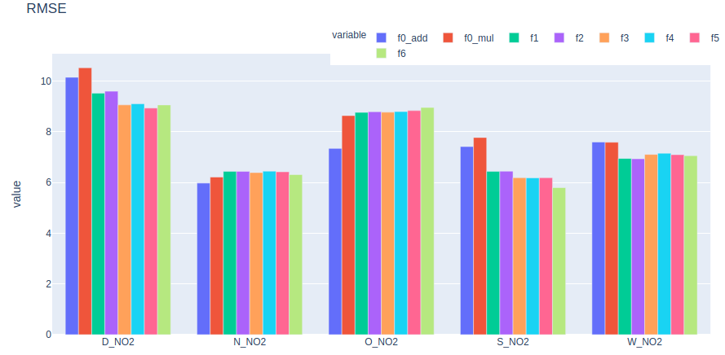
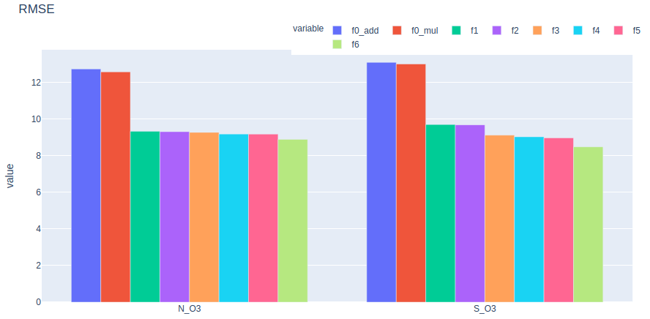
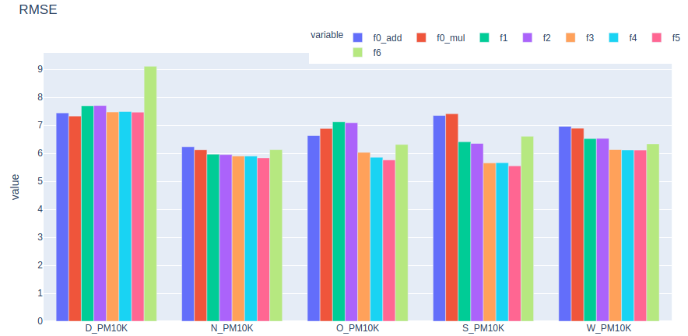
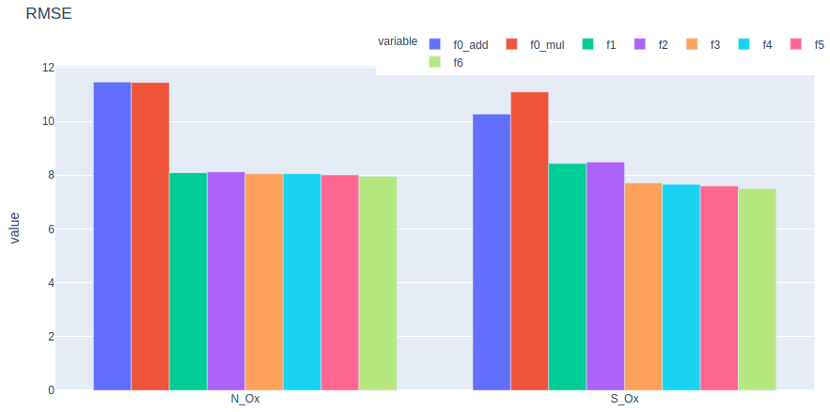
f6

