Slide 1
Graz air pollution

Slide 2
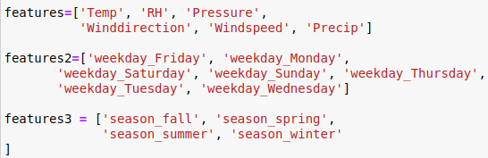
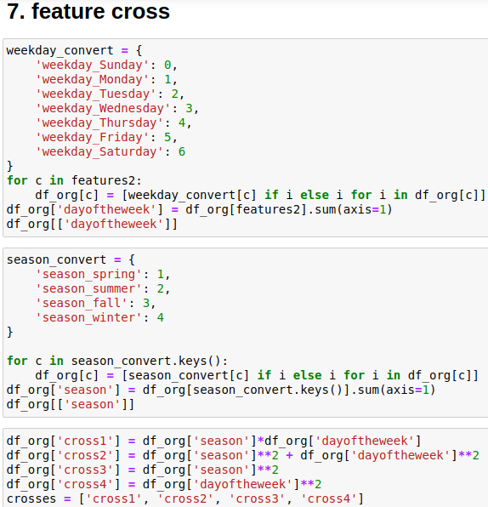
Methods
Base additive: f0_add
Base multiplicative: f0_mul
+ features: f1
+ features + features2: f2
+ holidays + features: f3
+ holidays + featues + features2 + features3: f4
6. + crossed_features: f5
7. + crossed_more_features: f6

Slide 3
Scenario 1
Train: → end of 2019
Test: 03 Jan – 10 Mar

Slide 4
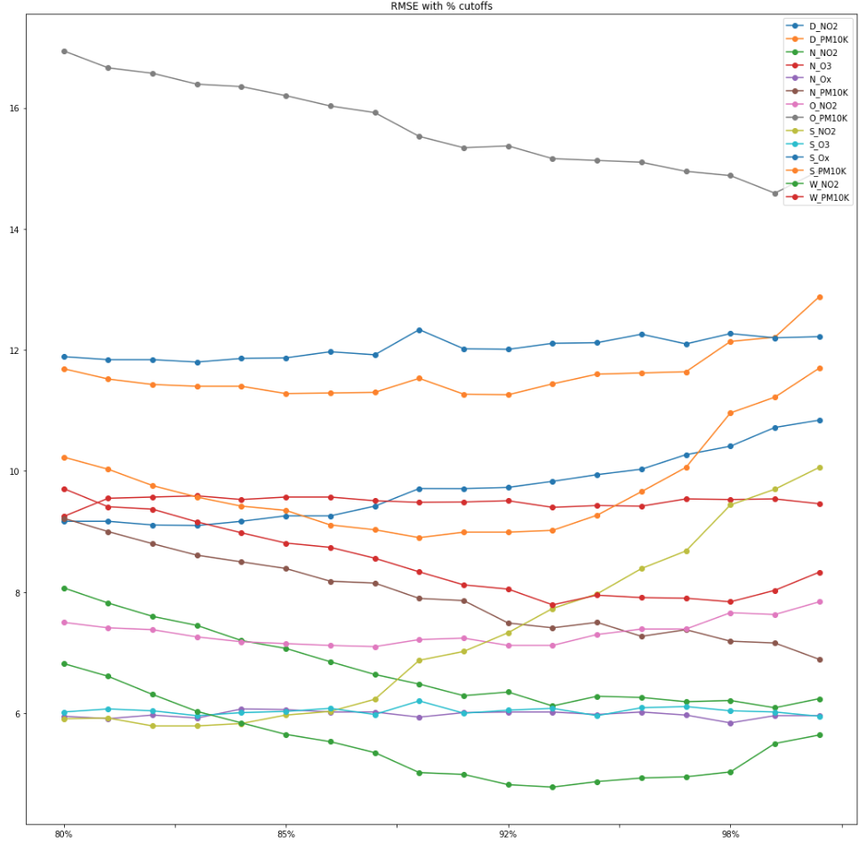
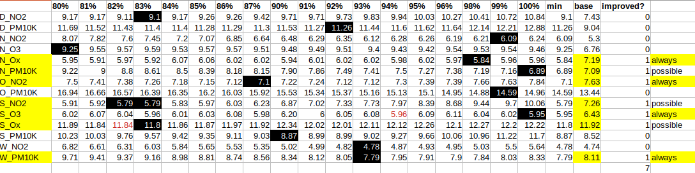
% Cutoffs (train set)
7/14 are better without parameter tuning
Notes: the rest is still running on the server

Slide 5
Scenario 2
Train: → 10 Mar 2019
Test: 11 Mar 2019 – 10 Mar 2020

Slide 6
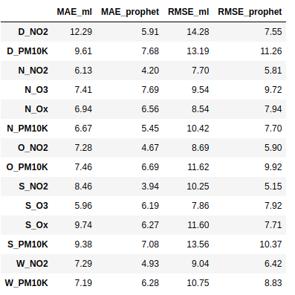
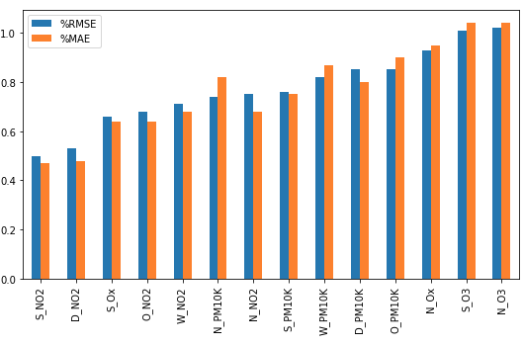
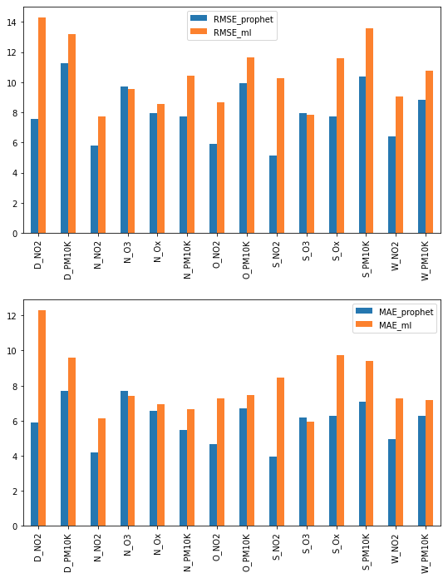
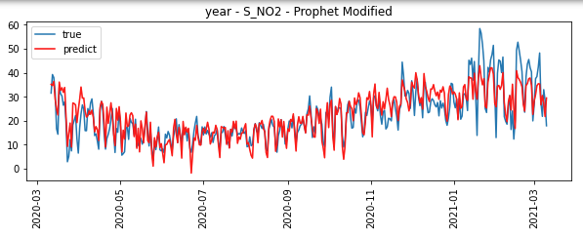
1 year
ML better only at N_O3 and S_O3
Prophet good at NO2
The best

Slide 7
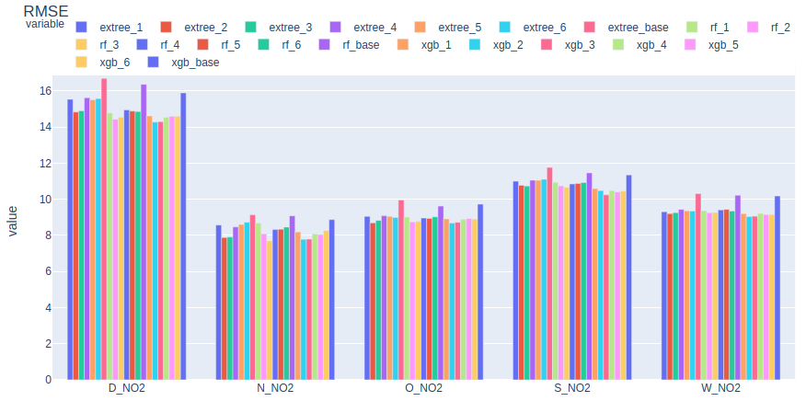
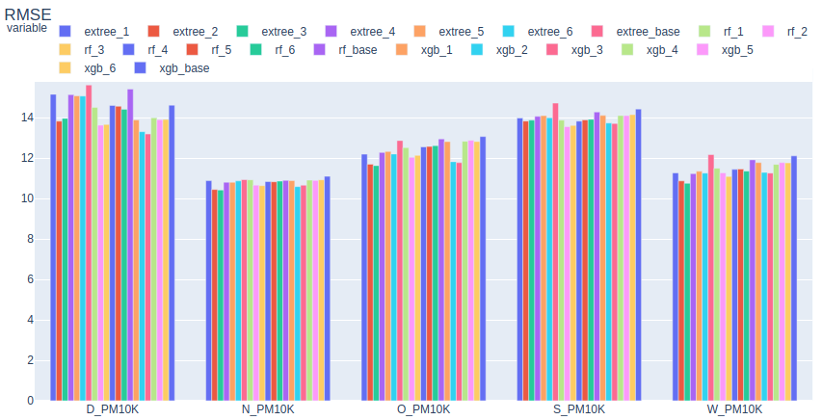
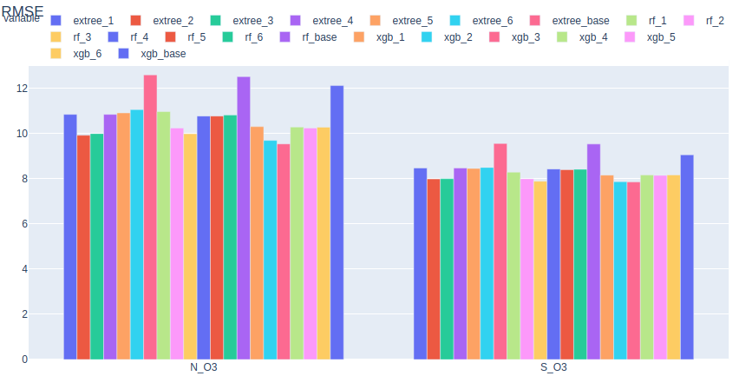
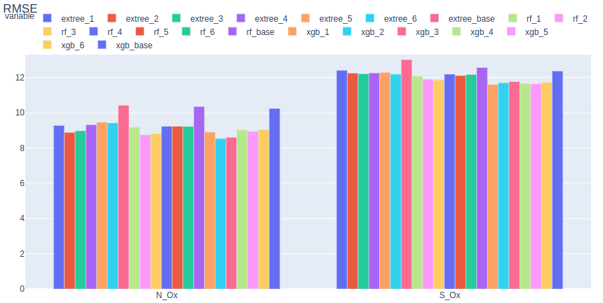

Slide 8
Thank you!

