Slide 1
Zagreb air pollution

Slide 2
Overview

Slide 3

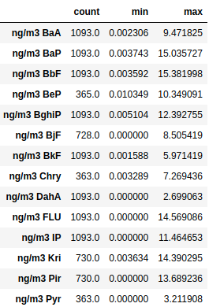
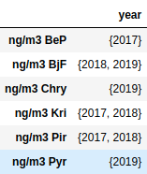



1. IMI
1095 rows
PAH_IMI 2017_2018_2019.xlsx
Columns having listed year data
Same behaviors

Slide 4
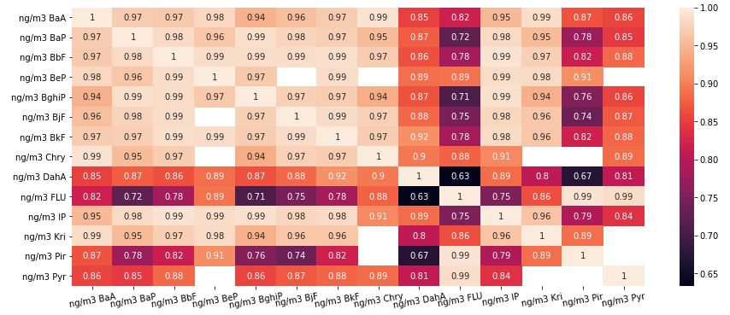
Many features highly correlated

Slide 5
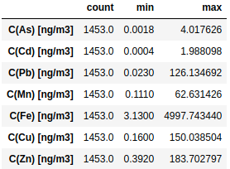
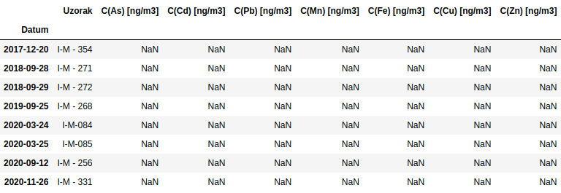
1. IMI
1461 rows
metal_IMI2017_2020.xlsx
NAs

Slide 6

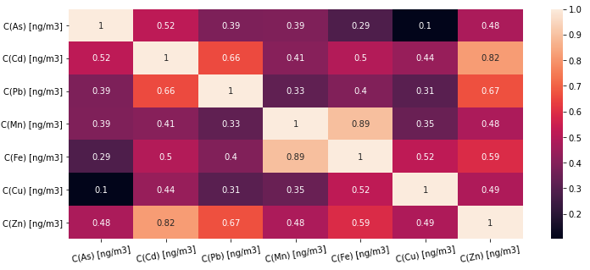




High correlation
Fe & Mn (0.89)
Cd & Zn (0.82)
Cd & Pb (0.66)
Fe & Zn (0.59)

Slide 7
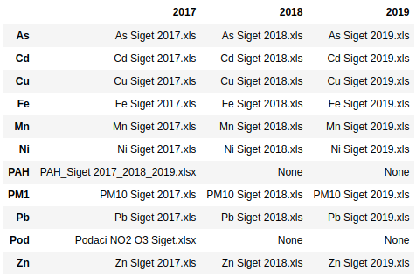
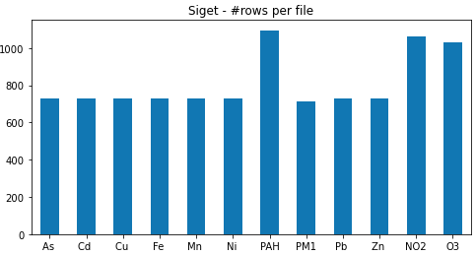
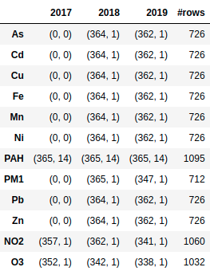
Siget – File Managment
2 files in different format
Only PAH, NO2, O3 has data in 2017

Slide 8
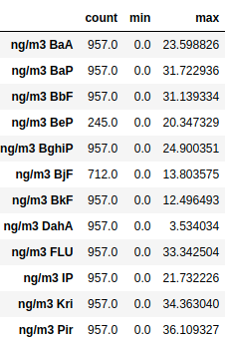
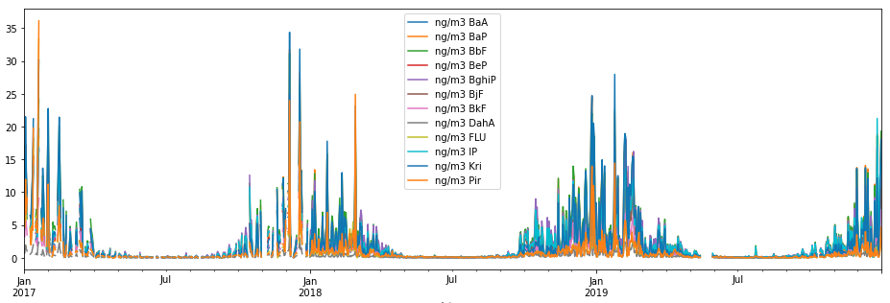
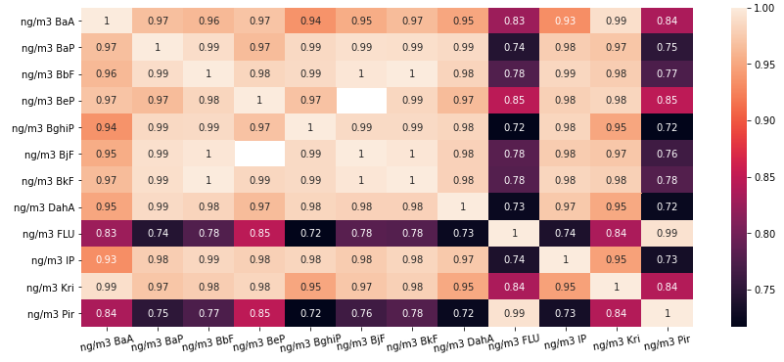
Siget
PAH_Siget 2017_2018_2019.xlsx
1095 rows
Super high correlation!

Slide 9


Siget
1095 rows
First look: no pattern?
Podaci NO2 O3 Siget.xlsx

Slide 10
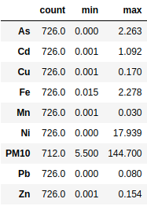



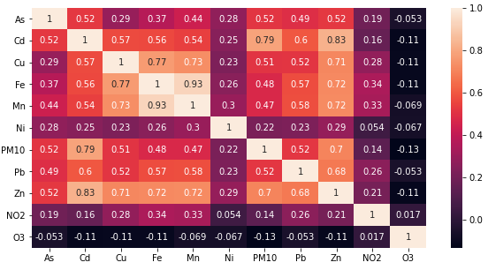


Siget
727 rows
Podaci NO2 O3 Siget.xlsx

Slide 11
Siget

Slide 12
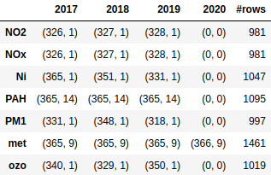
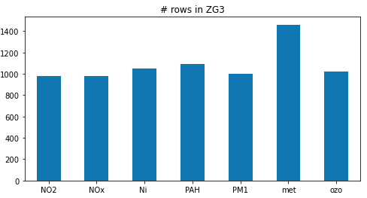
3. ZG3

Slide 13
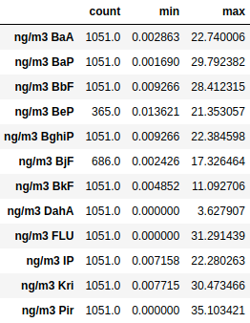
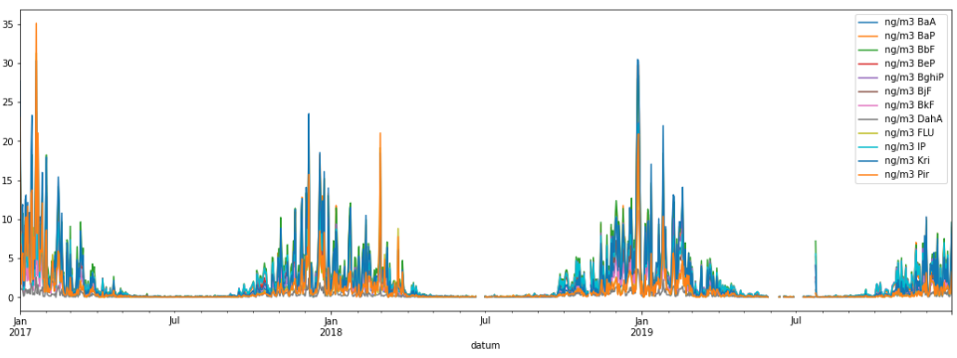
1095 rows
ZG3
PAH_Zg3 2017_2018_2019.xlsx

Slide 14

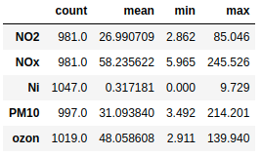



ZG3
Incomplete data: many gaps

Slide 15


Slide 16

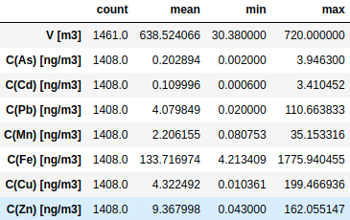



ZG3

Slide 17


ZG3

Slide 18
Questions

Slide 19
Thank you!

