Slide 1
Myo-Car
The revolutionary Car remote control

Slide 2


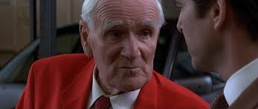



This was 20 years ago…
OBSOLETE

Slide 3
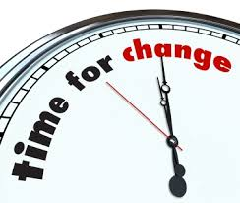
Meet Myo-Car

Slide 4
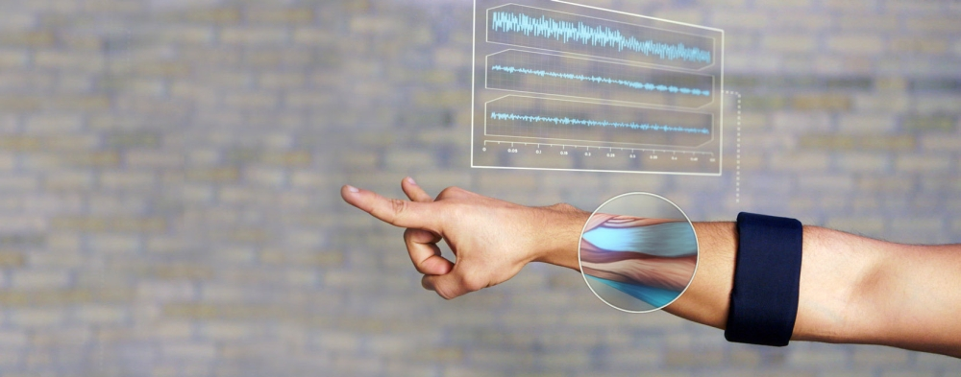
Myo Car is the new revolution in remote controlled driving

Slide 5
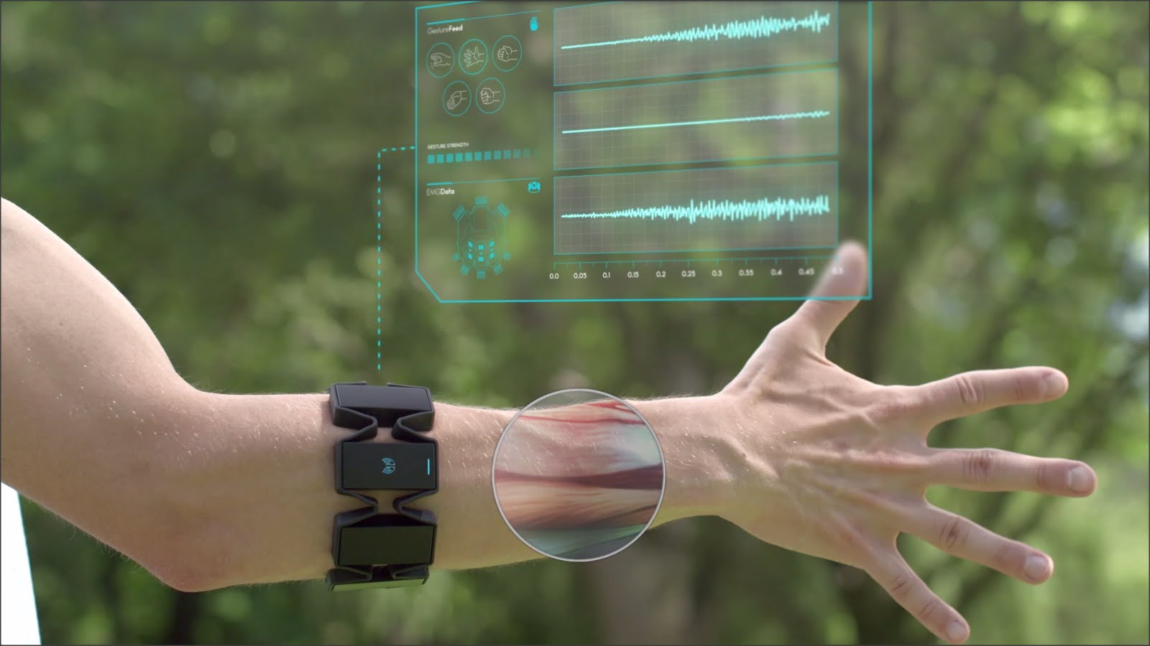
Use natural gestures instead of artifical driving aids…

Slide 6
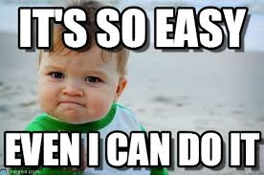
Used gestures
Rotating left arm: steering
Lifting right arm: acceleration
Lowering right arm: slowing down
Wave-out / wave-in: shifting gears
Clanging the fist of right / left hand: Turn signals

Slide 7
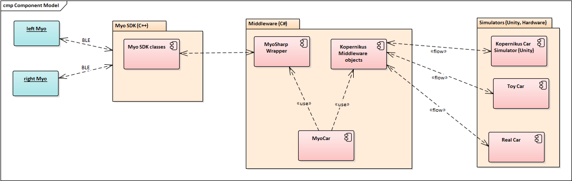
Architecture

Slide 8
Summary
MyoCar offers a natural way to remote-control a car
It uses forearm muscle tension to detect various gestures from the driver
By its modular architecture and design, it allows to easily adapt to various driving (or other) endpoints and can be customized to personal needs.
Suitable for various fields of businesses, e.g. Healthcare, defence, public transportation or even for British Secret Service agents ;-)

Slide 9
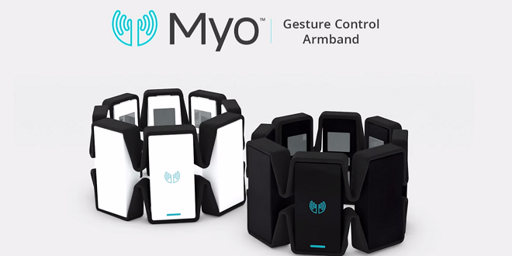
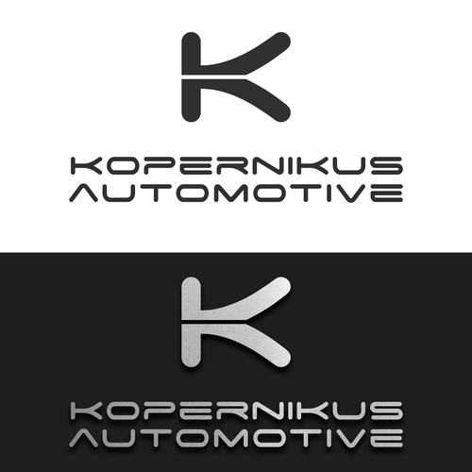

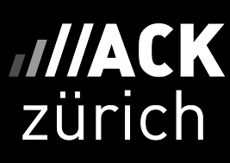
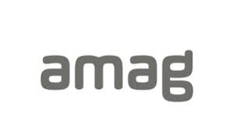
Thank you for your attention

