Slide 1
Myo-Car
The revolutionary Car remote control

Slide 2


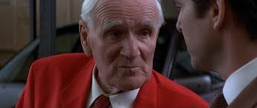



This was 20 years ago…
OBSOLETE

Slide 3
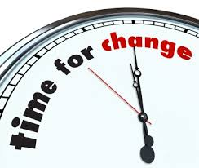
Meet Myo-Car

Slide 4
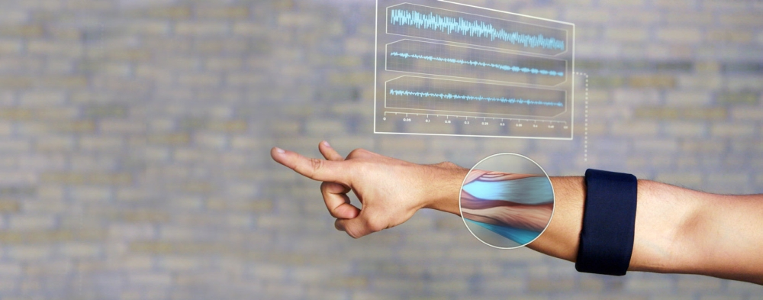
Myo Car is the new revolution in remote controlled driving

Slide 5
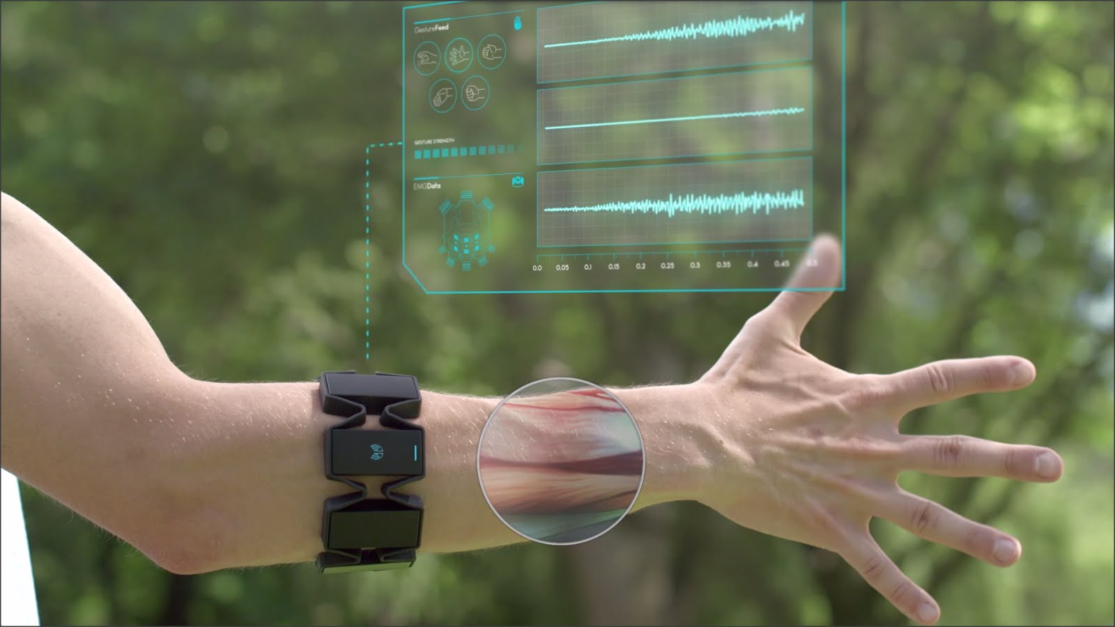
Use natural gestures instead of artifical driving aids…

Slide 6
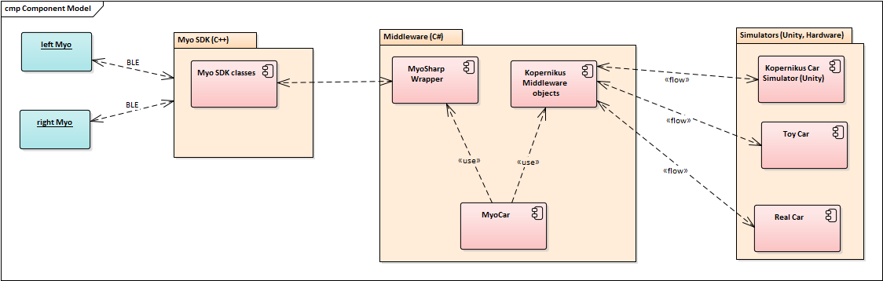
Demo

Slide 7
Used gestures in this demo
By rotating your left forearm you can control the steering angle of the car
By lifting your right arm you can accelerate the car
By lowering your right arm, you decrease the speed or break if under rest position
Shift gears via wave-out and wave-in gestures from neutral to forward or backward
Turn signals are turned on or off by clanging the fist of the respective hand

Slide 8
Summary
MyoCar offers a natural way to remote-control a car
It uses forearm muscle tension to detect various gestures from the driver
By its modular architecture and design, it allows to easily adapt to various driving (or other) endpoints and can be customized to personal needs.
Suitable for various fields of businesses, e.g. Healthcare, defence, public transportation or even for British Secret Service agents ;-)

Slide 9
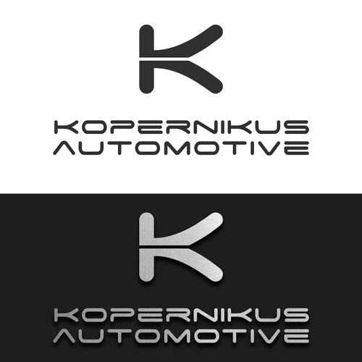
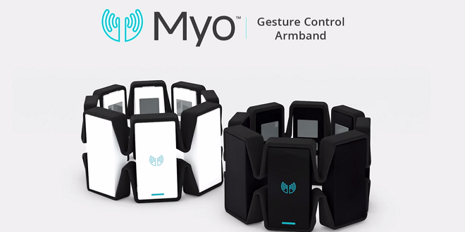

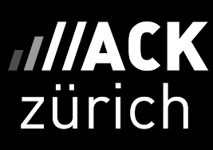
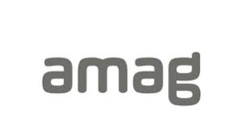
Thank you for your attention

