Slide 1
AI workshop
張庭維
tingwei626@gmail.com
2023.06.29

Slide 2
Outline
Introduction
Basic Skill
Build a Neural Network
Today’s Project
Discussion and Summary

Slide 3
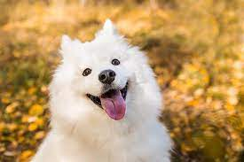

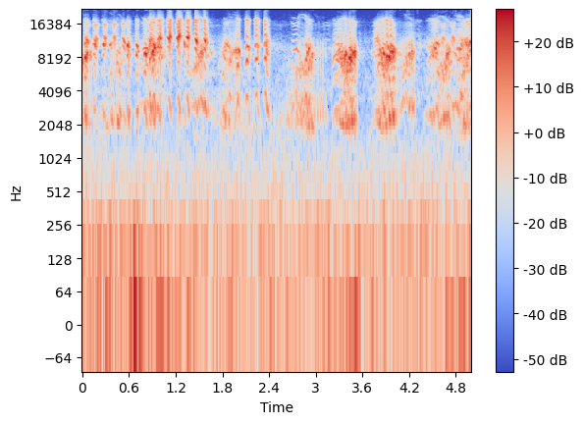

Introduction
A primary lecture for beginners of Artificial Intelligence and Python programming
Google Colab is recommended in Today’s workshop
Today’s project: Animal sound classification
Dog
All the material can be downloaded here
https://github.com/Ting-Wei-Chang626/Primary_AI.git

Slide 4
Basic Python Skill

Slide 5
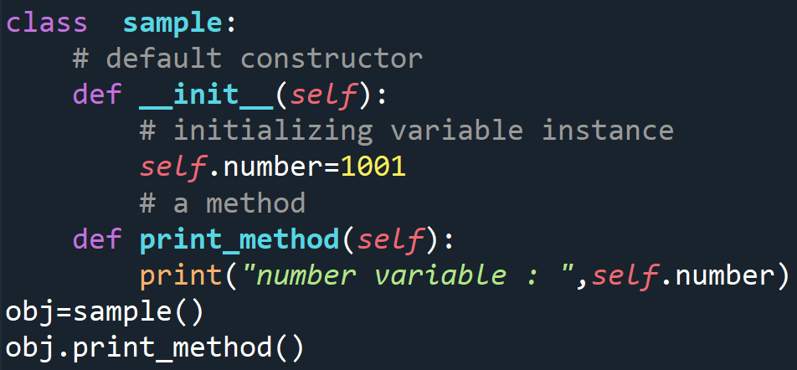
Introduction of OOP in python
Class (類別)
Object (物件)
Attribute (屬性)
Constructor (建構式)
Method (函式)

Slide 6

Class (類別) and Object (物件)
A class is a user-defined blueprint or prototype from which objects are created.
SRC
1,600 million
6 story
Building 1
RC
1,200 million
5 story
Building Class
Building 2

Slide 7
Constructor (建構式)、Attribute (屬性)
The constructor is a method that is called when an object is created.
class Net:
meow = 0
# default constructor
def __init__(self,):
self.l1 = nn.Linear(128, 8)
self.id = 0
my_net = Net()
my_net.id = 10
class Net:
# default constructor
def __init__(self, pretrain=False):
self.l1 = nn.Linear(128, 8)
self.id = 0
self.load_init_weight = pretrained
my_net = Net(pretrain=True)
my_net.id = 10
print (my_net.load_init_weight)
>> True
Refer to demo_attribute.ipynb

Slide 8
Method
Instance method
Class method
Static method
Abstract method
Refer to demo_method.ipynb

Slide 9
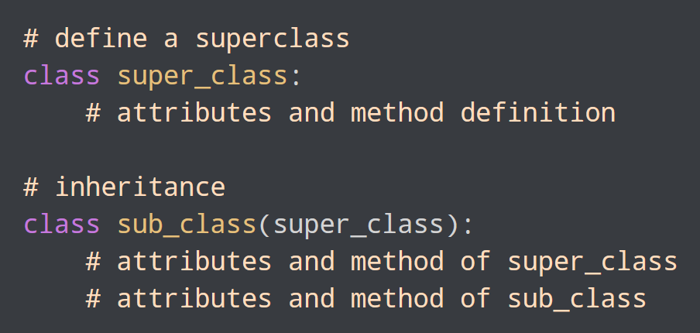
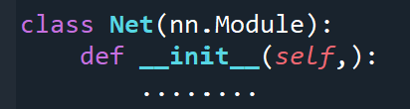
Inheritance
Inheritance allows us to define a class that inherits all the methods and properties from another class.
Always be used to create your own dataset and model
Refer to demo_inheritance.ipynb

Slide 10
The philosophy of programming
Thinking hard
Clear data structure
Debugging logically
Google is the best friend
Never ever write something you can’t understand

Slide 11
Basic Neural Network

Slide 12
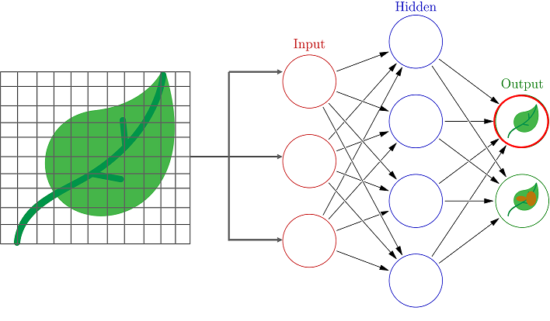
Neural Network
Hint:
For research you should consider
Clear io
Computation limitation
Tiny dataset test
SOTA Model test

Slide 13
Layers
Conv2d
(https://pytorch.org/docs/stable/generated/torch.nn.Conv2d.html)
BatchNorm2d
(https://pytorch.org/docs/stable/generated/torch.nn.BatchNorm2d.html)
Dropout
(https://pytorch.org/docs/stable/generated/torch.nn.Dropout.html)
Linear
(https://pytorch.org/docs/stable/generated/torch.nn.Linear.html)
Relu
(https://pytorch.org/docs/stable/generated/torch.nn.ReLU.html)

Slide 14
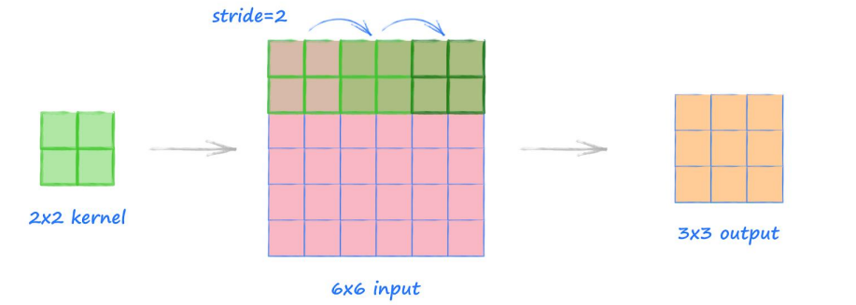
Conv2d
nn.Conv2d(in_channels, out_channels, kernel_size=2, stride=2)
Refer to demo_conv2d.ipynb

Slide 15
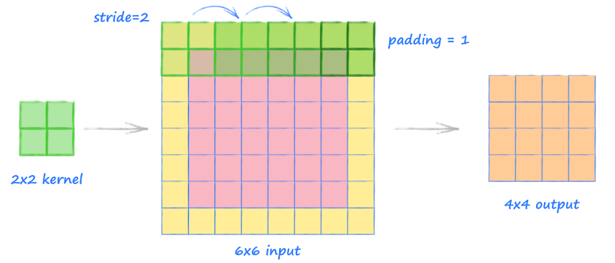
Conv2d
nn.Conv2d(in_channels, out_channels, kernel_size=2, stride=2, padding=1)

Slide 16
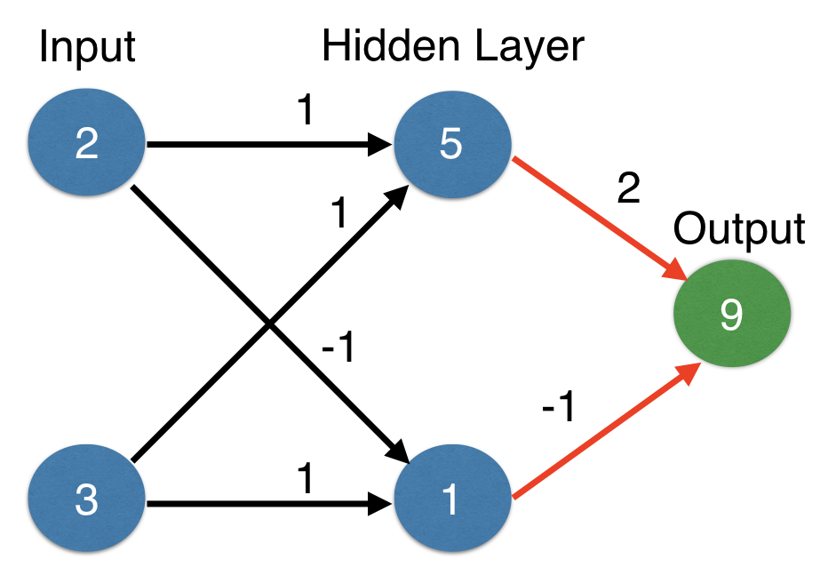
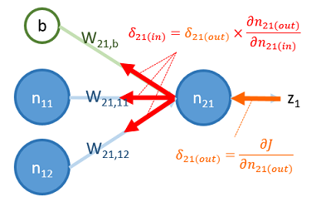
Forward Propagation / Backward Propagation
feedforward
backward
Refer to demo_forward_propagation.ipynb
Notes:
https://theneuralblog.com/forward-pass-backpropagation-example/
https://www.youtube.com/watch?v=Tb23YtZ92AE
https://www.kaggle.com/code/andls555/explain-forward-propagation

Slide 17
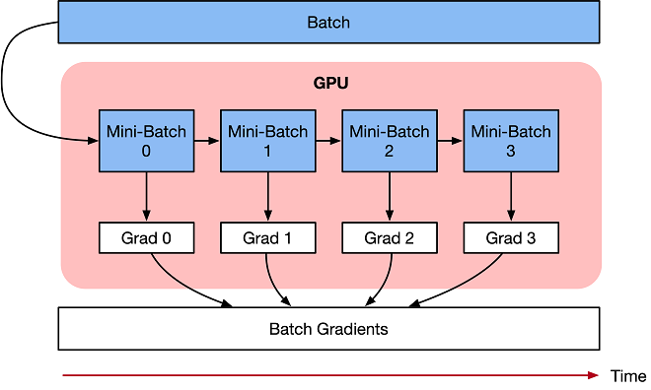
Gradient accumulation
Source: https://www.mindspore.cn/tutorials/experts/en/r1.8/others/gradient_accumulation.html
Notes:
https://www.mindspore.cn/tutorials/experts/en/r1.8/others/gradient_accumulation.html

Slide 18
Step-by-Step Conolution Neural Network
Load and preprocessing the data (Dataset, Dataloader)
Define a Convolutional Neural Network (torch.nn.Module)
Define a loss function (loss, Optimizer)
Train the network on the training data (Forward / Backward propagation)
Test the network on the test data
Refer to demo_mnist.ipynb
Notes:
https://nextjournal.com/gkoehler/pytorch-mnist

Slide 19
Project -Animal Sound Classify
Target：Build an image classifier to classify animal sound
We’ll learn
1. basic audio processing skill
2. create the custom dataset
3. how to build a NN model
4. perform training & testing on Colab
Source: Audio Classification using Librosa and Pytorch | by Hasith Sura | Medium

Slide 20
Data processing

Slide 21
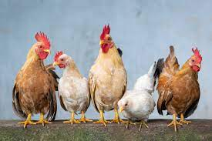
Dataset
The ESC-50 dataset is a labeled collection of 2000 environmental audio recordings.
Animal sounds occupy 1/5 (400/2,000)
_{Animal} | Natural soundscapes & water sounds | _{Human, non-speech sounds} | _{Interior/domestic sounds} | _{Exterior/urban noises}
Dog | Rooster | Pig | Cow | Frog
Cat | Hen | Insects | Sheep | Crow
Notes:
GitHub - karolpiczak/ESC-50: ESC-50: Dataset for Environmental Sound Classification

Slide 22
Basic audio processing
Visualize the audio
step1: mount the google drive
step2.1: librosa.load(path)
step2.2: check the wave plot
step3: convert the audio to fixed length
step4: get the mel-scaled spectrogram
step5 transform spectrogram to 0~255
Refer to demo_audio_processing.ipynb

Slide 23
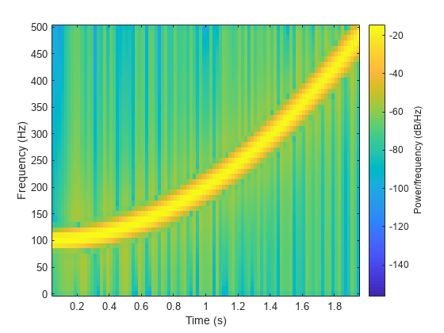
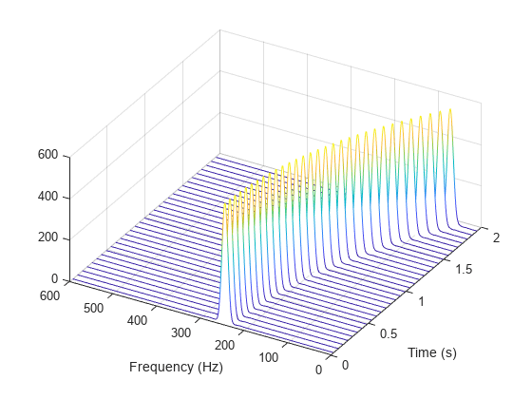
Spectrogram
A spectrogram is a visual representation of the spectrum of frequencies of a signal as it varies with time.
Source: https://pnsn.org/spectrograms/what-is-a-spectrogram
Notes:
https://pnsn.org/spectrograms/what-is-a-spectrogram
https://towardsdatascience.com/learning-from-audio-spectrograms-37df29dba98c

Slide 24
Build a Neural Network and Practice Transfer Learning

Slide 25
Build audio classification model
Load data
Custom dataloader
Declare model
Loss function
Design training process
Save model weight
Refer to demo_project.ipynb

Slide 26
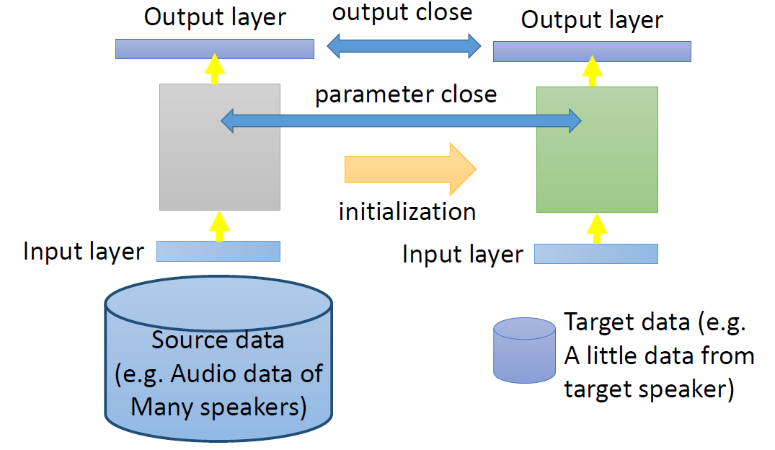
Transfer learning
Large source data and fewer target data
Notes:
https://www.youtube.com/watch?v=qD6iD4TFsdQ

Slide 27

Summary
We have learned
1. basic OOP in python
2. basic audio processing
3. build a simple NN model
4. perform training & testing on Colab
What’s the next?
It’s your turn!

