Slide 1
Mathematical Foundation of Machine Learning
II Optimization in Deep Learning

Slide 2
Outline
Optimization vs Training algorithm
Challenges in Neural Network Optimization
Basic algorithms
Advanced algorithms
Papers

Slide 3
Review:
Machine Learning Basics
tasks/problems
models
algorithms
Model Evaluation
Research: quantifying generalization error in deep learning
training data size
model compacity
smoothness of Neural Network

Slide 4
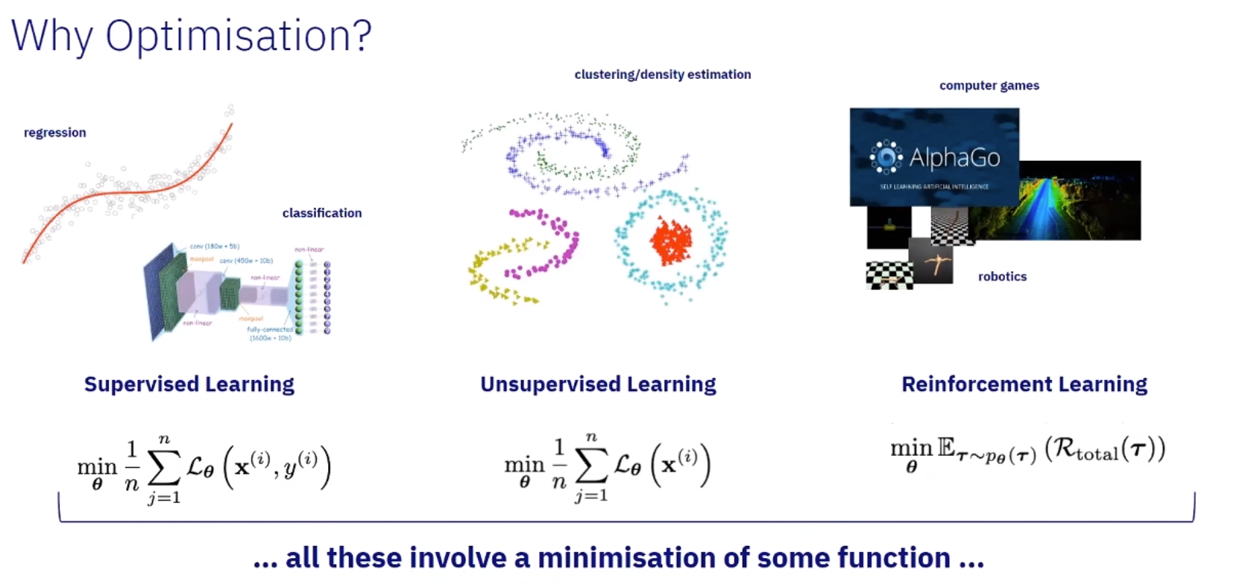

Slide 5


How Learning Differs from Pure Optimization?
Optimize performance for training NN: measure on test set indirectly;
Pure optimization is minimizing objective function itself.
Cost function over training data (empirical distribution p^)
Cost function over real data (data generating distribution p)
We prefer to minimize the expectation taken across the true underlining data distribution !!

Slide 6

Empirical Risk Minimization
If we knew the true data distribution, reducing the risk(expectation of loss function) would be an optimization problem; When we do not know the data generating distribution, we have a machine learning problem.
To convert an ML problem back to an optimization problem, we now minimize loss on training set, i.e. replacing the true distribution with an empirical distribution.
NOT feasible because:
Prone to overfiting when used with a high capacity NN. (answer from last lesson!)
Not able to use Gradient Decent based algorithm: many useful loss functions such as 0-1 loss do not have derivatives. (the derivative is either zero or undefined everywhere.)
Surrogate Loss Functions and Early Stopping

Slide 7
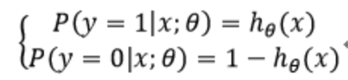
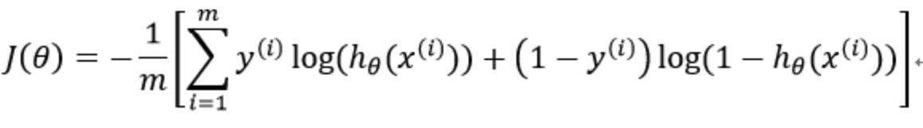
Surrogate Loss Function and Early Stopping
The negative log-likelihood of the correct class is typically used as a surrogate for the 0-1 loss, which will yield the lease classification error in expectation. (Besides, think multi-class classfication). For example,
Training often halts while the surrogate loss function still has large derivative (will talk in detail in later papers), while pure optimization algorithm is considered to have converged when the gradient becomes very small.

Slide 8

Batch and Minibatch Stochastic methods
Minibatch sizes are generally driven by the following factors:
Larger batches provide a more accurate estimate of the gradient, but with less than linear returns. (Var/sqrt(sample_size))
If all examples in the batch are to be processed in parallel (as is typically the case), then the amount of memory scales with the batch size. For many hardware setups this is the limiting factor in batch size.
Some kinds of hardware achieve better runtime with specific sizes of arrays. Especially when using GPUs, it is common for power of 2 batch sizes to offer better runtime. Typical power of 2 batch sizes range from 32 to 256, with 16 sometimes being attempted for large models.
Small batches has tradeoffs:
- pros: due to the noise they add to the learning process, generalization error is smaller;
- cons: Training with such a small batch size might require a small learning rate to maintain stability due to the highvariance in the estimate of the gradient. The total runtime can be very high due to the need to make more steps

Slide 9
Batch and Minibatch Stochastic methods: generalization error
When we do SGD or minibatch GD, we can argue that we are tring to optimize the cost function defined on the true data generating distribution and not on the assumed data distribution function. This is true for any total cost function that can be broken down over a sum of costs of individual points multiplied by probability.
The fact that stochastic gradient descent minimizes generalization error is easiest to see in the online learning case, where examples or minibatches are drawn from a stream of data. In other words, instead of receiving a fixed-size training set, the learner is similar to a living being who sees a new example at each instant,with every example (x, y) coming from the data generating distribution pdata(x, y). In this scenario, examples are never repeated; every experience is a fair samplefrom pdata.

Slide 10
Optimization vs Training algorithm
Challenges in Neural Network Optimization
Basic algorithms
Advanced algorithms
Papers

Slide 11




Challenges in Neural Network Optimization: ill - conditioning
Remember Taylor expension for cost function:
how much value will one step of -eps * g add to the cost ?
if the first term is greater than the second term, the cost function may go up even the gradient is high, causing SGD to get stuck in the sense that even very small steps increase the cost func(ill-condition).
how to check the influence of ill-conditioning?
norm: and

Slide 12
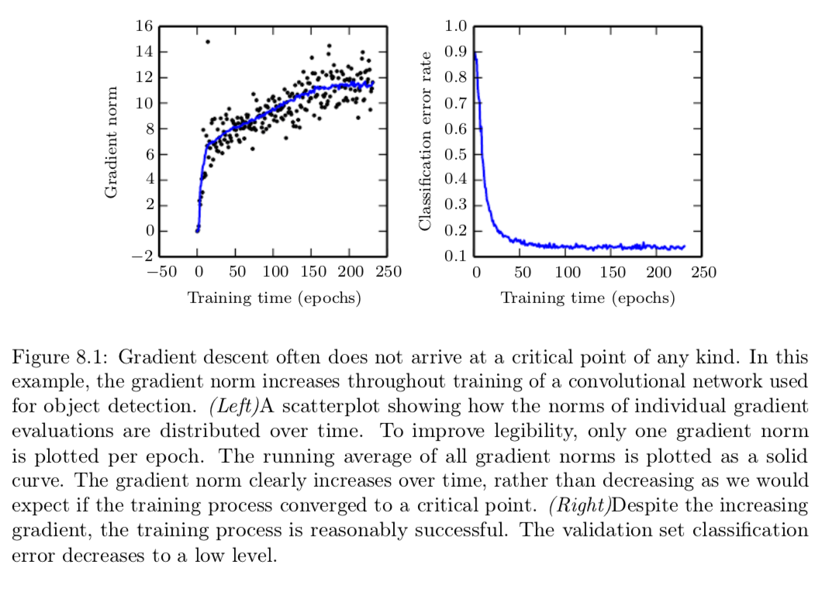
Gradient norm increses over time rather than decreasing as expected when converging to a critical point.
Despite the increasing gradient, the training process is successful in terms of validation error.

Slide 13
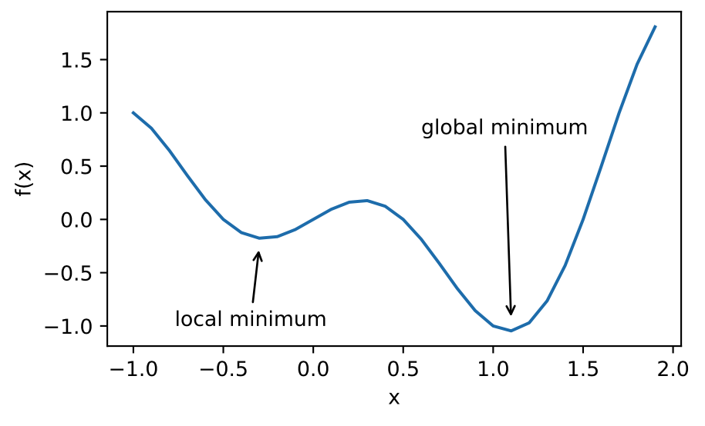
Challenges in Neural Network Optimization: local minima
convex problem: linear regression, SVM, logistic regression...
With non-convex cost function used in nueral networks, we are faced with the problem of local minima:
Deep Neural Network essentially have a large number of local minima. But this is not a major problem.

Slide 14
Challenges in Neural Network Optimization: local minima
model identifiability: if a model is trained with enough samples can rule out all but one setting of model parameters, the models is said to be identifiable. Models with latent variables are often not identifiable because we can obtain equivalent models by exchanging latent variables with each other.
Weight space symmetry: For example, we could take a NN and modify layer 1 by swapping the incoming weight vector for unit i with the incoming weight vector for unit j, then do the same for the outgoing weight vectors. If we have m layers for unit j, then do the same for the outgoing weight vectors. If we have m layers with n units each, then there are (n!)^m of arranging the hidden units.
weight manipulation: in any rectified linear, we can scale all the incoming weights and biases of a unit by alpha if we also scale all its outgoing weights by 1/alpha.
These model identifiability issues mean that there can be an extremely large or even uncountably infinite amount of local minima in a neural network cost function. However, all of these local minima arising from non-identifiability are equivalent to each other in cost function value. As a result, these local minima are not a problematic form of non-convexity.

Slide 15
Challenges in Neural Network Optimization: local minima
Local minima can be problematic if they have high cost in comparison to the global minimum. If local minima with high cost are common, this could pose a serious problem for gradient-based optimization algorithms.
It remains an open question whether there are many local minima of high cost for networks of practical interest and whether optimization algorithms encounter them. For many years, most practitioners believed that local minima were a common problem plaguing neural network optimization. Today, that does not appear to be the case. The problem remains an active area of research, but experts now suspect that, for sufficiently large neural networks, most local minima have a low cost function value, and that it is not important to find a true global minimum rather than to find a point in parameter space that has low but not minimal cost.
Check neural network optimization to local minima. Carefully test that can rule out local minima as the problem is to plot the norm of the gradient over time. If the norm of the gradient does not shrink to insignificant size, the problem is neither local minima nor any other kind of critical point. In high dimensional spaces, many structures other than local minima also have small gradients.

Slide 16
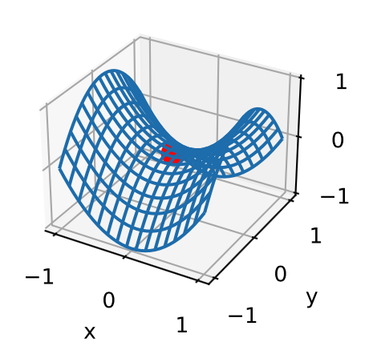
Challenges in Neural Network Optimization:
Saddle points
More saddle points in high dimensions than local minima. If the sign of eigenvalue of the Hessian is random, it is way more likely that one of the dimensions have a negative eigenvalue(saddle point) than all positive eigenvalue(local minima).
Regions of low cost have more positive eigenvalues. It also means that local minima are much more likely to have low cost; Critical points with high cost are far more likely to be saddle points. Critical points with extremely high cost are more likely to be local maxima.
Theoretical results on certain types of NN suggest large many saddle points with some global minima and no local minima.
SGD seems to be repelled from the rather than attracted to saddle points. Other methods like newton methods are attracted to it.

Slide 17
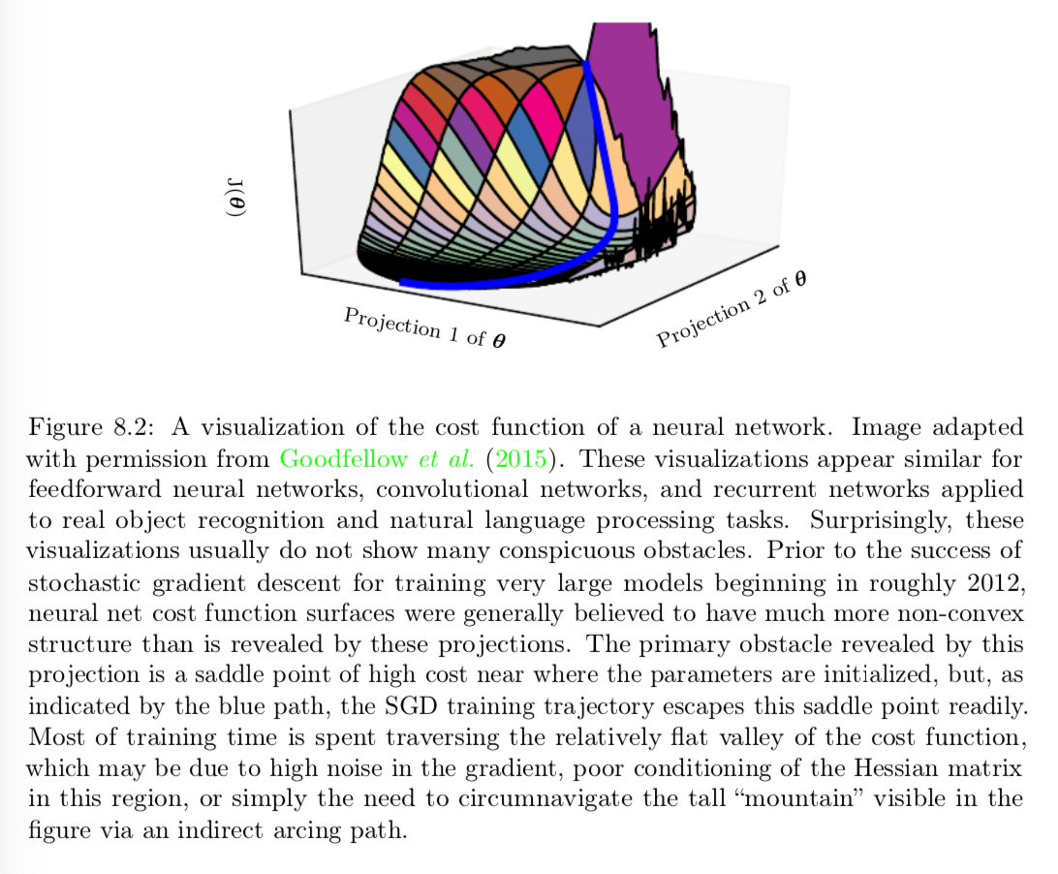
Primary obstabcle is the high cost of saddle points near where the parameters are initialized.
SGD train the trajectory escapes the saddle point repidly.
Most of the training time spent on traversing flat valley of the cost function.

Slide 18
Challenges in Neural Network Optimization: Plateaus and flat regions
Other types of zero gradient points can be:
Maxima - It may have 0 gradient but most optimization algorithms would not be attached to it.
Flat regions: NN cost function might have many flat regions where gradient and hession are both 0.

Slide 19
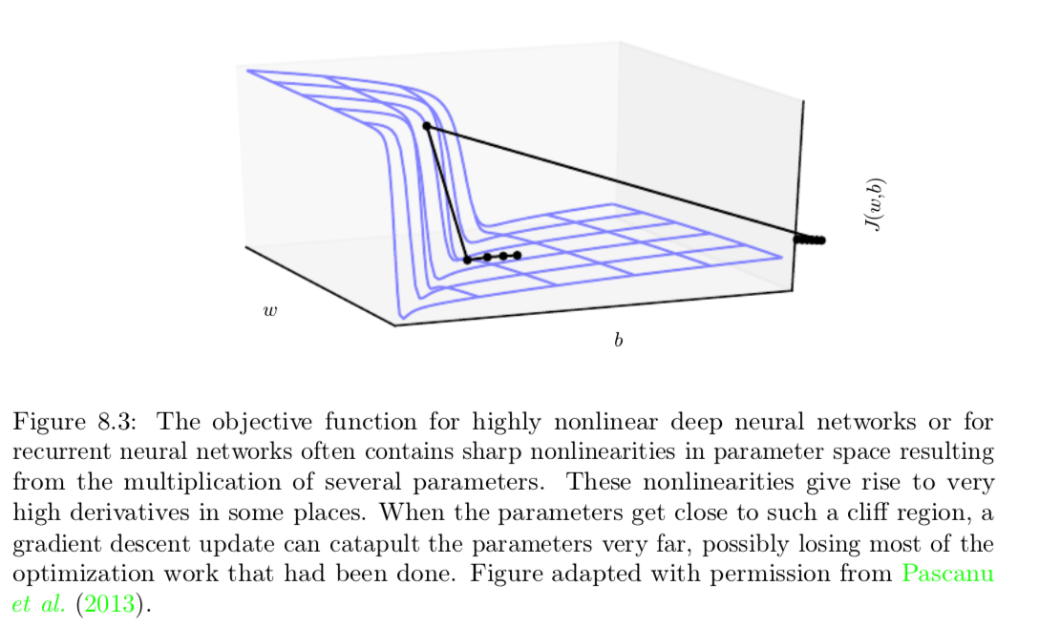
Challenges in Neural Network Optimization: Exploding Gradient
This can be remedied by gradient clipping.
When the gradient is too large, we can decreses the step size.

Slide 20

Challenges in Neural Network Optimization: Long term dependencies
If the computation graph consists of multiplying the weight matrix W a number of times(like RNN), it can lead to exploding or vanishing gradients.
Eigen values of weight matrix:
if has an eigen value >> 1, will explode
and if has an eigen value << 1, we cannot figure which direction to move.

Slide 21
Challenges in Neural Network Optimization: Inexact gradients
Gradients and hessians are just an approximate from the the sample and not exact
For some methods, the cost function is not tractable and the gradients are also not tractable. We can only approximate the gradients.
Various NN optimization algorithms are designed to account for imperfections in the gradient estimate. One can also avoid the problem by choosing a surrogate loss function that is easier to appxorimate than the true loss.

Slide 22
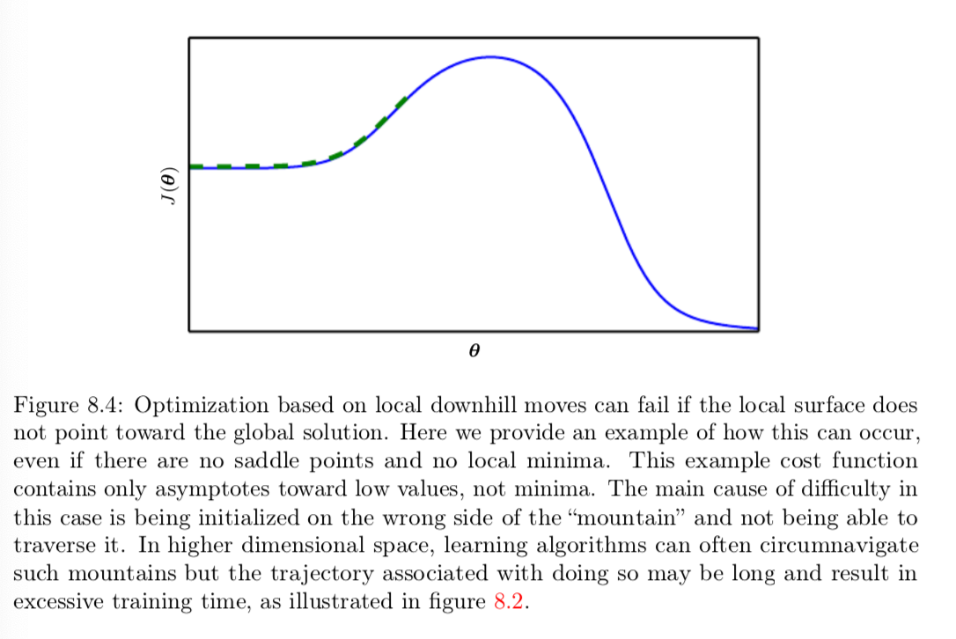
Challenges in Neural Network Optimization: poor correspondence between local and global structure
Local descent does not define a path to the solution
Most time is spent in traversing the length of the cost trajectory. We could think of it as time spent tracing the wide arc around a mountain shaped structure.
SGD generally never even arrives as a critical point like global minimum, local minimum or saddle point.
It would be better if we have an initialization method that can lead us to a better solution.
Notes:
Goodfellow, I. J., Vinyals, O., and Saxe, A. M. (2015). Qualitatively characterizing neural network optimization problems. In International Conference on Learning Representa- tions. 285, 286, 287, 291

Slide 23
Optimization vs Training algorithm
Challenges in Neural Network Optimization
Basic algorithms
Advanced algorithms
Papers

Slide 24
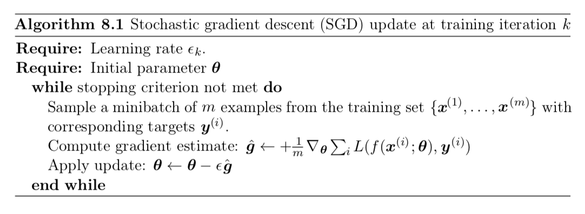

Stochastic Gradient Descent
Learning rate is not constant. In practice, it needs to be reduced over time. At iteration k, it is denoted as
SGD introduces a noise (the sample gradient is an estimate) that does not vanish even when we reach a minimum. If we do batch gradient descent, it does vanish at the minimum. This necessitates the need for a diminishing learning rate.

Slide 25
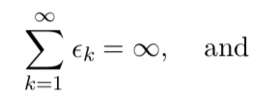
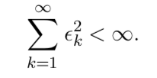
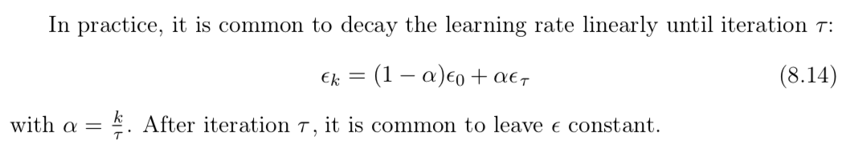

SGD: the sufficient condition
To study algorithm convergence:
Check theoretical error over excess error:
For convex functions, after k steps the excess error O(1/k)
For strong convex functions, after k steps the excess error O(1/sqrt(k))
Theoretical results (Bottou 2008) suggests it is not worthwhile to pursue optimization algorithm that converge faster than O(1/k) -- faster convergence presumably corresponds to overfitting.

Slide 26

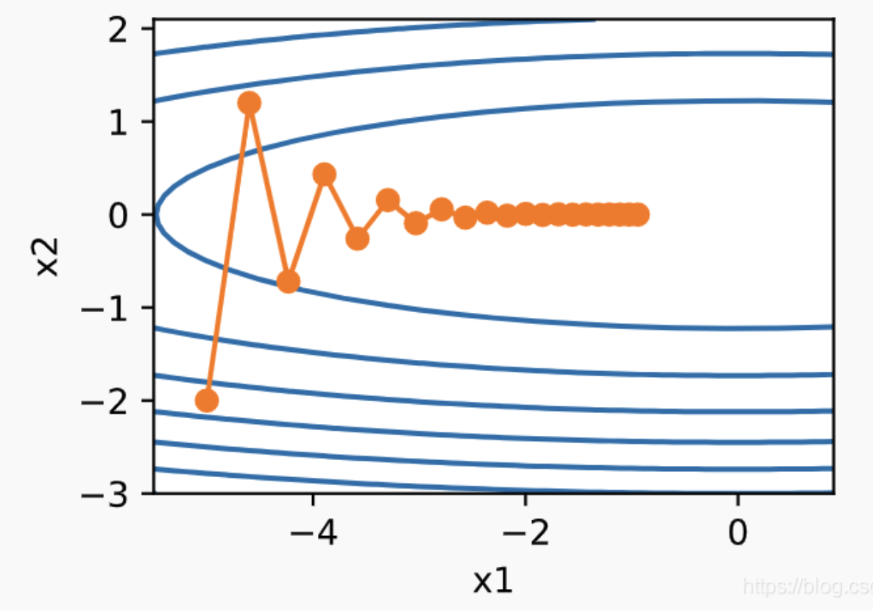
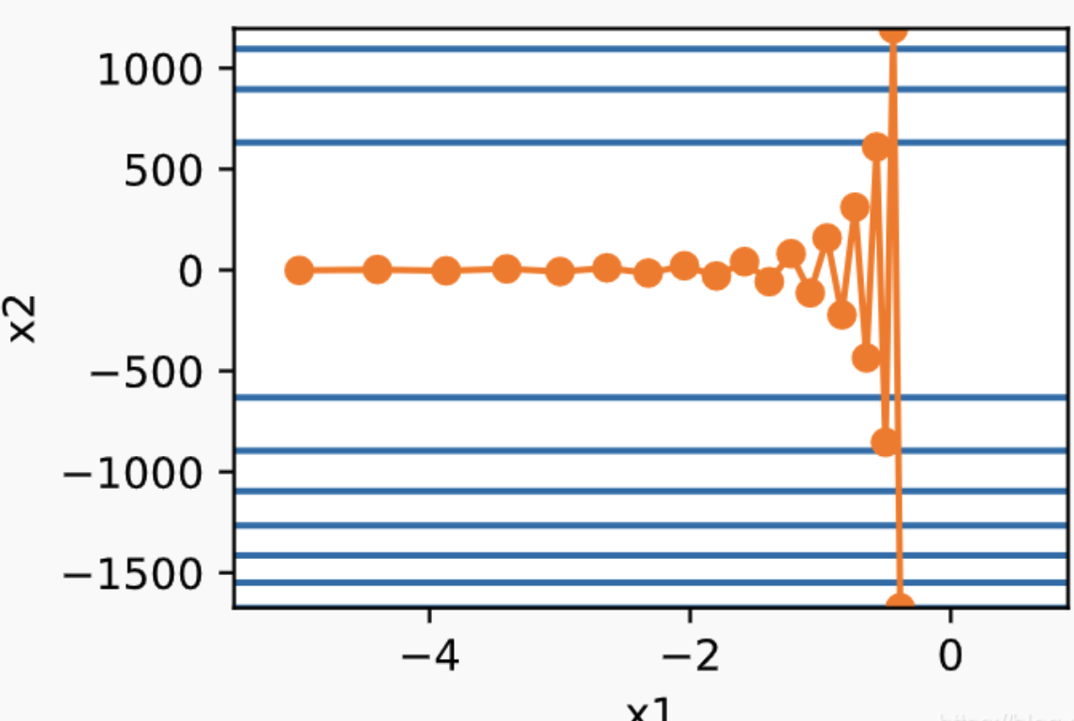
learning rate = 0.4
learning rate = 0.6

Slide 27
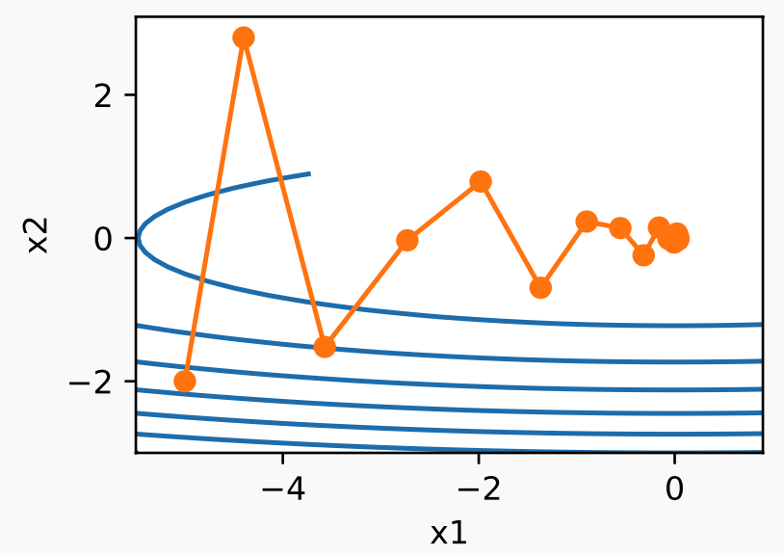


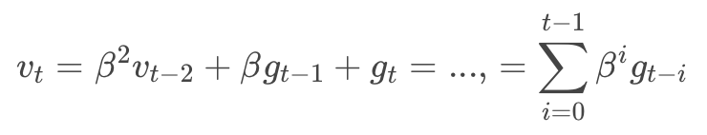
Momentum method On the importance of initialization and momentum in deep learning
learning rate = 0.6, beta = 0.5

Slide 28
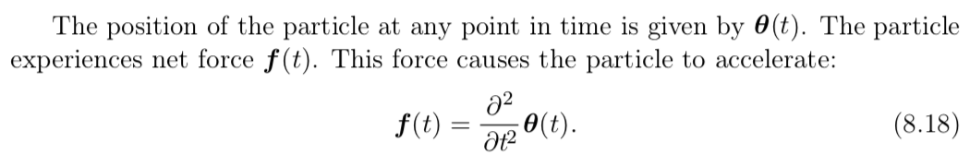


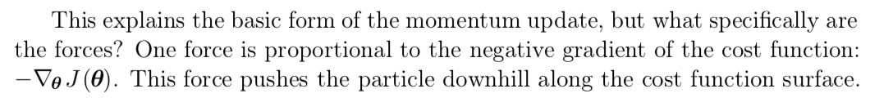
Mometum's interpretation as force
This explains the basic form of momentum update, but what are the forces? One force is proportional to the negative gradient of cost function
which pushes the particle downhill along the cost function surface.
If the only force is the gradient of the cost function, then the particle might never come to rest. So we need the other force, which is proportional to the velocity. (If it was proportional to the square of velocity, it would be too small and the puck would never stop; if it was a constant force, it might be too big and stop before reaching to minimum)

Slide 29
Optimization vs Training algorithm
Challenges in Neural Network Optimization
Basic algorithms
Advanced algorithms
Papers

Slide 30
Algorithms with adaptive learning rate
motivation:
Learning rate is the most difficult to set hyper-parameter. The cost is sensitive to some directions in parameter space and insensitive to others. It is somewhat remedied by momentum but it introduces another hyper-parameter. It is better to have a separate learning rate on each axis.
Early approches said that if the partial derivative wrt a paarameter changed signs then learning rate should decrease othersise increase.

Slide 31
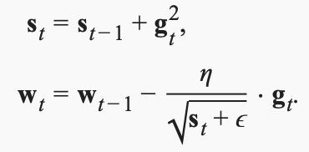
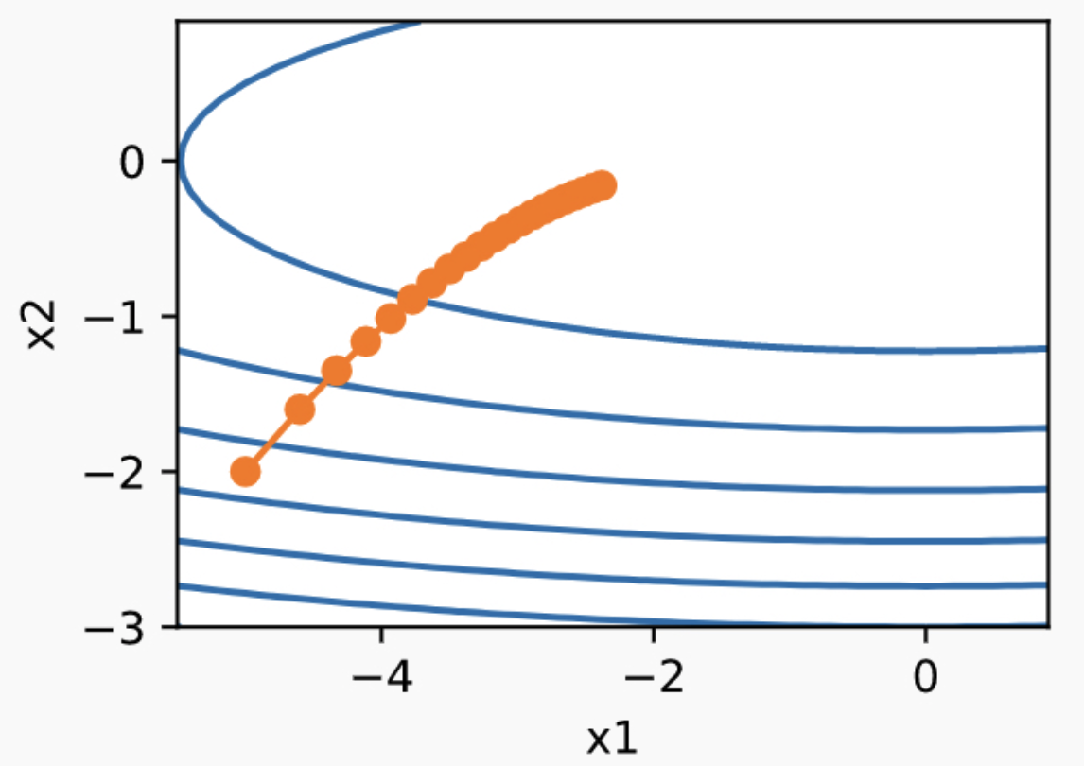
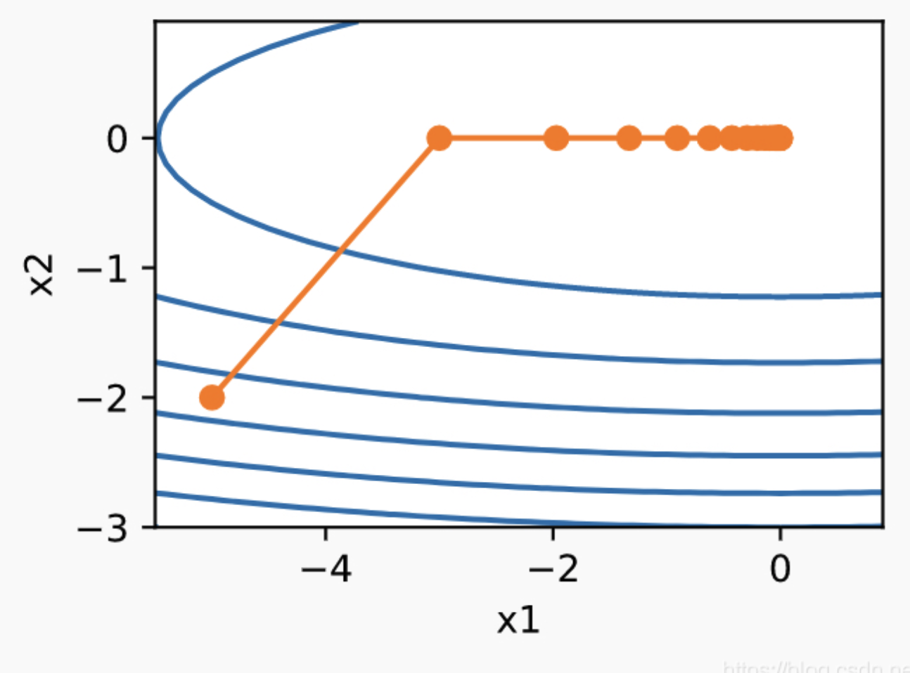
Adagrad: Adaptive Subgradient Methods for Online Learning and Stochastic Optimization
Learning rate = 0.4
Learning rate = 2

Slide 32
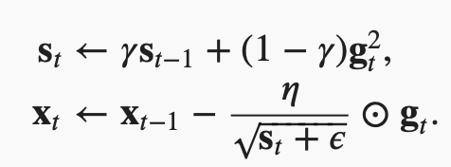
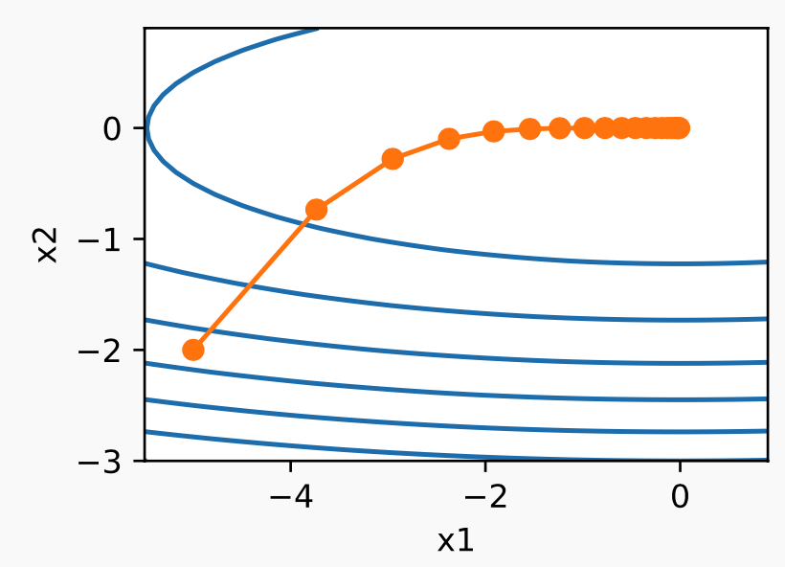
RMSProp: https://www.cs.toronto.edu/~tijmen/csc321/slides/lecture_slides_lec6.pdf
eta, gamma = 0.4, 0.9

Slide 33
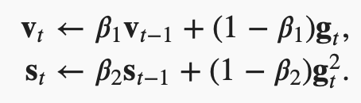
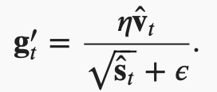

Adam. ADAM: A METHOD FOR STOCHASTIC OPTIMIZATION
https://d2l.ai/chapter_optimization/adam.html

Slide 34
Papers
QUALITATIVELY CHARACTERIZING NEURALNETWORK OPTIMIZATION PROBLEMS
ADAM: A METHOD FOR STOCHASTIC OPTIMIZATION (ICLR 2015)
On the Convergence of Adam and Beyond (ICLR 2018)
Adaptive Methods for Nonconvex Optimization (NIPS 2018)
AdaBelief optimizer: Adapting Setpsizes by the Belief Observed Gradients(NIPS 2020)

Slide 35

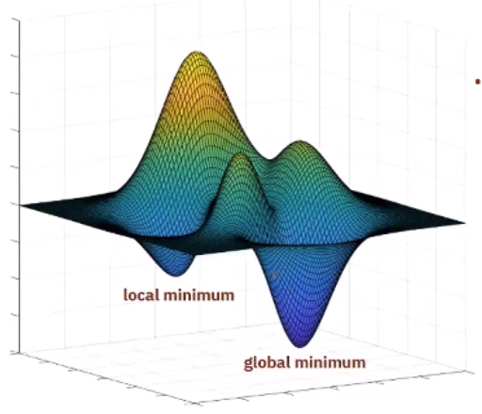
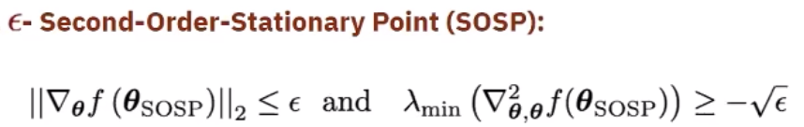
Adaptive Methods for Nonconvex Optimization
Global or local minima are NP-hard, we look for other types of points: staionary points !

Slide 36
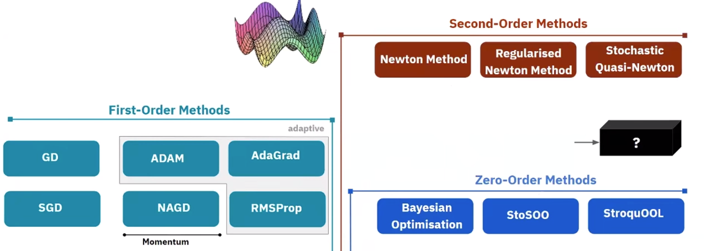
non-convex optimization
Note:
zero-order: e.g. bandit, don't scale well in terms of dimensions although guanranteed to be global minimal.
2nd-order: Assumption includes invertable Hessian matrix, where regularized Newton method comes into help.

Slide 37
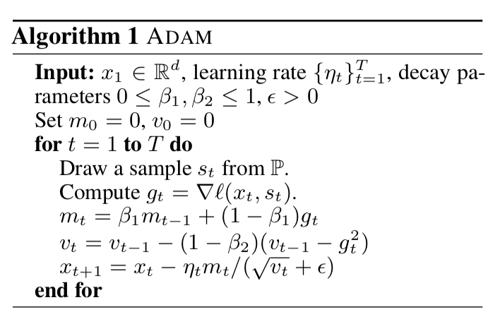
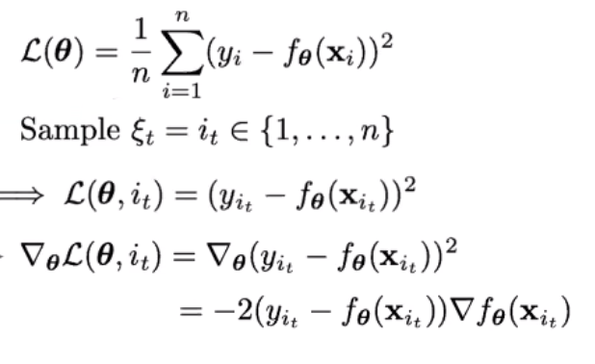

Adaptive Methods for Nonconvex Optimization
remember:
Q: How to prove Adam algorithm convergent under stochastic batch update and non-convex settings?
A: To study the change of loss over consecutive iterations, under paramter conditions as minibatch size increase:

Slide 38
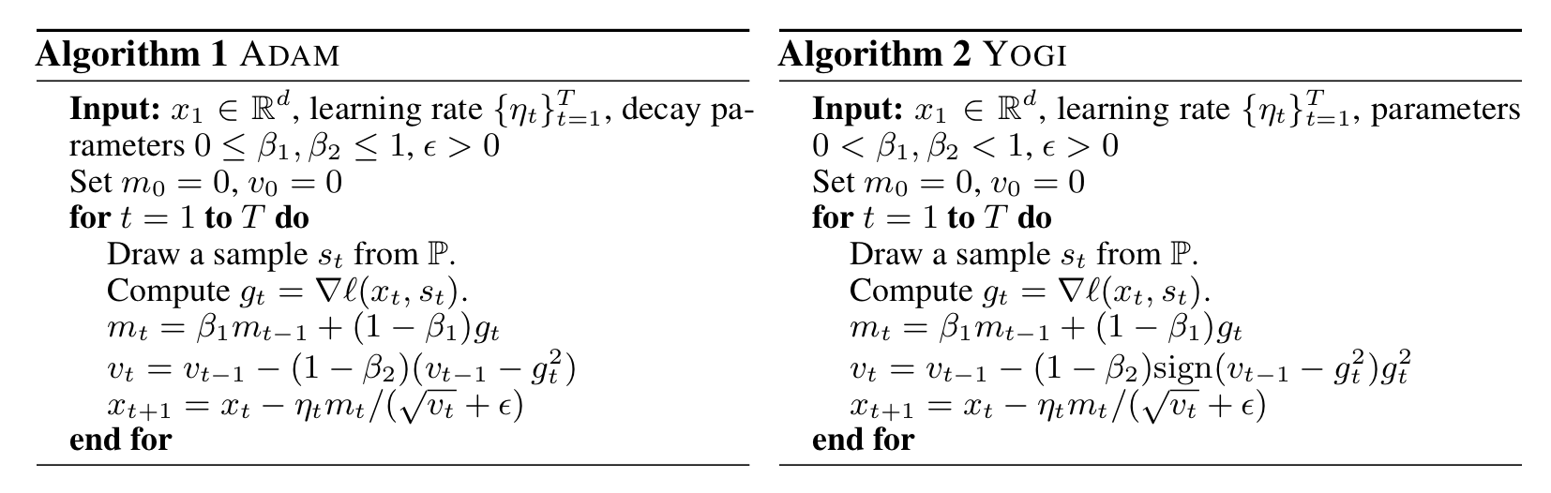
Adaptive Methods for Nonconvex Optimization

Slide 39
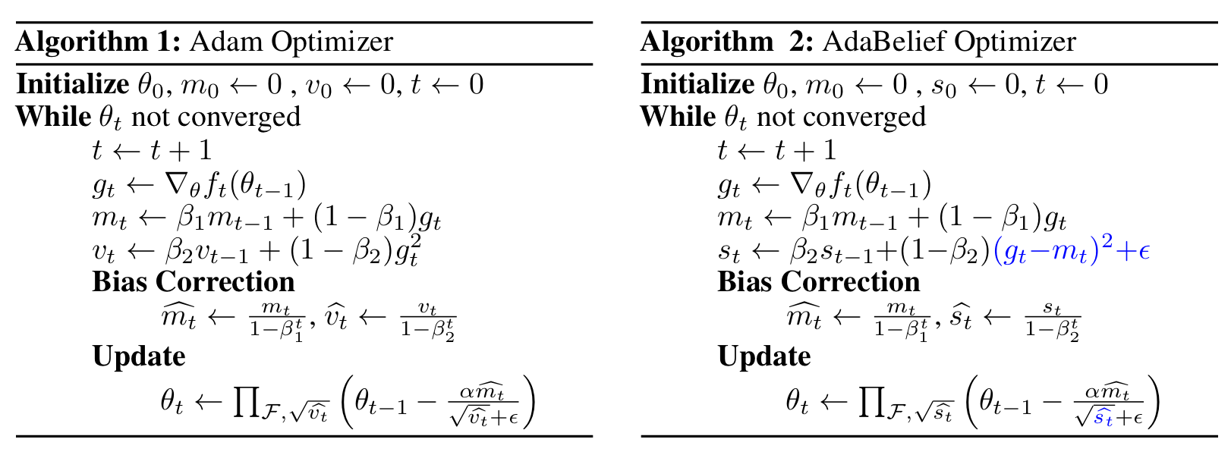
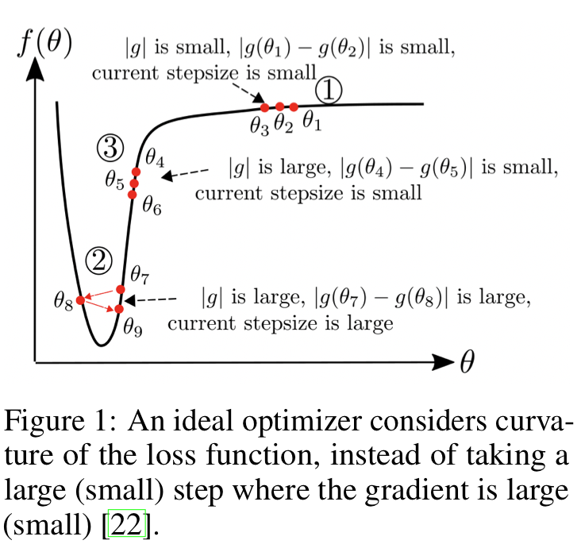
AdaBelief optimizer: Adapting Setpsizes by the Belief Observed Gradients(NIPS 2020)
Code: https://github.com/juntang-zhuang/Adabelief-Optimizer
Considering the curvature of the loss function

