Slide 1
MPI Final Project:
Forward Error Correction in Practice
Group 4

Slide 2
Outline
Problem Definition
Architecture
Input / Output
Encoder
Decoder
Computation Complexity
Communication Complexity
Team Members
(expected) Speed-up & Efficiency

Slide 3
Problem Definition
Forward Error Correction(FEC) is a technique used to make data communication and storage more reliable. It adds extra bits to the data stream, allowing the receiver to detect and correct errors without needing to resend the data.
In this practice, we focus on the standard array method of encoding and decoding data using FEC code, which requires a lot of matrix calculations.
MPI can be used to efficiently perform parallel matrix calculations, speeding up the processing of large matrices and using multiple processors working together.
Notes:
FEC 是透過對原本要傳遞的 data 編碼(加入一些冗余的字段)來提供接收方解碼後可以直接進行錯誤更正的技術，這種編碼及解碼的演算法我們稱作 FEC code。
FEC code 有很多種，實作中我們聚焦在需要大量矩陣運算的編碼及解碼的方式。並利用 MPI 的技術來加速矩陣運算的過程。

Slide 4
Architecture
We refer to the FEC Framework mentioned in the RFC 6363.
Application: Binary Data delivery over UDP (typical socket programming).
Manager/Worker model:
Sender side(sender as manager)
Receiver side(receiver as manager)
MPI Functions we are going to use:
MPI_Bcast()
MPI_Scatter()
MPI_Gather()
Sender
Receiver
Application Data
Application Data
Encoder
Decoder
Layer 4
Layer 4
Layer 3
Layer 3

Slide 5
Parity Check H, Table
Architecture
Sender
Receiver
Original Data
Corrected Data
Sliced Data
Reconstructed Data
16-bit
4*4 Matrix
16-bit
4*4 Matrix
Encoder
Decoder
28-bit
4*7 Matrix
28-bit
4*7 Matrix
Encoded Data
Transmission by Socket
Received Data
Notes:
Cyclic Code(7,4)
int* encoder(int* org_data, int len, int* G);
return *enc_data;
int* decoder(int* rec_data, int len, int* H);
return

Slide 6
Encoder
Notes:
!1!@

Slide 7
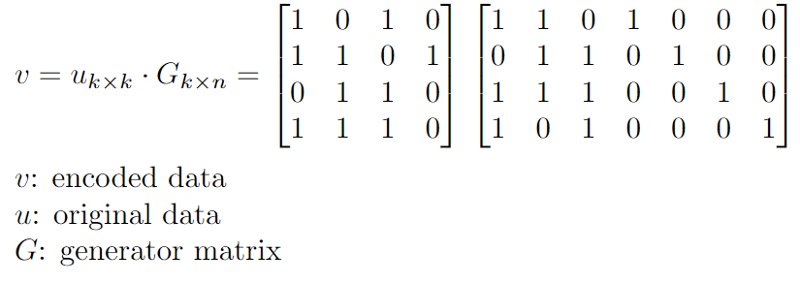
Input / Output - Encoder
Sender side(sender as manager):
Manager split the application data into blocks(u) and scatter them to all workers.
Manager broadcast the generator matrix(G) to all workers.
Workers use their own part of the generator matrix(perhaps one or more columns) to encode the data.
The encoded data(v) will be gathered back to the manager and sent to the receiver.

Slide 8
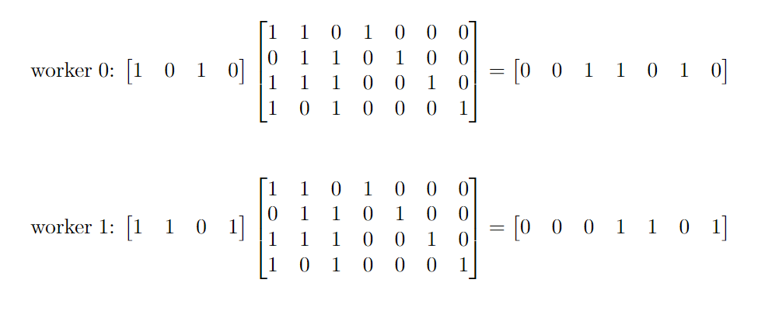
Encoder - take (7, 4) hamming code as an example
Notes:
In a (n, k) systematic code, there would be a k*n generator matrix, only (n-k) columns need to be calculated.

Slide 9
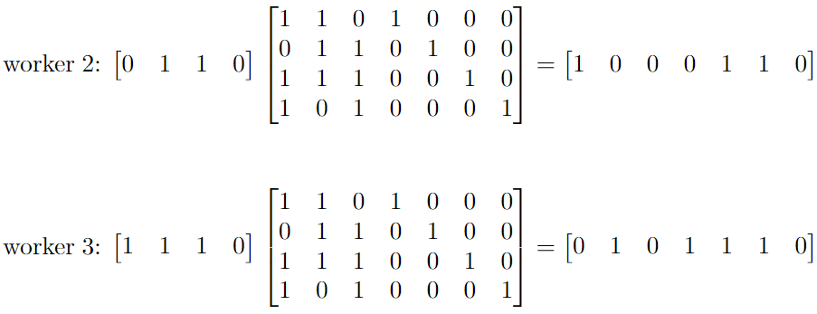
Encoder - take (7, 4) hamming code as an example
Notes:
In a (n, k) systematic code, there would be a k*n generator matrix, only (n-k) columns need to be calculated.

Slide 10
Decoder

Slide 11
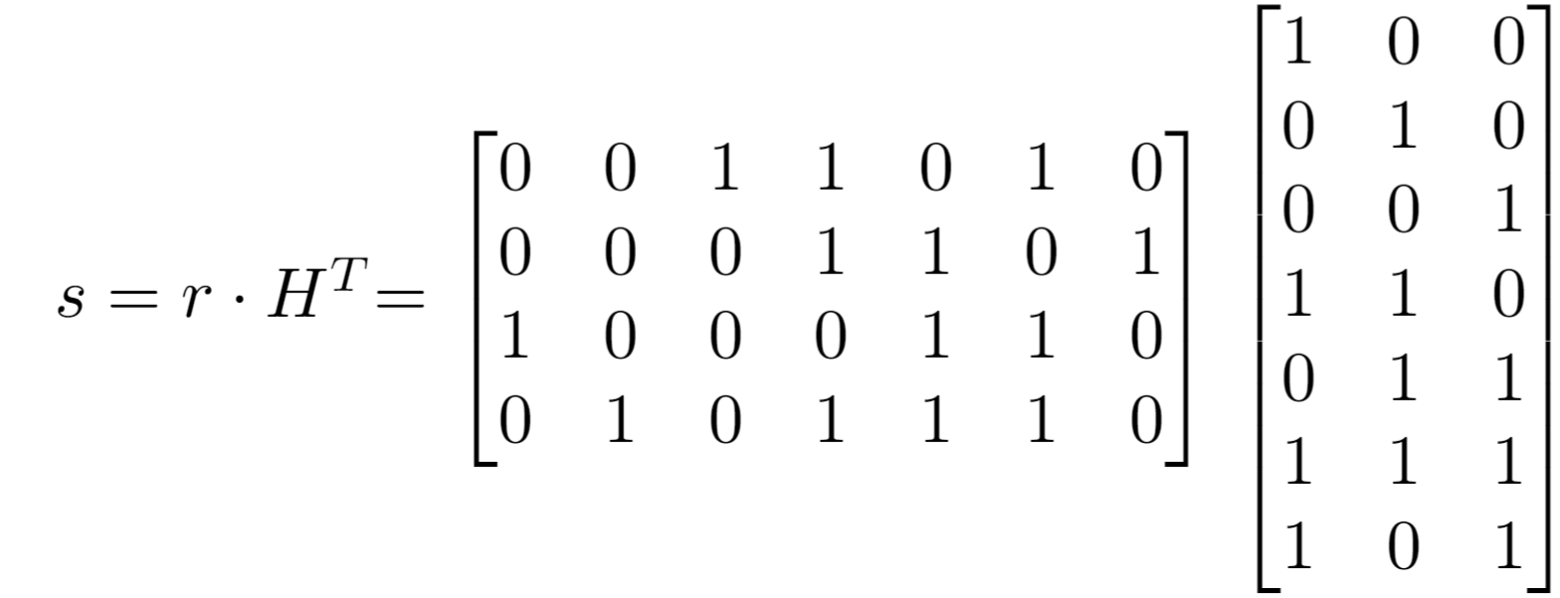
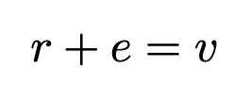
Input / Output - Encoder
Receiver side(receiver as manager):
Manager broadcast the received data(r) to all workers.
Manager scatter the parity-check matrix(H) to all workers.
Workers use their own part of the parity-check matrix(perhaps one or more columns) to calculate the syndrome.
The syndrome(s) will be gathered back to the manager, then manager will get the error pattern(e) of corresponding syndrome.
Manager add the error pattern to the received data to get the original data.

Slide 12
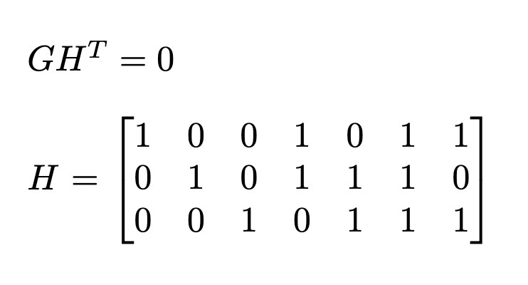
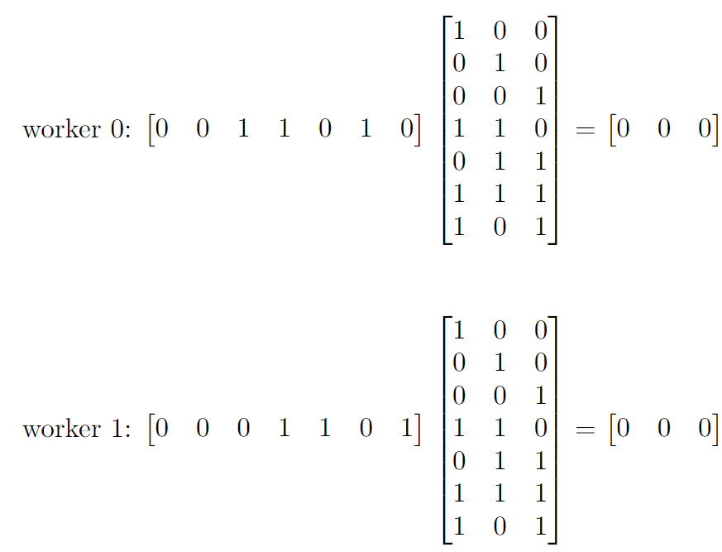
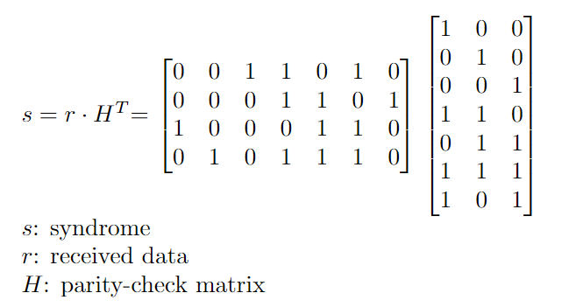
Decoder - take (7, 4) hamming code as an example
Notes:
0 0 1 1 0 1 0
0 0 0 1 1 0 1
1 0 0 0 1 1 0
0 1 0 1 1 1 0
1 0 0
0 1 0
0 0 1
1 1 0
0 1 1
1 1 1
1 0 1

Slide 13
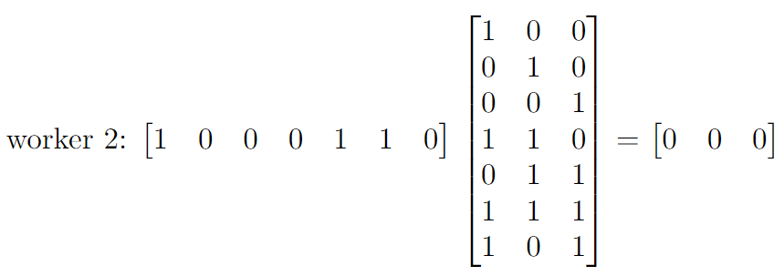
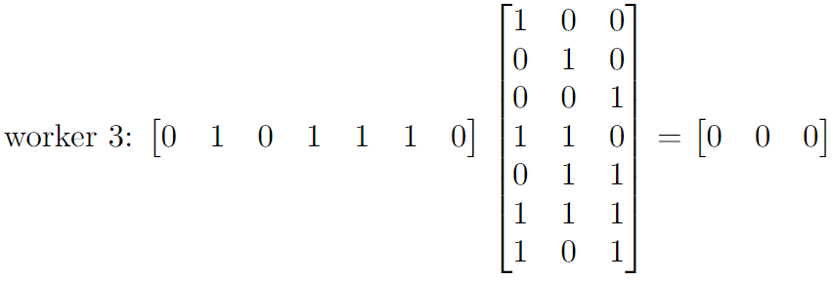
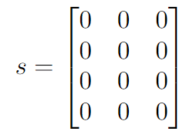
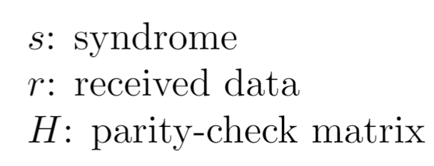
Decoder - take (7, 4) hamming code as an example

Slide 14
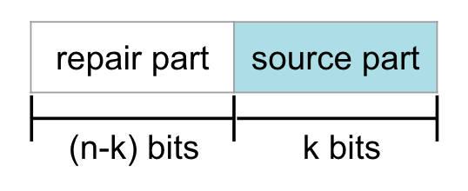
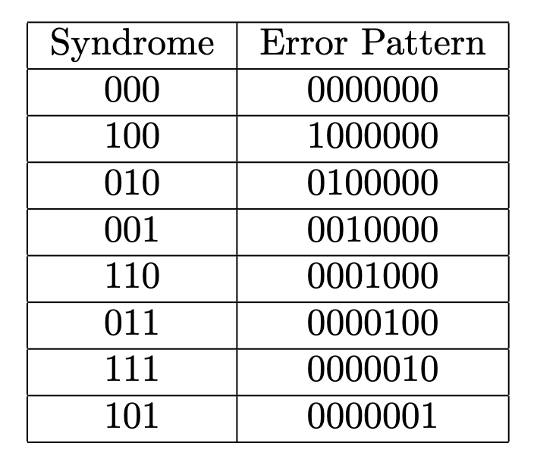
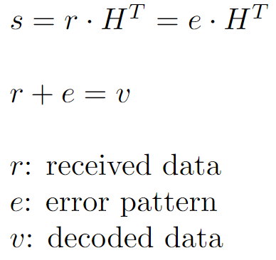
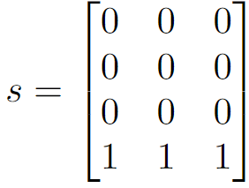

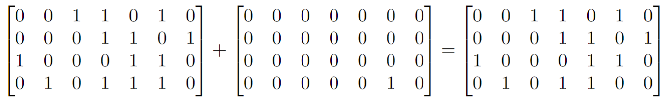
Syndrome - take (7, 4) hamming code as example

Slide 15
Computation Complexity

Slide 16
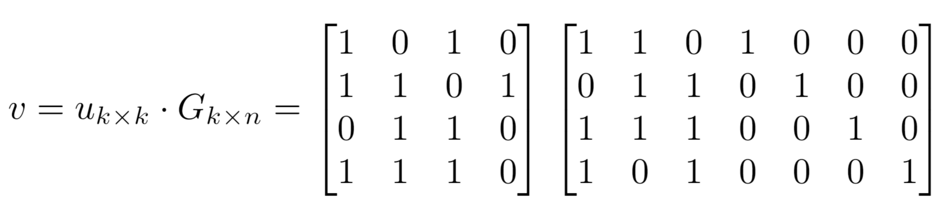

Computation Complexity - Encoder
Each row of G multiplies 𝑢: 𝑘 multiplications and 𝑘-1 additions.
Totally 𝑛-𝑘 columns.
Total number of operations: (𝑛-𝑘) * (𝑘 + 𝑘 -1) = 2𝑛𝑘 – 𝑛 + 𝑘 - 2𝑘²
n = 7
k = 4
⇒ 𝑂(𝑚𝑛)
Matrix 𝑢 ∈ ℝ and Matrix G ∈ ℝ
Notes:
(𝑛-𝑘) * (2k-1) = 2nk-n-2k^2+k

Slide 17
Computation Complexity - Decoder
Each row of G multiplies 𝑢: 𝑛 multiplications and 𝑛-1 additions.
Totally 𝑛 columns.
Total number of operations: 𝑛 * (𝑛 + 𝑛 - 1) =2𝑛² - 𝑛
n = 7
k = 4
⇒ 𝑂(𝑚𝑛)
Matrix 𝑟 ∈ ℝ and Matrix 𝐻 ∈ ℝ

Slide 18
Communication Complexity

Slide 19
Parity Check H, Table
Architecture
Sender
Receiver
Original Data
Corrected Data
Sliced Data
Reconstructed Data
16-bit
4*4 Matrix
16-bit
4*4 Matrix
Encoder
Decoder
28-bit
4*7 Matrix
28-bit
4*7 Matrix
Encoded Data
Transmission by Socket
Received Data
Notes:
Cyclic Code(7,4)
int* encoder(int* org_data, int len, int* G);
return *enc_data;
int* decoder(int* rec_data, int len, int* H);
return

Slide 20
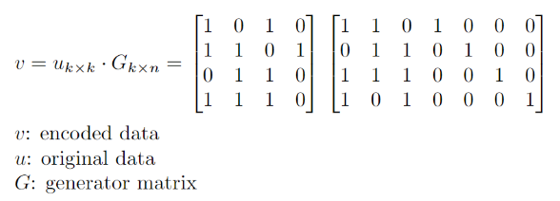
Communication Complexity
• Broadcasting G: k * n
• Send a row of u: k
• Send the dot product of the row and G back to the manager: 1
• Totally k rows.
• Total number of floating-point numbers to be communicated:
(k * n) + k*(k + 1) = k² + nk + k

Slide 21
Team Members
111321512 劉怡君：FEC Encoder & Decoder.
111321511 田蕙瑜：FEC Decorder API + PPT
109321053 繆亭霄：Socket Programming Function
109321050 紀見如：Application Data Slicing

