Slide 1
Formal Verification Project Implementation and Verification of CNN
Advisor: Prof. Yean-Ru Chen
Member:
N26081385 | Chih-Cheng Ting
N26081424 | Hang Chen
N26081482 | Yu-Ting Huang
N26081505 | Chi-Kai Wang
N26084749 | Sih-Han Chen

Slide 2
Outline
Design Specification
Data Flow
Convolution
Fully Connected
Simulation

Slide 3
Design specifications
Input Layer
Conv Layer
Max-pooling Layer
Conv Layer
Max-pooling Layer
Fully Connected Layer
Fully Connected Layer
Output Layer

Slide 4
Design specifications (cont’d)
Input size： 28*28 grayscale image (MNIST dataset)
Output Layer： 10 classes
Convolution Layer 1 with 20 5*5 kernel
Max-pooling Layer 1 with 20 2*2 kernel
Convolution Layer 2 with 50 5*5 kernel
Max-pooling Layer 2 with 50 2*2 kernel
Fully connected Layer with 500 neurons

Slide 5
Data flow (Convolution)

Slide 6
Data flow (Convolution)(cont’d)
When (conv_start or conv1_done)
receive original image from sram_rdata_a (for conv1)
receive data after conv1 from sram_rdata_b (for conv2)
receive weight (for convolution filters)
module “reg” use box_sel signal to select data from sram_rdata_a. b as src_window
import src_window into module “conv & pooling” for convolution and max pooling
import ori_data into module “quantize” for
normalization (32 bits to 8 bits)
ReLU
store quantized_data into
sram_data_b (for conv2)
sram_data_d (for fully connected)

Slide 7
Data flow (Convolution)(cont’d)

Slide 8
Data flow (Convolution)(cont’d)
convolution
max pooling

Slide 9
Data flow (Fully Connected)
src_window
unquantized_data[22:0]
quantized_data[7:0]
fc_quantize
When (conv_done)
receive data after convolution from sram_rdata_d (for FC_1)
receive data after first FC from sram_rdata_e (for FC_2)
fc_data_reg combine data from sram_rdata_d. e as src_window
import src_window into fc_multiplier_accumulator for muliply and add operation
import data_out into fc_quantize for
ReLU (for FC_1)
normalization (for FC_2)
store quantized_data into
sram_data_e (for FC_2)
sram_data_f (for output)
src_window

Slide 10
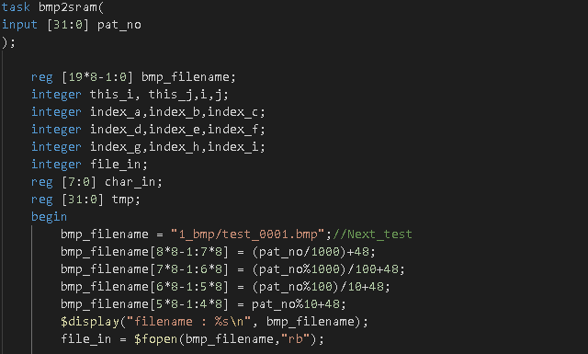
Simulation
Platform: Cadence NCverilog
在這裡加入您的文字
Read file from dataset folder
Change the file name with ASCII code

Slide 11
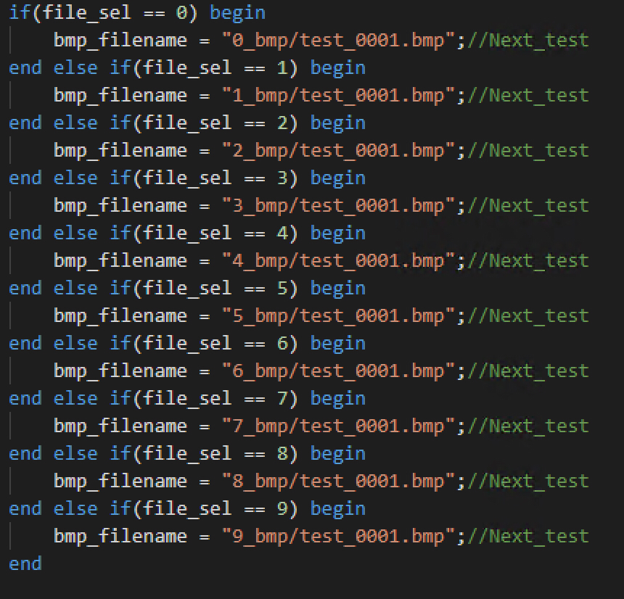
Simulation

Slide 12
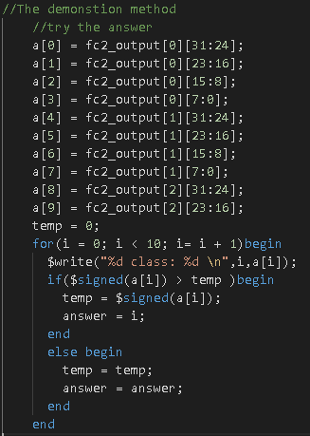
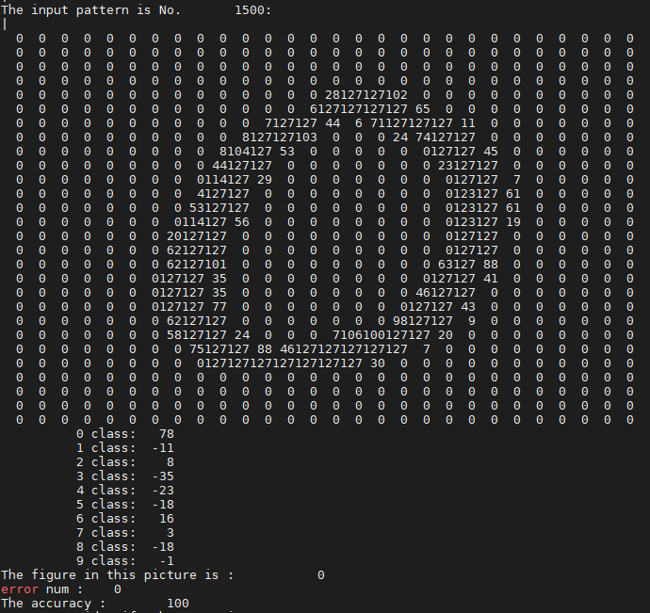
Simulation (cont’d)
Neural Network Output value (10 classes)
Find the max value of 10 classes (predict output)

Slide 13
Simulation (cont’d)

Slide 14
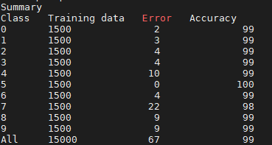
Simulation (summary)
Testing Data: 15000 images (each class 1500 images)
Number of predict error: 67
Accuracy: 99.55%

