Slide 1
Vga_rom_pic

Slide 2
Vga_rom_pic
In previous chapter, we have been introduced the VGA protocol, but the picture data is generate by the vga_pic module, in this chapter we will using rom to reading the stored picture data and shows on screen.
In this chapter, will using embedfire’s material to store the picture data to rom .

Slide 3

Objective
Revise the vga_color_bar rtl code, make screen show as below picture, the background is color bar, and the center shows 100*100 embedfire logo.
The resolution is 640*480@60Hz.

Slide 4
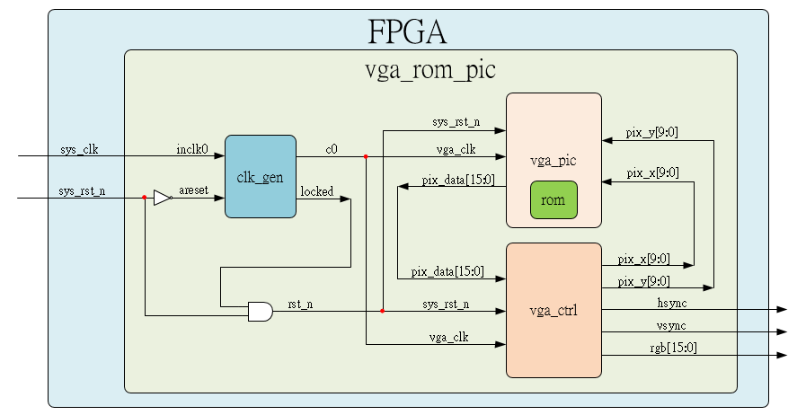
System

Slide 5
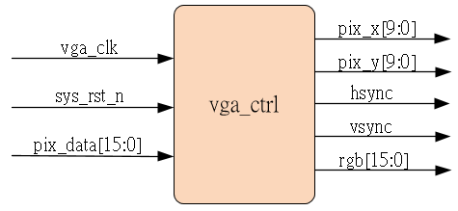
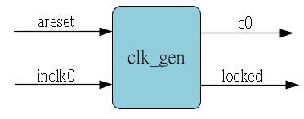
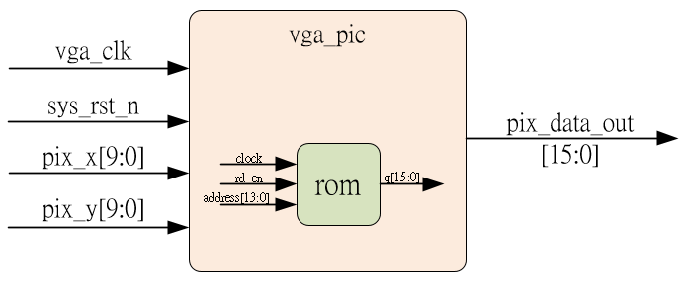
Sub-module
using previous
Ip_core
Inner rom is ip_core, initial by embedfire material

Slide 6
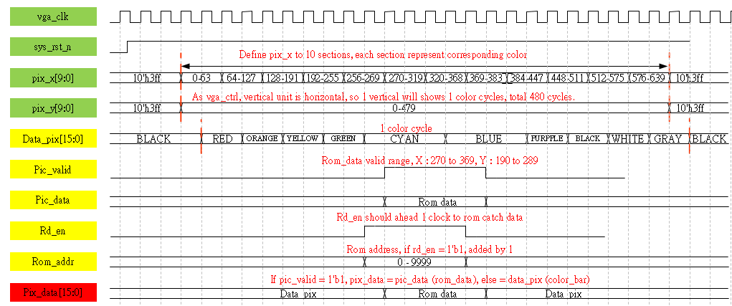
Waveform Graph – vga_pic
Revise the vga_color_bar waveform

Slide 7
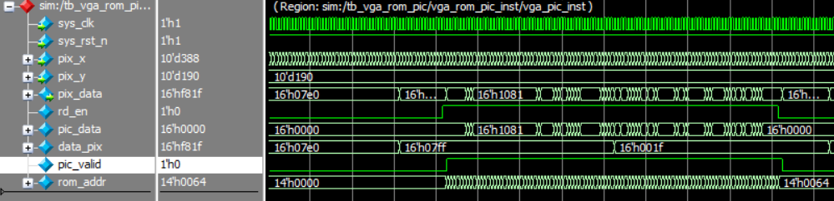
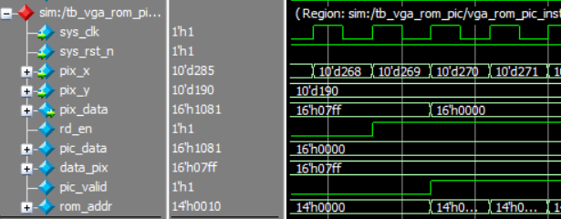
Simulation-vga_pic_1
The rd_en raise in pix_x = 10’d269, OK.
The pic_valid raise in pix_x = 10’d270, OK.
During pic_valid raised, the pix_data = pic_data, else = data_pix, OK.

Slide 8
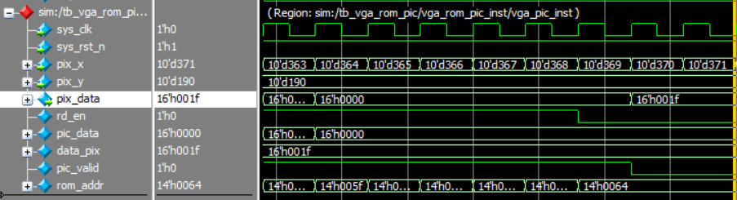
Simulation-vga_pic_2
The rd_en fall in pix_x = 10’d368, OK.
The pic_valid fall in pix_x = 10’d369, OK.
During pic_valid raised, the pix_data = pic_data, else = data_pix, OK.

