Slide 1
Vga_rom_pic_jump

Slide 2
Vga_rom_pic_jump
In previous chapter, we have been generate the vga_rom_pic module, but the picture is fix on screen center, in this chapter we want to revise the module to make picture can jump on screen, as below picture shows.(moving to edge then move to opposite direction)
1
2
picture
moving
moving
picture
3
4
moving
picture
picture
moving

Slide 3

Objective
Revise the vga_rom_pic rtl code, make screen show as below picture, and picture can be jump on screen, the background is color bar, and the center shows 100*100 embedfire logo.
The resolution is 640*480@60Hz.

Slide 4
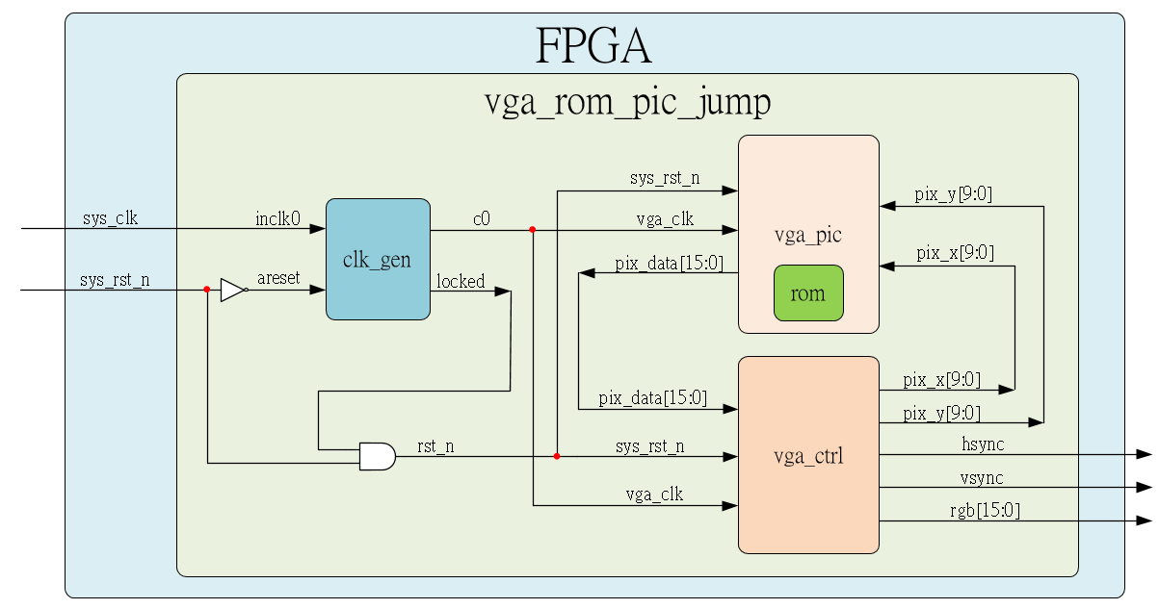
System

Slide 5
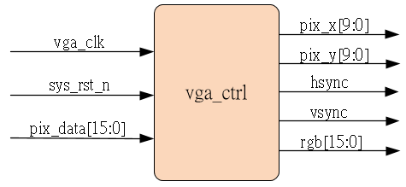
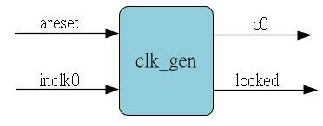
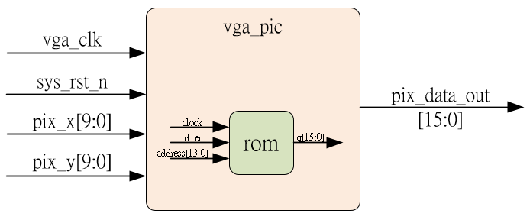
Sub-module
using previous
Ip_core
Revise the previous vga_pic module

Slide 6
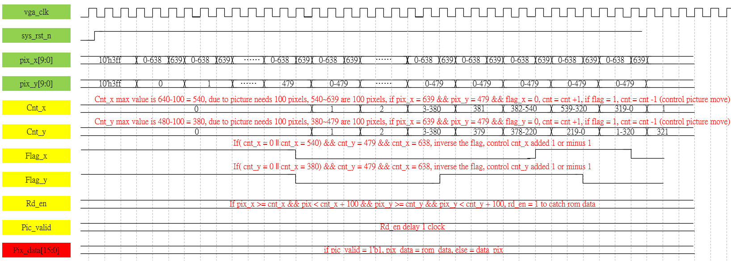
Waveform Graph – vga_pic
Revise the vga_rom_pic waveform, the variable data_pix and pic_data is same

Slide 7
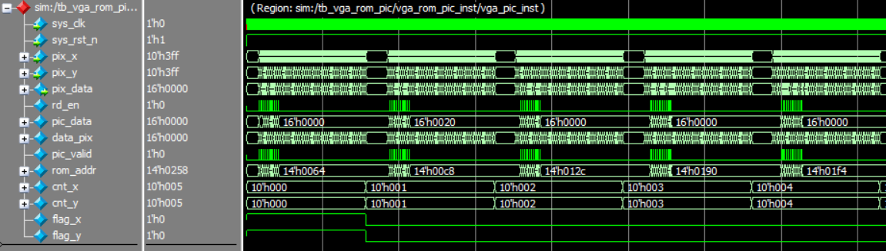
Simulation-vga_pic_1
We can observe the first cycle, cnt_x & cnt_y is 0, and each cycle cnt_x & cnt_y add 1 when flag is 1’b0. (parameter have been modified for easy to observe, detail refer to sim code)

Slide 8
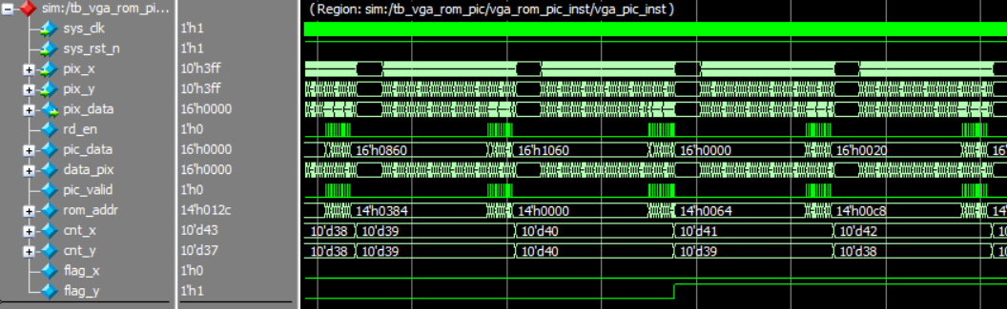
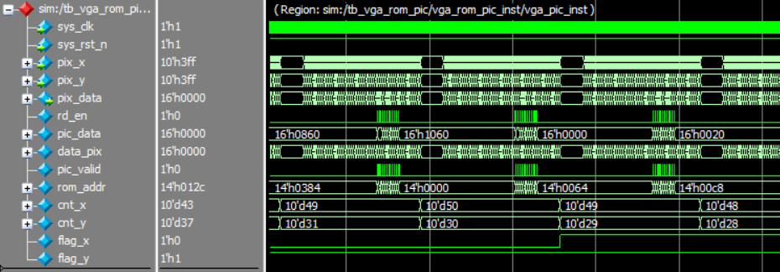
Simulation-vga_pic_2
Due to jump key point are cnt & flag, other variable not check in this chapter
When flag became 1’b1, cnt minus 1.

