Slide 1
Spi_flash_pp

Slide 2
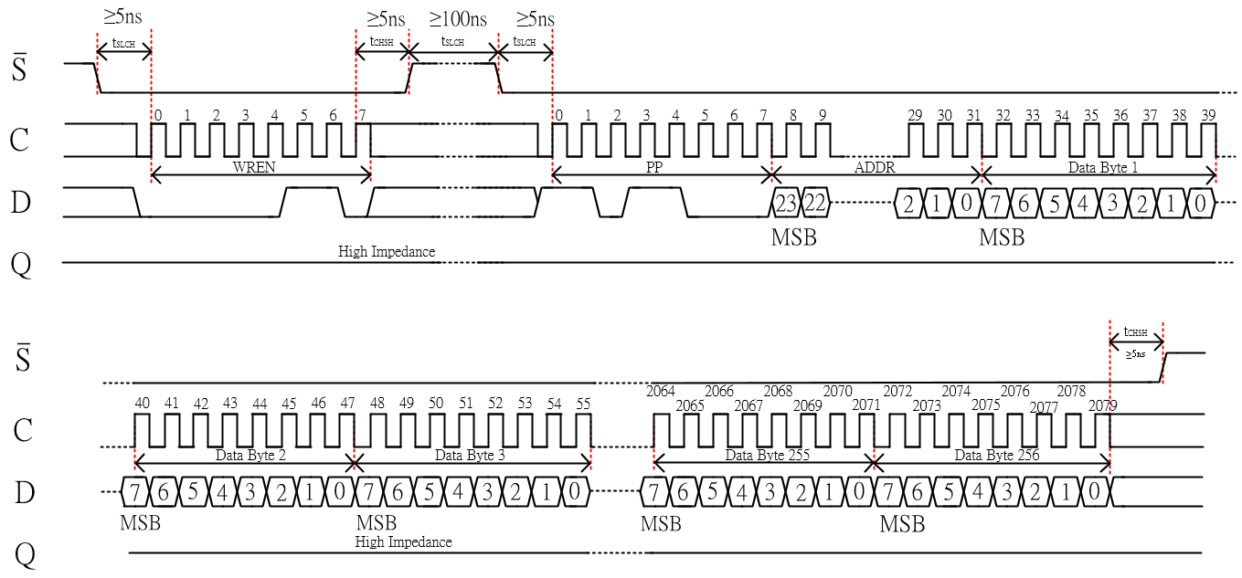
SPI_PP
In this chapter, we will using PP, Page Program command to write the data to flash, and PP need WR_EN command executed first also.
Refer to datasheet, we know the 1 page can store 256 bytes data, if we want to write the data, we need to give the start address then give the data as below picture, detail refer to datasheet.

Slide 3
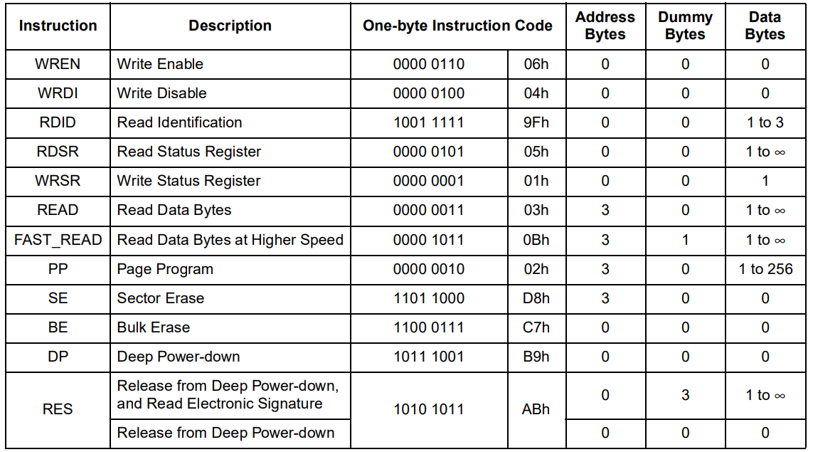
Objective
If push the key button then WR_EN & PP command will implement, and writing data number is 100.
The parameter, CPOP = 0, CPHA = 0.
PP command as below table.

Slide 4
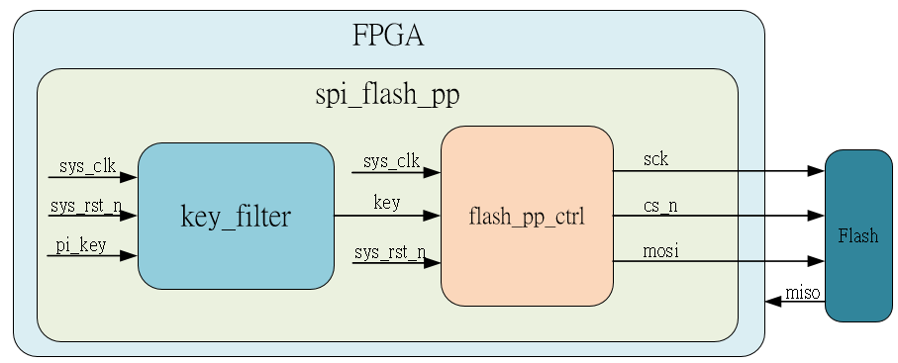
System

Slide 5
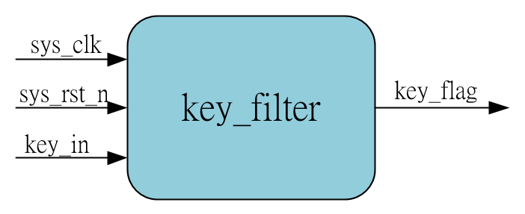
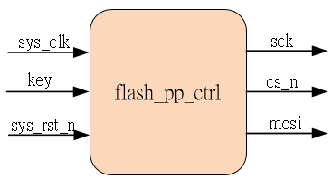
Sub-module
using previous
Inner fifo is ip_core

Slide 6
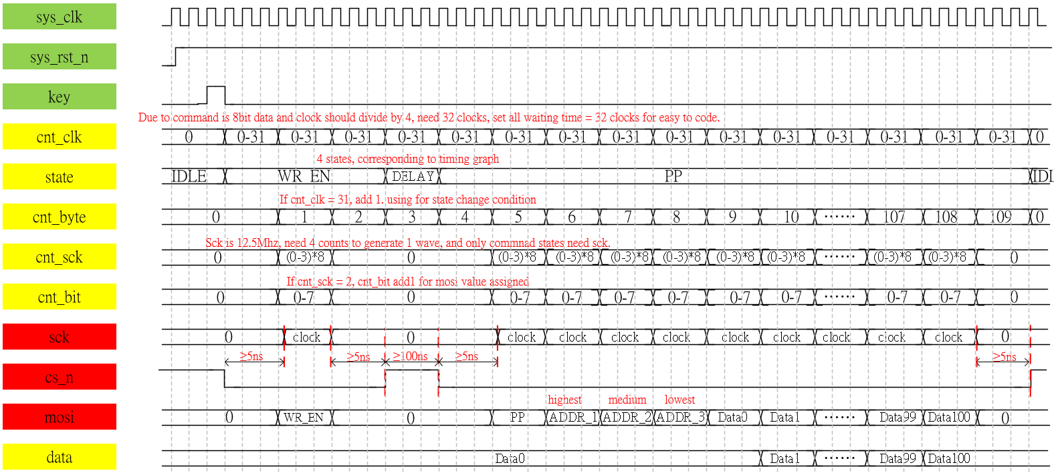
Waveform Graph – spi_flash__pp_ctrl
Due to PP command is similar to SE command, revise the SE module to get PP module

Slide 7
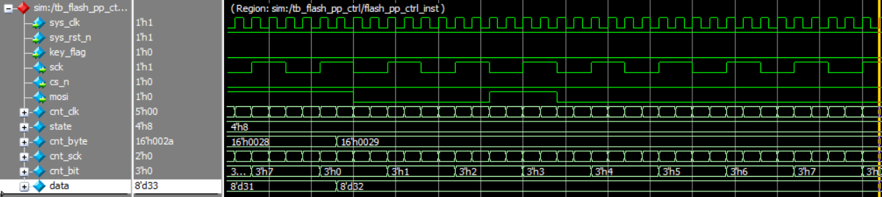
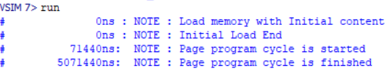
Simulation-spi_flash_pp_ctrl
0
0
1
0
0
0
0
0
According to transcript, we know the pp command is complete correctly, and the mosi in above picture is same as data 8’d32 which we generated.

