Slide 1
Spi_flash_seq_wr

Slide 2
SPI_seq_wr
In previous chapter, we using the PP command to write the data to flash memory, but if you read the data sheet, you would know the if writing data more than 256 bytes, the data will be overwrite and only write can in same page.
If we want to write more than 256 bytes and crossing the page, we should revise the PP module a little, make it write continuously.
For example, we can using rs232 to sending pi_data & pi_flag to FPGA, if FPGA receive the data and flag, doing 1 PP command, and update the address after PP command.

Slide 3
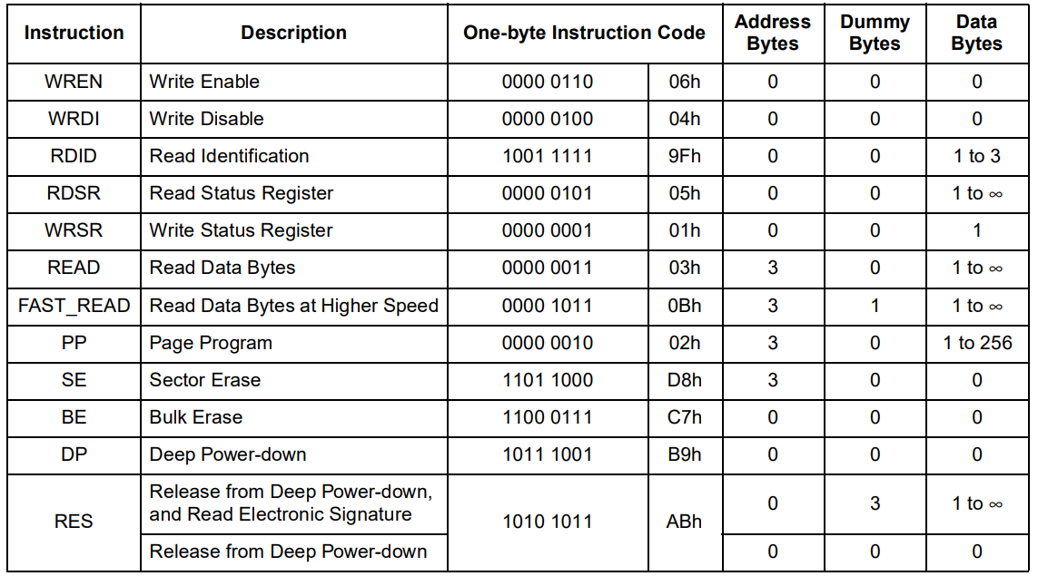
Objective
Using rs232 to transfer data & flag to FPGA, if receive data & flag, implement 1 WR_EN + PP command, after finished, address added 1 for next cycle using.
The parameter, CPOP = 0, CPHA = 0.
PP command as below table.

Slide 4
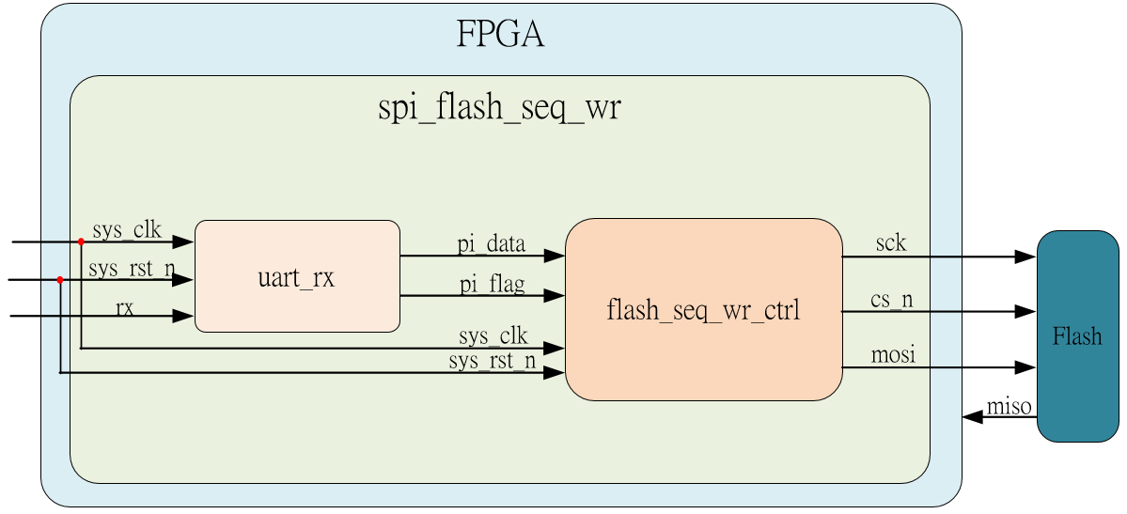
System

Slide 5
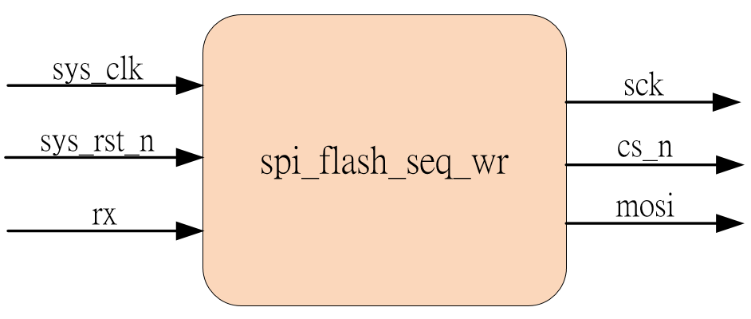
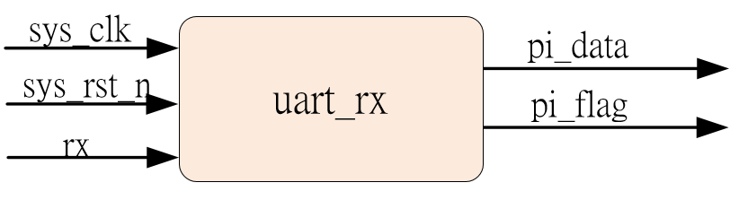
Sub-module
using previous
Inner fifo is ip_core

Slide 6
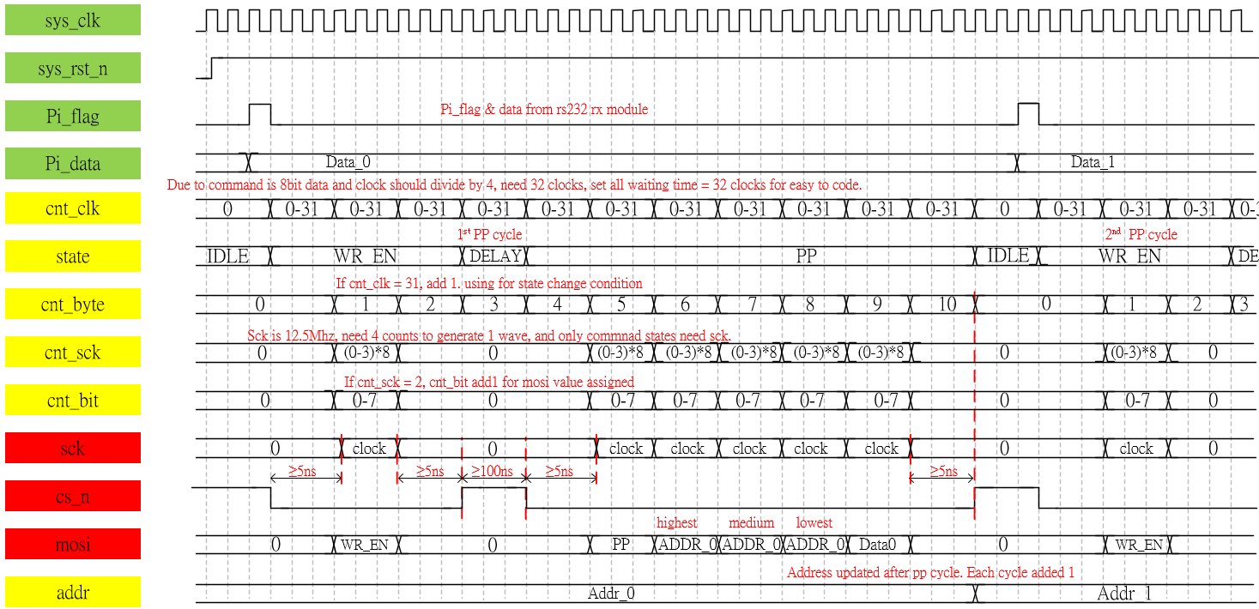
Waveform Graph – spi_flash__seq_wr_ctrl
Seq_wr is base on pp module, make little revise such as pi_flag & pi_data & address refresh.

Slide 7
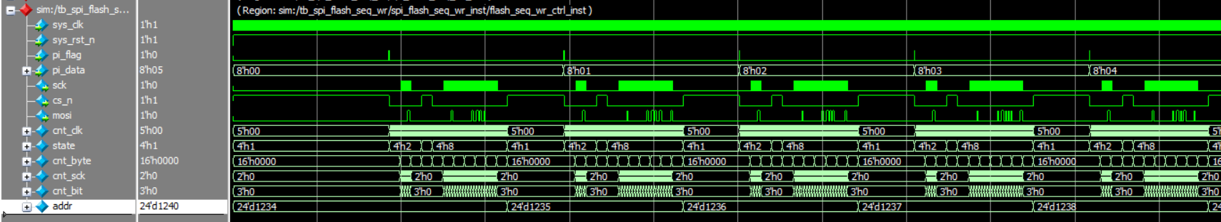
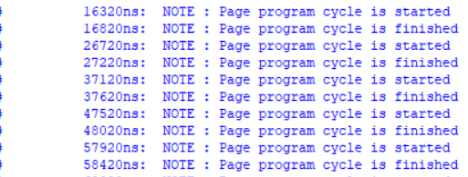
Simulation-spi_flash_seq_wr_ctrl
0
0
1
0
0
0
0
0
According to transcript, we know the pp command is complete correctly, and the address is added 1 after each cycle finished.

