Slide 1
Key_filter

Slide 2
Key_filter
When we pushing the key button, the signal will occur the vibration then become stable signal, and release also.
So we need to using the counter to judge the signal is stable when pushed the key button to prevent the device action false trigger.
If stable time is enough, key_flag will rise 1 clock.

Slide 3
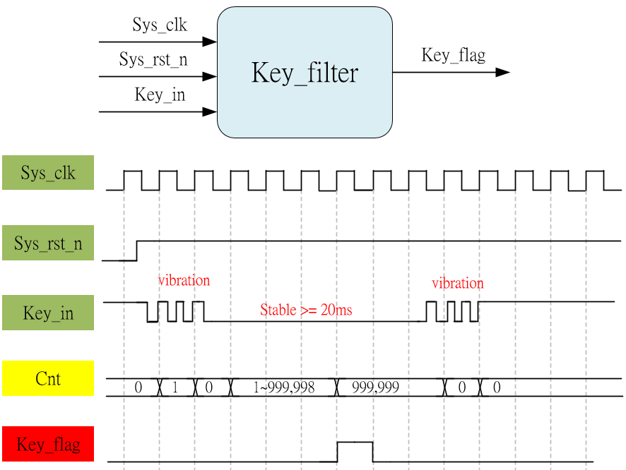
System & Waveform Graph

Slide 4
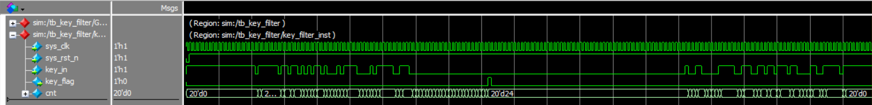
Waveform Graph - Simulation
Stable time enough
Vibration

