Slide 1
Flip_flop

Slide 2
Flip_flop
Flip_flop have 3 input like clock, sys_rst_n (reset) and data_in. And 1 output data_out.
In Verilog, using sequential logic will generate the flip_flop to store the data until clock rising (posedge) then flip_flop can be written and data released.
Sys_rst_n, in this chapter using the asynchronous, means when reset signal is falling (negedge) or low-level voltaga, flip_flop data will reset to default, reset doesn’t needs to wait the clock posedge.
Flip_flop
Data_in
Data_out
System_Clock
System_reset_n

Slide 3
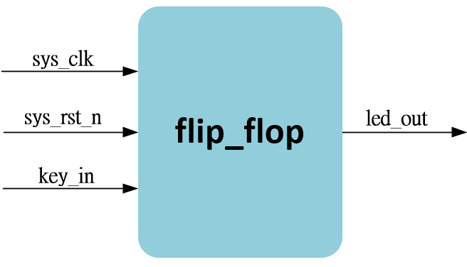
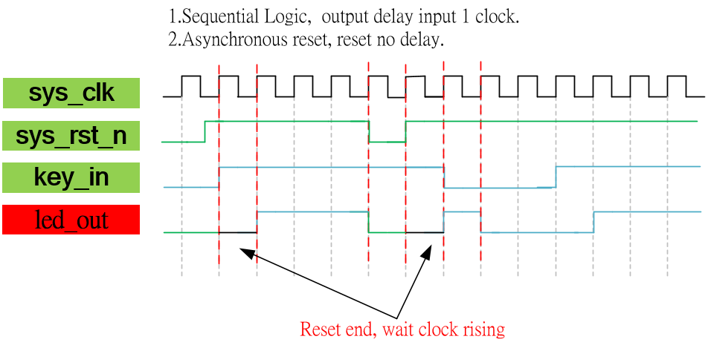
System & Waveform Graph

Slide 4
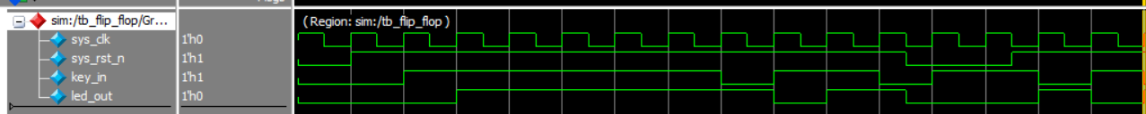
Waveform Graph - Simulation

