Slide 1
Divider_six

Slide 2
Divider_six
We know the counter is the count of clock, if we using counter can generate the the frequency divider.
For example, every 3 counts of sys_clk then reverse the clk_out signal can getting divider_six.

Slide 3
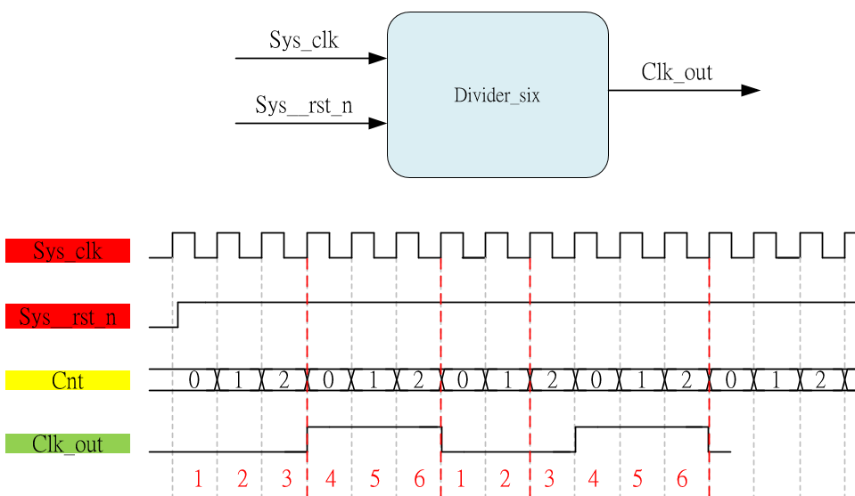
System & Waveform Graph

Slide 4
Waveform Graph - Simulation

