Slide 1
Divider_five

Slide 2
Divider_five
We know the counter is the count of clock, if we using counter can generate the the frequency divider.
In last chapter divider_six, we using every 3 counts of sys_clk reverse the clk_out to get the divider_six, but if we want to generate the divider_five, we can’t using 2.5 counts of sys_clk to generate.
So we need to using clk_posedge and clk_negedge to generate the divider_five.
And we also generate the clk_flag for syntax judgment.

Slide 3
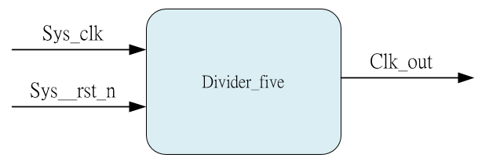
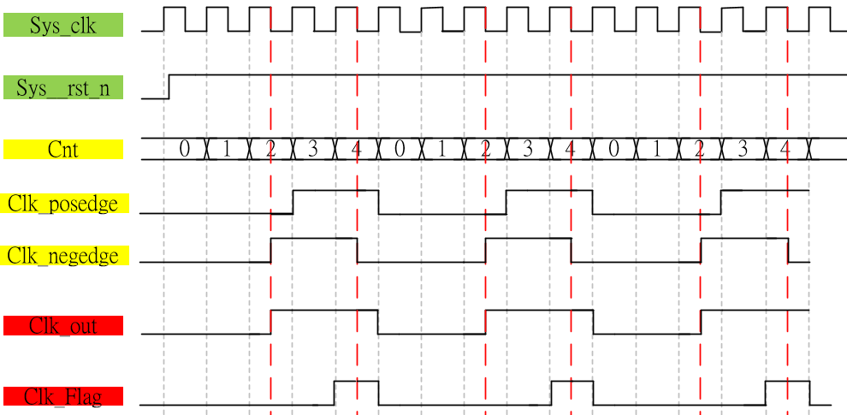
System & Waveform Graph

Slide 4
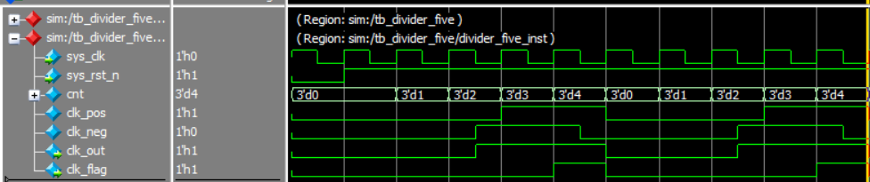
Waveform Graph - Simulation

