Slide 1
ip_core_fifo

Slide 2
fifo
FIFO (First In First Out),which can store the data and doing the clock domain crossing process.
In this FPGA, we need to provide the clock, data, wr_req and rd_req to writing and readind the data by fifo, it’s doesn’t need address.
We also using the quartus’s ip_core fifo in this chapter, the simple working principle as below picture.
FIFO, data transfer form 1 to 9 by sequence.
Write, need wr_req, data, wr_clk.
Read, need rd_req, rd_clk.
In
9
8
7
6
5
4
3
2
1
Out
In
9
8
7
6
5
4
3
2
1
Out
T8
T7
T6
T5
T4
T3
T2
T1
T0
T8
T7
T6
T5
T4
T3
T2
T1
T0

Slide 3
Objective
Using fifo to transfer 256 datas, and writing data speed is 20ns, after written, read the data out.
In this chapter, we introduce the synchronous clk and using the usedw, empty and full signal to check the function. Note: if want to try asynchronous clk between rd & wr, please refer to rtl code & sim test bench to observe the detail function.

Slide 4
System_synchronous
Empty: fifo doesn’t have data. Full: fifo full of data. (we using 256 num) q: read data out.
Usedw: how many data in fifo.

Slide 5
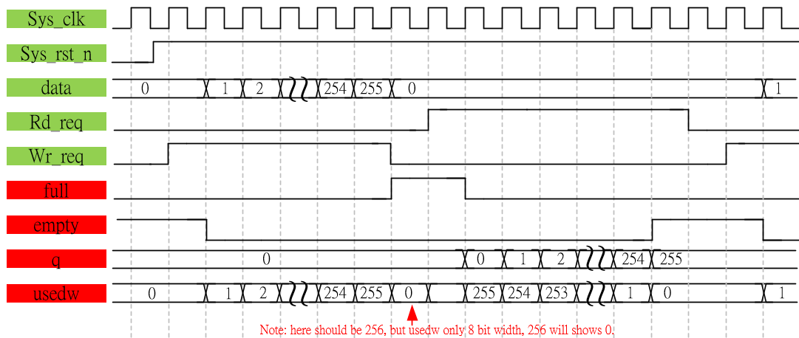
Waveform Graph_sychrounous

Slide 6
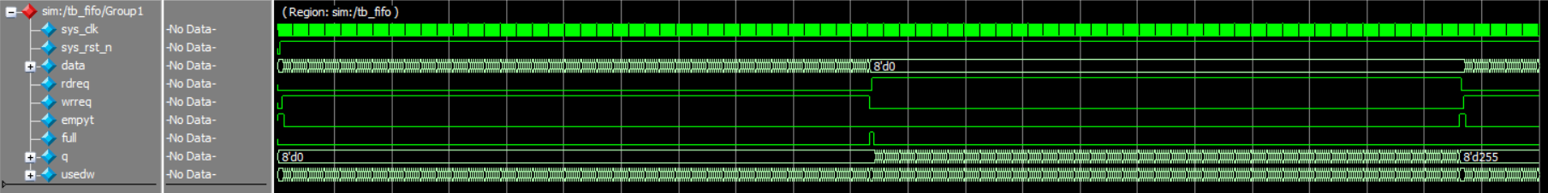
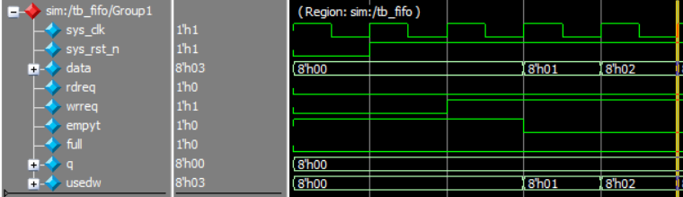
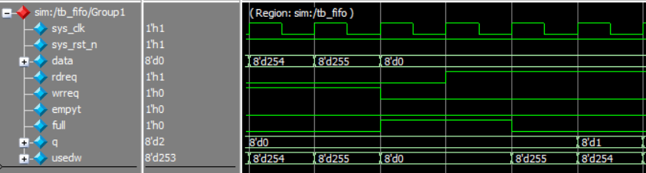
Simulation- synchronous_fifo- 1
begin
256 dada have been written to fifo

Slide 7
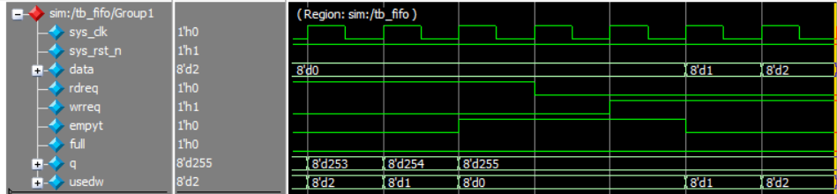
Simulation- synchronous_fifo- 2
256 dada have been read from fifo

