Slide 1
VGA_colorbar

Slide 2
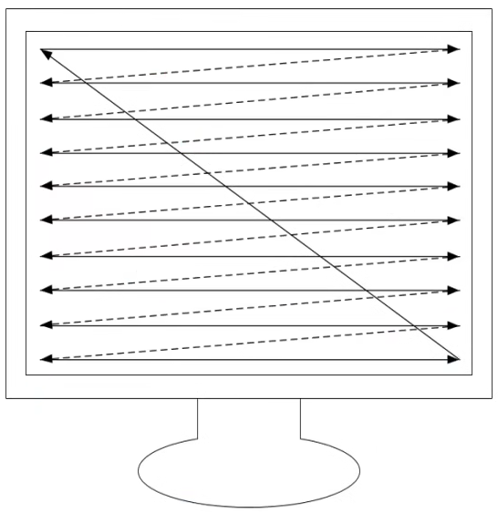
VGA
VGA (Video Graphics Array), which using analog signal to transfer data.
VGA using scanning method to display the video, using hsync (horizontal synchronous) and vsync (vertical synchronous) signal to scan the data to the displayer, the sequence is left to right and top to bottom,

Slide 3
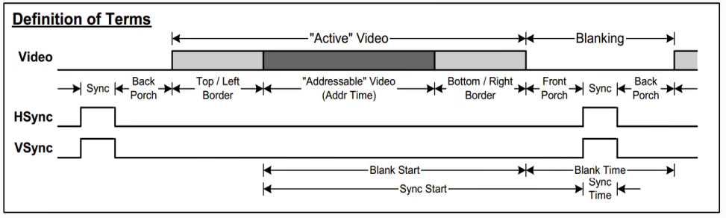
VGA – Timing-1
In this chapter, we will introduce the VGA timing base on VESA standard.
The VGA timing shows as below picture, the hsync and vsync timing is same, both have 6 steps, and the addressable video step is show the video on screen which we watch.
And the hsync and vsync base unit is different, hsync is base on pixel (clock), but vsync is base on horizontal.
Hsync, unit: pixel (1 clock)
Vsync, unit: horizontal (1 horizontal)

Slide 4
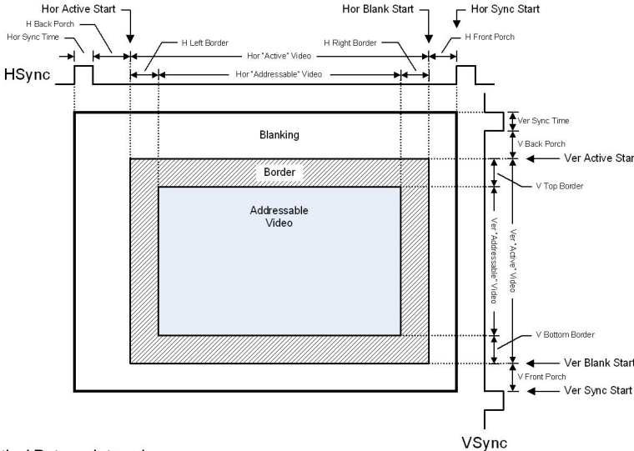
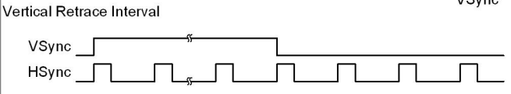
VGA – Timing-2
We can see the total frame timing as below picture.

Slide 5
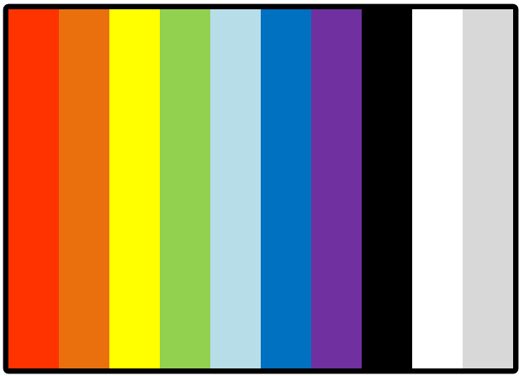
Objective
In this chapter, we want to using VGA to display the color bar on screen and resolution is 640x480, frequency is 60 Hz, refer to below table we knows the VGA_clk should be 25.175MHz and follow the parameter.
The display result as below picture.

Slide 6
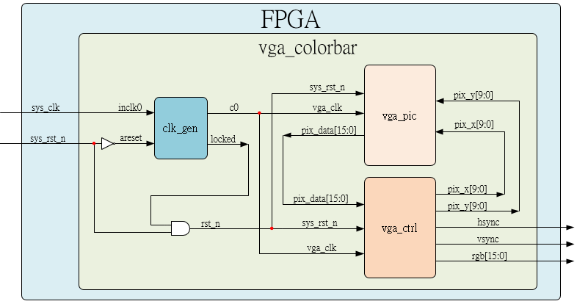
System

Slide 7
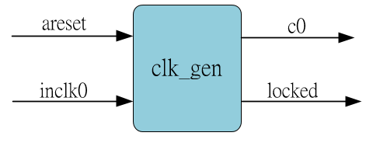
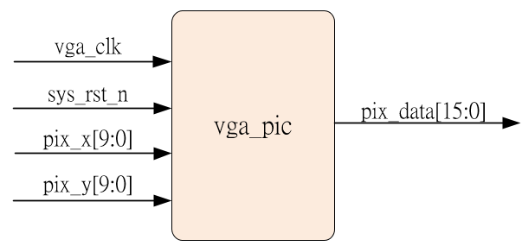
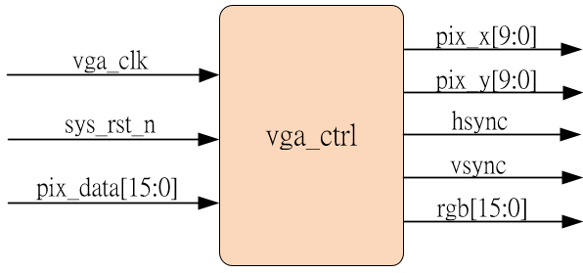
Sub-module
Ip_core
Generate hsync & vsync to device, and transger pix_x & pix_y to vga_pic to receive pix_data and output to device.
Receive vga_ctrl module pix_x & pix_y, then transfer corresponding pix_data out

Slide 8
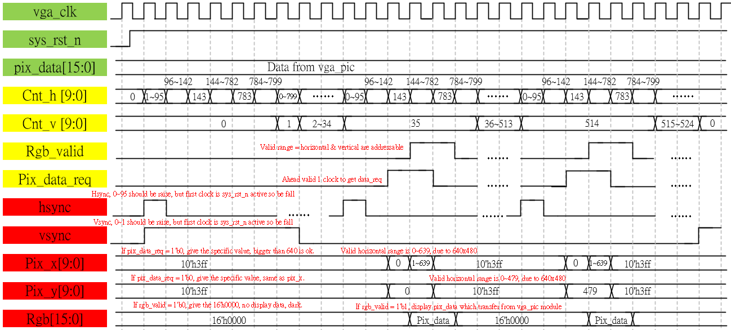
Waveform Graph – vga_ctrl

Slide 9
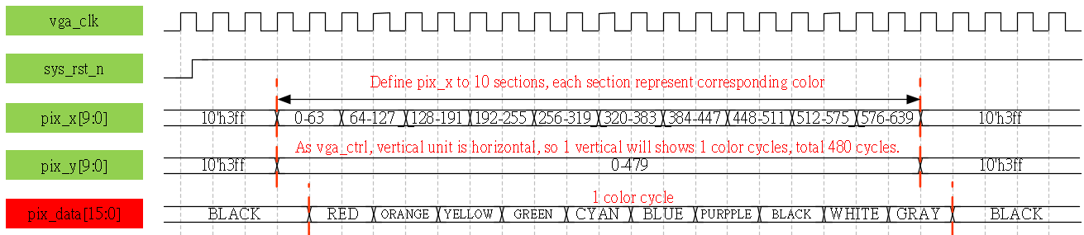
Waveform Graph – vga_pic

Slide 10
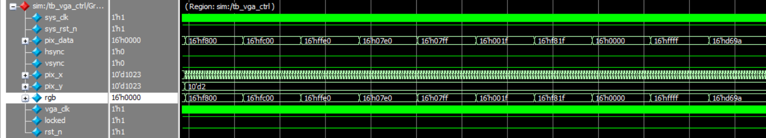
Simulation- vga_colorbar
Due to simulation range is too large, here only shows the result, rgb output is 10 colors, the detail as same as waveform.

