Slide 1
VGA_character

Slide 2
VGA_character
In previous chapter, we using VGA to shows the color bar, in this chapter we want to using VGA to shows the character.
This chapter using embedfire’s material to display the character, if you want to display other character can using the tool transfer character picture to hex file.
We knows the display resolution is 640x480, so if we want to display 256x64 character on the screen center, we need to using pix_x and pix_y to control display area.

Slide 3

Objective
In this chapter, we want to using VGA to display the character on screen and resolution is 640x480, frequency is 60 Hz, the character size is 256x64, need to display on screen center.
The display result as below picture.

Slide 4
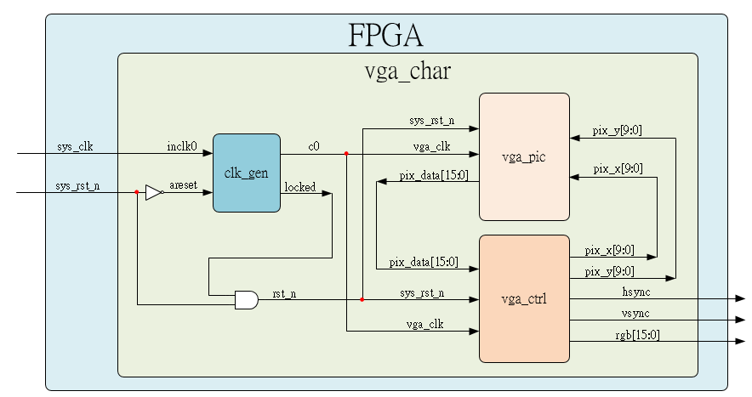
System

Slide 5
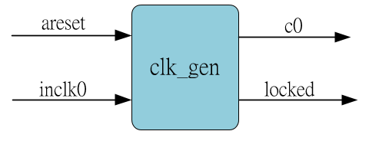
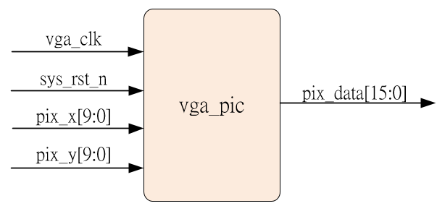
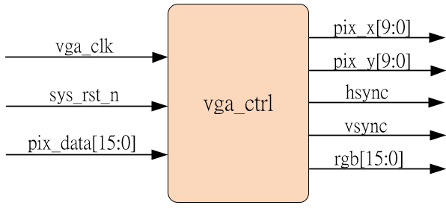
Sub-module
Ip_core
Revise the display data & area
Using previous

Slide 6
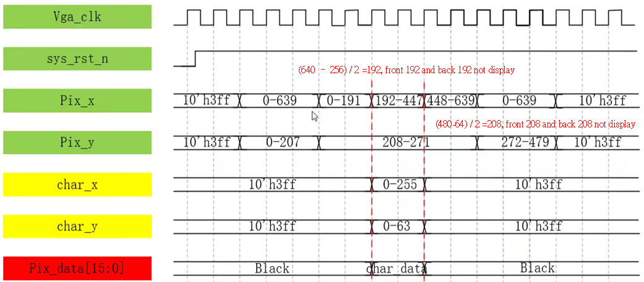
Waveform Graph – vga_pic

Slide 7
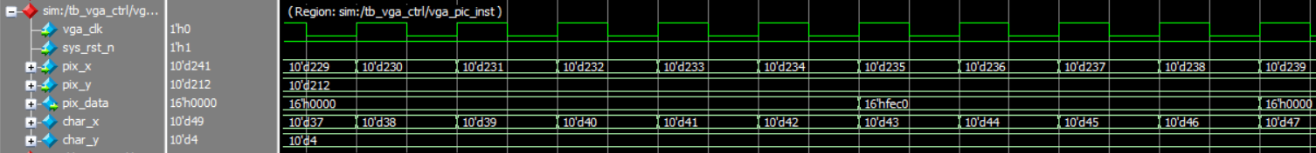
Simulation- vga_char
Due to simulation range is too large, here only shows revised code corresponding waveform.
Here 3C = 8’b00111100, and the position corresponding to char_y =4, char_x = 42 to 45, sequential logic so that pix_data delay 1 clock, it’s correct.

