Slide 1
RS232

Slide 2
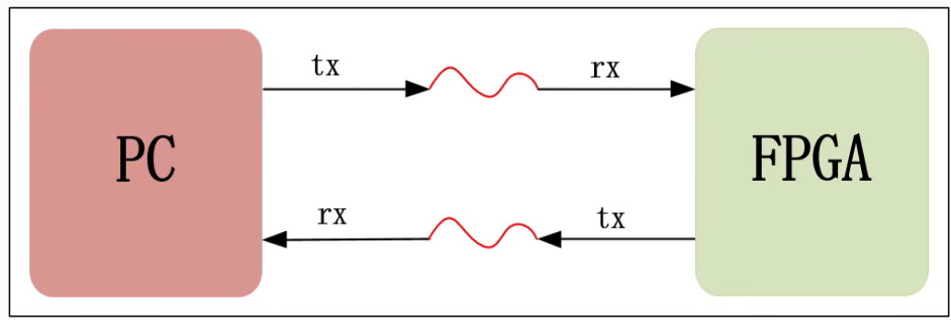
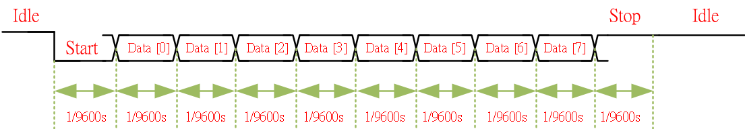
RS232
RS232 is belong to UART communication protocol, rx module receive serial in signal from device and transfer to parallel signal, final tx module serial out to device, and RS232 can receive and transfer data at the same time.
RS232 needs 10 steps to transfer & receive data, start, 8bit and stop steps.
In this chapter, we want to using rs232 to deliver data, and using baud rate is 9600, it means 1 bit need 1/9600 second to deliver.

Slide 3
Objective
In this chapter, we want to using RS232 to deliver data, and the baud rate is 9600.

Slide 4
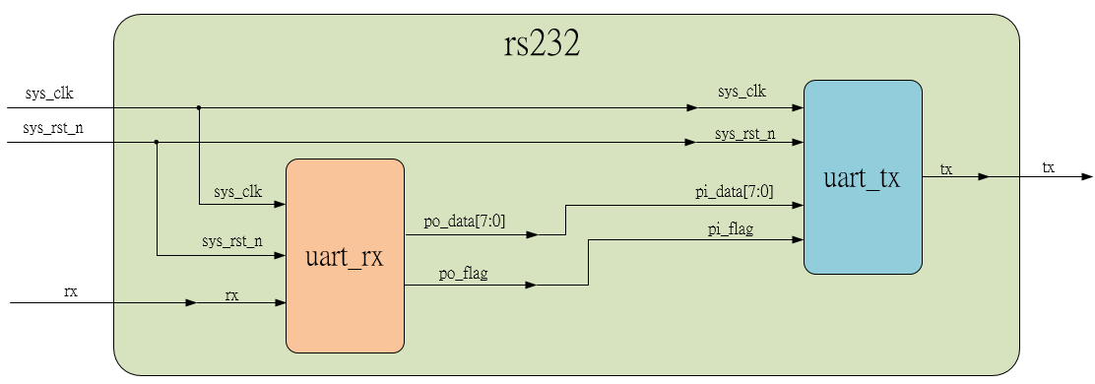
System

Slide 5
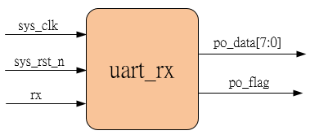
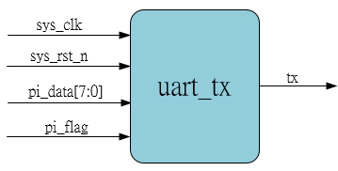
Sub-module
Receive data
Transfer data

Slide 6
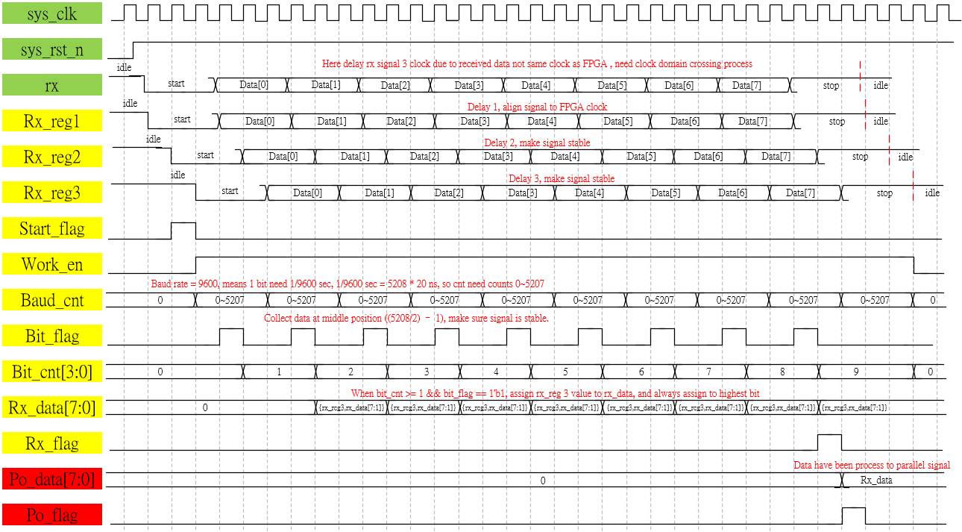
Waveform Graph – rx

Slide 7
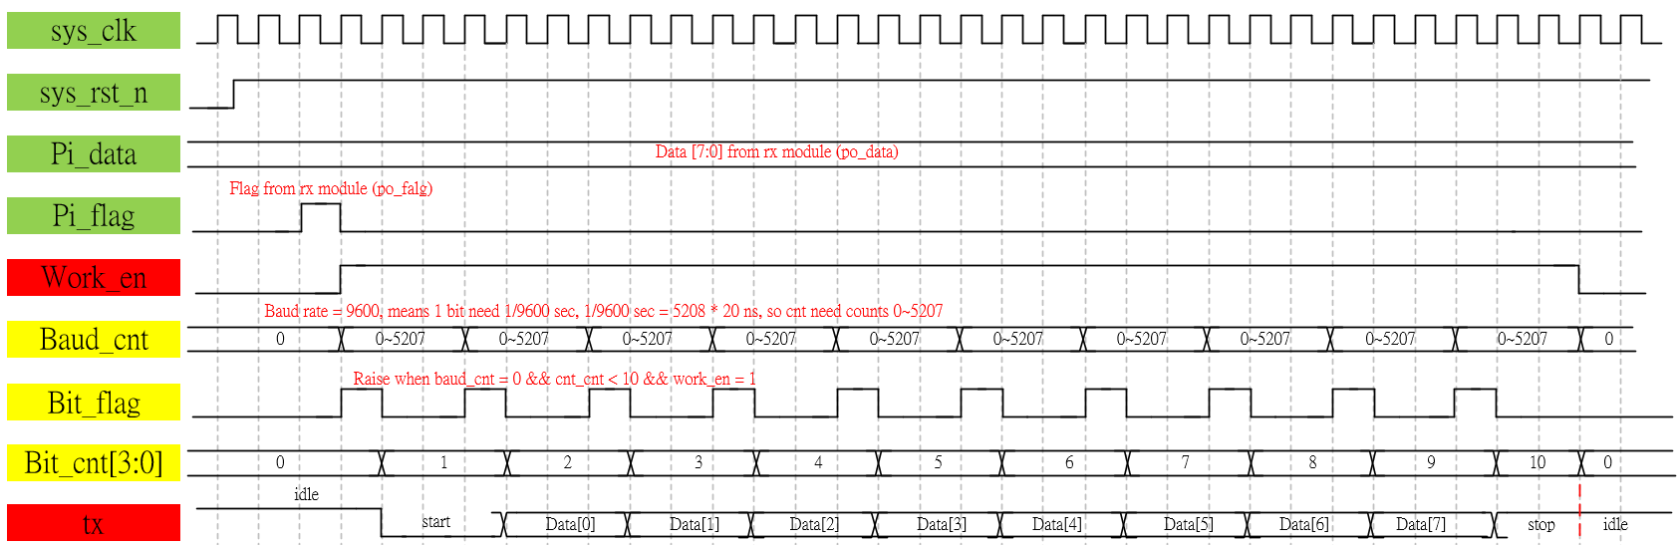
Waveform Graph – tx

Slide 8
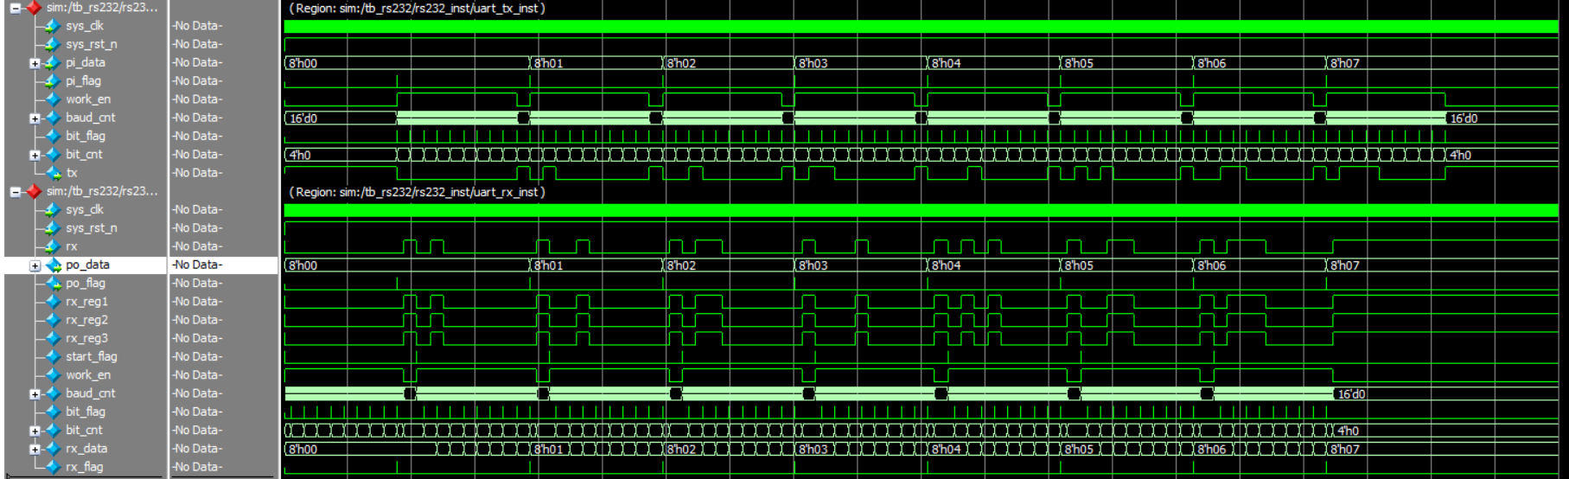
Simulation- rs232
Due to simulation range is too large, here only shows the result, the data transfer correct. (as test bench, 0 to 7)

Slide 9
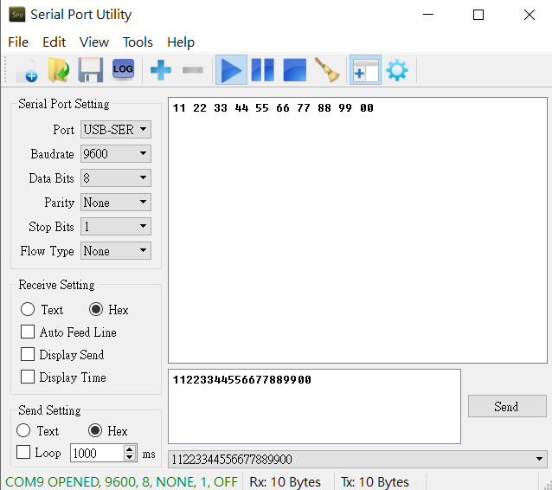
Test- rs232
Using serial port utility test, transfer 11 to 00 byte data, OK.
Receive from tx module
Send to rx module

