Slide 1
RS485

Slide 2
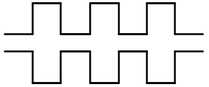

RS485
RS485 is similar to RS232, it also belong to UART communication protocol, but it using differential signal to transfer data and RS485 can’t receive and transfer data at the same time.
RS485 also needs 10 steps to transfer & receive data, same as RS232.
In this chapter, we want to using rs485 to deliver data, and using baud rate is 9600, it means 1 bit need 1/9600 second to deliver.
differential signal
output
sender
receiver

Slide 3
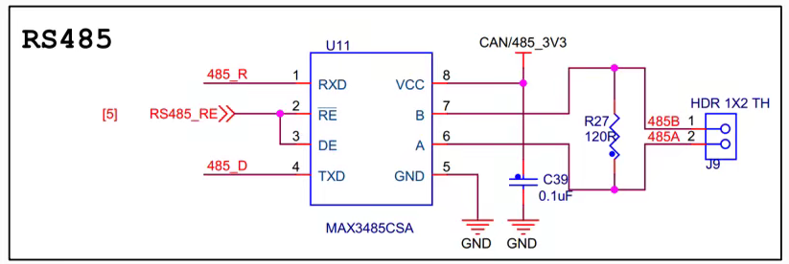
Objective
In this chapter, we want to using RS485 to deliver data, and the baud rate is 9600.
RS485 is very similar with RS232, so rx and tx module can be used too, just tx module need to revise a little, due to RS484 need 1 signal to control receive or transfer action.
1’b0 : receive mode 1’b1:transfer mode

Slide 4
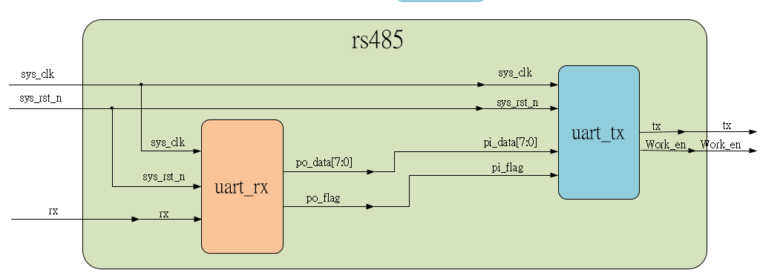
System

Slide 5
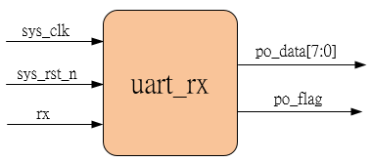
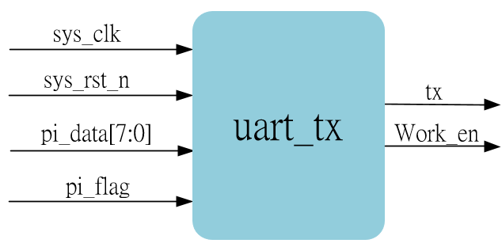
Sub-module
Using previous
Transfer data
Work_en being output 1. if low-level, receive mode 2. if high-level, transfer mode (just 1 mode at time)

Slide 6
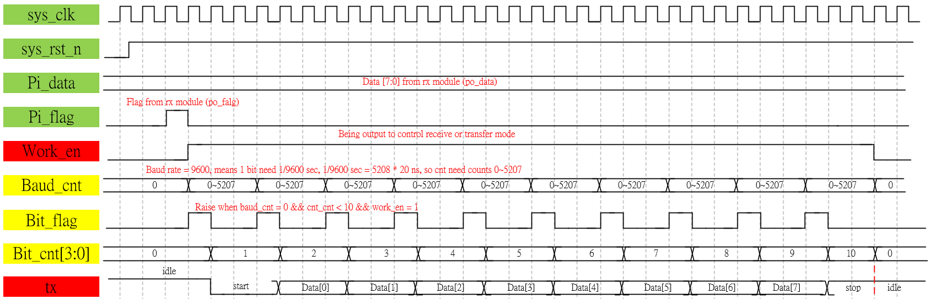
Waveform Graph – tx

Slide 7
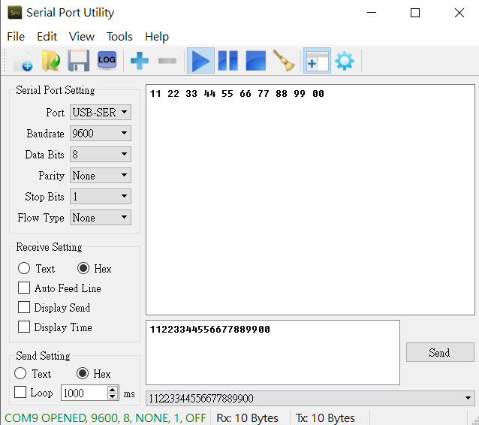
Test- RS485
Using serial port utility test, transfer 11 to 00 byte data, OK.
Receive from tx module
Send to rx module

