Slide 1
Water_led

Slide 2
Water_led
In this FPGA, LED is low-level lighted up, if we want to make 4 LEDs light up by sequence, we can using counter to do.
In this chapter, we want to light up 4 LEDs as below figure and the interval is 0.5sec.
1
2
LED1
LED2
LED3
LED4
0.5sec
LED1
LED2
LED3
LED4
0.5sec
4
3
0.5sec
LED1
LED2
LED3
LED4
0.5sec
LED1
LED2
LED3
LED4

Slide 3
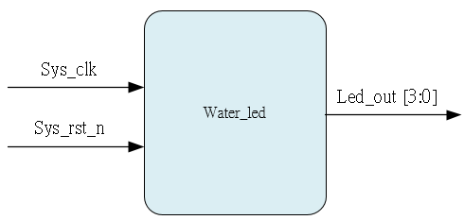
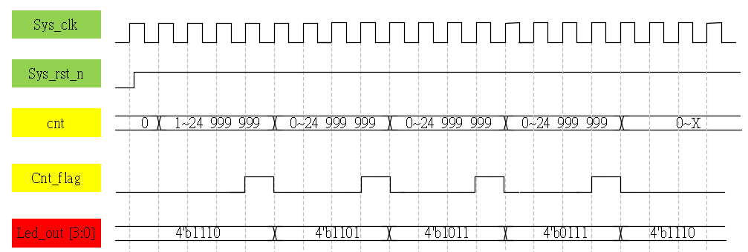
System & Waveform Graph

Slide 4
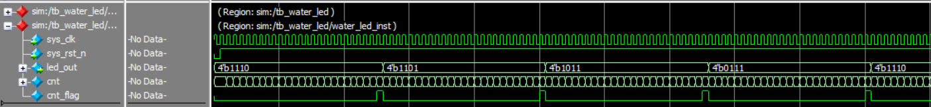
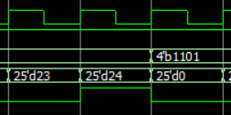
Waveform Graph - Simulation
Cnt_max set to 24, shorten the time for easy to observe.

