Slide 1
Simple_fsm

Slide 2
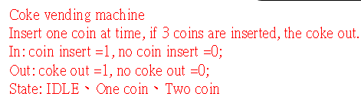
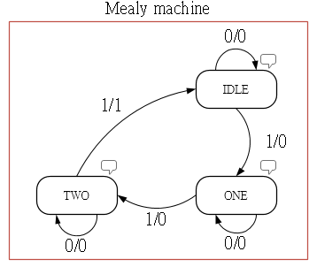
Simple_fsm
Let’s talk about fsm (state machine), we can define the states about the our design needs, if condition met, the state will change to next state.
For example, if we want design the coke vending machine as below requires, we need to define the 3 states, IDLE, ONE and TWO.

Slide 3
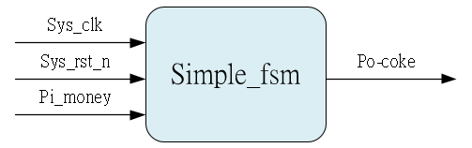
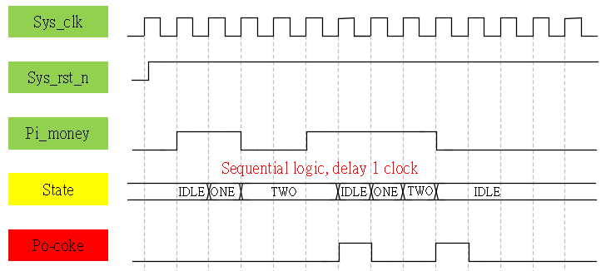
System & Waveform Graph

Slide 4
Waveform Graph - Simulation
3’b001 => IDLE
3’b010 => ONE
3’b100 => TWO

