Slide 1
Complex_fsm

Slide 2
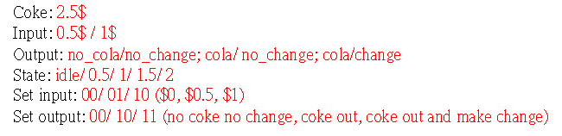
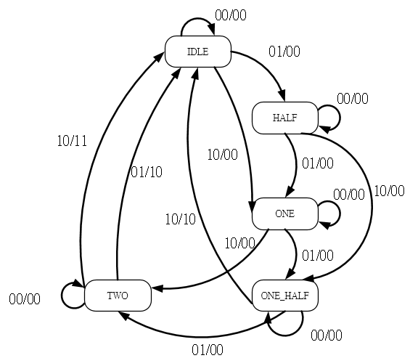
Complex_fsm
In previous chapter, we generate the coke vending machine base on fsm, but it just a simple_fsm.
In this chapter, we will enhance the coke vending machine’s function, such as make change and 2 type coins input.

Slide 3
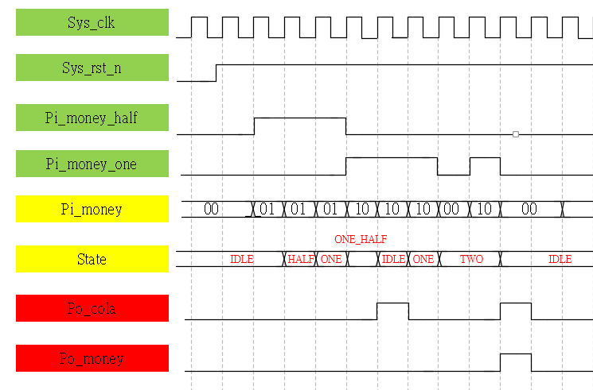
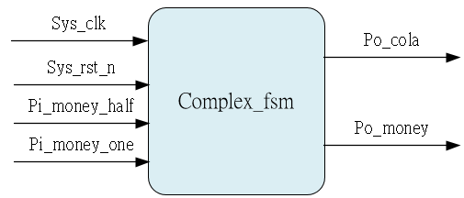
System & Waveform Graph

Slide 4
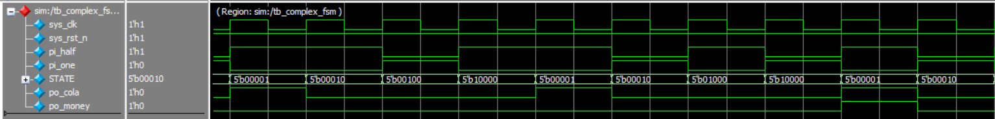
Waveform Graph - Simulation
5’b0_0001 => IDLE
5’b0_0010 => HALF
5’b0_0100 => ONE
5’b0_1000 => ONE_HALF
5’b1_0000 => TWO

