Slide 1
Frequence_meter

Slide 2
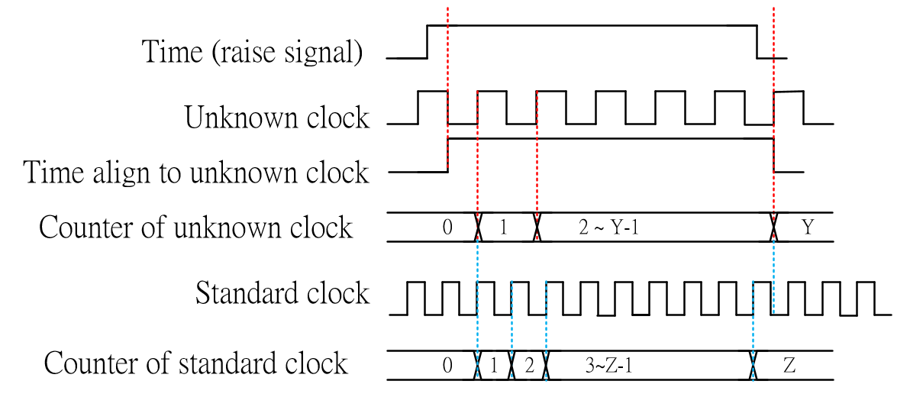
Frequence_meter
In this chapter, we want to using Equally accurate measurement to measure the unknow frequency clock.
We need build a time to measure, and counts how many clock cycle counts by unknown clock Y(counts) and standard clock Z(counts).
If we get Y and Z, just calculate Y / Z * standard clock frequence, get the unknown clock frequence.

Slide 3
Objective
In this chapter, we want to design a simple frequence meter, and using seven-segment display to display the value.
Due to our seven-segment display just shows 6 digits, it means max value is 999_999, but the clock frequence bigger than 100 MHz maybe, so we need to divide the value by 1_000_000, it means the values shown on seven-segment display unit is MHz, and last three digits is decimal.
?
?
?.
?
?
?
MHz

Slide 4
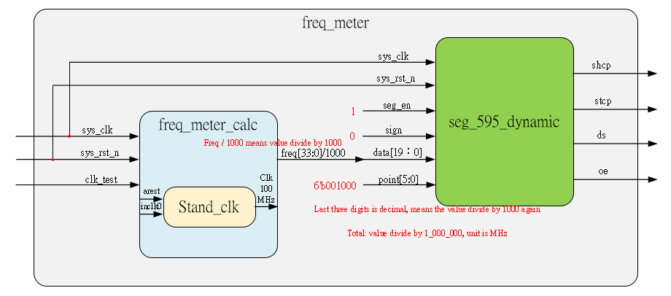
System

Slide 5
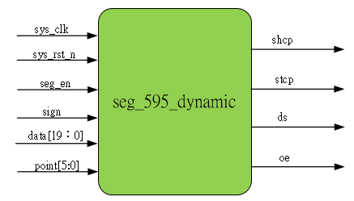
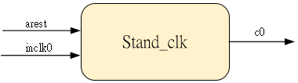
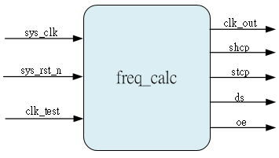
Sub-module
Using previous
Ip_core

Slide 6
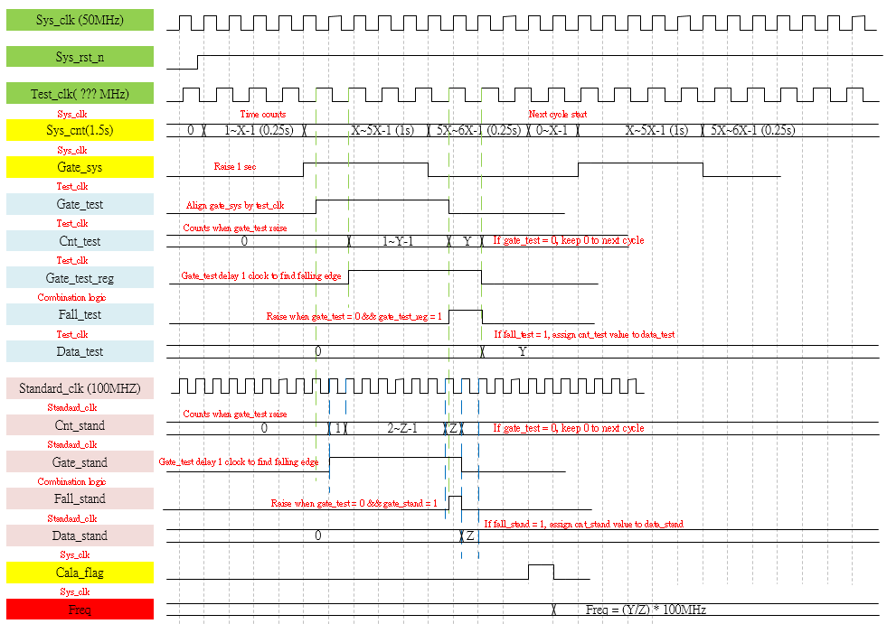
Waveform Graph – freq_meter_calc

Slide 7
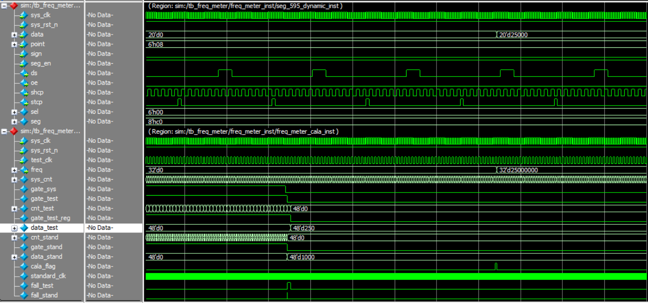
Simulation-freq_meter
The simulation result is matching test bench, we define the test_clk is 25MHz, the freq result 25_000_000 is correct, divide by 1000 then transfer to seg_595_dynamic also correct, valus is 25_000

