Slide 1
DDS

Slide 2
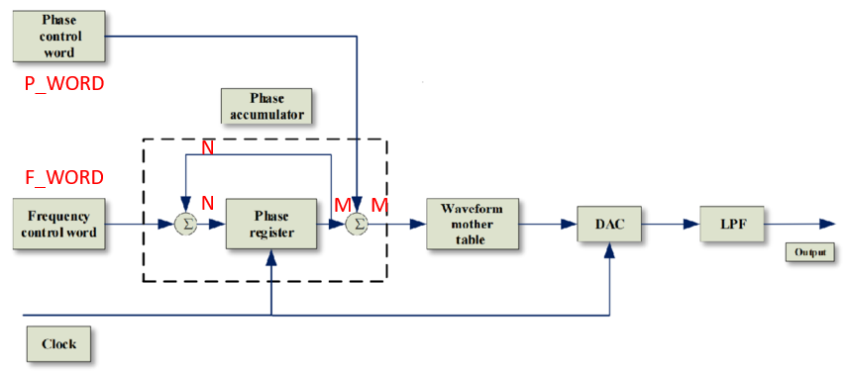
DDS_1
DDS, Direct Digital Synthesizer, using to generate signal wave like sine wave, square wave, triangle wave, sawtooth wave and so on.
Let’s introduce DDS formula in simple, the frequence clk_out = F_WORD * Clock / 2^{N}, clock is DDS working clock, F_WORD is input value, N is bit width of phase accumulator.
Otherwise, P_WORD is using to control phase shift or not, and M in picture is the bit width of waveform mother table (using rom).

Slide 3
DDS_2
We have been introduced the N is bit width of phase accumulator and M is the bit width of waveform mother table (rom), ,for example F_WORD is 1, means the value on phase accumulator every clock added 1, so if N=M, means each 1 data input have 1 corresponding address of rom.
But if N>M, we need using high bits to correspond to rom address, for example N=32 and M=12, it means only high 12 bit corresponding to rom address, so it needs 2³² clocks to reading full data of rom.(refer to rtl code)

Slide 4
Objective
In this chapter, we want to generate DDS module to generate signal wave and frequency is 500 Hz, the wave material txt file is from embedfire.
And using 4 button to control DDS generate sine wave, square wave, triangle wave, sawtooth wave.

Slide 5
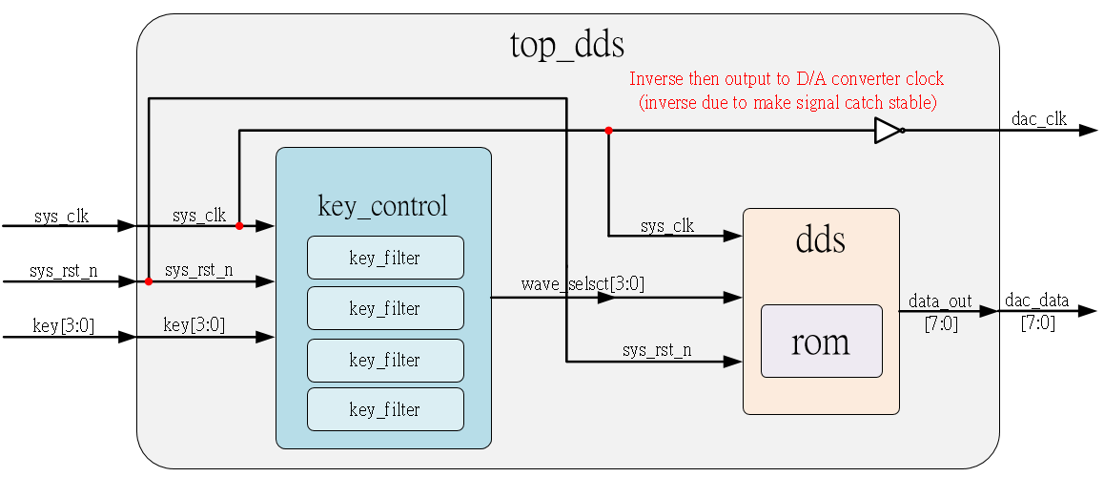
System

Slide 6
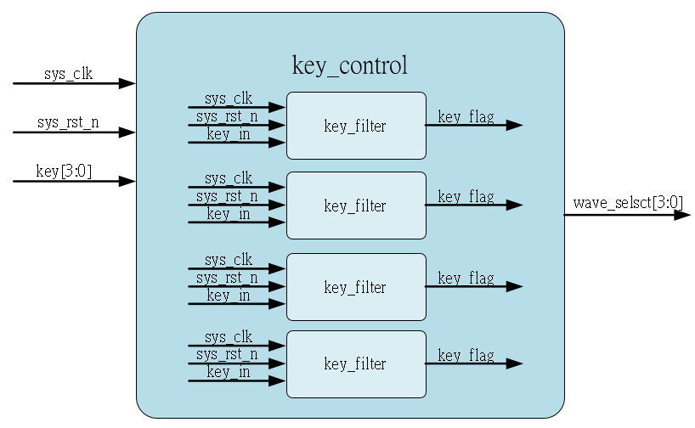
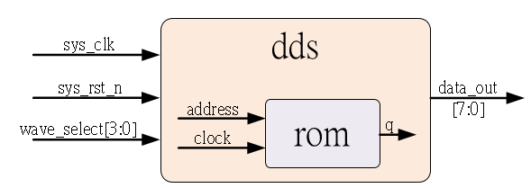
Sub-module
Internal key_filter using previous
Internal rom is Ip_core, initial by embed fire material

Slide 7
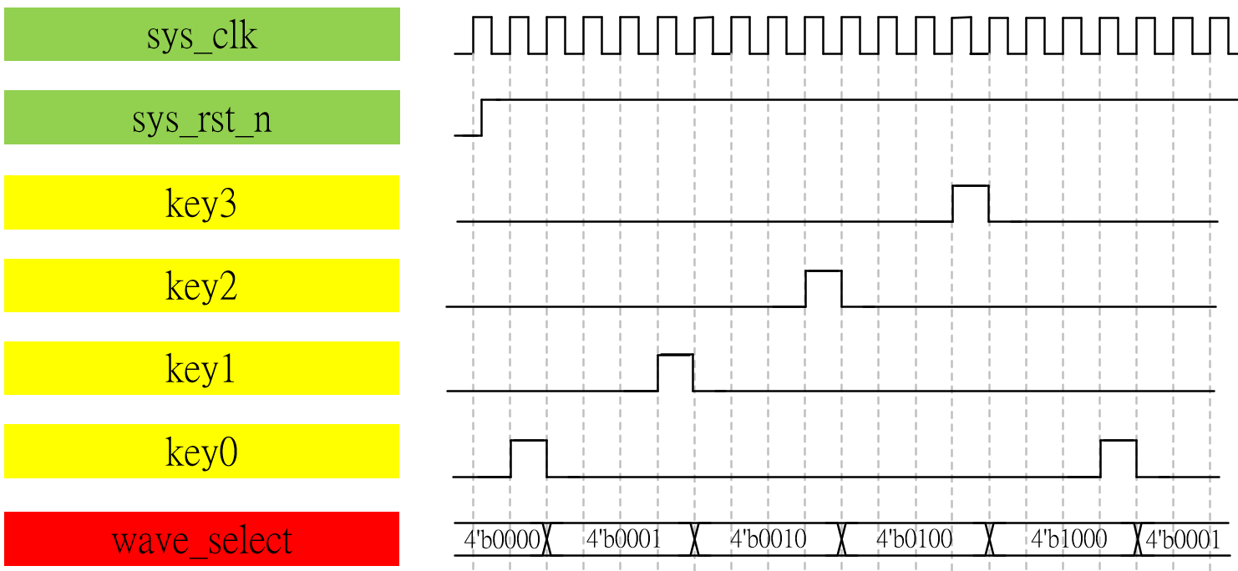
Waveform Graph – key_control

Slide 8
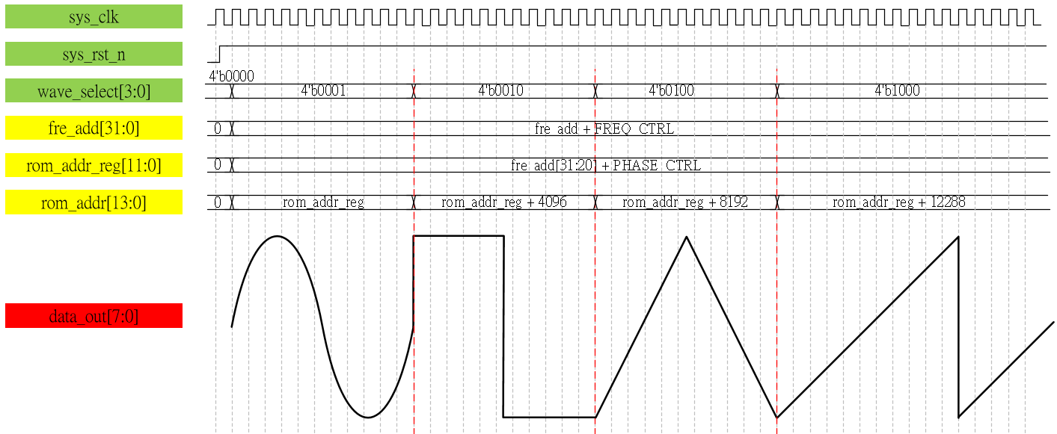
Waveform Graph – dds

Slide 9
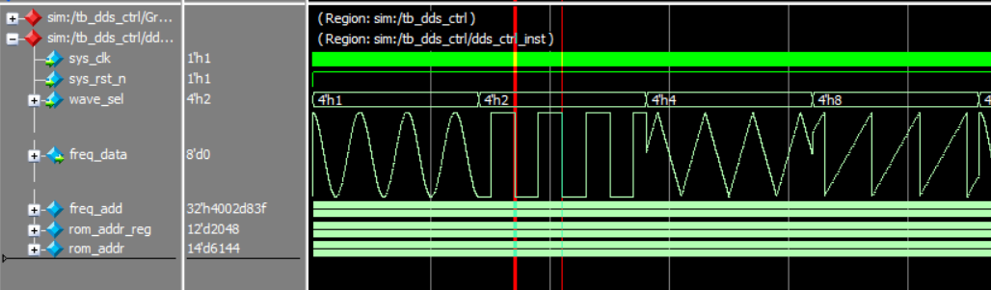

Simulation-freq_meter
The simulation result is matching out waveform graph, and frequency is 500 Hz.

