Slide 1
I2c_eeprom

Slide 2
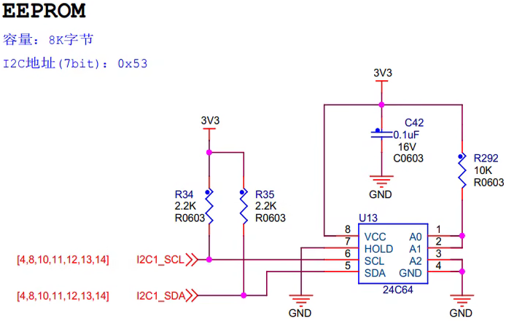

I2C_EEPROM
In previous chapter we have been introduced the UART protocol like rs232 & rs485 and SPI protocol to drive flash memory, in this chapter, we will introduce the I2C, Inter-Integrated Circuit also is a protocol.
If we want to control the slave device by i2c, we need to know the device address & timing, in this FPGA, the eeprom device address is 101_0011 as below picture.
Device first 4 bit is setting by manufacturer
Memory capacity : 8K bytes. I2C device address (7bit) : 0x53
LSB: 0 is write, 1 is read

Slide 3
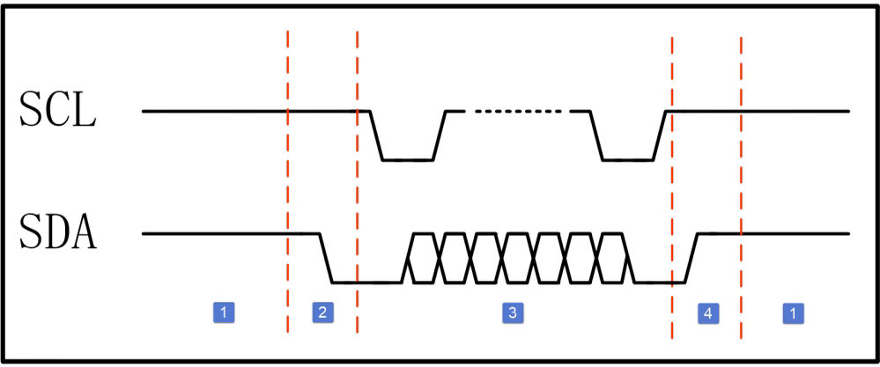
I2C_EEPROM_timing
I2c protocol timing as below picture shows.
1: IDLE 2: START, SDA fall 3: Working, Address & write & read
4: STOP, SCL high & SDA raise

Slide 4
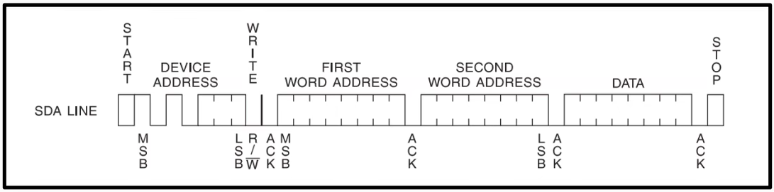
I2C_EEPROM_timing_write
Writing timing as below picture.

Slide 5
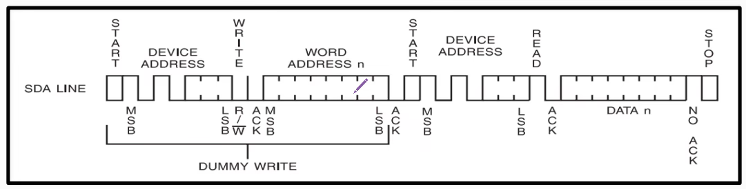
I2C_EEPROM_timing_read
Reading timing as below picture.

Slide 6
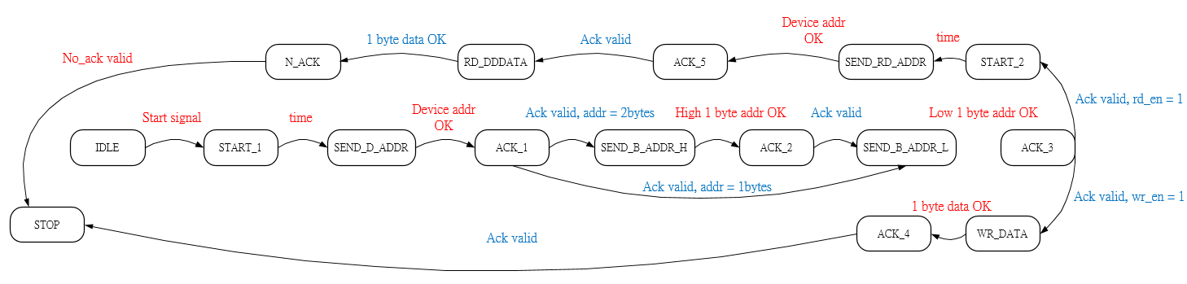
I2C_ctrl state diagram
According to i2c timing form, we can define thee i2c state as below picture. Red: ack & data is from FPGA (master) Blue: ack & data is from eeprom (slave)

Slide 7

Objective
Generate the i2c_eeprom module, and using 2 button to control write & read command.
First push the wr_button, write 1 to 10 10 bytes data to eeprom then push the rd_button to read the data which have been write to eeporm, and using seven-segment-display to show the data. (each data show 500 ms)
SCL clock is using 250KHz.

Slide 8
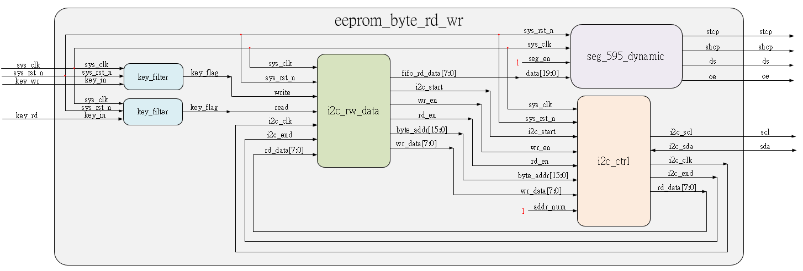
System

Slide 9
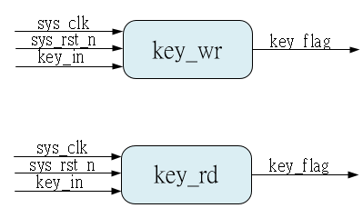
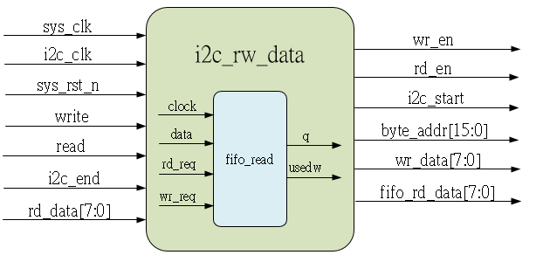
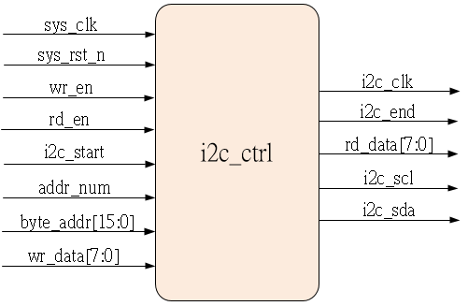
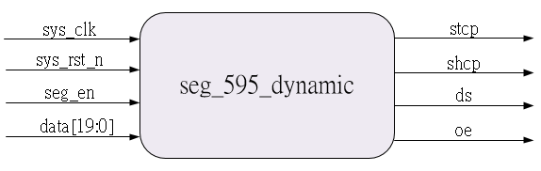
Sub-module
using previous
Inner fifo is ip_core
using previous
using previous

Slide 10
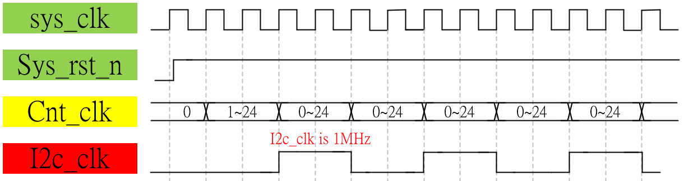
Waveform Graph – i2c_ctrl_i2c_clk
Due to we using 250KHz for SCL clock, we can using 1MHz divide by 4 to get the SCL clock.
The 1MHz clock is using for i2c module working clock, faster than 250KHz and slower than sys_clk 50 MHz.
Using 1MHz clock can make sure better working speed and using smaller counts to generate variables.

Slide 11
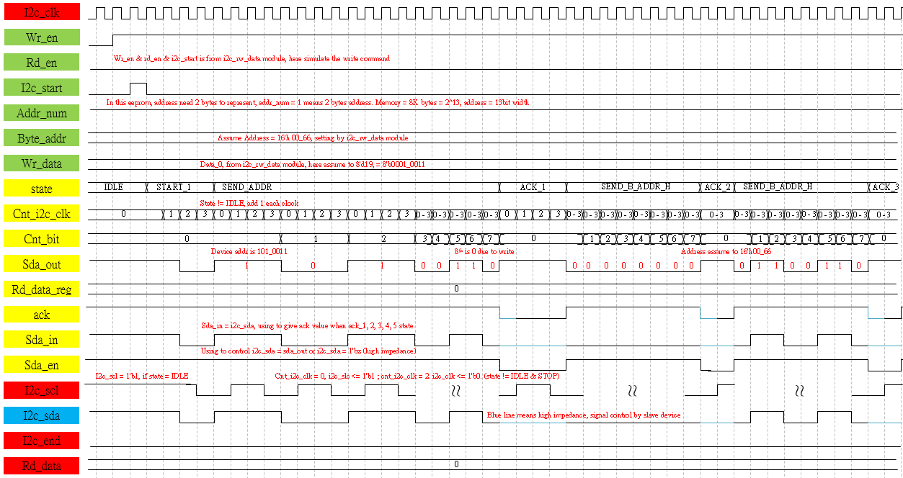
Waveform Graph – i2c_ctrl_wr_1
High resolution picture please refer to png file.

Slide 12
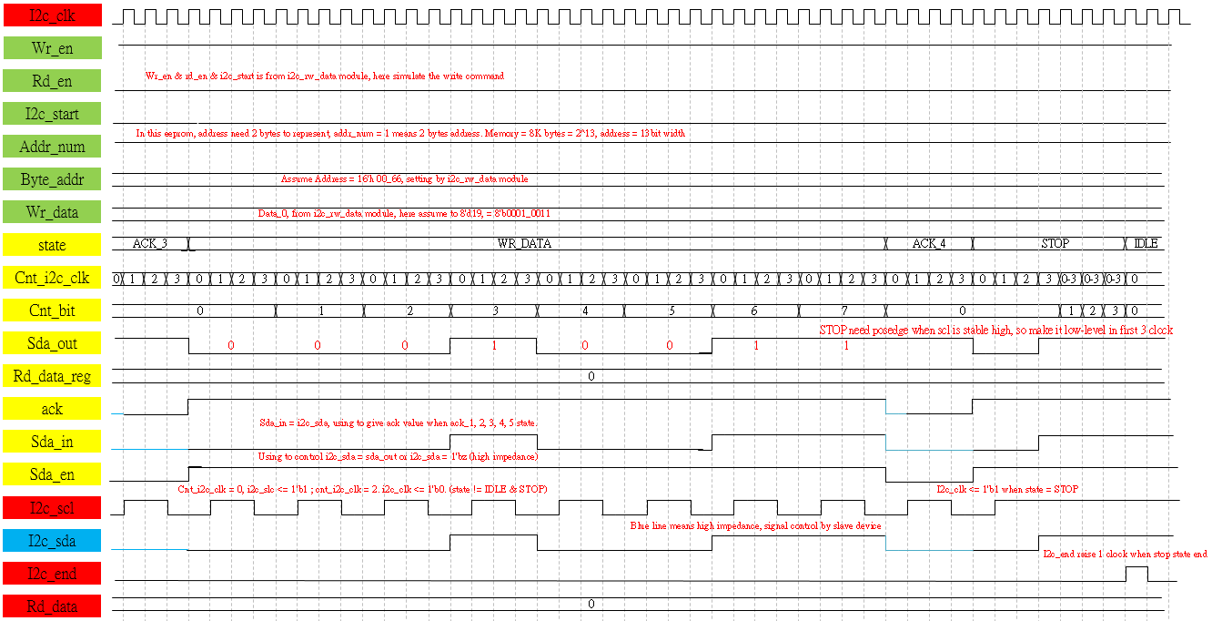
Waveform Graph – i2c_ctrl_wr_2
High resolution picture please refer to png file.

Slide 13

Waveform Graph – i2c_ctrl_rd_1
High resolution picture please refer to png file.

Slide 14
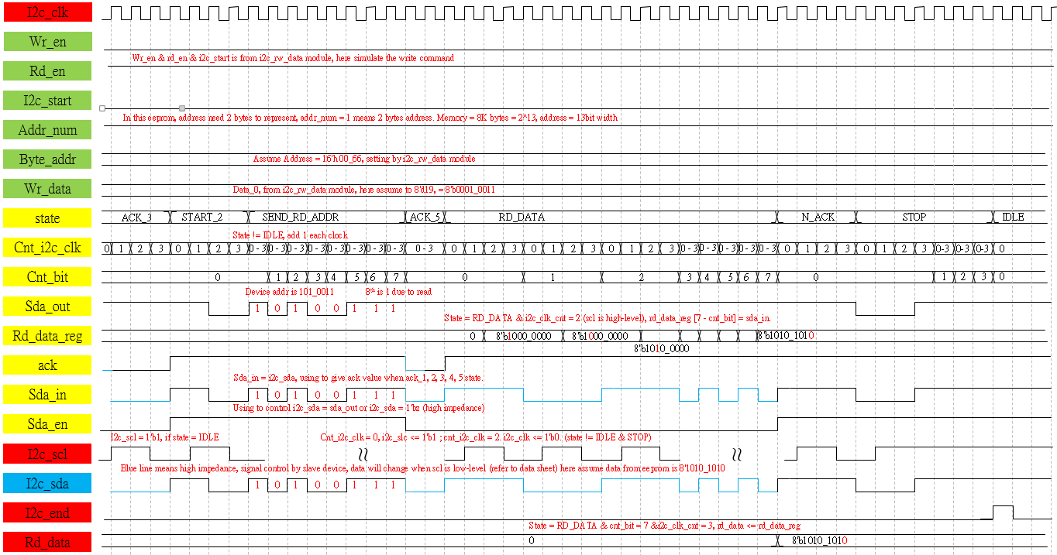
Waveform Graph – i2c_ctrl_rd_2
High resolution picture please refer to png file.

Slide 15
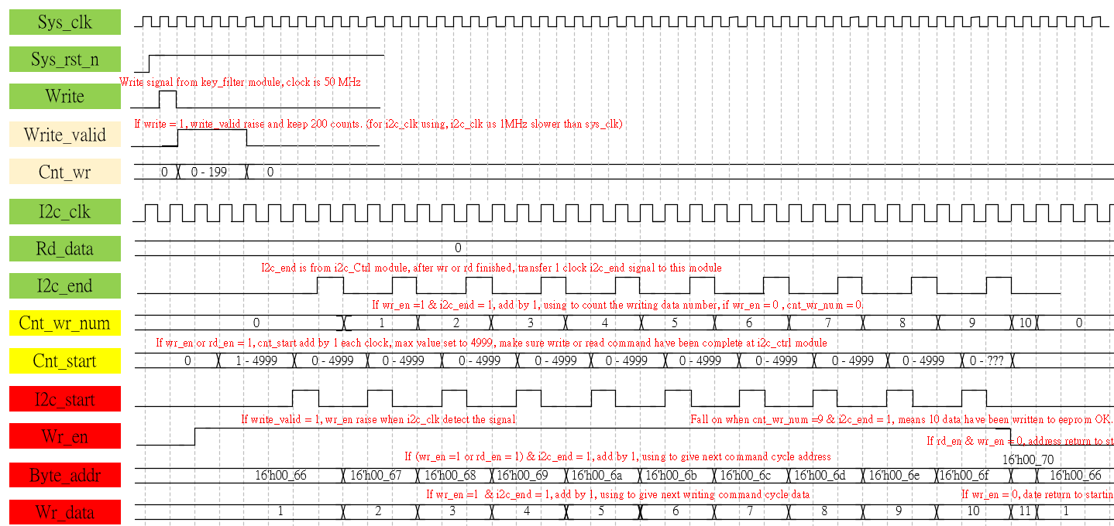
Waveform Graph – i2c_rw_data_write
High resolution picture please refer to png file.

Slide 16
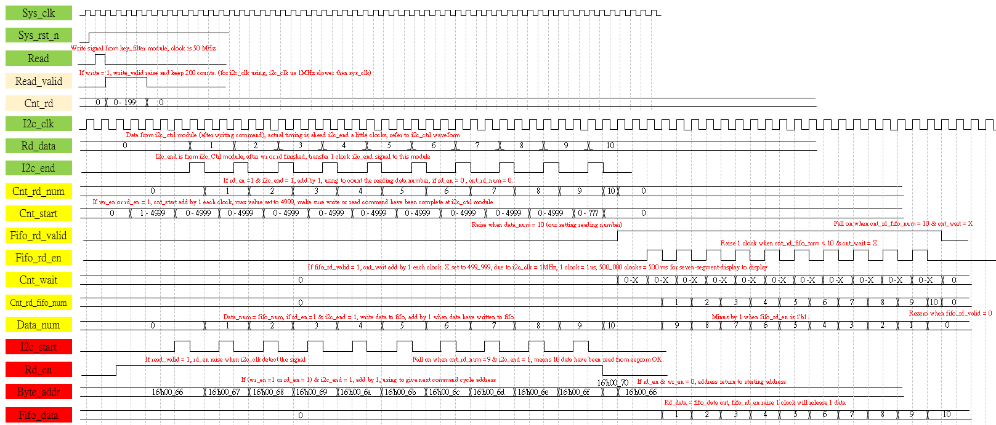
Waveform Graph – i2c_rw_data_read
High resolution picture please refer to png file.

Slide 17
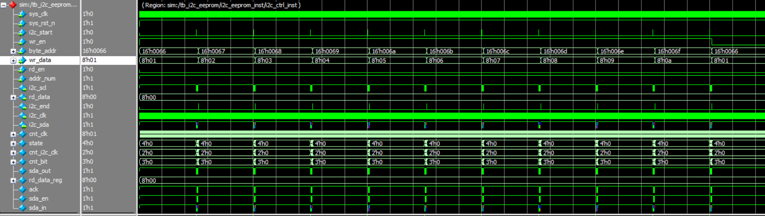
Simulation-i2c_ctrl_write
In i2c, we also need to using test bench file to simulate, but this test bench file have problem, so just check some variables. we can observe the address & data & i2c_start from i2c_rw_data module is OK. And i2c_end transfer out is OK.

Slide 18
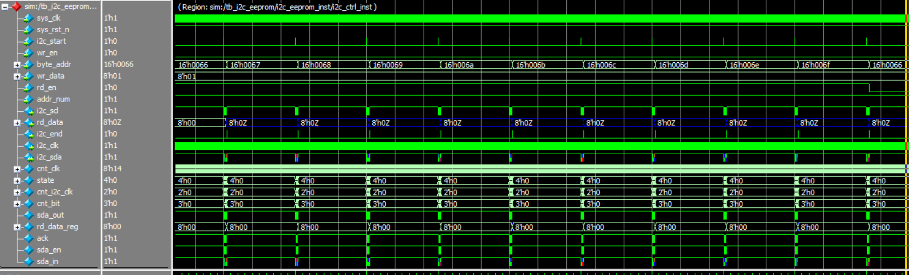
Simulation-i2c_ctrl_read
In i2c, we also need to using test bench file to simulate, but this test bench file have problem, can’t feedback correct data which reading from test bench file so just check some variables. we can observe the address & i2c_start from i2c_rw_data module is OK.
And i2c_end transfer out is OK.

Slide 19
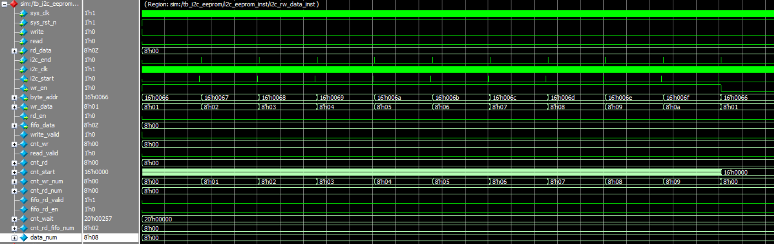
Simulation-i2c_rw_data_write
In i2c, we also need to using test bench file to simulate, but this test bench file have problem, can’t feedback correct data which reading from test bench file so just check some variables. we can observe the i2c_end from i2c_ctrl module is OK.
Combine with i2c_ctrl_write simulation, the signal transfer out is ok.

Slide 20
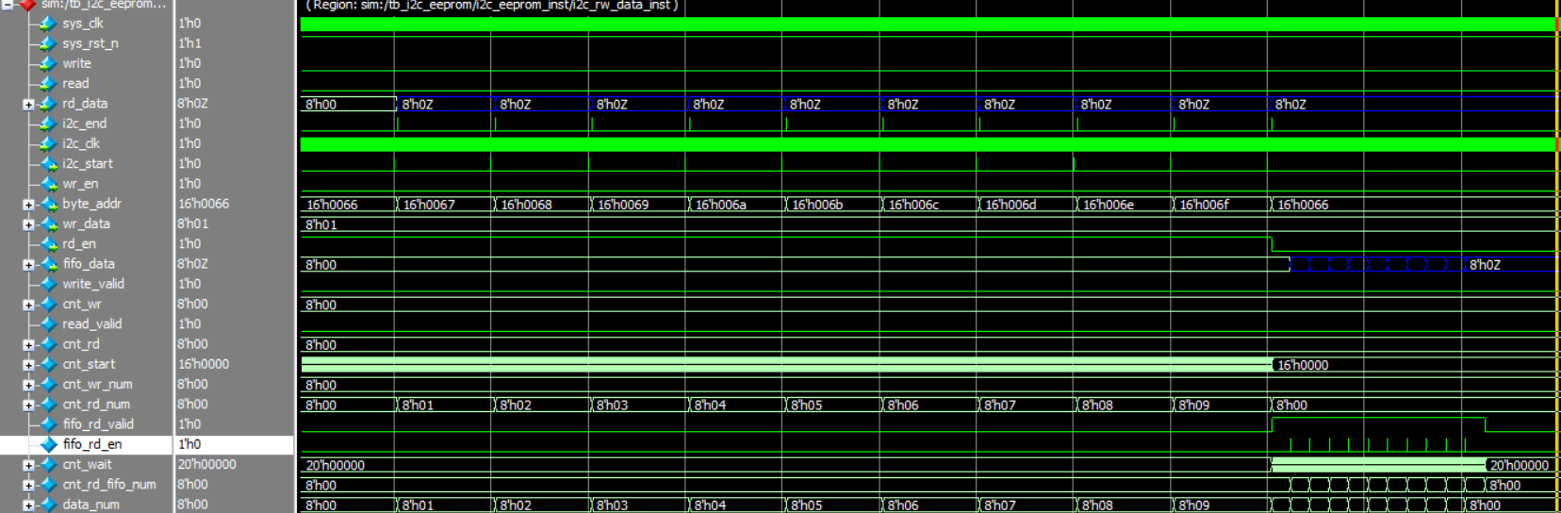
Simulation-i2c_rw_data_read_1
In i2c, we also need to using test bench file to simulate, but this test bench file have problem, can’t feedback correct data which reading from test bench file so just check some variables. we can observe the i2c_end from i2c_ctrl module is OK.
Combine with i2c_ctrl_write simulation, the signal transfer out is ok.

Slide 21
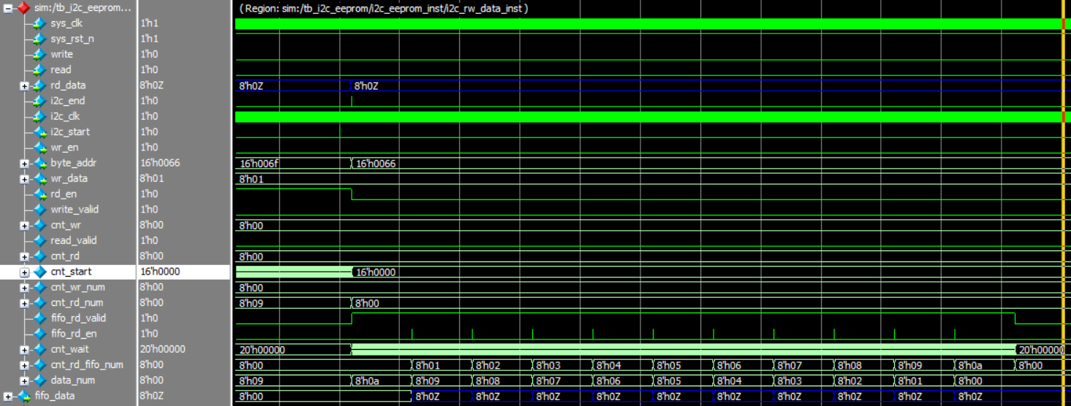
Simulation-i2c_rw_data_read_2
In read, we also check the data_num is OK, means the 10 bytes data have been written to fifo and read out is OK. Due to test bench file have some problem, if you want to test the function, can using the rtl code and make a project , then generate the jic file then download to FPGA

