Slide 1
Mux2_1 (multiplexer)

Slide 2
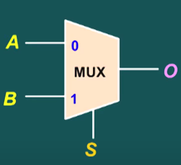
Mux2_1
Mux2_1 have 2 input (A&B) & 1 selector (S) & 1 output (O).
If selector signal is 1, the output = A.
If selector signal is 0, the output = B.

Slide 3
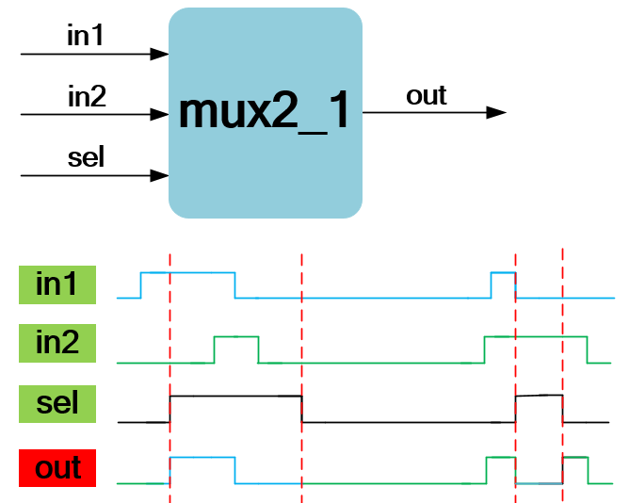
Waveform Graph

Slide 4
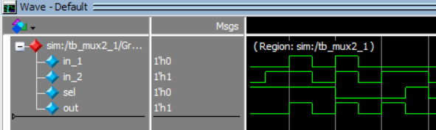
Waveform Graph - Simulation

