Slide 1
Hdmi_colorbar

Slide 2
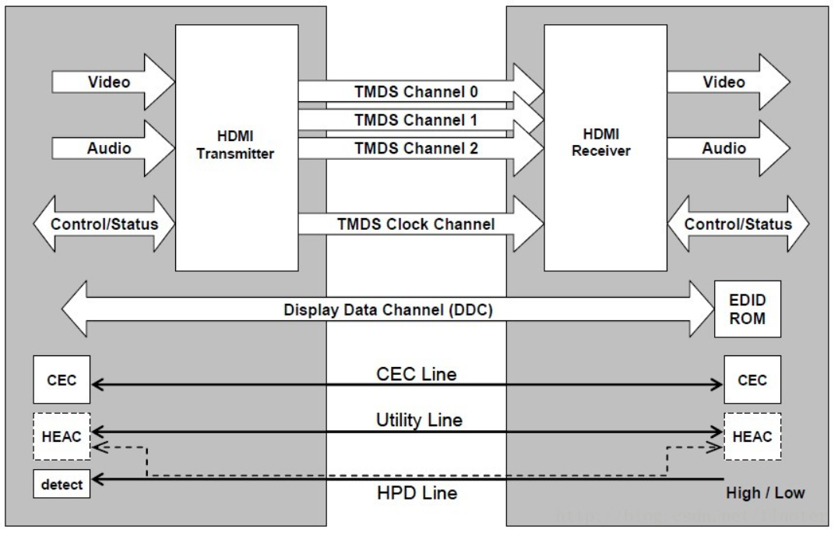
HDMI
HDMI, High Definition Multimedia Interface, using to transfer video and audio data.
In this chapter, we will using HDMI to display color bar on screen, and basse on vga_colorbar module, but the HDMI is using rgb888 & differential signal to display the video data, so we need to generate the HDMI control module.
If we want to transfer picture data, we need to generate section which in the red box.

Slide 3
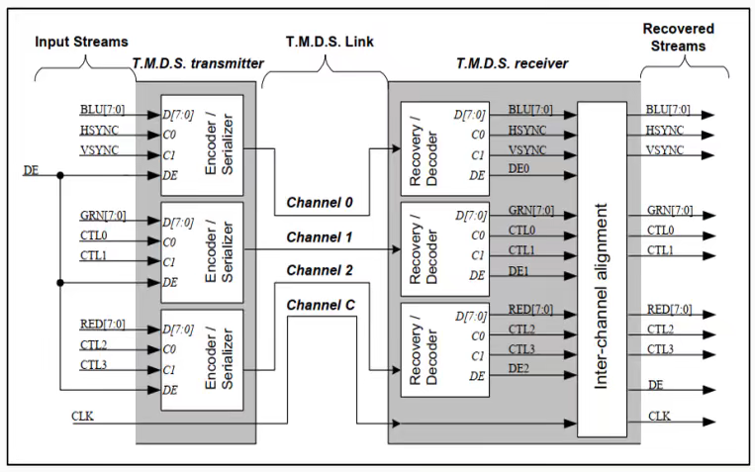
HDMI_TMDS
TMDS, Transition Minimized Differential Signaling, if we need to using HDMI to display the color bar on screen, we should generate HDMI control module which including the encoder module and differential signal module.

Slide 4
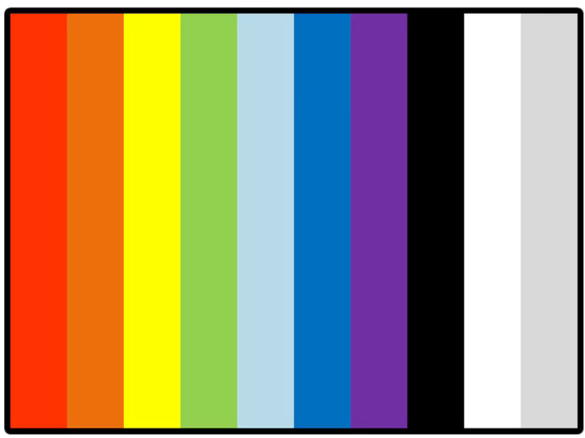
Objective
Base on vga_color_bar module, generate hdmi_ctrl module then using HDMI to transfer picture data, the screen shows color bar as below picture.

Slide 5
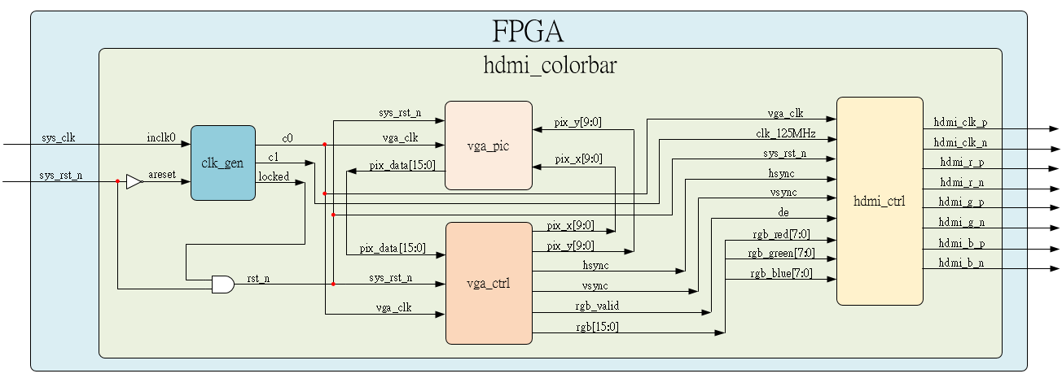
System

Slide 6
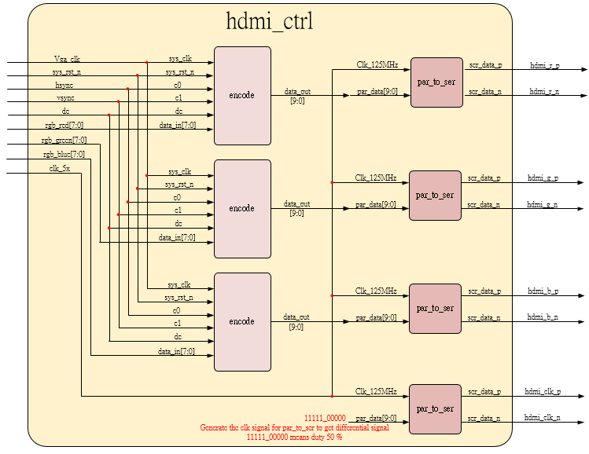
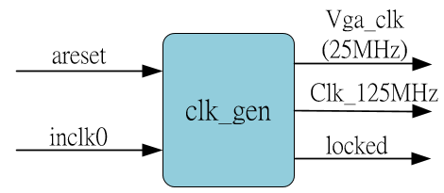
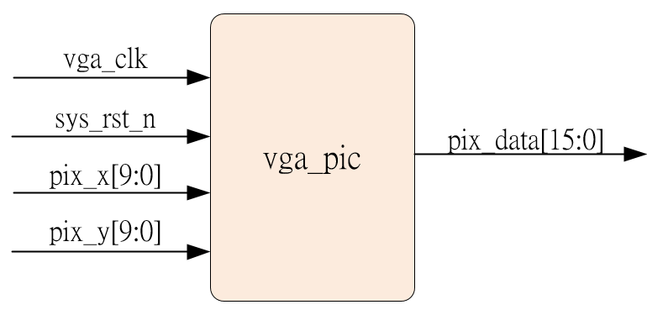
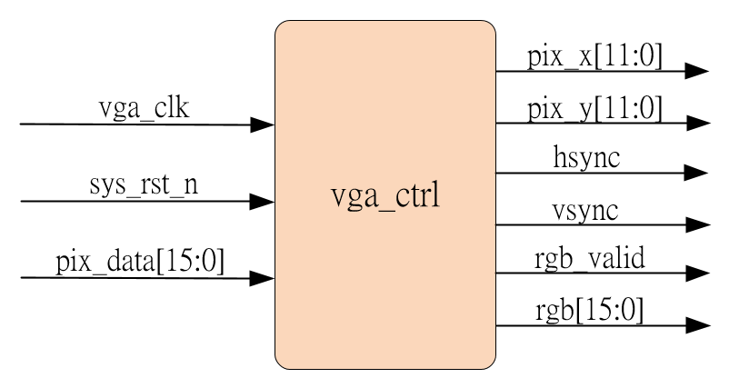
Sub-module
Ip_core
using previous
using previous , but rgb_valid should be output

Slide 7
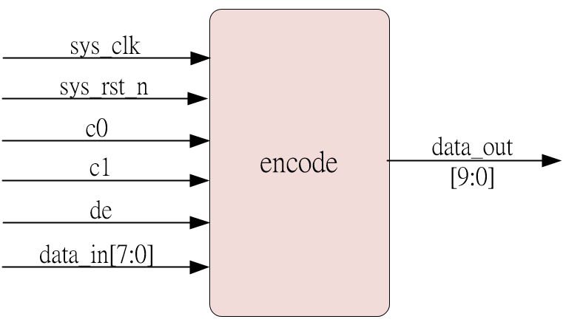
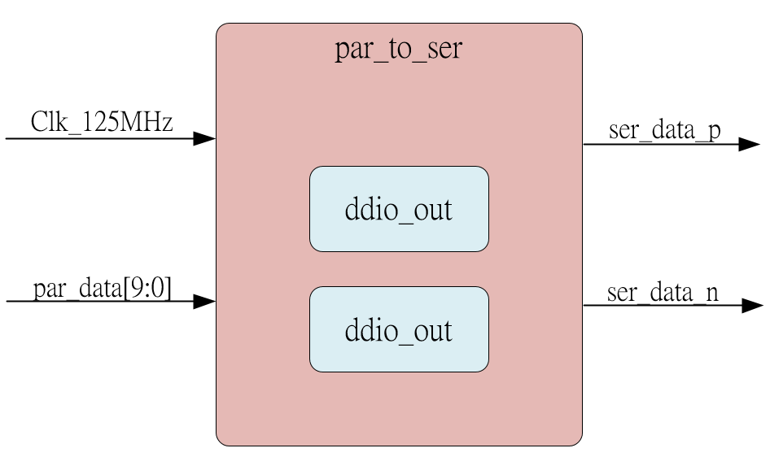
Sub-module_hdmi_ctrl
Follow encode algorithm to program
Inner dido is Ip_core
Dido is posedge & negedge will catch the input parallel signal par_data then output to serial signal. Due to par_data is 10 bit data, and dido is both edge catch data, so clock needs 10*25MHz (input data clock) / 2 (both edge) = 125MHz.

Slide 8
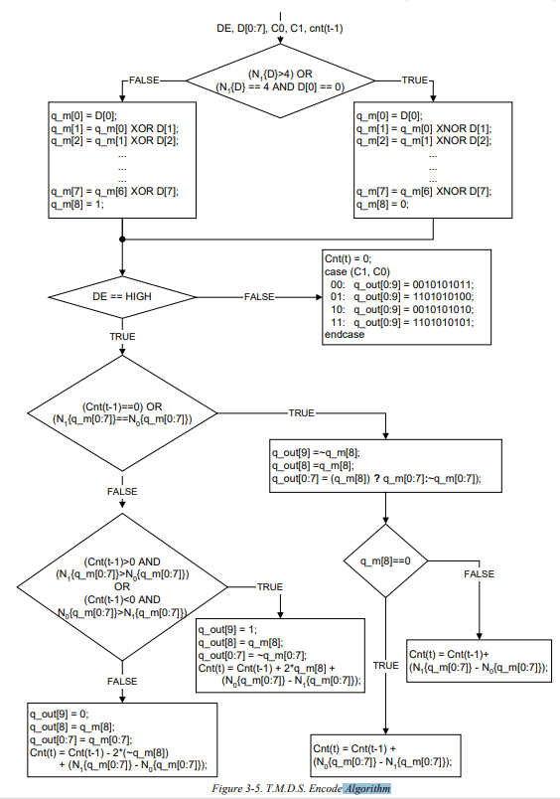
Encode Algorithm
Have been check waveform is same as embedfire encode, ok for use.
Ctrl 1
Detail refer to rtl encode code
Ctrl 2
Ctrl 3

Slide 9
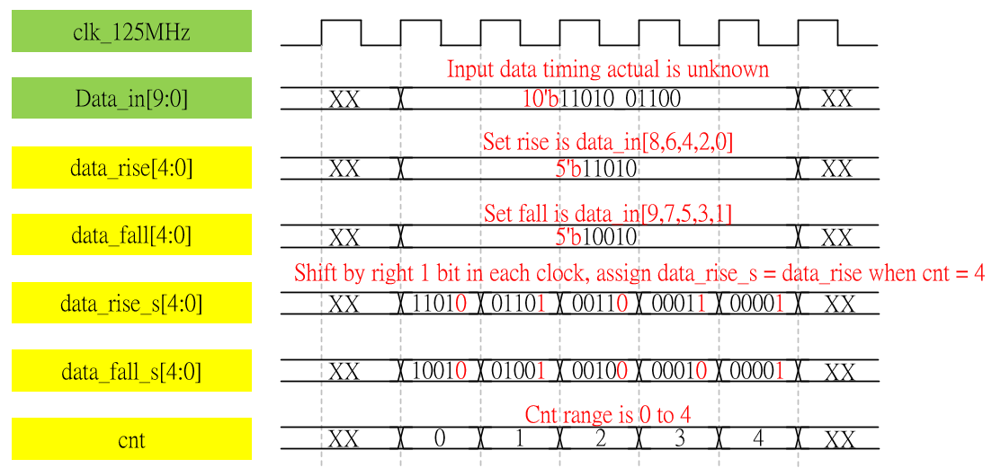
Waveform Graph – par_to_ser
Input timing is unknown but if catch data_in is OK then module is OK.

Slide 10
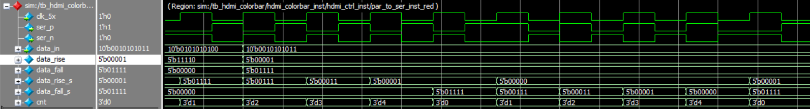
Simulation-par_to_ser
Input data timing is not align waveform, but we using cnt = 4 then assign value to data_rise_s & data_fall_s, it catch data success.
And shift by right is OK.
Others module wouldn’t simulate due to previous generate, and hdmi_ctrl & hdmi_colorbar just connect with others module

