Slide 1
Fifo_sum

Slide 2
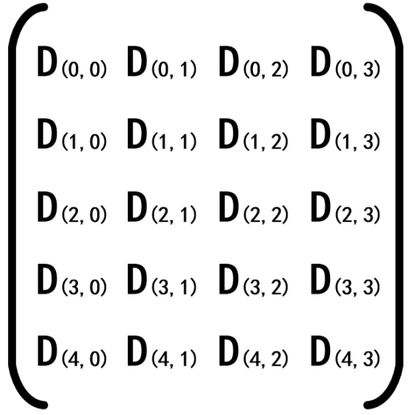
Fifo_sum
In previous chapter, we have been introduced the fifo, and using fifo to doing domain clock crossing process.
In this chapter, we want to using fifo to doing the data calculate for next chapter sobel operator pre-study.
If we have 5 x 4 matrix data need to calculate 3 adjacent rows, we can using 2 fifo to doing this.
4 columns
S0 = { d00+d10+d20, d01+d11+d21, d02+d12+d22,d03+d13+d23} S1 = { d10+d20+d30, d11+d21+d31, d12+d22+d32,d13+d23+d33}
S2 = { d20+d30+d40, d21+d31+d41, d22+d32+d42,d23+d33+d43}
fifo1
D (0,3)
D (0,2)
D (0,1)
D (0,0)
Data write to fifo 1 after calculate
5 rows
fifo2
D (1,3)
D (1,2)
D (1,1)
D (1,0)
3 data added find sum
Data write to fifo 2 after calculate
D (2,0)

Slide 3
Objective
Using rs232 to transfer data to FPGA, generate fifo_ctrl module to calculate the sum of matrix data then output.
The data material is using from embedfire.

Slide 4
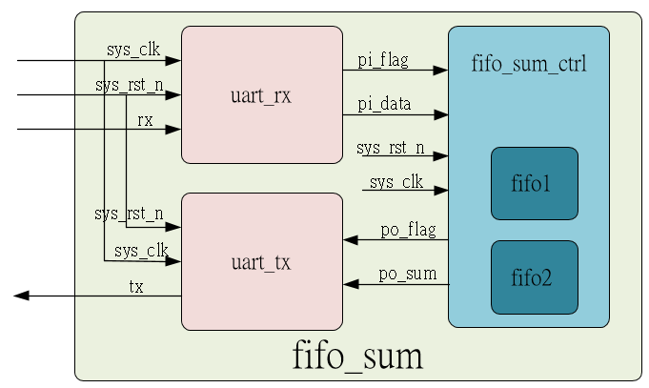
System

Slide 5
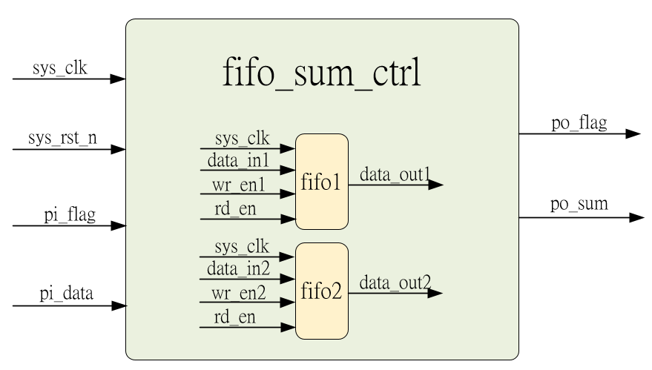
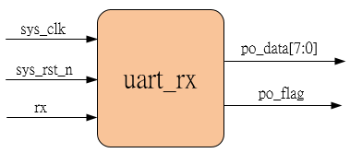
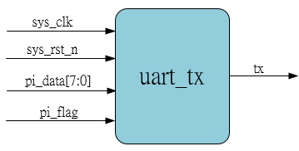
Sub-module
Inner fifo is ip_core
using previous
using previous

Slide 6
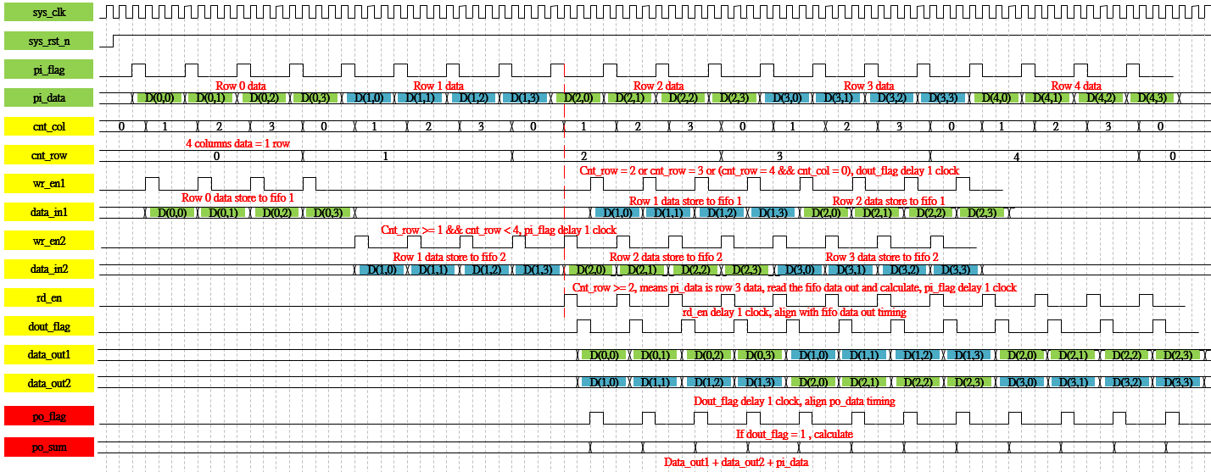
Waveform Graph – fifo_sum_ctrl

Slide 7
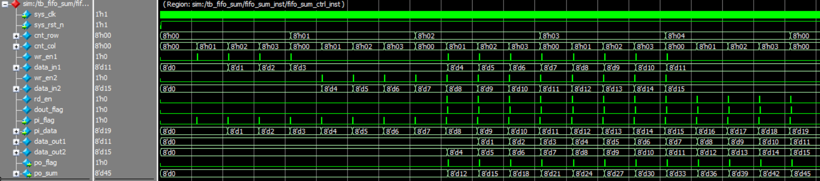
Simulation-fifo_sum_ctrl
The data calculate is correct and the data transfer to fifo is OK.

