Slide 1
Sobel

Slide 2
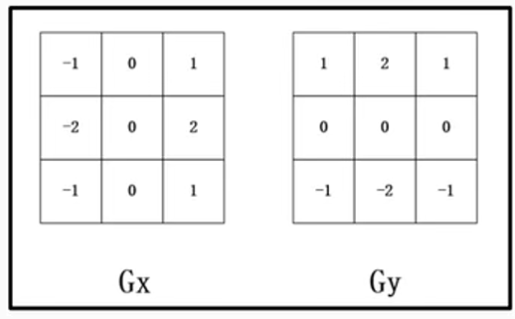
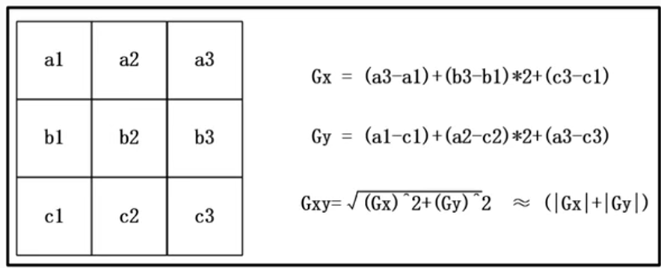
Sobel
In previous chapter, we have been introduced the fifo_sum, using to calculate 3 adjacent rows data, but in this chapter we want to calculate the 3 adjacent rows and columns data.
In this chapter, we want to using sobel to process the picture data, sobel is calculate 3 adjacent rows and columns data, it using to process grey image to black and white image.
After sobel process, we will get the gxy, and gxy should compare with threshold value, if gxy > threshold, the data should be display in Black, else is White, below is sobel formula.
The material is using from embedfire material.

Slide 3

Objective
Base on vga_rom_jump module, but using rs232 to transfer data to FPGA, generate sobel_ctrl module to process the data then transfer to vga_pic module, display the processed image on screen.
The data material is using from embedfire.
sobel

Slide 4
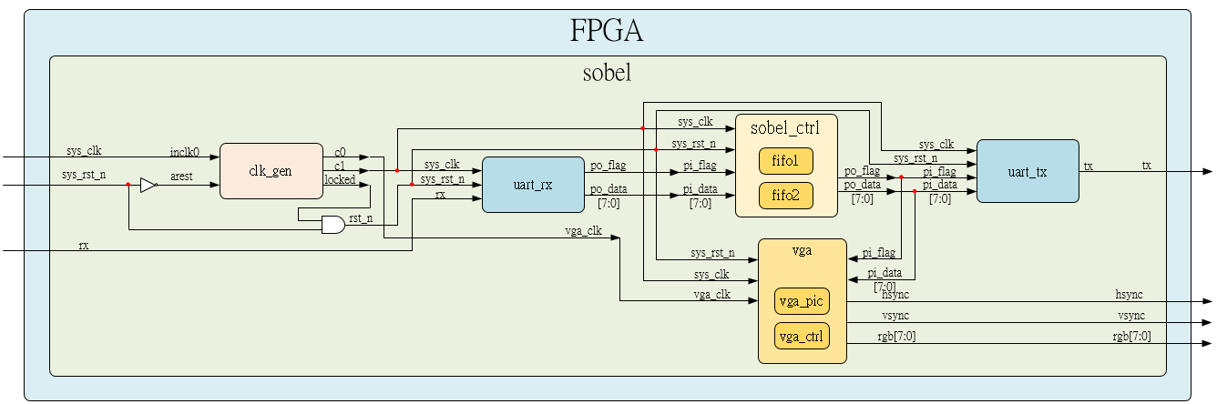
System

Slide 5
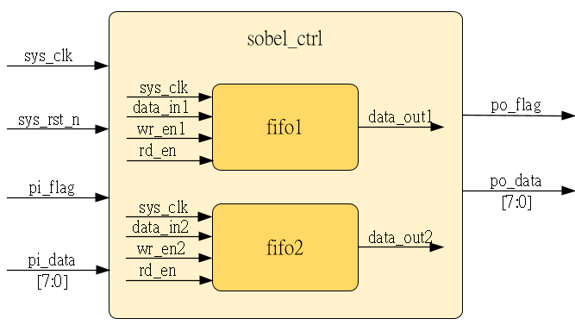
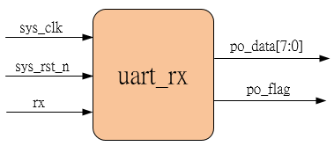
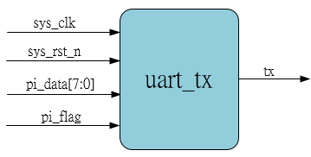
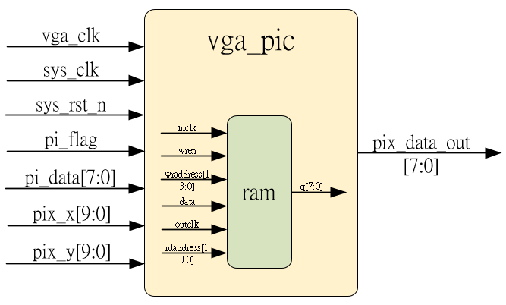
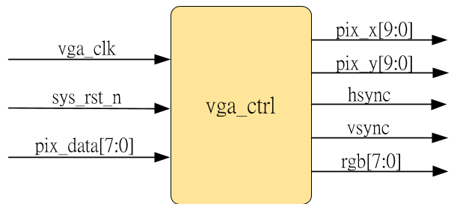
Sub-module
Inner fifo is ip_core
using previous
using previous
Revise a little section, refer to rtl code
using previous

Slide 6
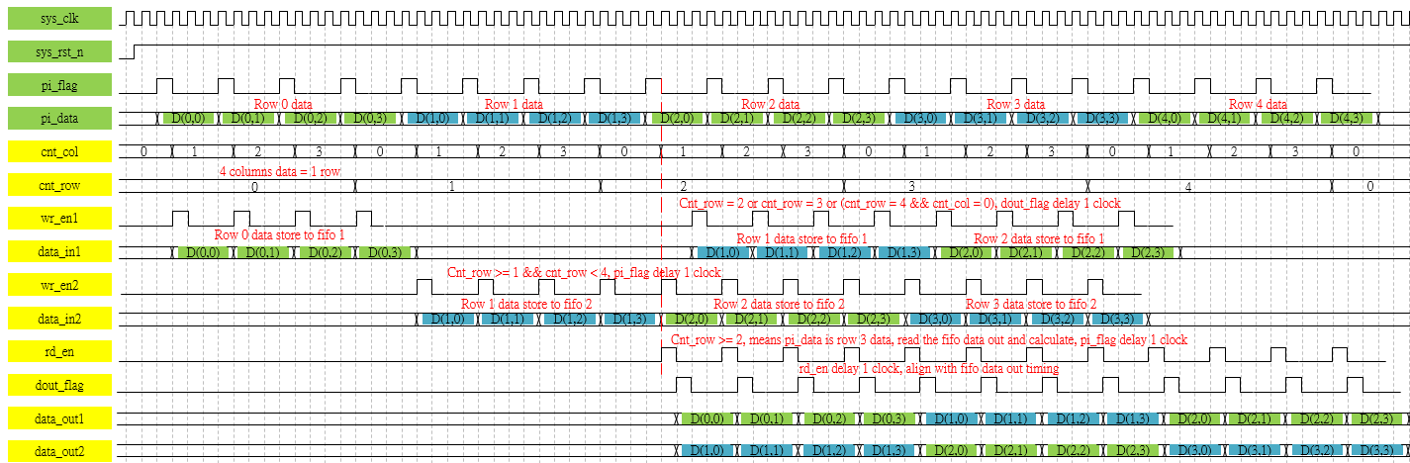
Waveform Graph – sobel_1
Full picture please refer to sobel_ctrl.png, high resolution, and here we using 5x5 matrix to draw the wave form for easy to observe

Slide 7
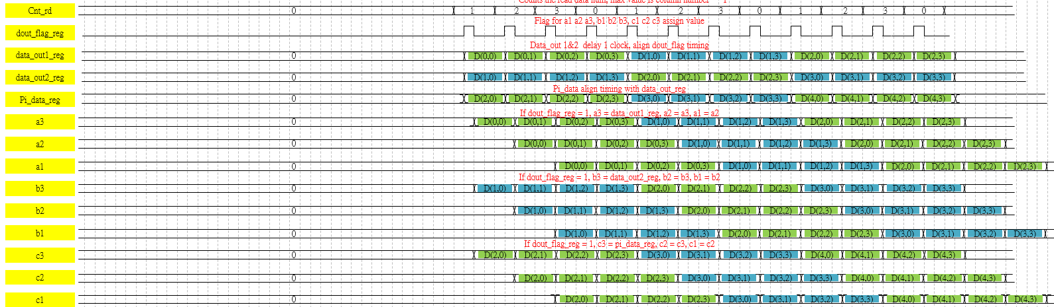
Waveform Graph – sobel_2

Slide 8
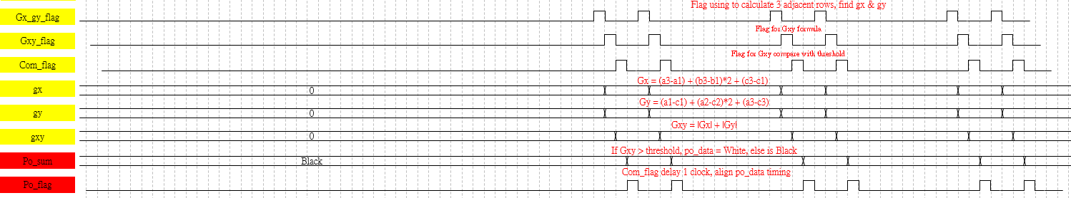
Waveform Graph – sobel_3

Slide 9
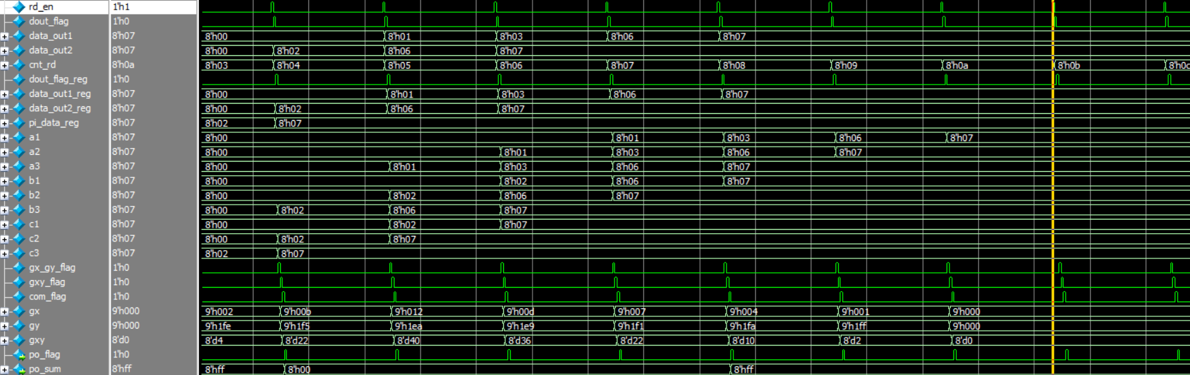
Simulation-fifo_sum_ctrl
The simulation is same as waveform, OK.
And the threshold is set to 8’d12, so gxy > 12, po_sum = 8’h00 (Black), else = 8’hff (White) is correct.

