Slide 1
Decoder_3_8

Slide 2
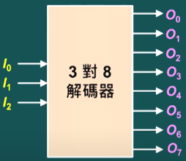
Decoder_3_8
Decoder 3x8 have 3 inputs and 8 outputs.
The output is determined by 3 inputs, 2x2x2 =8, have 8 output data.

Slide 3
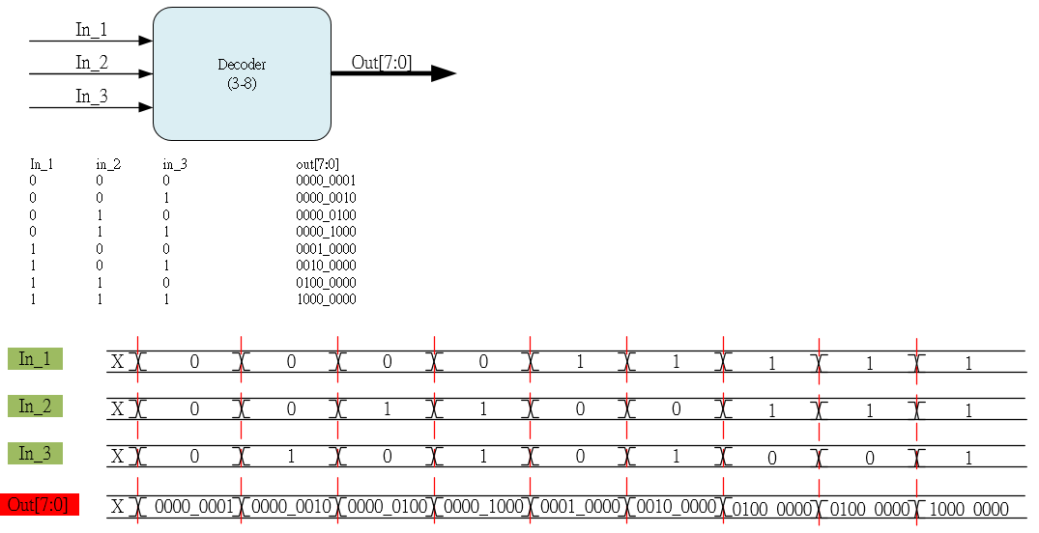
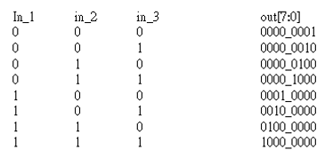
Waveform Graph

Slide 4
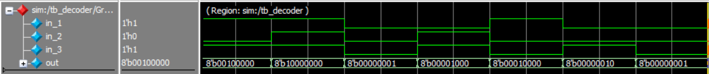
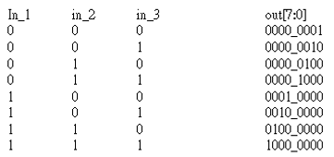
Waveform Graph - Simulation

