Slide 1
Half_adder

Slide 2
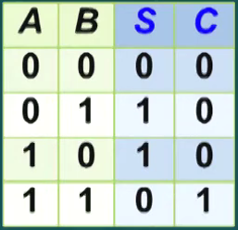
Half_adder
2 input (A&B) plus have 4 situations , show as below picture.
Only if in_1 and in_2 both 1 would be generate 1 carry.

Slide 3
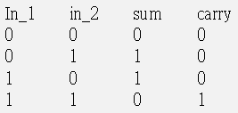
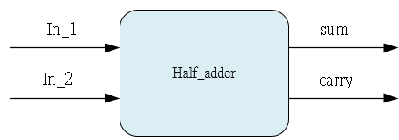
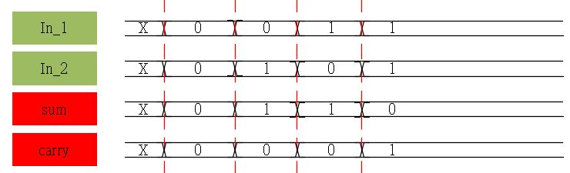
Waveform Graph

Slide 4
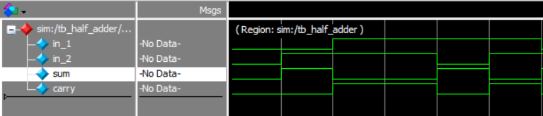
Waveform Graph - Simulation

