Slide 1
Full_adder

Slide 2
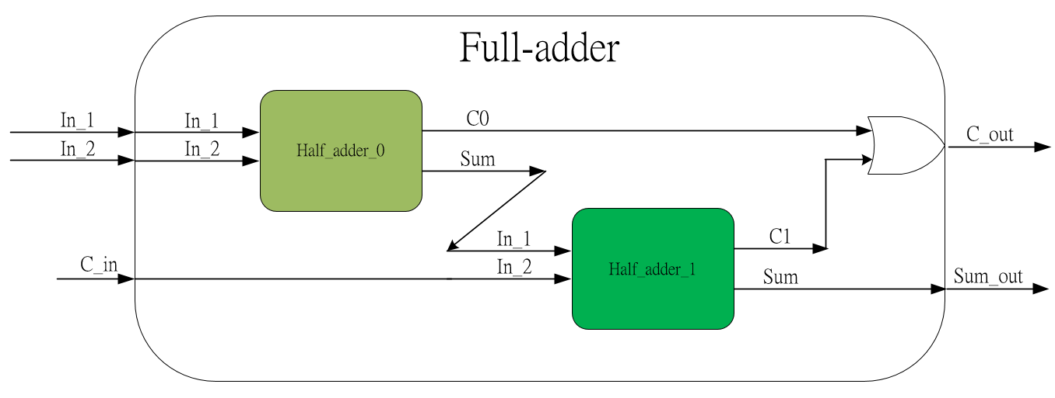
Full_adder
Full_adder using 2 half_adder to calculate the bit plus.
Full_adder calculate the current 2 bit data and previous 2 bit calculated carry daya.
For example, 2’b11 + 2’b01 = 3’b100.
2’b11+2’b01 = 3’b100 1 1
+ 0 1
－－－－－－－－－－
1 0 0
C_in
1
Previous carry
In_1
In_2
Previous sum
Previous carry
C_out
Sum_out

Slide 3
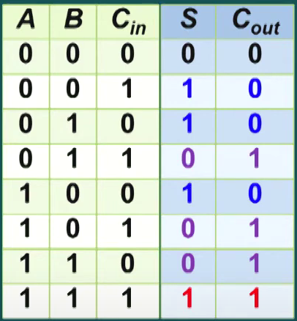
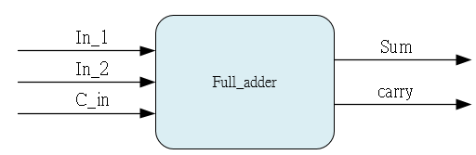
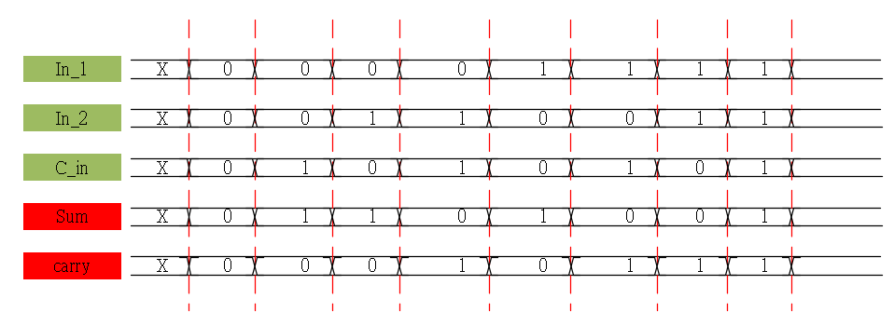
System & Waveform Graph

Slide 4
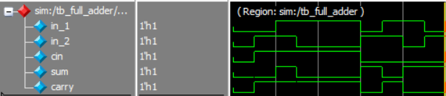
Waveform Graph - Simulation

