Slide 1
Touch_ctrl_led

Slide 2
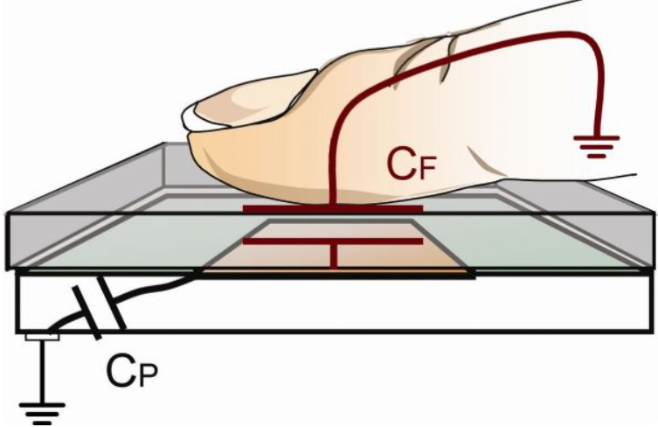
Touch_led_ctrl
Touch key, using finger touch to transfer the signal.
If we want to using touch key control the LED become light up or light out, we need to use the input signal to generate the flag, when flag is high-level, led changed the state.

Slide 3
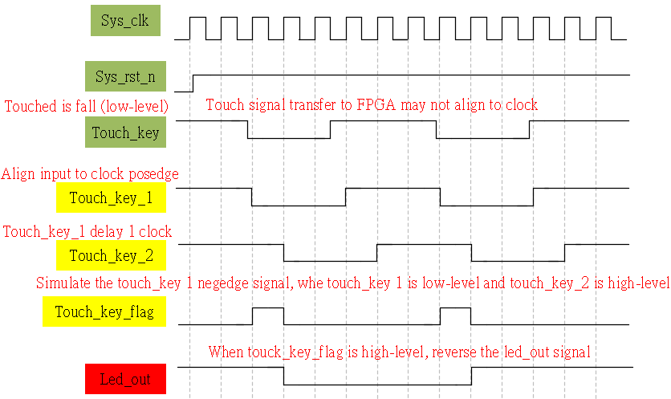
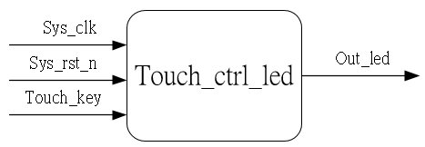
System & Waveform Graph

Slide 4
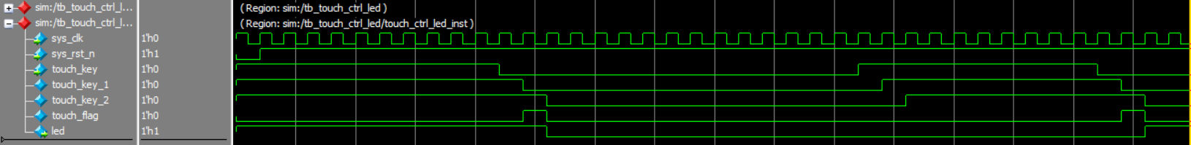
Waveform Graph - Simulation

