Slide 1
Breath_LED

Slide 2
Breath _LED
If we want to make a Breath_LED, it needs using PWM to do.
For example, if want to make LED gradually light up, the high-level voltage time should be gradually longer during the lighting period. And the gradually light out is reversed.
In this chapter, we using the PWM to control LED gradually light up and light out, and the period is 1 sec each cycle.(light up & light out)
Gradually light up, 1 sec.
LED
LED
LED
LED
LED
Gradually light out, 1 sec.

Slide 3
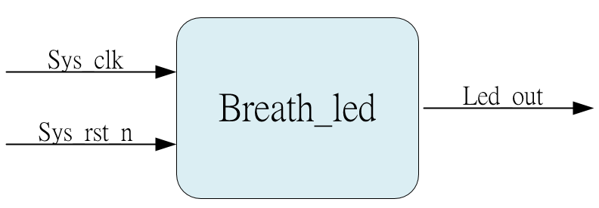
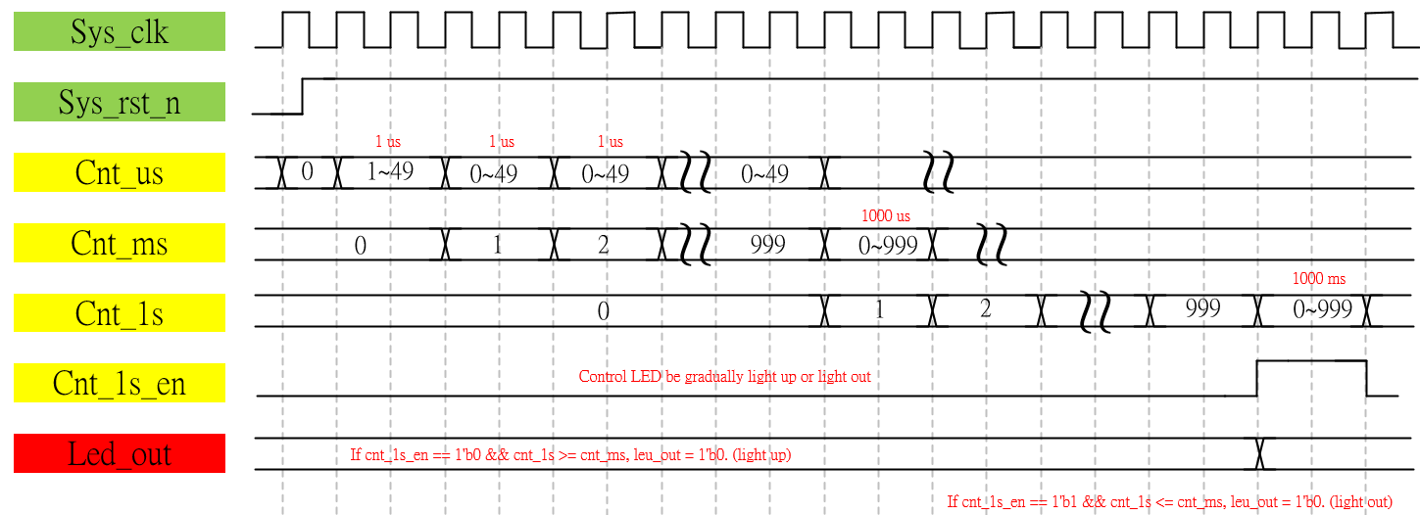
System & Waveform Graph

Slide 4
Waveform Graph - Simulation
Control LED be gradually light up or light out.

