Slide 1
Beep

Slide 2
Beep
If we want to pronounce the do, re, mi, fa, so, la and si tone by beep, we need to using PWM to control the voltage with corresponding frequency.
And the duty will influence on sound volume, in this chapter we set to 50%.
The scale corresponding frequency table as below.
Tone | Do | Re | Mi | Fa | So | La | Si
Hz | 262 | 294 | 330 | 349 | 392 | 440 | 494
Counter | 190839 | 170067 | 151514 | 143265 | 127551 | 113636 | 101214
* We using 50MHz sys_clk, the cycle is 20ns.
For example, if we want to count the tone cycle, the formula is : 1sec/HZ/20ns = (1/Hz/20) * 10^9

Slide 3
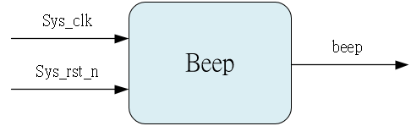
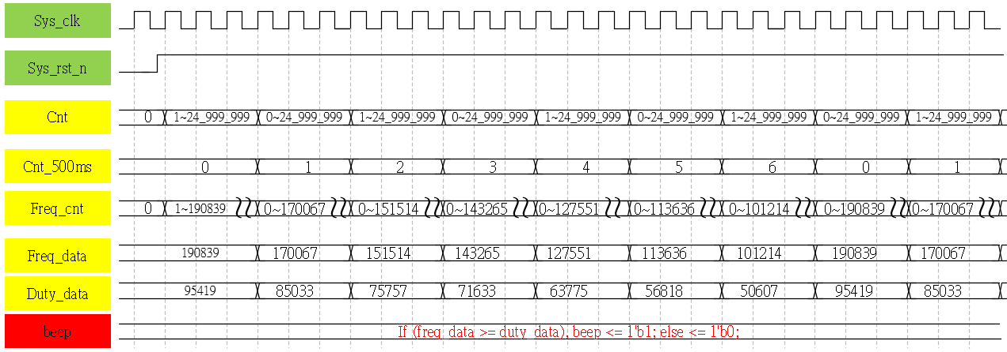
System & Waveform Graph

Slide 4
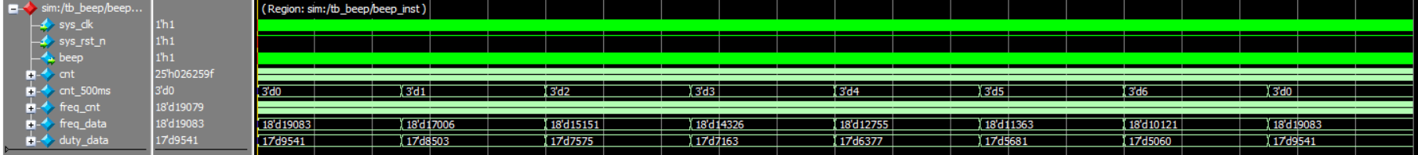
Waveform Graph - Simulation
Each parameter divide by 10.

